Slide 1


1. These are my attempts at a logo so far. Not great, but kind of the idea of a symbol that can be used with or without the name and in dark or light mode.
EdgeCraft
EdgeCraft
2. Since the sigma symbol looks like the letter E, it could be used as the first letter of EdgeCraft, which ties the concepts of edge and expectancy together. It could be used with or without the rest of the word. Either the rest of the font would likely need to be changed, or the styling of the sigma symbol could be changed (more italic or some other styling).
dgeCraft
dgeCraft

Slide 2
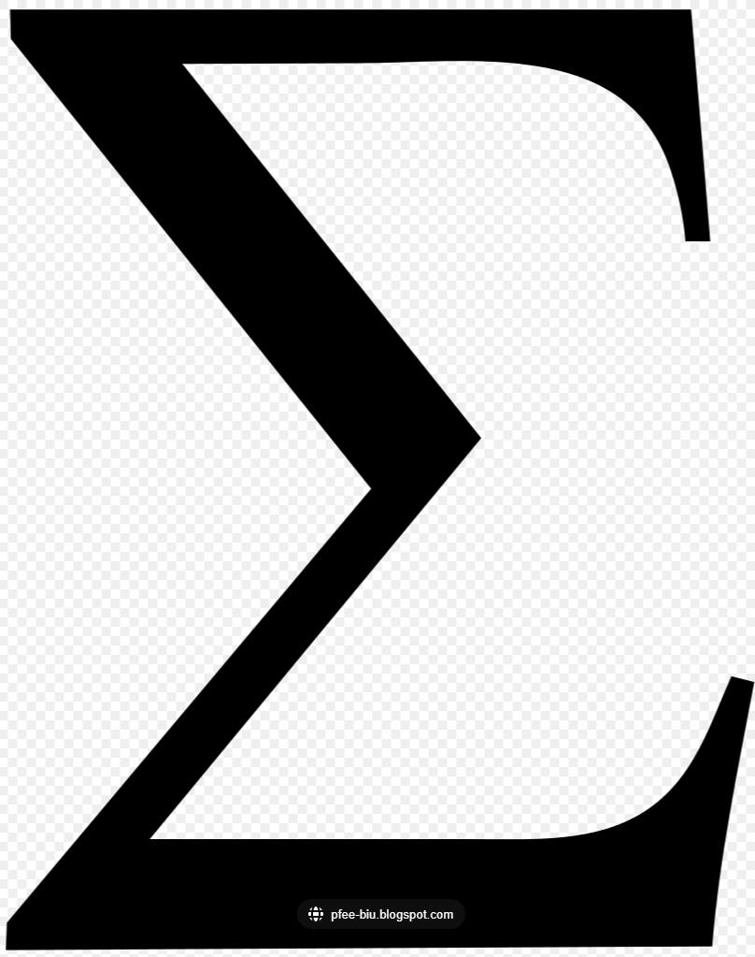

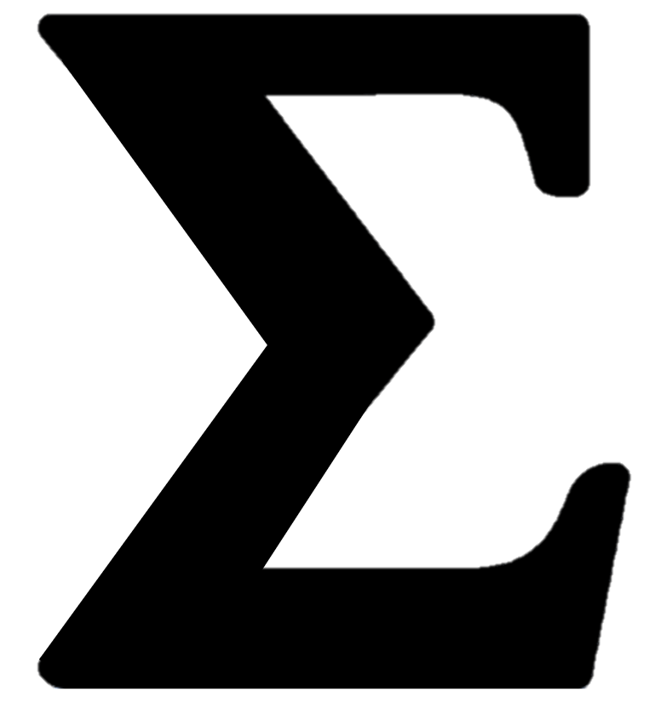








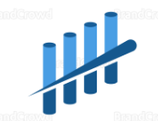
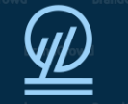
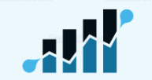





3. The sigma symbol by itself is a bit awkward-looking and can be either a bit too strong or too skinny and light.
4. I used an AI logo generator and it came up with a number of logos that tried to introduce the concept of trading into the font. Perhaps something like this could be incorporated with the sigma symbol.
This one is not bad.
This is the one I’m using now, but it is not colored well.
I found these examples of making the ampersand and infinity symbols a little more artistic or abstract. Perhaps something similar could be done with the sigma symbol.
See next slides examples where I tried to create something like this.

Slide 3
These are my attempts to come up with an abstract kind of shape that doesn’t look exactly like the sigma symbol, but it can be seen if you look at it the right way.
This was the first thing I came up with. It is basically a square, but bifurcated with white space in such way that you can kind of see the sigma symbol. And it can be used in light or dark mode.
The other thing I like about it is made up of 5 segments. The formula I use for getting to expectancy is made up of 5 parts. If we can make this type of shape work, I could imagine showing all 5 parts represented by boxes or triangles or something, then using the morph tool to have it morph into the final logo. Something like this.
But this shape is not my favorite unless it can be cleaned up somehow.

Slide 4
I have tried various permutations of the same idea like these:
Modified the shapes a bit to make it look more like a sigma symbol, but still abstract.
Still looks too square.
Modified the shapes a bit to make it look more like a sigma symbol, but still abstract. A little more italic. And the white space also looks like and upward slanting arrow.

Slide 5
Had the idea of somehow actually using the sigma symbol in some level of transparency. I don’t particularly like this representation of it. Just an idea.

Slide 6
The rest of the slides are just my experiments.

Slide 7
Win
Rate
Setup
Price
Time
Risk
Tactics
S
T
E
Win
Ratio

Slide 9
Win
Rate
Setup
* Price
* Time
Risk
Tactics
* Stop
* Target
* Entry
Win
Ratio

Slide 10
Win
Rate
Setup
* Price
* Time
Risk
Tactics
* Stop
* Target
* Entry
* Size
Win
Ratio

Slide 11
Win
Rate
Setup
* Price
* Time
Risk
Tactics
* Stop
* Target
* Entry
* Size
Win
Ratio

Slide 12
Win
Rate
Setup
* Price
* Time
Risk
Tactics
* Stop
* Target
* Entry
* Size
Win
Ratio

