Slide 1
NexMuv
Moving for the next generation

Slide 2


About
Us
NexMuv is the next logical evolution in professional moving. Professional moving clients have battled soaring prices, acute capacity problems and deteriorating service levels.
NexMuv was founded by lifelong moving professionals who have developed the answer to better moving services. Poised as THE industry disruptor, we deliver faster, offer guaranteed prices and even offer no credit check financing options. We are a technology first organization using proprietary software to deliver moving's best service experience.

Slide 3



NEXMUV Vision
The traditional moving industry is broken, outdated, inefficient, and unable to change.
Our Mission
Our Vision
Our Goal
Disrupt a sleepy giant of an inefficient industry
Revolutionize an $86B industry by providing great value to everyone involved
Becoming the moving platform of choice
NexMuv Customers - Consumers, Movers, Corporate Clients, and Relocation Management Companies all receive better value with NexMuv than anywhere else.
As NexMuv’s market share grows, the customer acquisition cost and operational cost plummets. This creates even more market penetration, more efficiencies, and exponential growth.
NexMuv’s deep understanding of the professional moving industry, supported by extensive market research has set NexMuv up for ultimate success in disrupting this industry by creating cost-saving efficiencies throughout.

Slide 4

Moving’s Problems
02
04
COST
CAPACITY
SERVICE
TRANSPARANCY
Moving cost has skyrocketed over the last three years. Charges have increased 38% since 2018.
Long-haul driver shortages and limited equipment coupled with growing demand has pushed capacity to a
crisis state
Quality labor has been difficult to source and afford. Virtually all RMC’s report a decline in service quality
Too many margin layers...van line, agent, driver and help. In addition, charges are convoluted and
confusing
01
03

Slide 5
What NexMuv Has Accomplished
Improve Service Levels
Break the Typical
Moving Mold
Eliminate Capacity Constraints
Simplify the Moving Process
Reduce Costs
5
4
1
2
3

Slide 6



SOLUTION
Uberized Process
NexMuv automatically audits: Compliance, Insurance, Regulatory, Bonding, Background checks, and Quality.
One Point of Contact
Today moves are sold from broker to broker until it’s finally sold to a mover. Many entities involved means a confusing line of correspondence for the customer.
Value Proposition
Book Now Pay Later
Moving has a high price tag, but no one has ever offered a pay later solution. Much less a no credit check offer.
GPS Tracking
Bringing the Customer Experience to the 21st Century
Amazon has conditioned consumers to expect real-time tracking of goods. Only NexMuv enables you to track all of your belongings door to door.
Simple Honest Pricing
NexMuv’s proprietary algorithms and data are backed up by a checks and balances process giving the first instant pricing solution that won’t change.

Slide 7
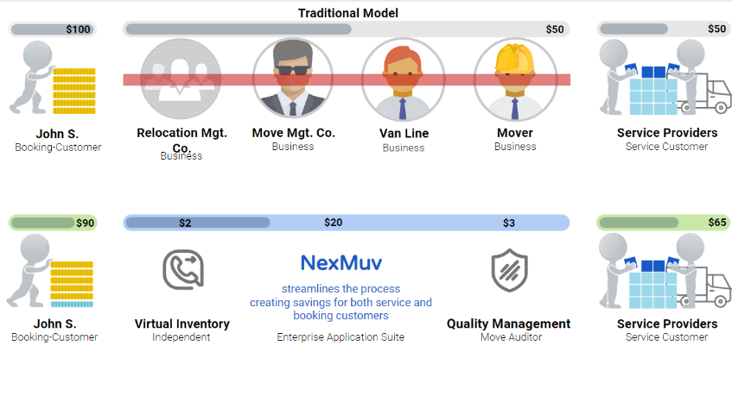


COMPETITION
Brokers
Adding substantial additional cost (greater than 20%) and no additional value.
Brokers
Truck and Labor
Van Lines
The traditional van line model is no longer viable.
Van lines have added too much additional cost with diminishing value.
Movers have morphed into brokers adding a significant markup
All on the back of trucks and labor
Relocation Mgt.
Visual Survey Co.
Truck and Labor

Slide 8

NexMuv Built-in Checks and Balances
Independent Survey
Company
Immediate Capacity Secured
8 years in the virtual survey business with dozens of survey consultants in any time zone. Captures all extra services up front and establishes checks and balances for the mover.
01
04
Virtually limitless capacity even during peak moving days.
Independent groups working together to mitigate risk and error
Multiple Network Service Providers
02
03
With several professional teams engaged there are a series of checks and cross checks.
Concierge Service
Proven, proactive process operated by our award-winning team of experienced customer service professionals.

Slide 9

Old School Moving vs. NexMuv
VALUE DRIVEN
By being the Uber of moving and cutting out all of the middle men margin, we deliver moves at a better value
01
EXPENSIVE
Professional moving prices have increased 38% in the last three years alone
01
CONVENIENT
Virtual surveys and delivery spreads are flexible and driven by the customer’s schedule
02
INCONVENIENT
In person surveys, incredibly long load and delivery spreads
02
OLD SCHOOL MOVING
INDUSTRY BEST TRANSIT TIMES
Day and time specific local loading, fast LTL carrier transit times and day certain deliveries makes things fast and flexible
NEXMUV
LONG TRANSIT TIMES
Using a single driver to move several shipments in geographically efficient ways has always been a challenge
03
03
04
BETTER RESULTS AND SERVICE
Best in class providers treat customers as the priority at a lower cost
INCONSISTENT RESULTS LOW PRIORITY CLIENTS
Consumer business is historically low priority
and more expensive
04

Slide 10

NexMuv Customer Service Process (Truncated)
NexMuv is a tech-driven moving company that automates the move management process.
The move manager provides the customer with any necessary forms and documentation, including a list of items to be moved and a detailed inventory of the shipment automatically.
The system assigns a move manager to act as the point of contact for the customer. Our talented team has mastered the moving process and have exceptional customer service skills.
The move manager confirms all details of the move with the customer, including the date of the move, the origin and destination addresses, and any special requests.
If any issues arise during the move, the customer service team should be available to help the customer resolve them and provide any necessary support.
Move Manager
Detail Review
Move Prep
Issue Mgmt.
1
3
5
7
9
2
4
6
8
Info Gather
Quote Prep
Scheduling
Oversight
Follow Up
The system gathers all relevant information about the move, including the customer's name, contact information, the date of the move, the origin and destination addresses, and a detailed list of items to be moved coming from the video survey.
Based on the information gathered, the customer service team uses the system to prepare a quote for the customer, the system automatically considers the distance of the move, the size of the shipment, and any special services required.
Based on the confirmed details, the system automatically schedules the move with the movers and ensure that all necessary resources, such as trucks and equipment, are available on the scheduled date. The Move Manager confirms receipt of order and reviews plan with crew teams.
The customer service team should monitor the move, ensuring that the movers are communicating with the customer and updating them on the status of the shipment.
After the move is completed, the move manager follows up with the customer to ensure that they are satisfied with the service provided. They will also handle any post-move issues or complaints that may arise.
Our proprietary technology streamlines the process, offering customers a seamless experience and peace of mind. We have simplified the complex and often stressful task of moving.

Slide 11
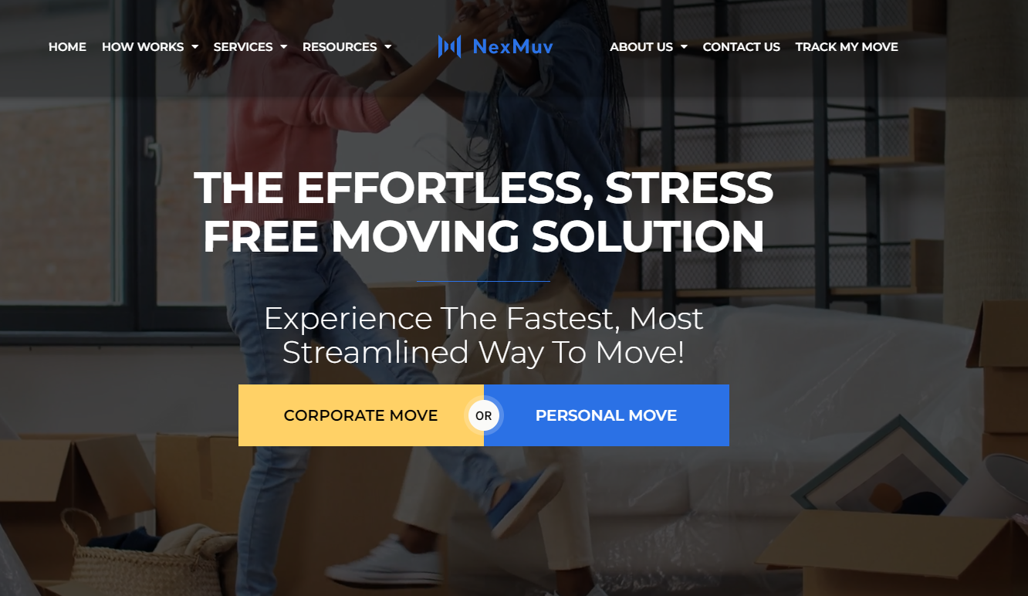
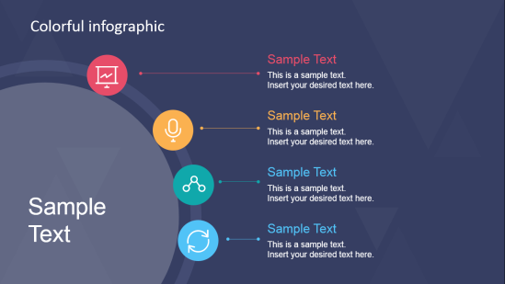
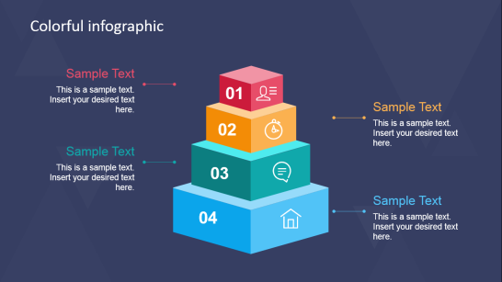
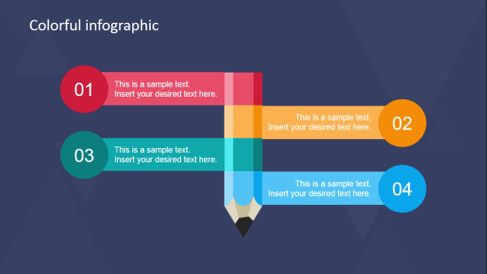
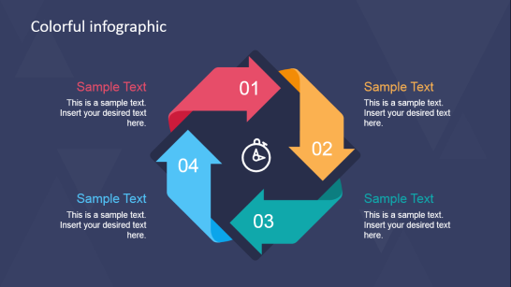
NexMuv White Label
Partner with NexMuv and take advantage of our cutting-edge technology to gain a competitive edge in the industry.
NexMuv offers a white labeling solution for companies looking to capture lump sum and consumer direct moves. Our technology platform can be customized with your branding to provide a seamless integration with your existing systems and processes. This allows you to offer a top-notch moving experience to your customers, while leveraging the power of NexMuv's proven technology. With this solution, you can streamline your operations, increase customer satisfaction, and capture more business in the growing market of long-distance moves.

Slide 12
?
Do you have any questions?

Slide 13
619 W. Main Street
Oklahoma City, OK 73102
Thank
You!
(800) 338-3803
nexmuv.com
support@nexmuv.com

