Slide 1

Pitch-Deck Foundation IdéeSport
www.ideesport.ch
Mai 2023

Slide 2

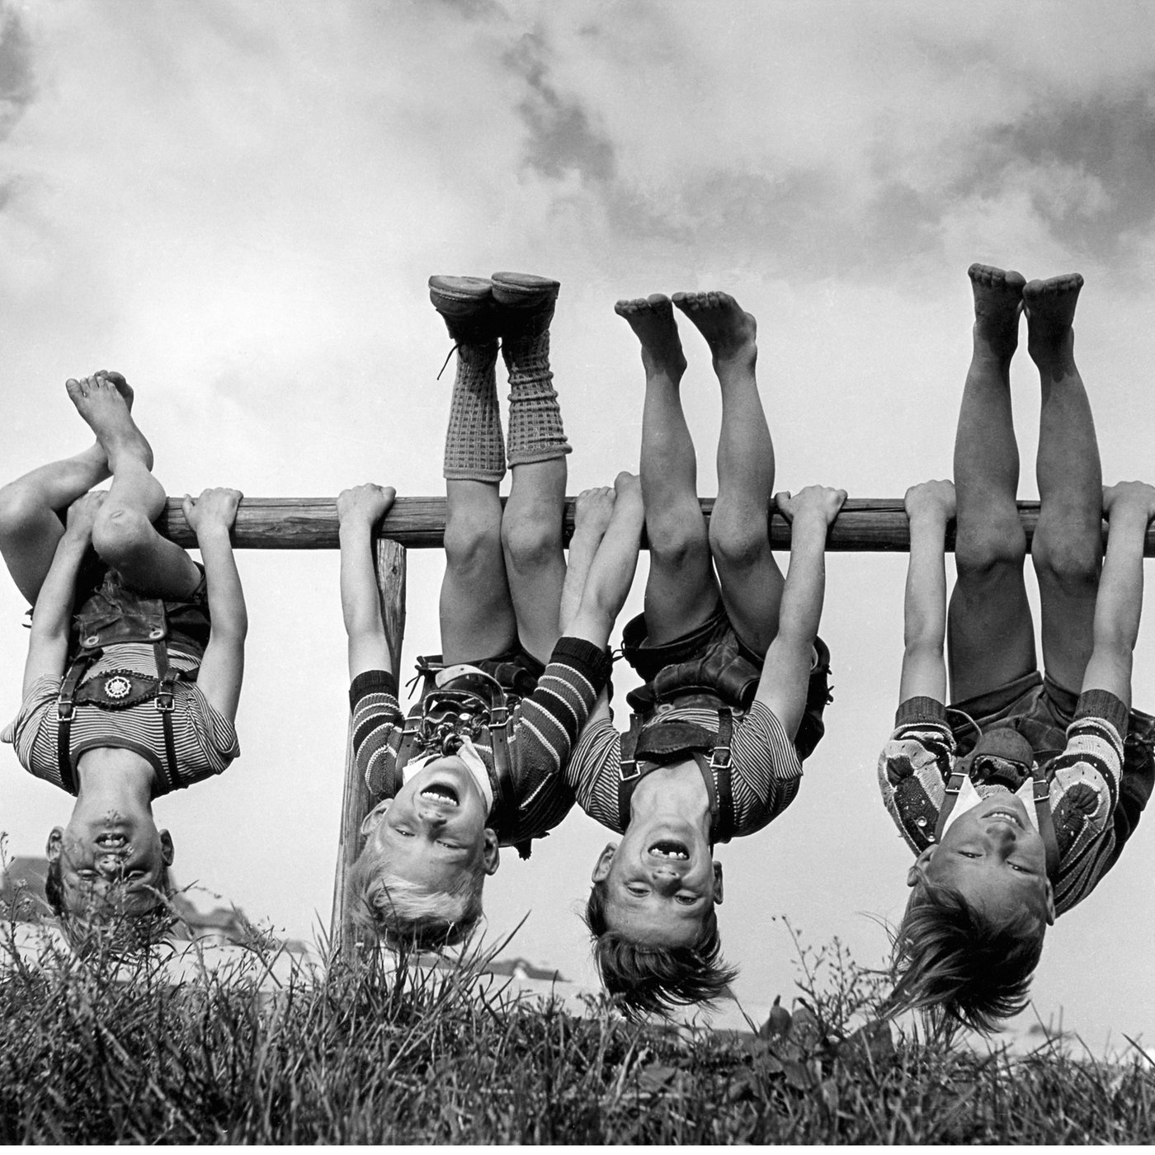
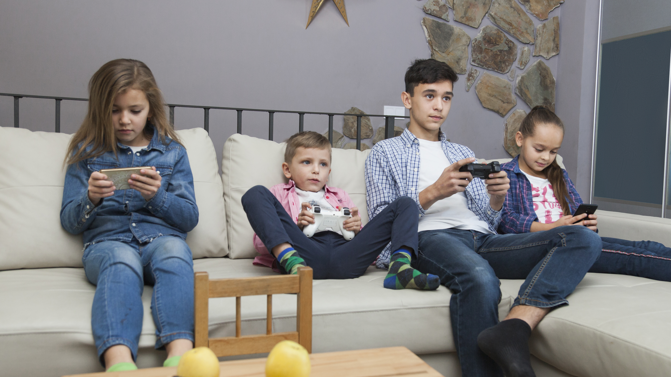
«Hanging around»
earlier versus today
This has serious effects on health (overweight, psychological problems, etc.)
Notes:
⌀ Movement time
Children & Adolescents:
1970: 3-4h
Today: 78min
Half of 6 year olds can't do a somersault!
33% of adolescents show severe depressive symptoms
11 to 15 year olds spend an average of 8 hours a day in front of the screen (cell phone, TV, computer, tablet, gaming etc.) on weekends according to SuchtSchweiz.

Slide 3
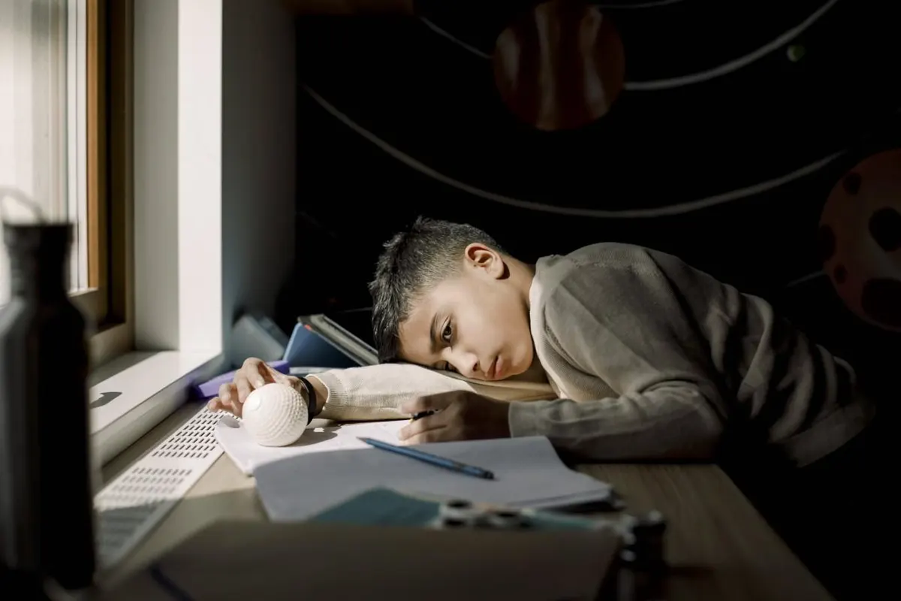
More difficult entry into the labor market and the adult world
The transition from school to vocational education is complex and challenging.
The consequences: Orientation difficulties and excessive demands; especially for young people from disadvantaged families or with learning difficulties.
30 percent of 16- to 24-year-olds are emotionally exhausted.
Quelle: Gesundheitsförderung Schweiz

Slide 4
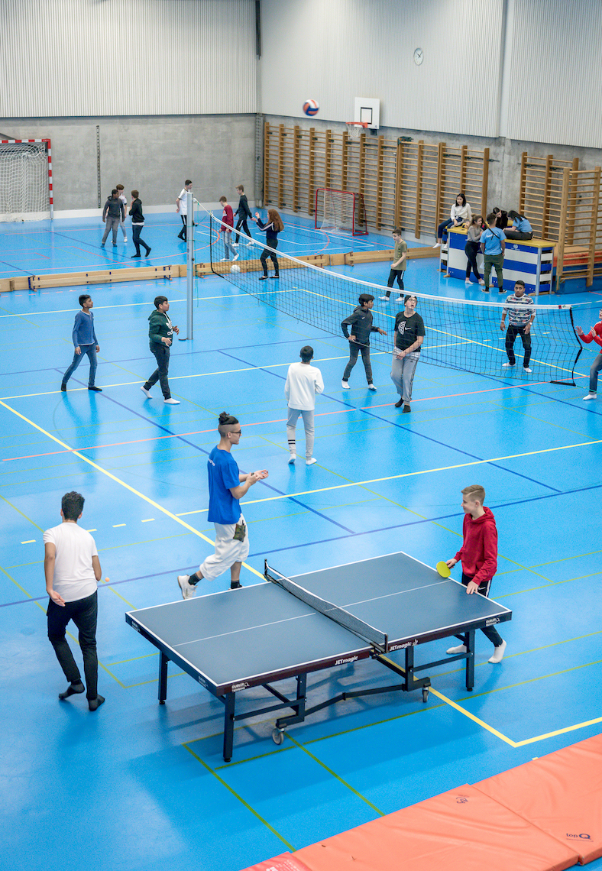
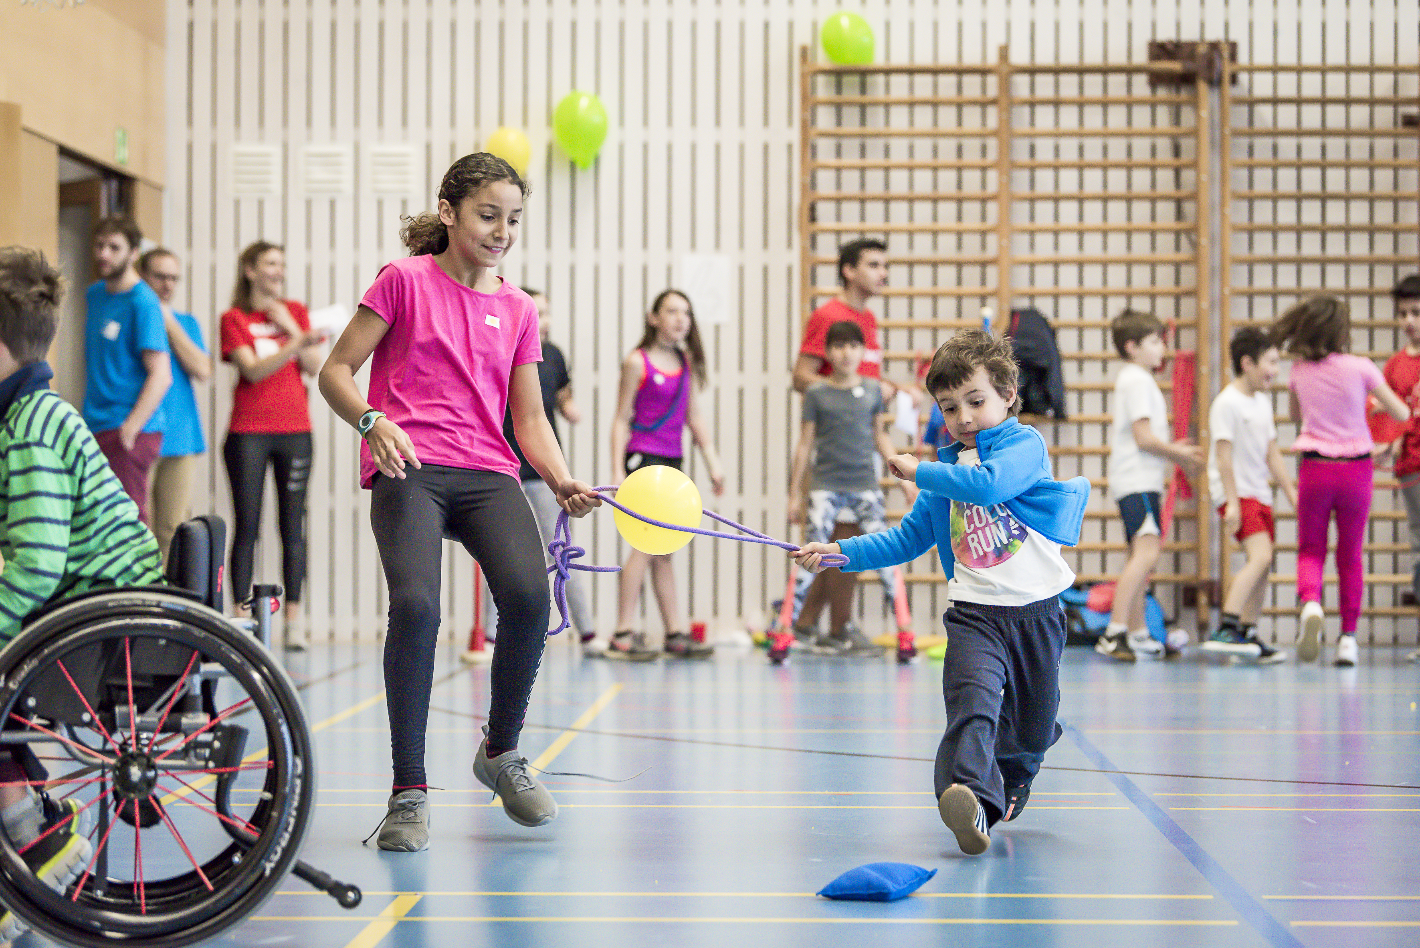
Foundation IdéeSport
We have been opening vacant sports halls for children and young people since 1999.
Low-threshold and regular meeting places, for movement and encounter projects.
Different programs for all ages
Led by specially trained youth coaches
-> Promotion of health, equal opportunities, prevention and integration
Notes:
What else must be on it:
Weekend
Winter months
Various programsLess text and more pictures (video at best). Text can be more on the soundtrack. Best no sentences

Slide 5
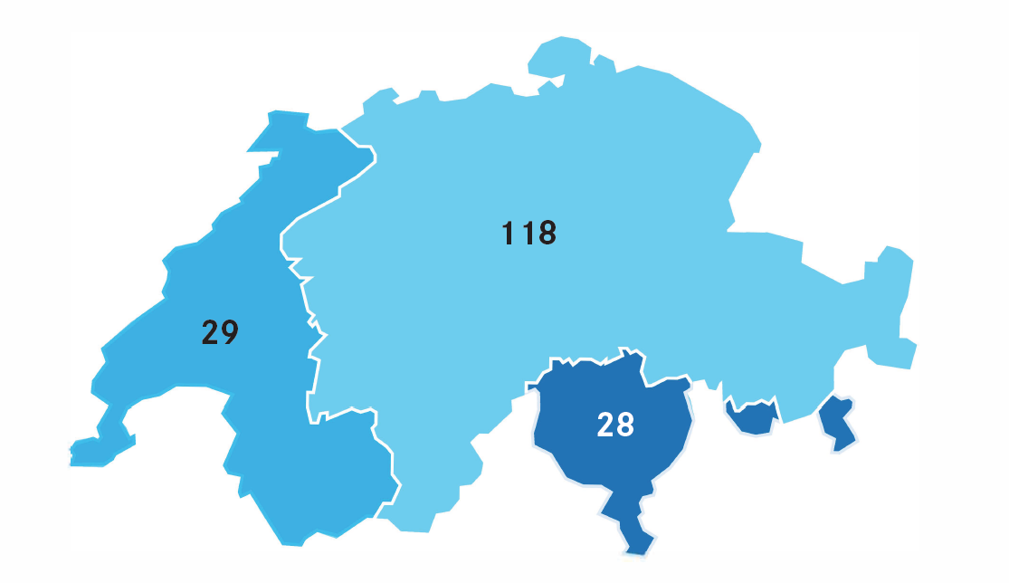
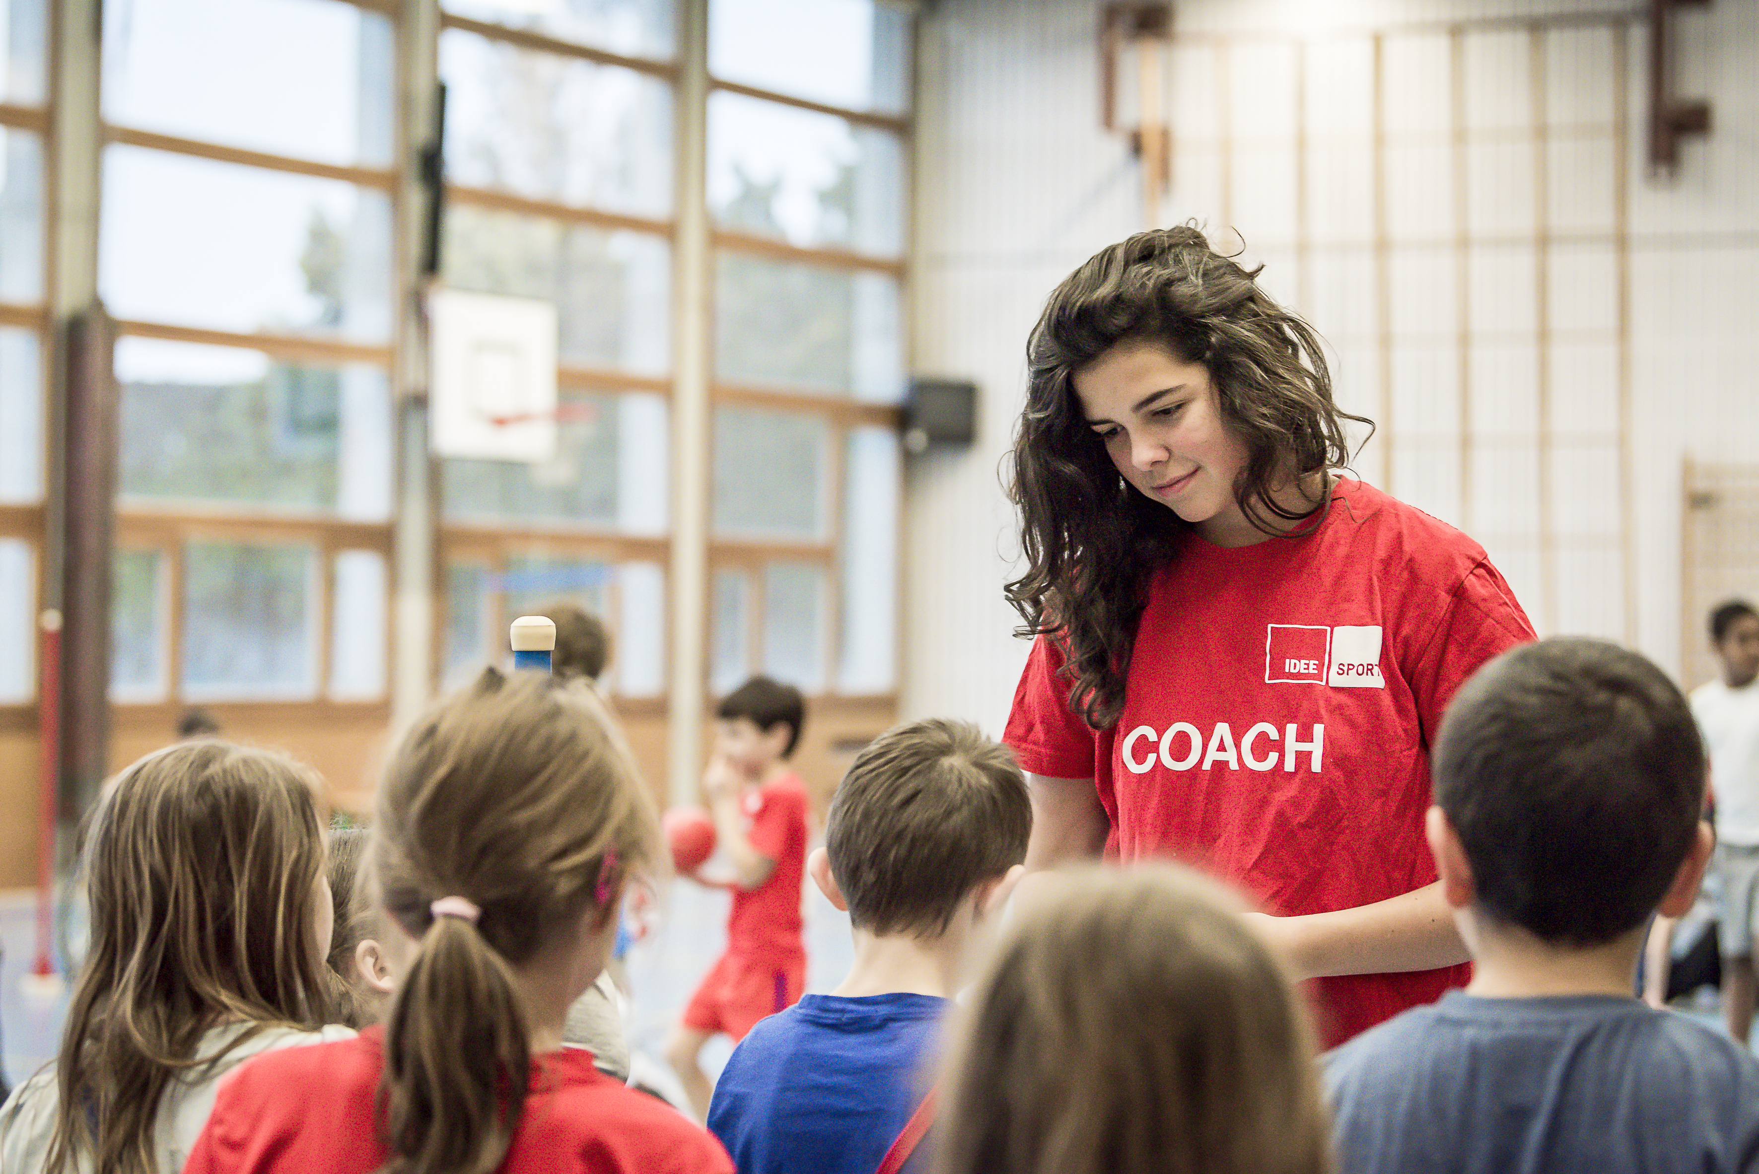
IdéeSport in numbers
175 locations
3'500 events
20 cantons
Over 128'000 participations &
16'000 coaching assignments per year
Notes:
Look at the map with all projects on the website?ask Ray for the map
If necessary another picture (without the boy)
"A big platform "
Round numbers
Map must be extracted and inserted separately. Numbers can then be written next to it by hand
Adjust figures as soon as we have the new evaluationsFacts & Figures

Slide 6
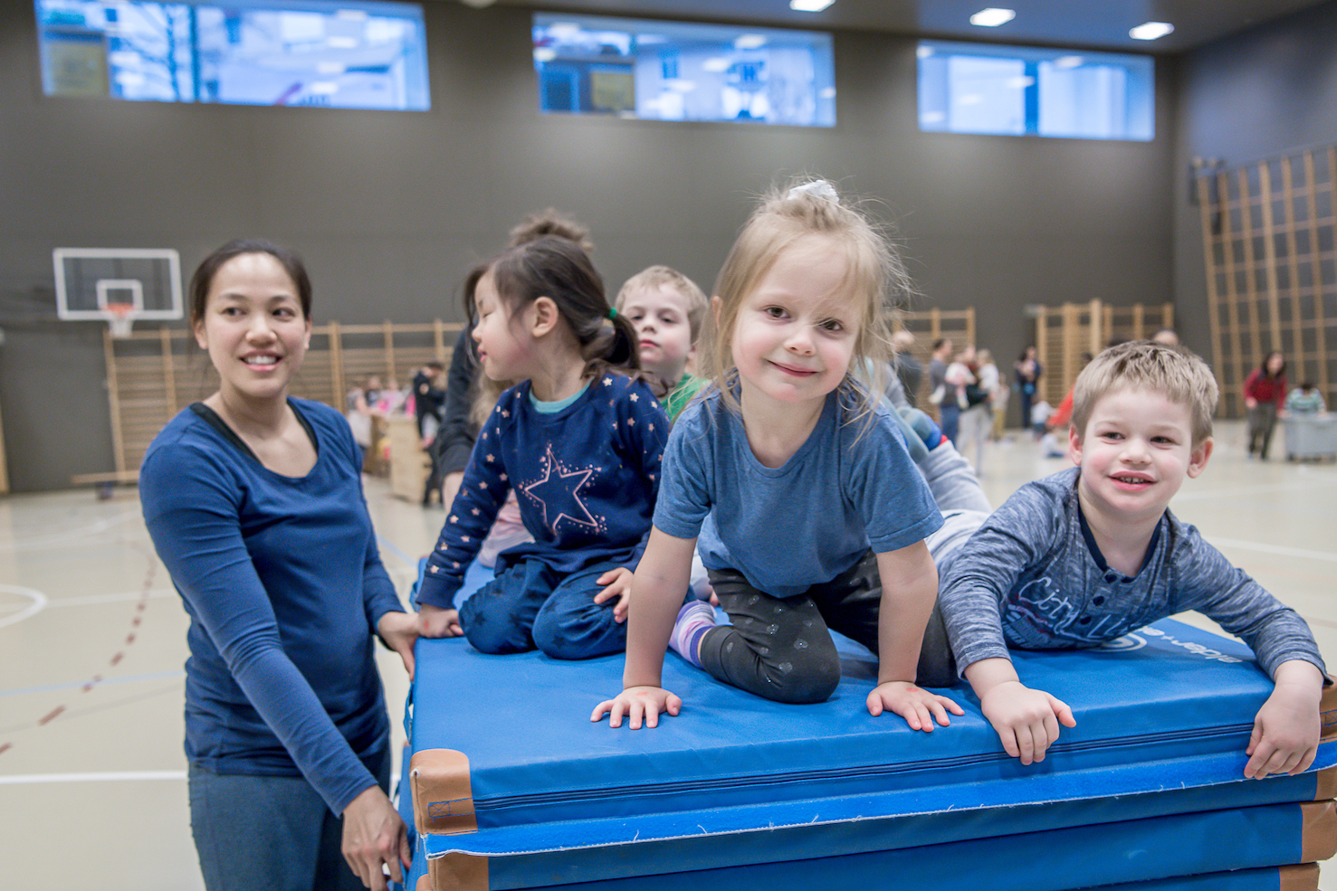
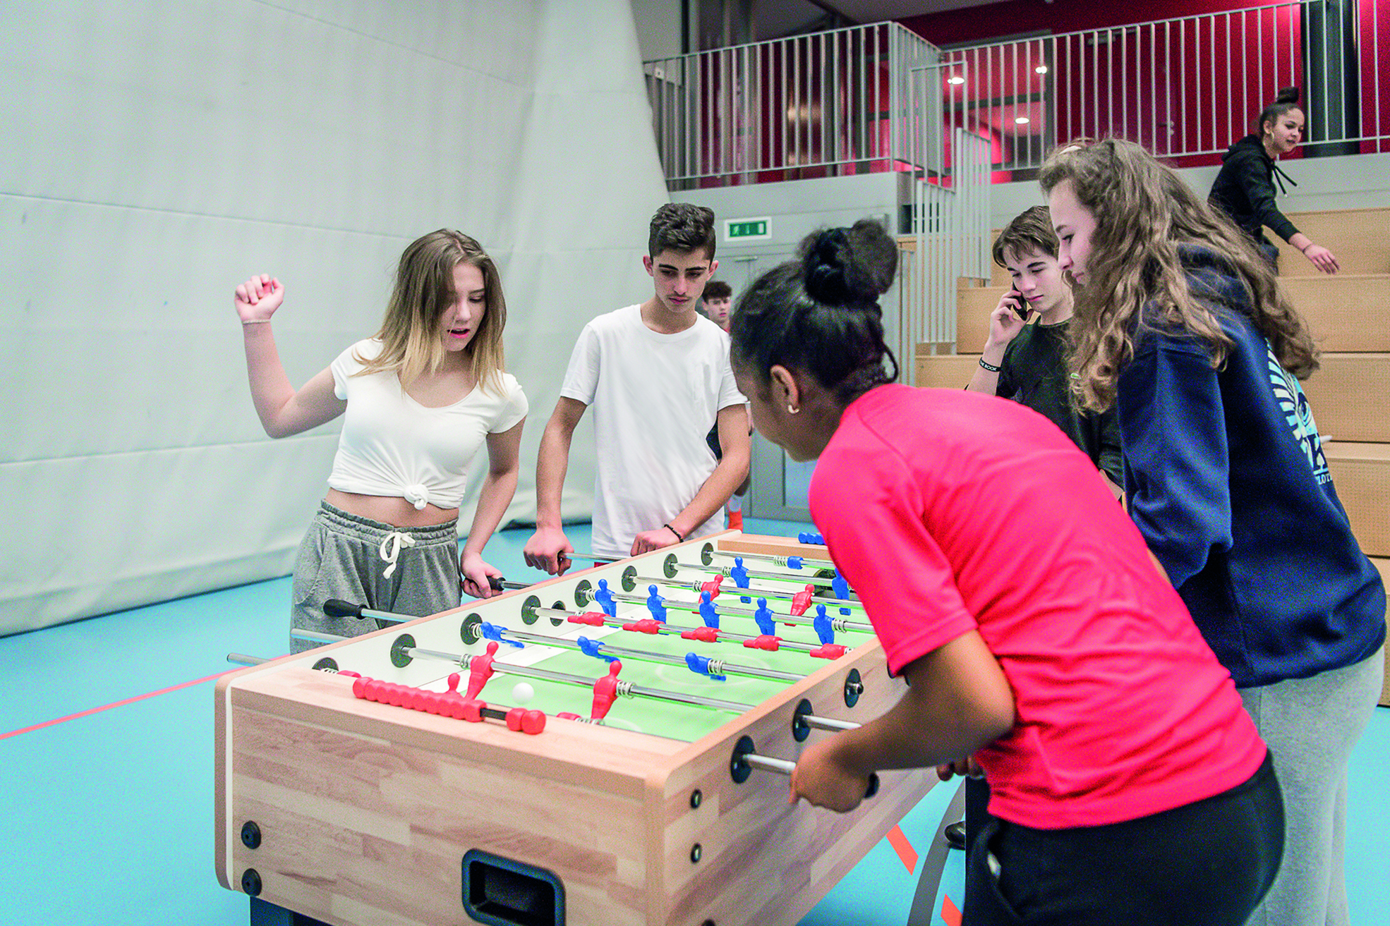
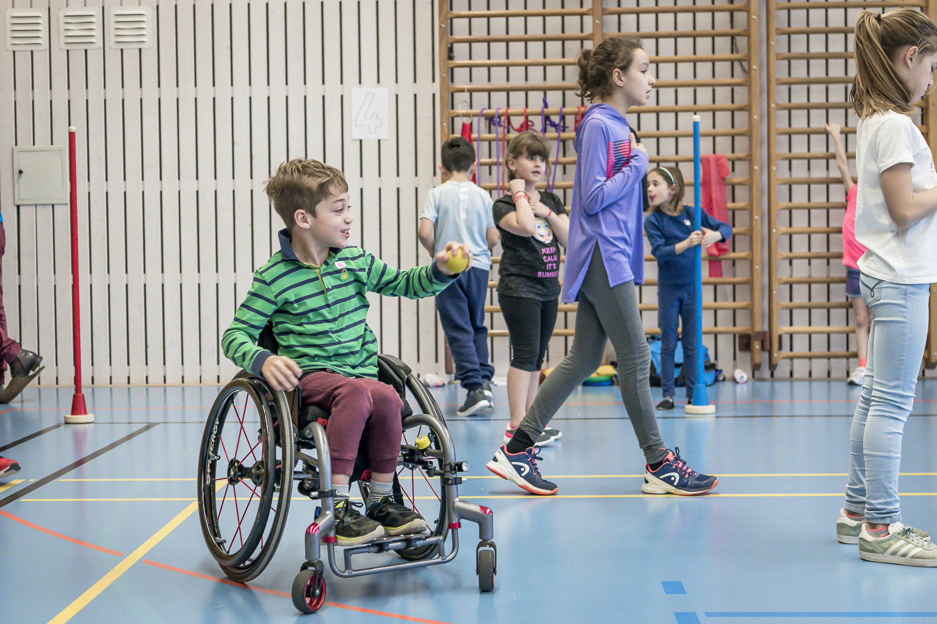
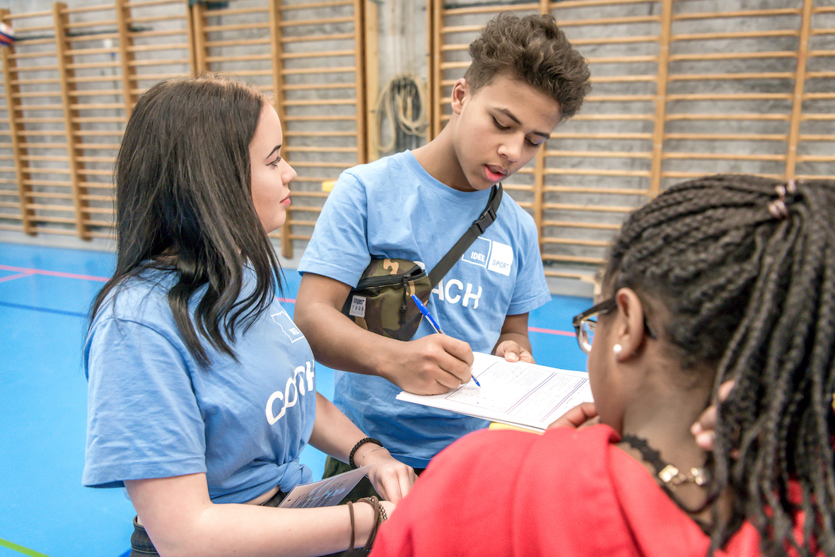
Topics overview
strengthened families
healthy youth
inclusive society
equitable education

Slide 7
strengthened families
Families:
Strengthen relationship building
Motivate children & parents to play together
Children:
Variety of movement possibilities
Promote friendships
Early promotion
Parents / reference persons:
Interaction with people from different backgrounds
Own free space
Compatibility between work & family
Notes:
MiniMove: With open gyms, IdéeSport offers space for movement and encounter for preschool children and their adult caregivers.
MoveYourSummer: During school vacations, we offer a full-day program that allows parents to reconcile work and family life.

Slide 8
Facts and figures «strengthened families»
MiniMove:
15 projects
268 events
6 200 participating children
5 700 participating adults caregivers
MoveYourSummer:
5 projects
25 events
1 400 participations

Slide 9
healthy youth
Physical health:
Prevention of addiction
Movement promotion
Mental health:
Social participation
Personality development
Peer to Peer
Notes:
MidnightSports: On Saturday evenings, we offer youth a protected space for exercise and social interaction that increases equity and reduces inequality.
EverFresh: Participants are informed and educated by EverFresh coaches about substance use and its negative effects in a fresh, fun and interactive way.

Slide 10
Facts and figures «healthy youth»
MidnightSports:
102 projects
2 300 events
83 000 participations
35% girls
EverFresh:
64 events on resilience promotion and addiction prevention
1 400 participations

Slide 11



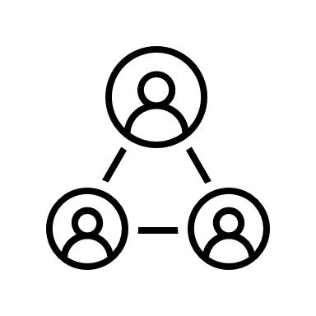

inclusive, diverse society
Handicap | Gender | Origin | social status | sportive abilities
Notes:
OpenSunday: On Sunday afternoons, IdéeSport offers an inclusive physical activity program for children of primary school age, regardless of athletic, linguistic, cognitive or social abilities.

Slide 12
Facts and figures «inclusive, diverse society»
308 participations with handicap
Heterogeneous teams in terms of gender, academic performance and origin
High number of participants with a migration background
Low-threshold: free of charge, regular, without registration
No pressure to perform, no training character, also possible in everyday clothes

Slide 13
equitable education
Preparation for the transition to vocational education:
Experience themselves as part of a team
Education and training courses
Take responsibility
Competence and personality development:
Expand personal & professional competencies
Confidence in one's own abilities
Participation and involvement within the scope of their possibilities and interests
Notes:
With the CoachProgram, we offer youths and young adults a learning environment for initial work experience in order to promote the development of skills and personality.

Slide 14
Facts and figures «equal opportunity education»
263 Project managers
2 510 coaches
74 000 working hours
35 day courses
181 team courses
  of which 25 courses for „inclusion“

Slide 15
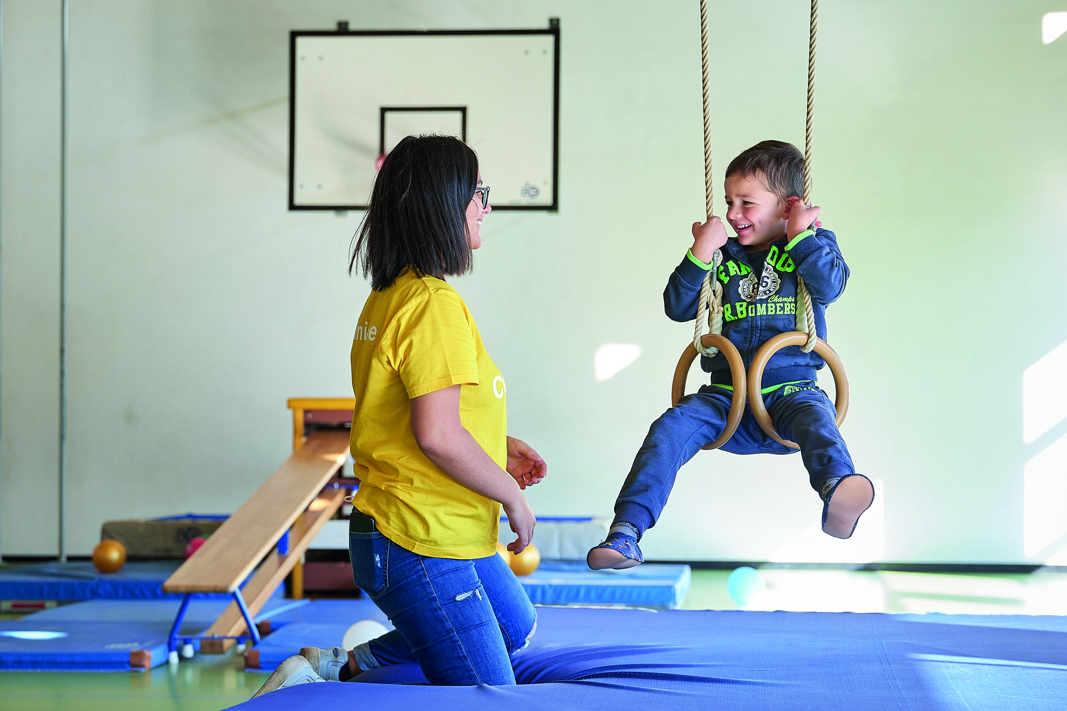
Partnership model
We are committed to working together for a strong and self-determined society
Shares the vision and values of IdéeSport
Communicates together with IdéeSport and benefits from high visibility
Benefits from several services depending on your commitment

Slide 16
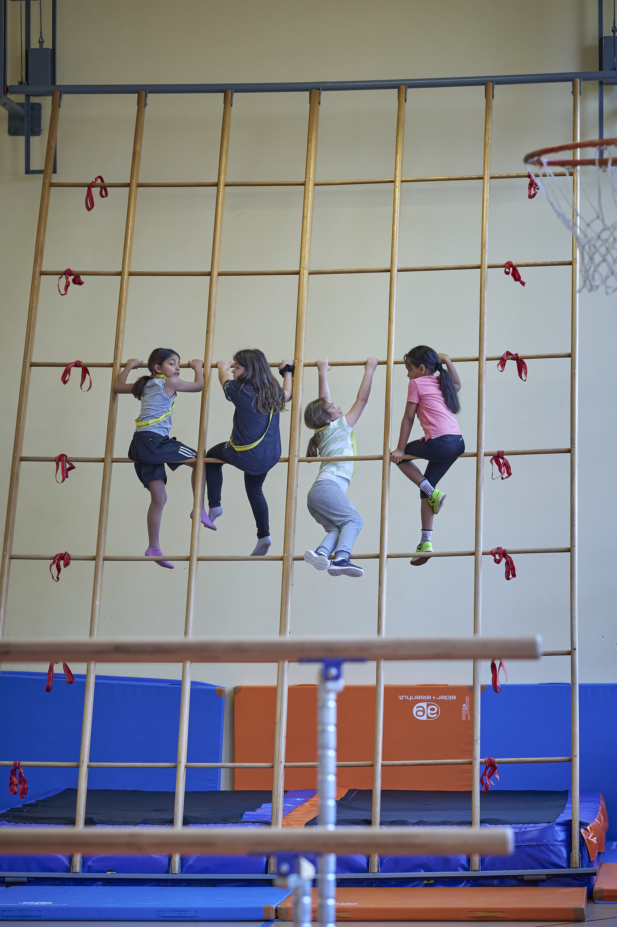
Partnership model
Strategic partner
From CHF 100,000
Main partner
from CHF 25'000
sponsoring partner
from CHF 10'000
Supporter
up to CHF 10‘000

Slide 17
​ | Strategic partner​ from 100k​ | Main partner​ from 25k​ | Sponsoring partner​ from 10k​ | Supporter​
Logo presence​ | ​ | ​ | ​ | ​
Homepage​ | large | medium​ | small​ | ​
Flyers | ✓​ | ​ | ​ | ​
Communication service | ​ | ​ | ​ | ​
Press release​ | ✓​ | ​ | ​ | ​
Foundation Report​ | ✓​ | ​ | ​ | ​
Newsletter | ✓​ | ✓​ | ​ | ​
LinkedIn-Post | ✓​ | ✓​ | ✓​ | ​
Usage IDS Komm. Package​ | ✓​ | ✓​ | ✓​ | ✓​
Event Presence​ | ​ | ​ | ​ | ​
Competition​ | ✓​ | ​ | ​ | ​
Market stall​ | ✓​ | ​ | ​ | ​
Logo presence​ | ✓​ | ​ | ​ | ​
Visit program incl. guided tour | ✓​ | ✓​ | ✓​ | ​
Miscellaneous​ | ​ | ​ | ​ | ​
Specialist presentation​ | ✓​ | ​ | ​ | ​
Presentation IDS in the company | ✓​ | ✓​ | ​ | ​
Invitation IDS Partner Meeting | ✓​ | ✓​ | ✓​ | ✓​
Partnerschaftsmodell

Slide 18

Are you willing to participate in promoting the physical and mental health of children and adolescents in Switzerland?
Partner Logo

Slide 19
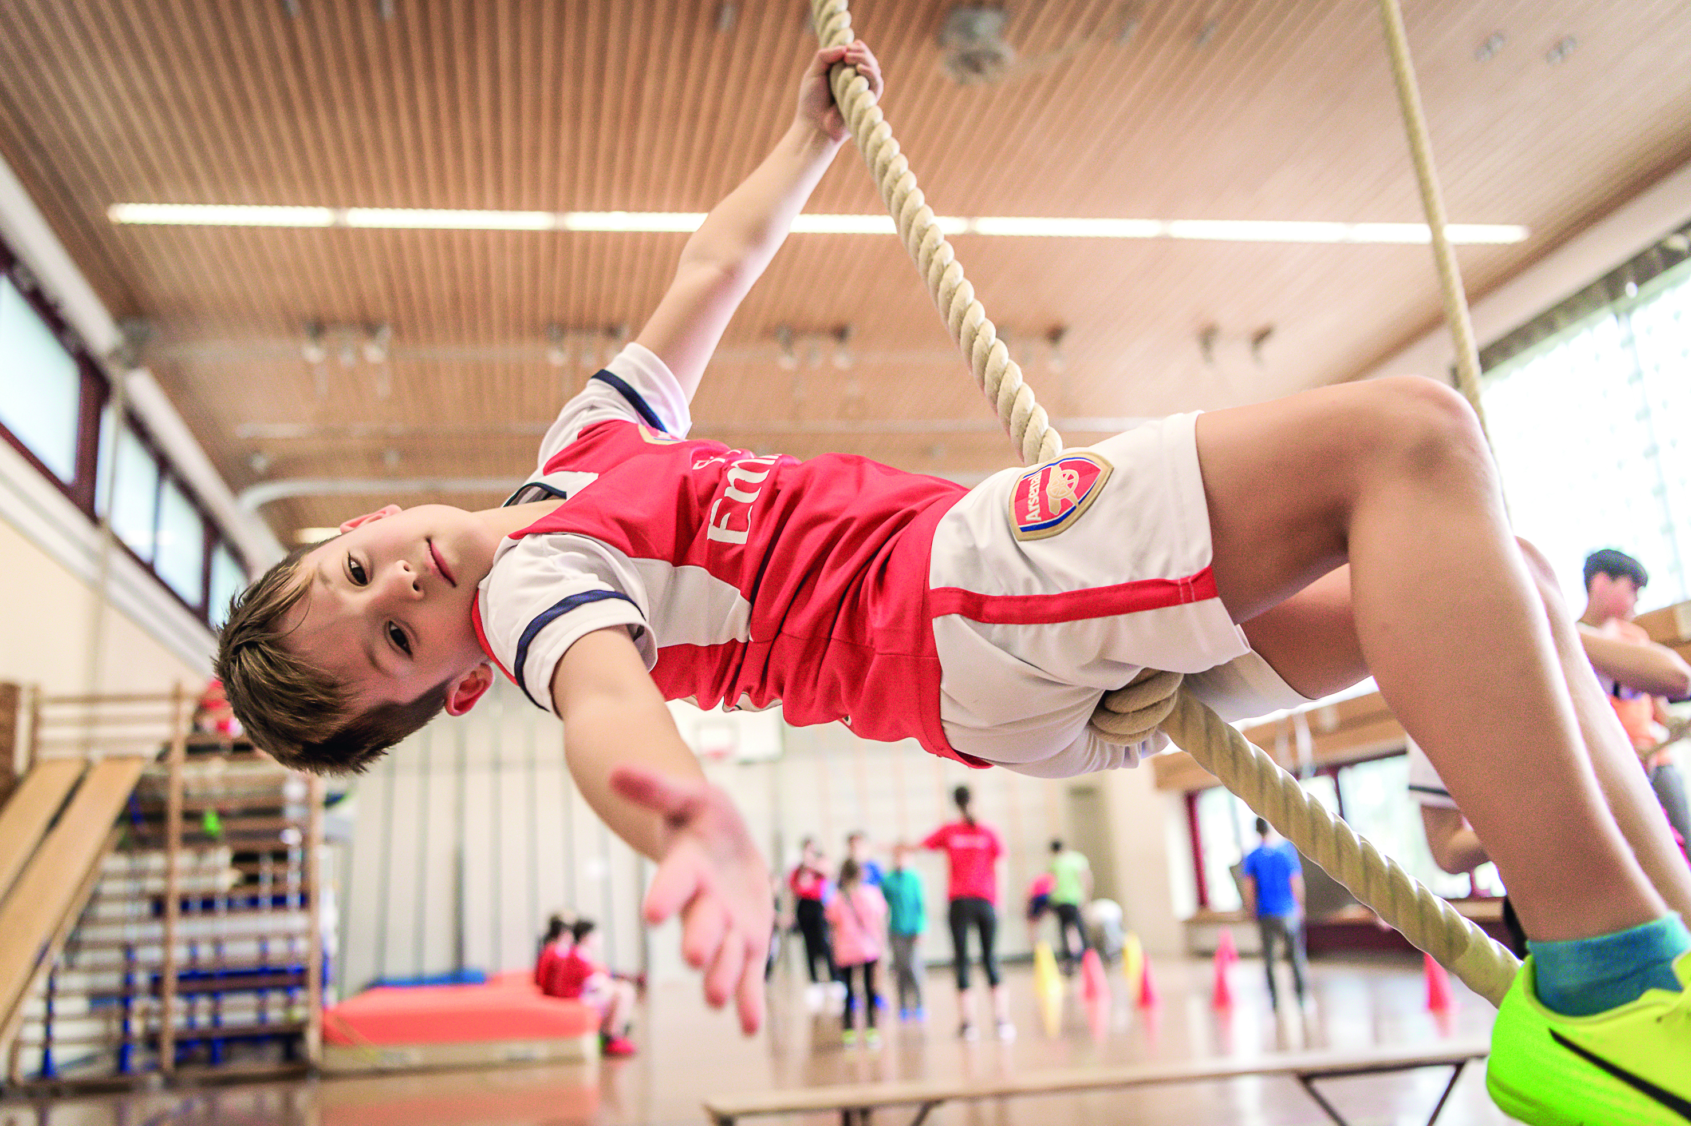
Shake hands with IdéeSport...
so that young people expand competencies
gain confidence in their abilities
take responsibility
and to advocate for their concerns.
Notes:
((version 2))
so that children and adolescents in Switzerland develop in a physically and psychologically healthy manner
to shape a future-oriented society in a self-determined way.

