Slide 1

Allow us to do your laundry.

Slide 2
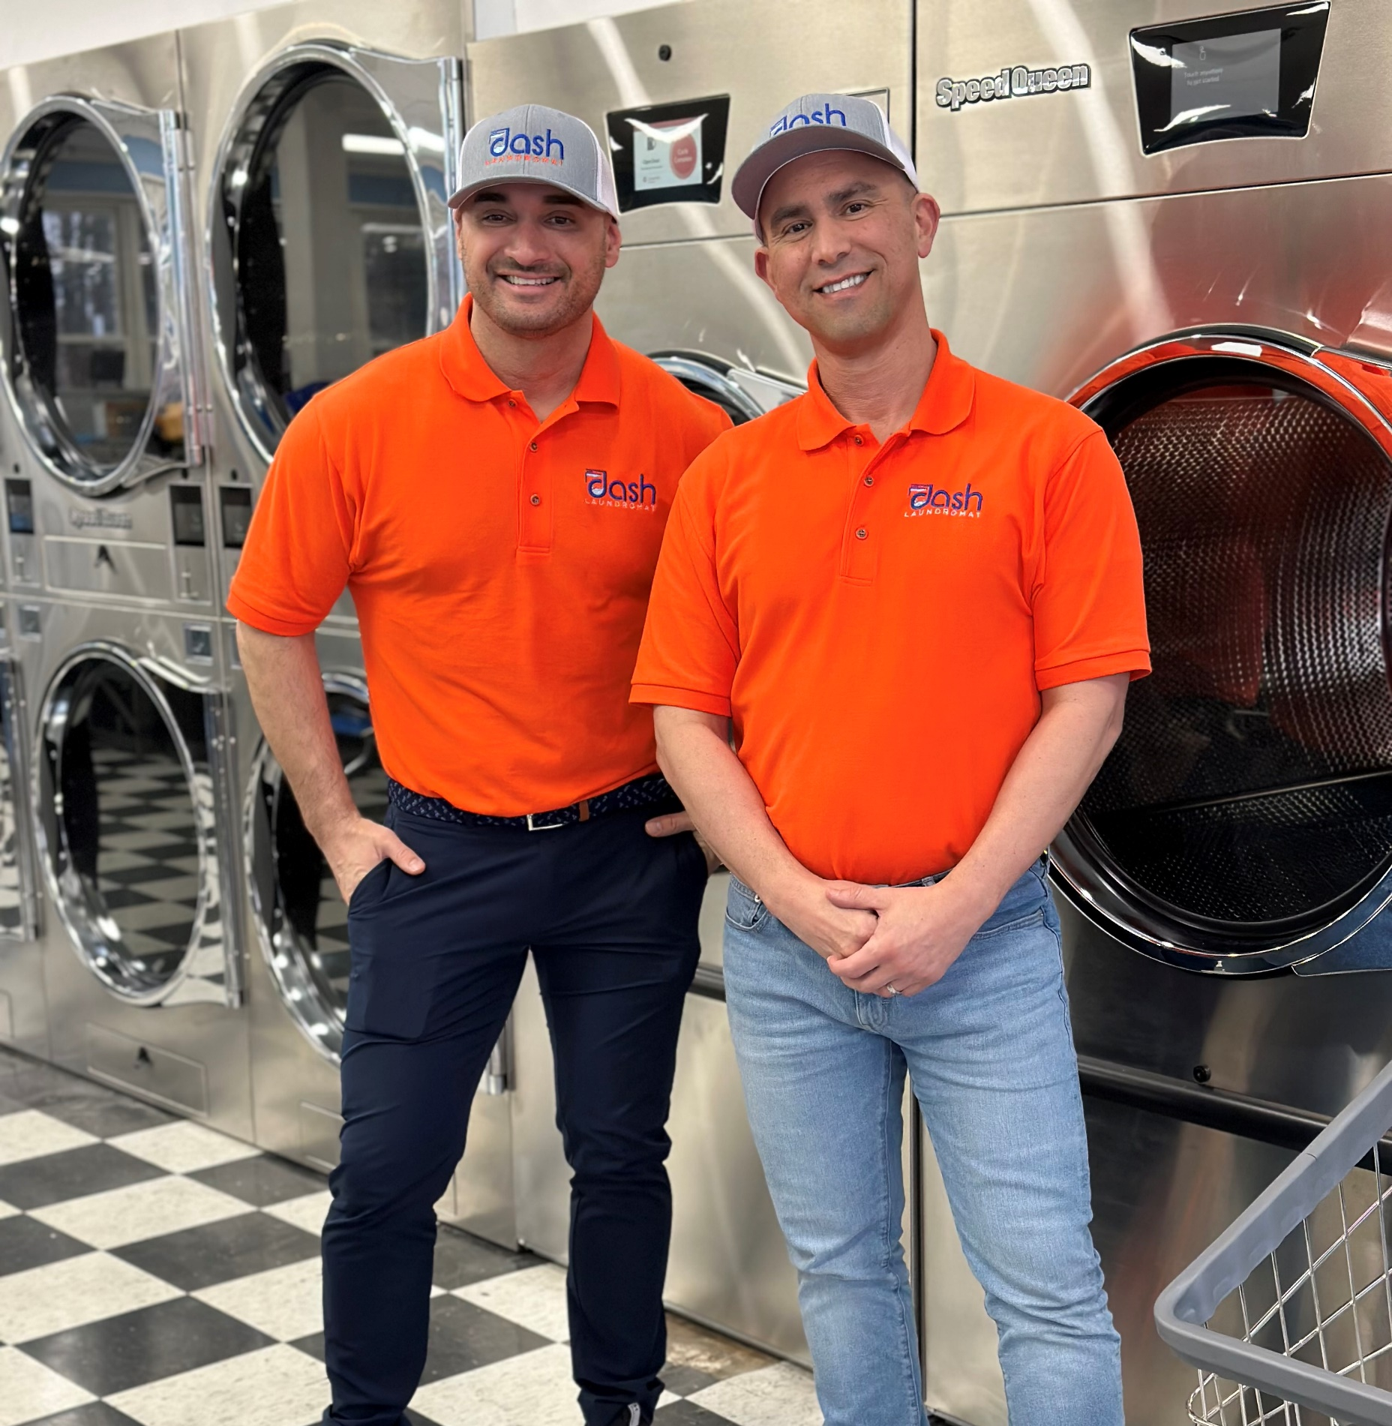
About us
Welcome to Dash Laundromat.
A staple in the area for nearly 50 years, the former Marianne’s Coin Laundry has received a major facelift.
Jason Araujo has been a small business owner since the age of 18. Today, he is broker-owner of HomeSmart Heritage Realty, and owner of Dash Laundromat.
Michael Sousa, class of UMass Dartmouth ‘97 in Biology, is a leader in the biotechnology industry for 26+ years. Together with Jason, he is owner of the new Dash Laundromat.

Slide 3




Dash Laundromat offers 3 services
Coin Laundry
Wash Dry & Fold
Free Delivery
Sizes ranging from 20 lb to 80 lb washers
Low prices starting at $1.00
App and Web enabled. Servicing all of South Coast.

Slide 4
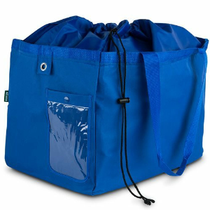
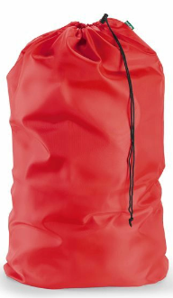
And now, cost effective Student & Faculty Subscription Plans
Student & Faculty will select the size that meets their needs:
  Standard Bag, up to 40 pounds of laundry, $119/mo ($0.75/lb)
  Large Bag, up to 60 pounds of laundry, $139/mo ($0.59/lb)
  Monthly Subscription Plan required.
  1 bag per week.
  Cancel anytime.
  Convenient and Hassle Free.
  App and Web Enabled.
  Free Delivery.
  All this, for just cents per pound of laundry!

Slide 5
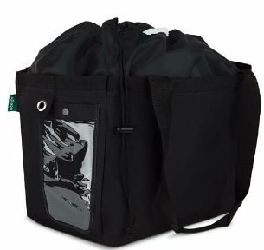
Or as an alternate, Free Delivery Plans are also Available
Select the size that meets your needs:
  Small Bag, up to 20 pounds of laundry, $25 / bag
  Standard Bag, up to 40 pounds of laundry, $50 / bag
  Large Bag, up to 60 pounds of laundry, $75 /bag
  App and Web Enabled.
  Free Delivery.

Slide 6
Giving Back to our Community
1 Student will receive free laundry for an entire semester, for every 25 subscriptions signed with Dash Laundromat.
  $420 value
  Standard Size Bag, 1x per week, for entire 14-week semester

Slide 7
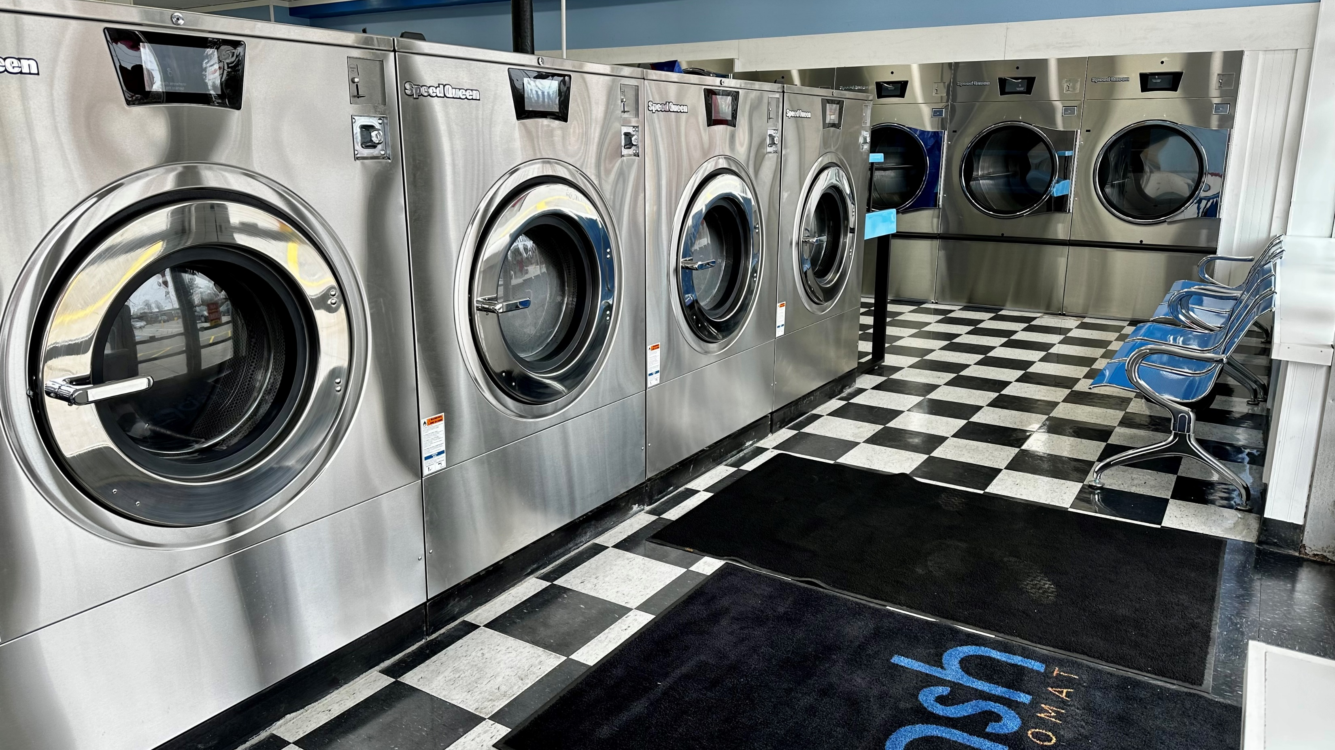

Slide 8
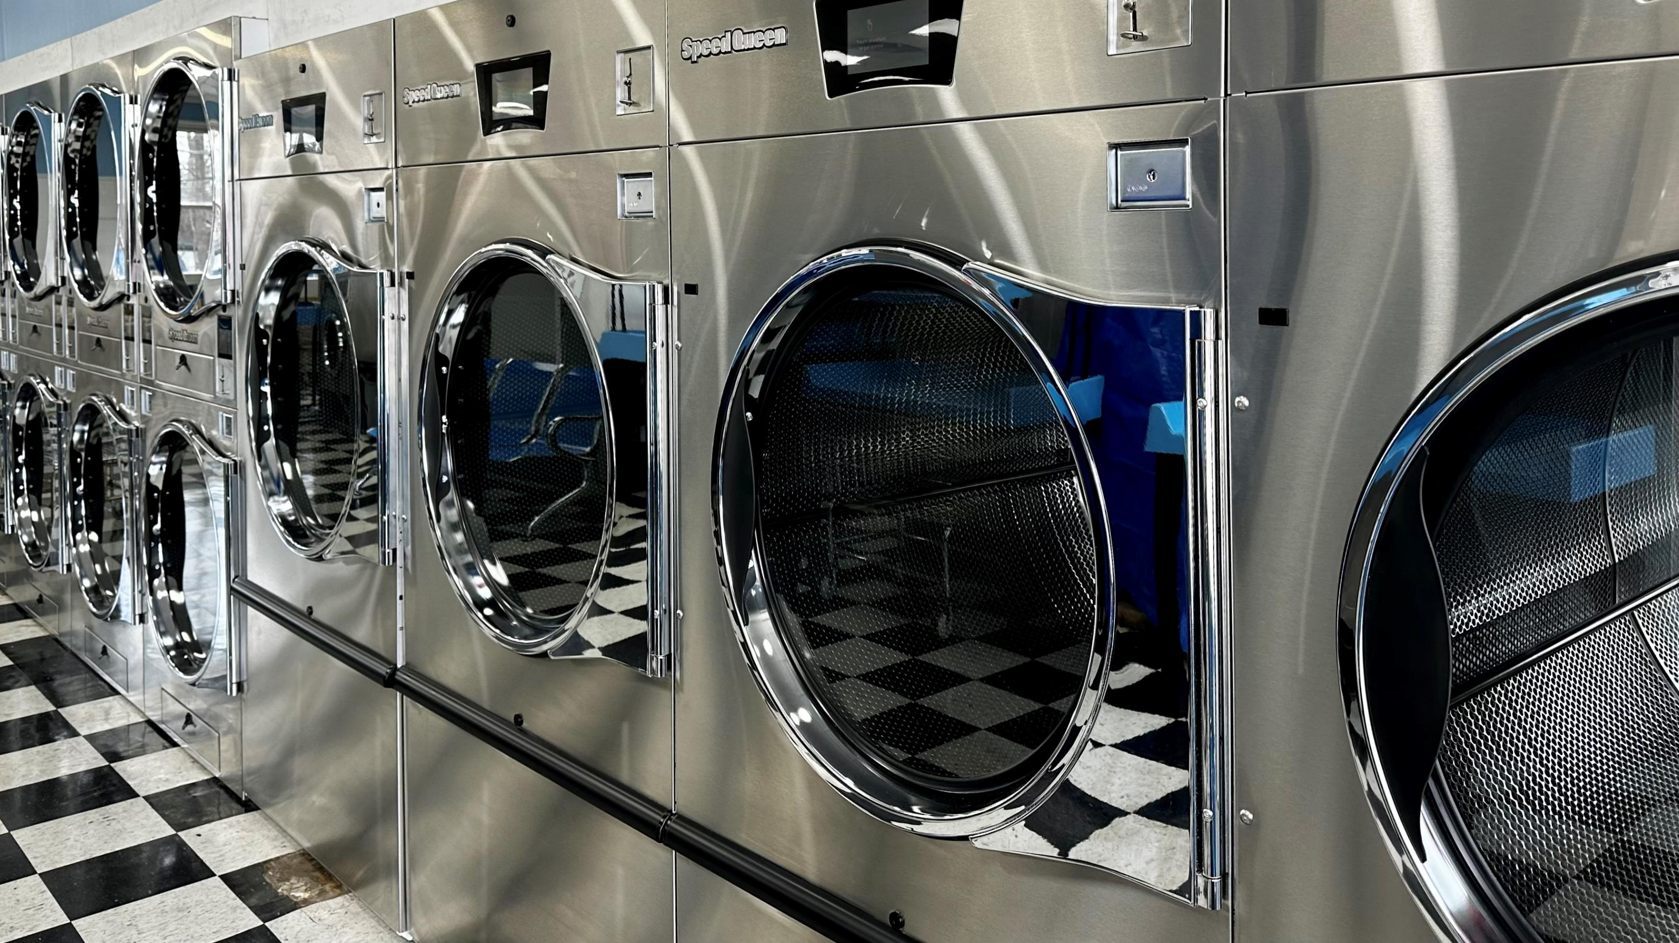

Slide 9
