Slide 1



Travel Management
Services

Slide 2


Seize this re-set opportunity to transform your travel program with an intelligent travel management platform built around the priorities of the new world of travel.
Zeno is now even safer, leaner and smarter than before.
02

Slide 3




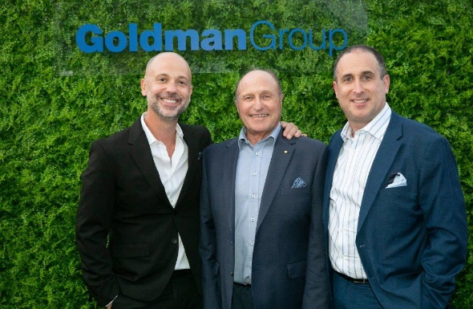
Goldman Travel Corporation Benefits
For 40 years, we have continued to deliver a bespoke model of travel management solutions including:
Direct access to owners
Link Travel Group
Preferred Hotel & Air Programs
VIP Corporate
Flexibility & Travel Policy Transformations
06

Slide 4





Come back safer.
Instil confidence in your stakeholders with a travel program that puts your travellers' safety first and supports your organisation's duty of care requirements.
Airline & hotel safety measures visually highlighted within the booking flow
Visually track your travellers’ current & upcoming trips on the Zeno dashboard
Multi-tier approval workflows can be dynamically assigned based on trip parameters
03

Slide 5


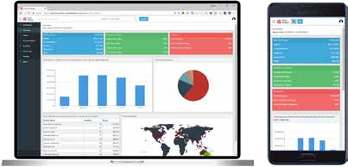

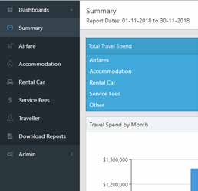
Travel Analytics
Our Travel Analytics responsive framework allows its informative dashboards to render into any device you need to access the reports in, including desktop, laptop, tablet and mobile.
Summary, Airfare, Accommodation, Rental Car, Service Fees and a new traveller dashboard and report download section provide stakeholders access to the data they need when they need it.
04

Slide 6


Visually appealing graphics is just the start
Travel Analytics tech stack provides customers access to the latest graphics, which are de- signed to communicate information efficiently and effectively.
Informative hover text, on screen filters, drill down displays and predictive text searches and drill down click events feature prominently on all dashboards.
07

Slide 7



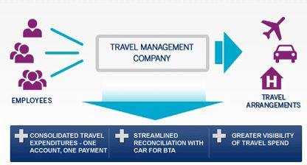


Virtual Card Payment
Solutions
We’ve made payment and reconciliation a whole lot easier with our virtual card payment solutions offering full cost breakdowns and enhanced data.
Benefits
Report and reconcile easily
Pay on-the-go, in-app or online
Security and controls per card number
05

Slide 8




03
Further Automation
Automate the predictable so we can humanize the exceptional
Goldman Travel Corporation Roadmap For 2023 And Beyond
Staff Training Programs
Continue our TAFE accredited travel & tourism management courses
02
01
Sustainability
Working with our travel partners to support our clients journey to a net zero travel prggram
A
08

Slide 9
David Goldman
Joint Managing Director
E : david@goldmantravel.com.au | W : goldmantravel.com.au

