Slide 1
Name Your Project – Mendota Group sustainable energy consulting company logo design
Task Description -
  Who: We are a consulting company working primarily on energy efficiency, electrification, and renewable energy. Our clients:
    are usually utilities (primarily electric, but also gas and water) but other clients include –
    Government entities that regulate energy
    Businesses that are installing energy projects
    Other energy services companies
    Investment firms focused on energy
  What:
    The “logo” should focus on our name, Mendota Group. We are interested in variations that include the initials MG.
    Our company does not have “products” nor are we really associated with any specific geographic area
    We would also like to incorporate one or both of the following elements:
      Electrification (possible symbols to integrate: plug and cord, lightning bolt)
      Renewable energy (possible symbols to integrate: leaf with lightning bolt)

Slide 2
Logo Text –
  Mendota Group or MG
  We would also like some options that include the tagline, The Power of Bright Ideas
Additional Design Considerations –
  Colors:
    We like our current colors (strong blue and green – see gradient values on following slide) but the colors can be modified; however, the colors will be used on our website and other documents so the theme should be somewhat universal
    We will also want black and white versions of the logos
    We will need variations with white and clear/transparent backgrounds
  Other (logo variations)
    Full Name – Mendota Group
    Initials Only - MG
    Full Name with tagline - “Mendota Group” with “The Power of Bright Ideas”
See other information on next slide

Slide 3
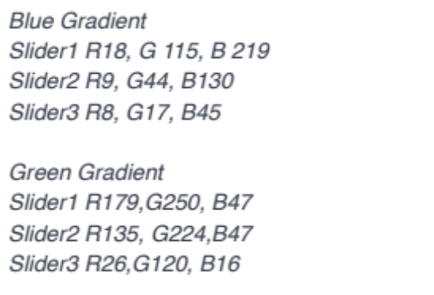

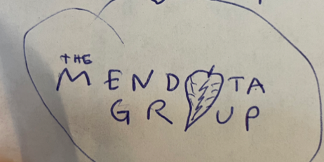
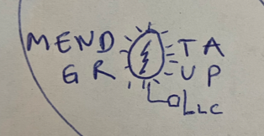











Current Company colors (not necessary to duplicate but we generally like them):
https://mendotagroup.com
Created from a logo design website
Ideas:
Cool symbol from a logo design website

