Slide 1
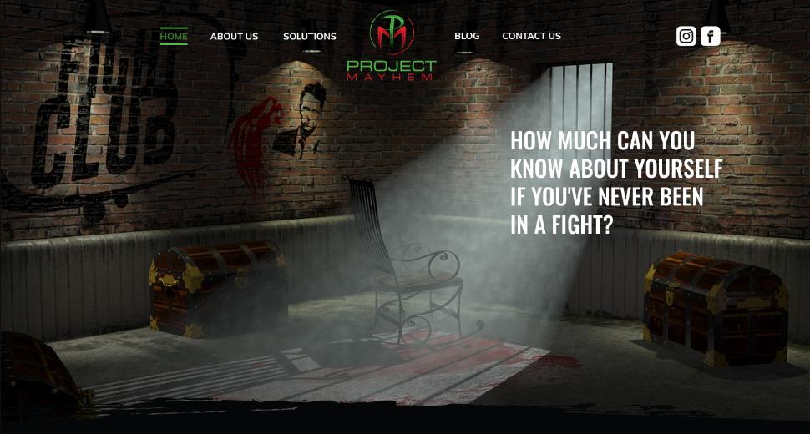
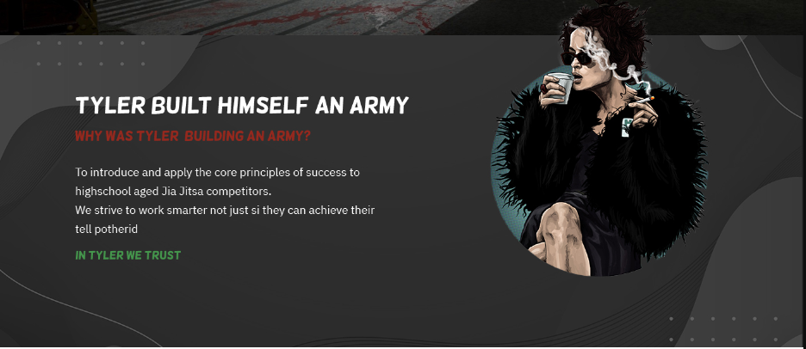
Please remove Social Media links from main page
Make red and place so it could look like it is what she is thinking/saying (when bottom image slid up)
I like the tear away bottom of the image (slide image up)
Make green and larger so it’s the title of that following paragraph

Slide 2
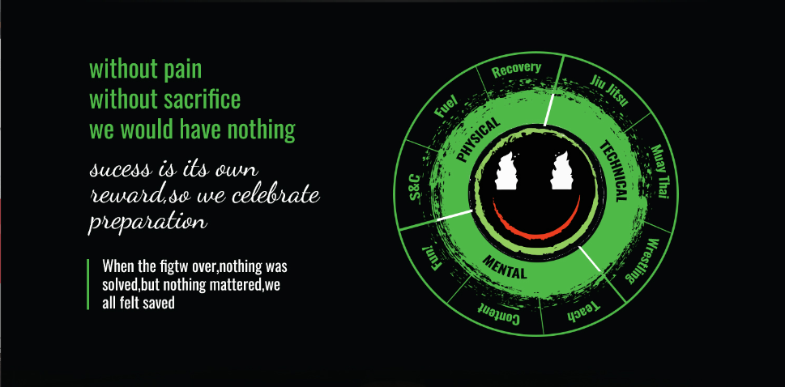





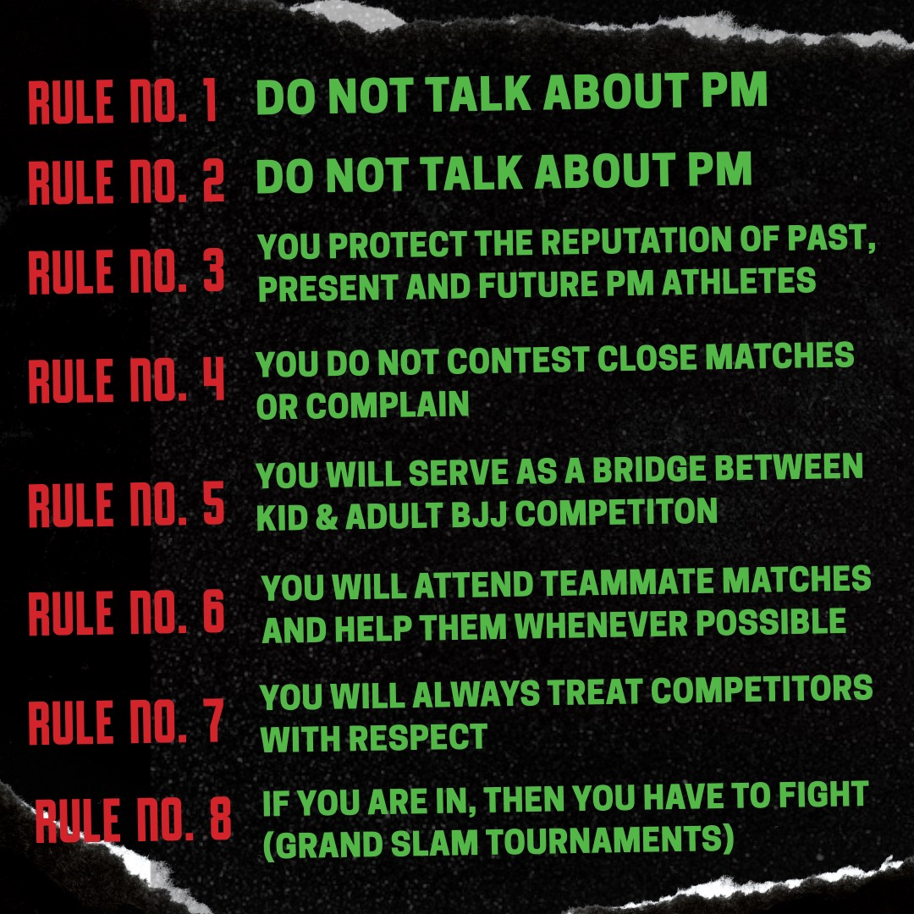
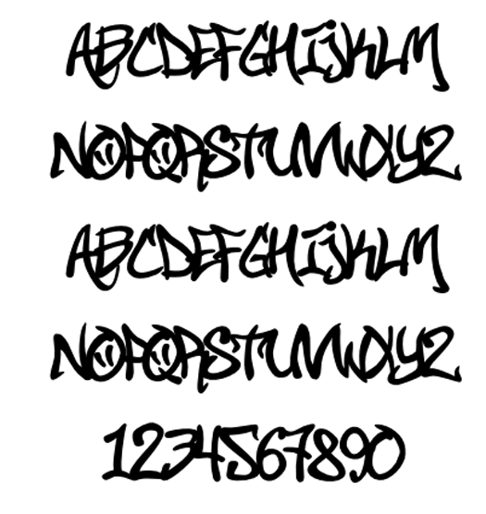


Success is its own reward,
we celebrate preparation
Can you try to match this font (or versions of it) throughout the website?
Can you make these nine subcategories the same as your other circle chart (Personal Goals, Challenges, Drills, etc…)
Can you make these lines red?
This can go anywhere on this page that looks good
Can you change this font to more of a street-art look…and make red? (cursive is too formal)?
Also make this the quote that reads, “I’m breaking my attachment to physical power…power of the spirit”.
You do not talk about Project Mayhem
You DO NOT talk about Project Mayhem
Feel free to use your judgment on spacing and font combination
Can these be red paint splatters?
Can you fit this image better in your green circle (get rid of white part in background)?

Slide 3
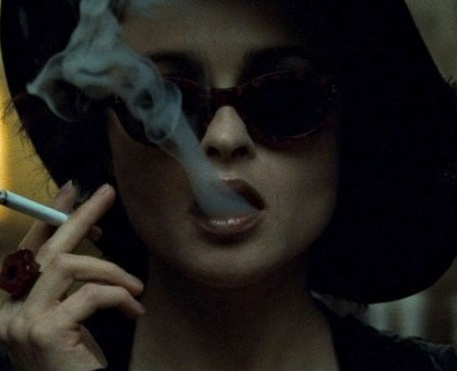
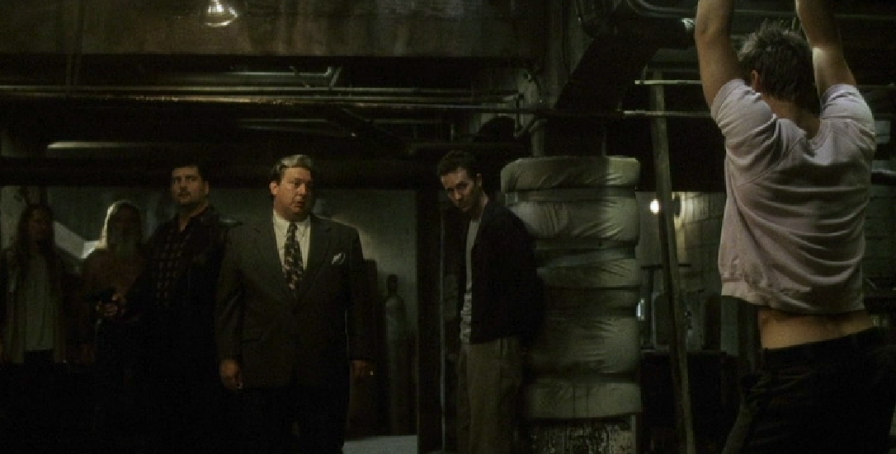
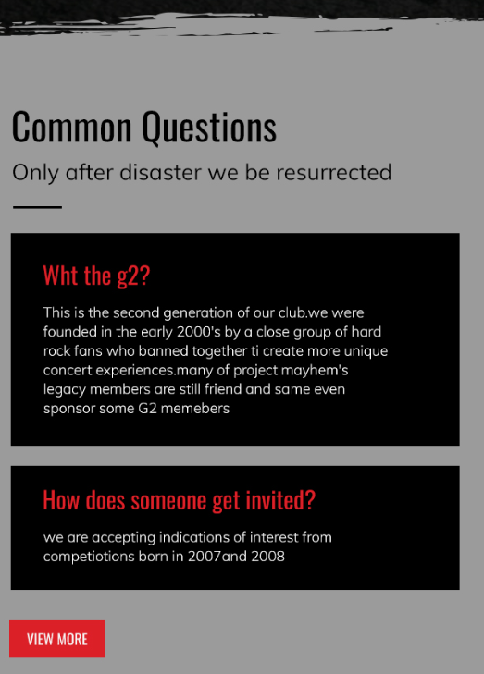
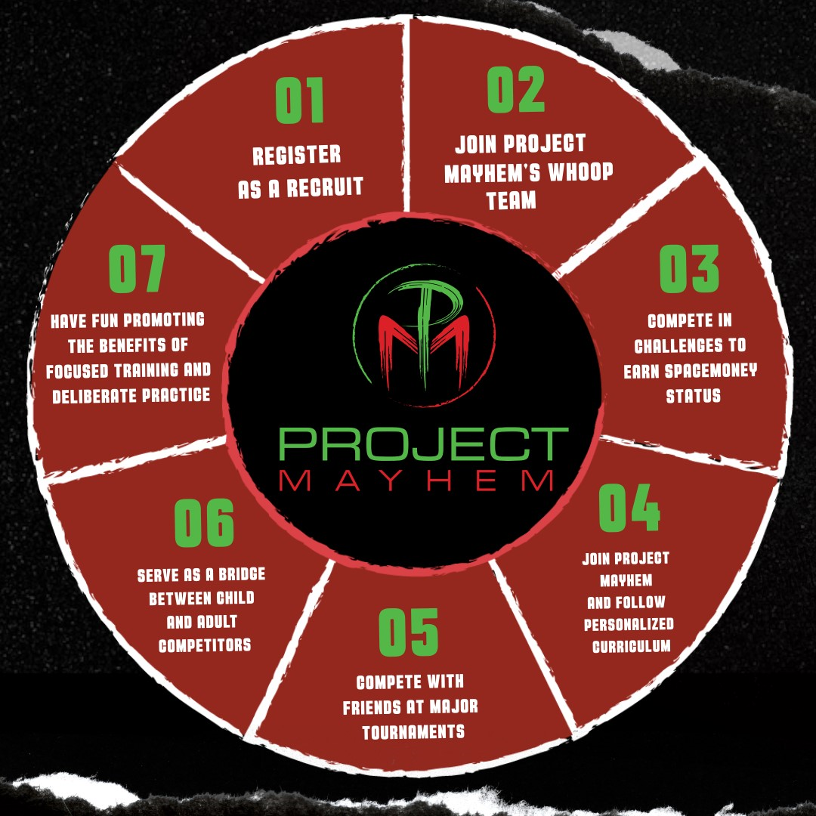


Move this quote up to top and away from “Q&A Section”.
In Tyler We Trust…
Can you start the numbering here (with “1”)?
Have button read, “Apply for More” (and be green).
Can you match the red better?

