Slide 1

Brief Logo
Future of Communication

Slide 2

Who we are ?
Losam is a marketing agency specializing in the creation and animation of decision-makers communities.
Losam created Future of Communication for the company Stratégies, a project dedicated to Directors of Communications from top-tier companies and brands. It is a real community of interest that carries the collective strategic thinking of the communication world in order to co-build the future of the sector and new collaboration models between the stakeholders.
What is Future of Communication ?
  1 founding committee composed of 6/8 leaders which will define the themes of the different meetings.
  5 meetings a year (5 dinners).

Slide 3
Who is Stratégies ?
Stratégies, the reference media for brand professionals, aims to give brand professionals the keys to a better understanding of the changes in communication and marketing.
More information can be found here :
https://www.strategies.fr/

Slide 4
Stratégies - Brand Guidelines
Color palette
MAIN COLOR
CMJN 30 / 30 / 30 / 100 I RVB 10 / 2 / 3 I # 0a0203
CMJN 0 / 100 / 50 / 0 I RVB 237 / 20 / 91 I # ed145b

Slide 5
Strategies - Typography Guidelines
S E C T I O N D E S I G N A T I O N
Page Headline
Content Title/Sub-headline
Body
Gotham, 10pt, Bold
Gotham, 24pt, Normal
Gotham, 14pt, Semi-bold
Gotham, 14pt, Normal

Slide 6
Stratégies – Brief
What: Creating a logo
Sector/Target: Director of Communications
Logo text: Future of Communication
Elegant
Fun
Traditional
Personal
Feminine
Colored
Low-end
Audacious
Serious
Modern
Professional
Masculine
White & Black
High-end
v
v
v
v
v

Slide 7

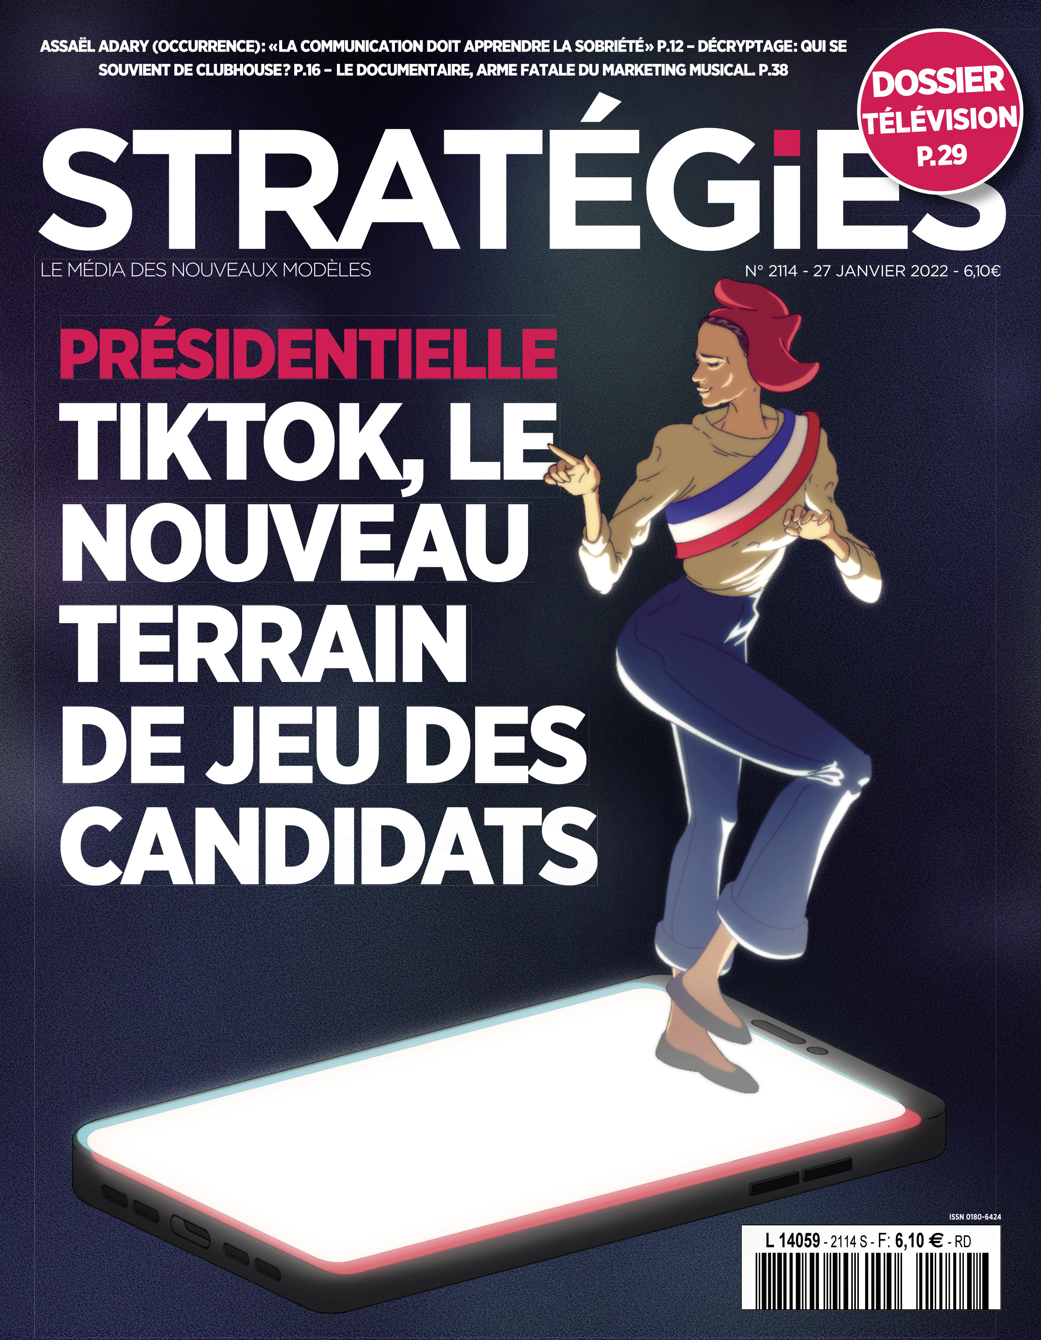
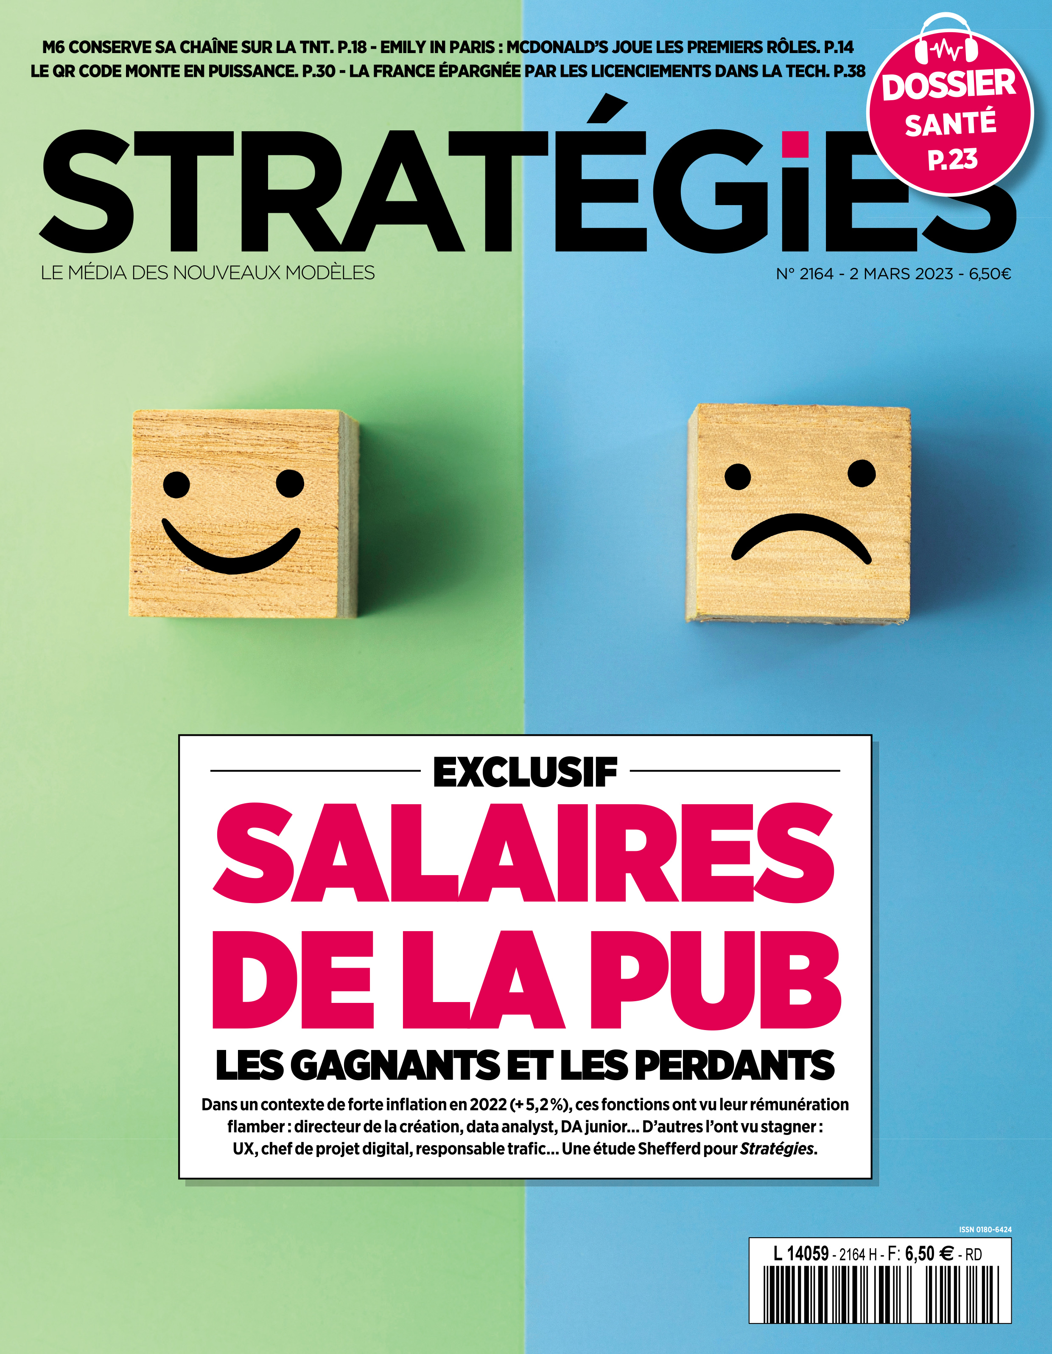
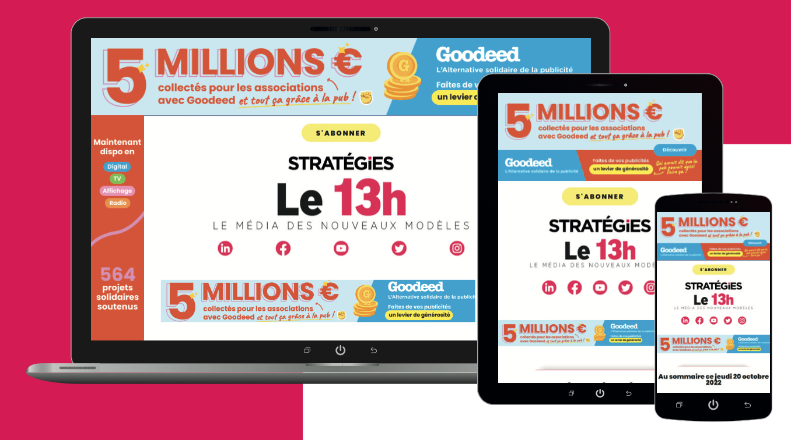
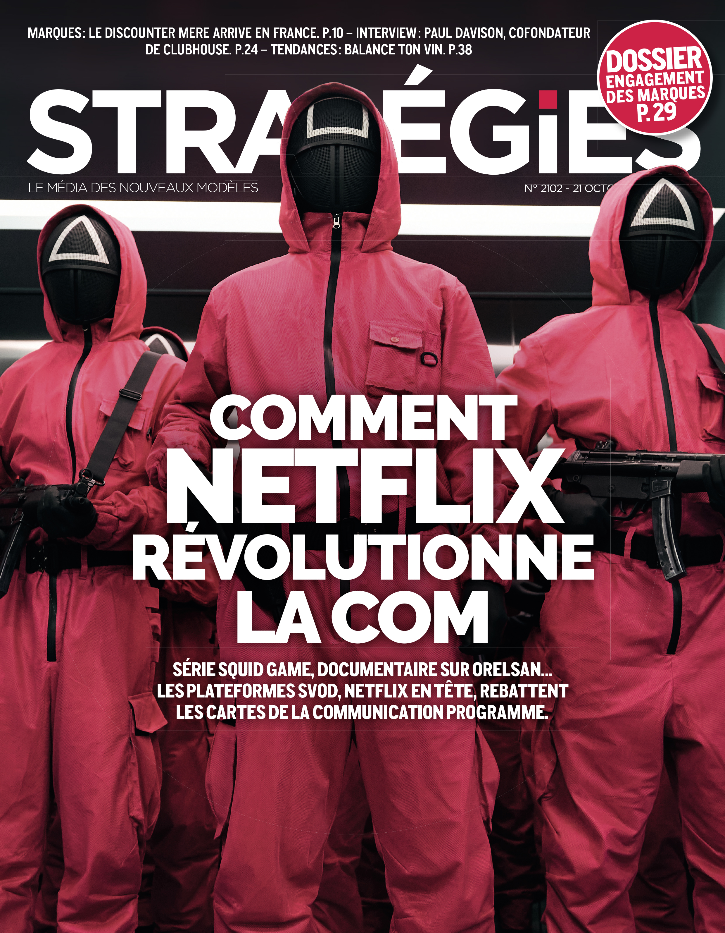
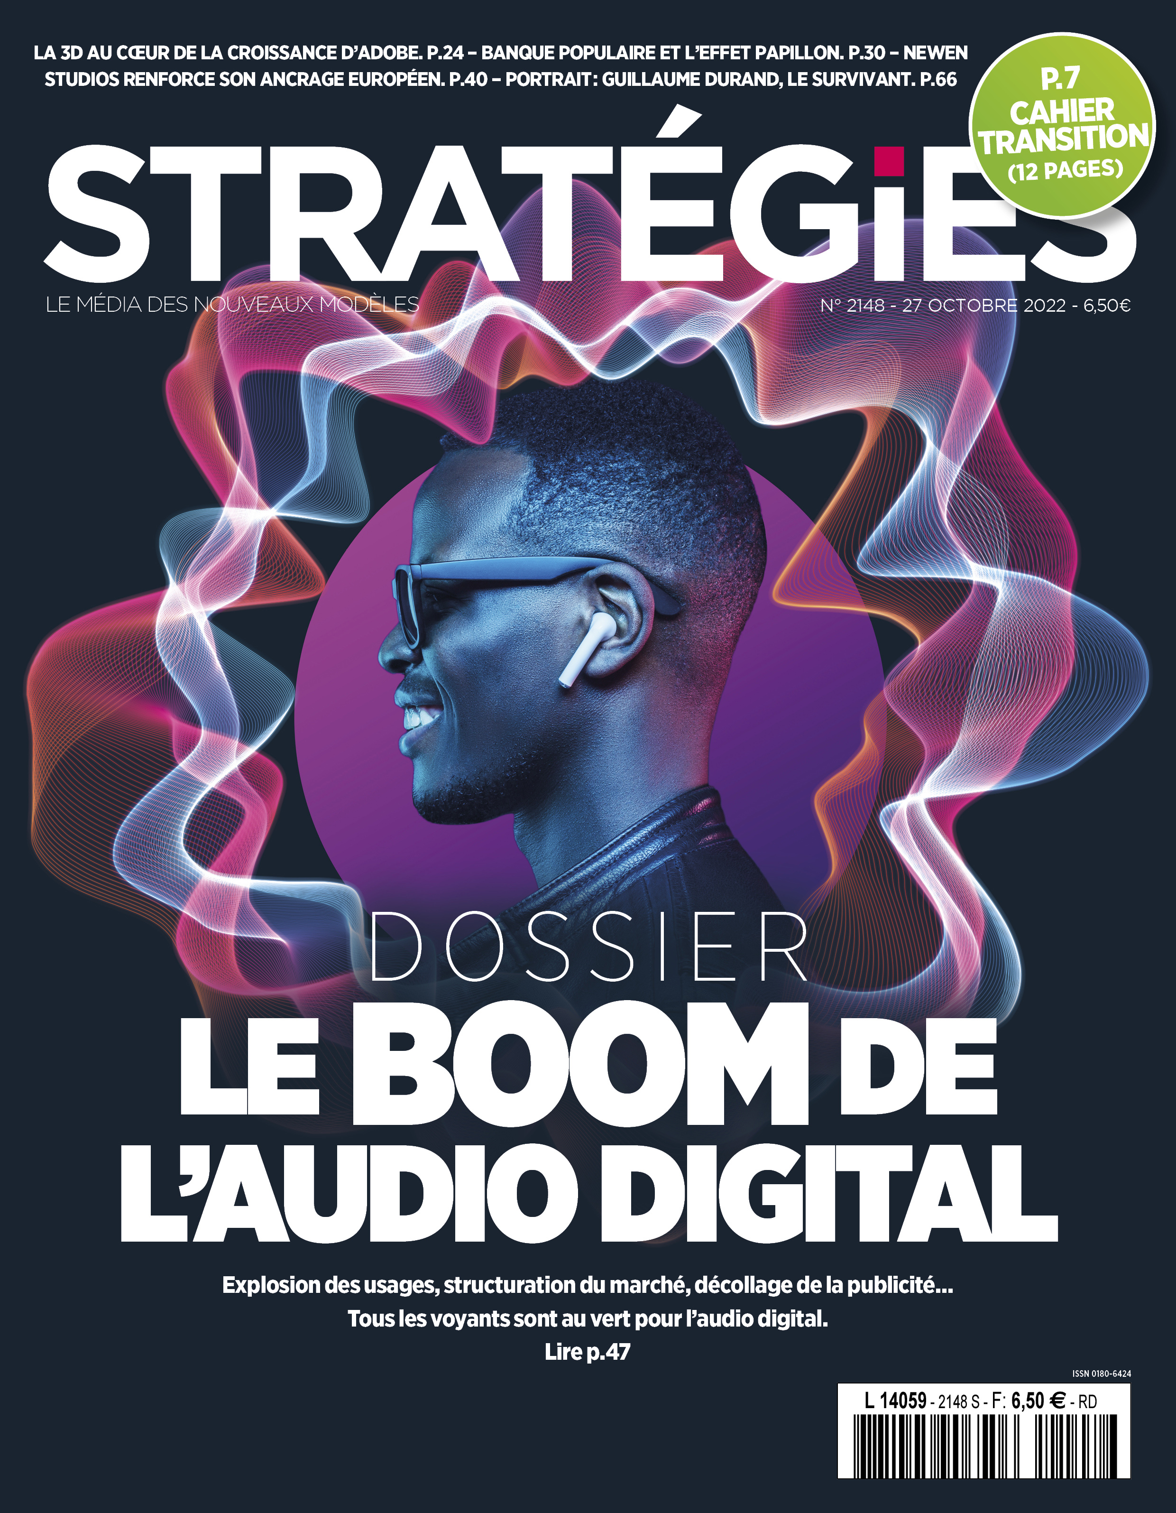
Stratégies- DNA

Slide 8
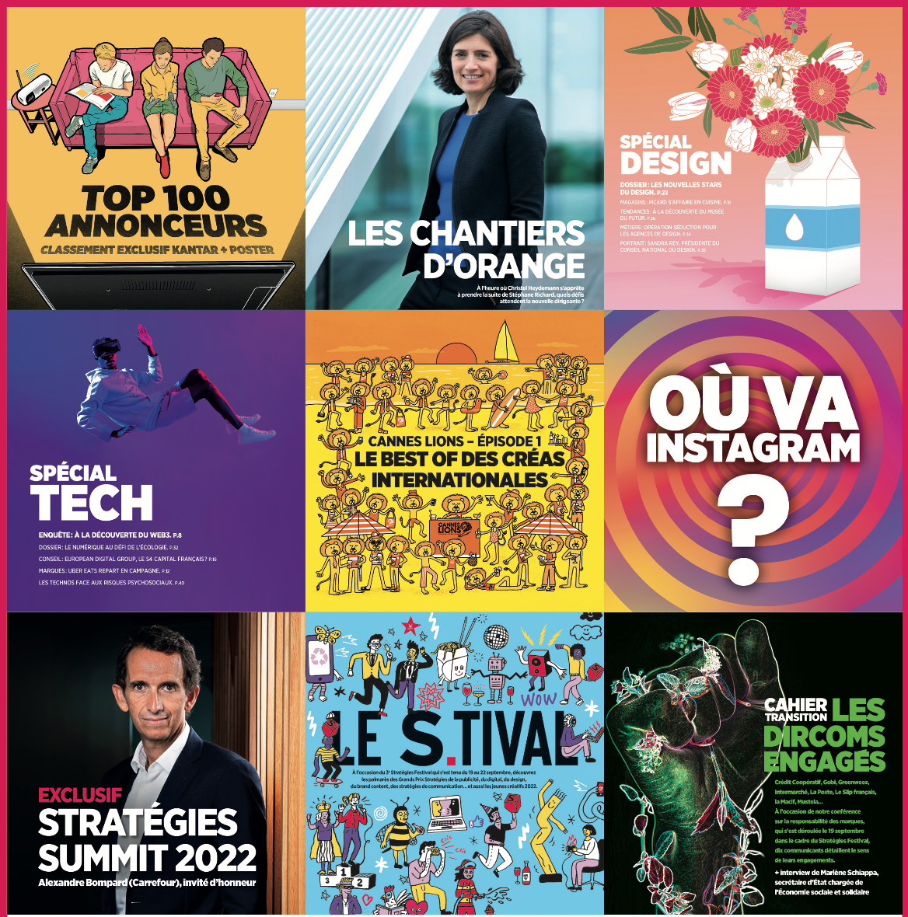


MOODBOARD

