Slide 1

Balanced scorecard slide 1
Title Slide that can be customized with client logo as needed

Slide 2
AGENDA SLIDE
SLIDE TO EXPLAIN UPFRONT WHAT WE WILL COVER IN MEETING IF NEEDED
NOTE – MAY NOT BE NEEDED IF SHORTER DECK
1. CNCData Overview etc
2. etc etc

Slide 3
Balanced scorecard slide 1
Section Slide

Slide 4
Who are we
CNCData is a global B2B data and marketing services company, partnering with marketers at every step of their customers journey.
The combination of our proprietary database, local market expertise allows us to help marketers find, engage and convert contacts to customers
Notes:
Key points
Global
Working with marketers
Our services reflect the full customer journey from contact to customer.
Proprietary data is core to all services.

Slide 5

GLOBAL SERVICE DELIVERY FOOTPRINT –.
UNITED STATES
(Corporate Office)
SINGAPORE
(Regional HQ)
UNITED KINGDOM
MALAYSIA
PHILIPPINES
COVERING:
- Philippines
COVERING:
- UK
-- Germany
France
All Europe counties
COVERING:
- Malaysia
Indonesia
Hong Kong
Taiwan
COVERING:
- Singapore (BPO Only)
COVERING
THAILAND
INDIA
PHILIPPINES
VIETNAM
CHINA
CEBU:
COVERING:
- Australia
- New Zealand
COVERING:
- Thailand
COVERING:
- India
- South Asian Countries
COVERING:
- Vietnam
COVERING:
- China
Sales and Execution Office
Execution Office Only

Slide 6
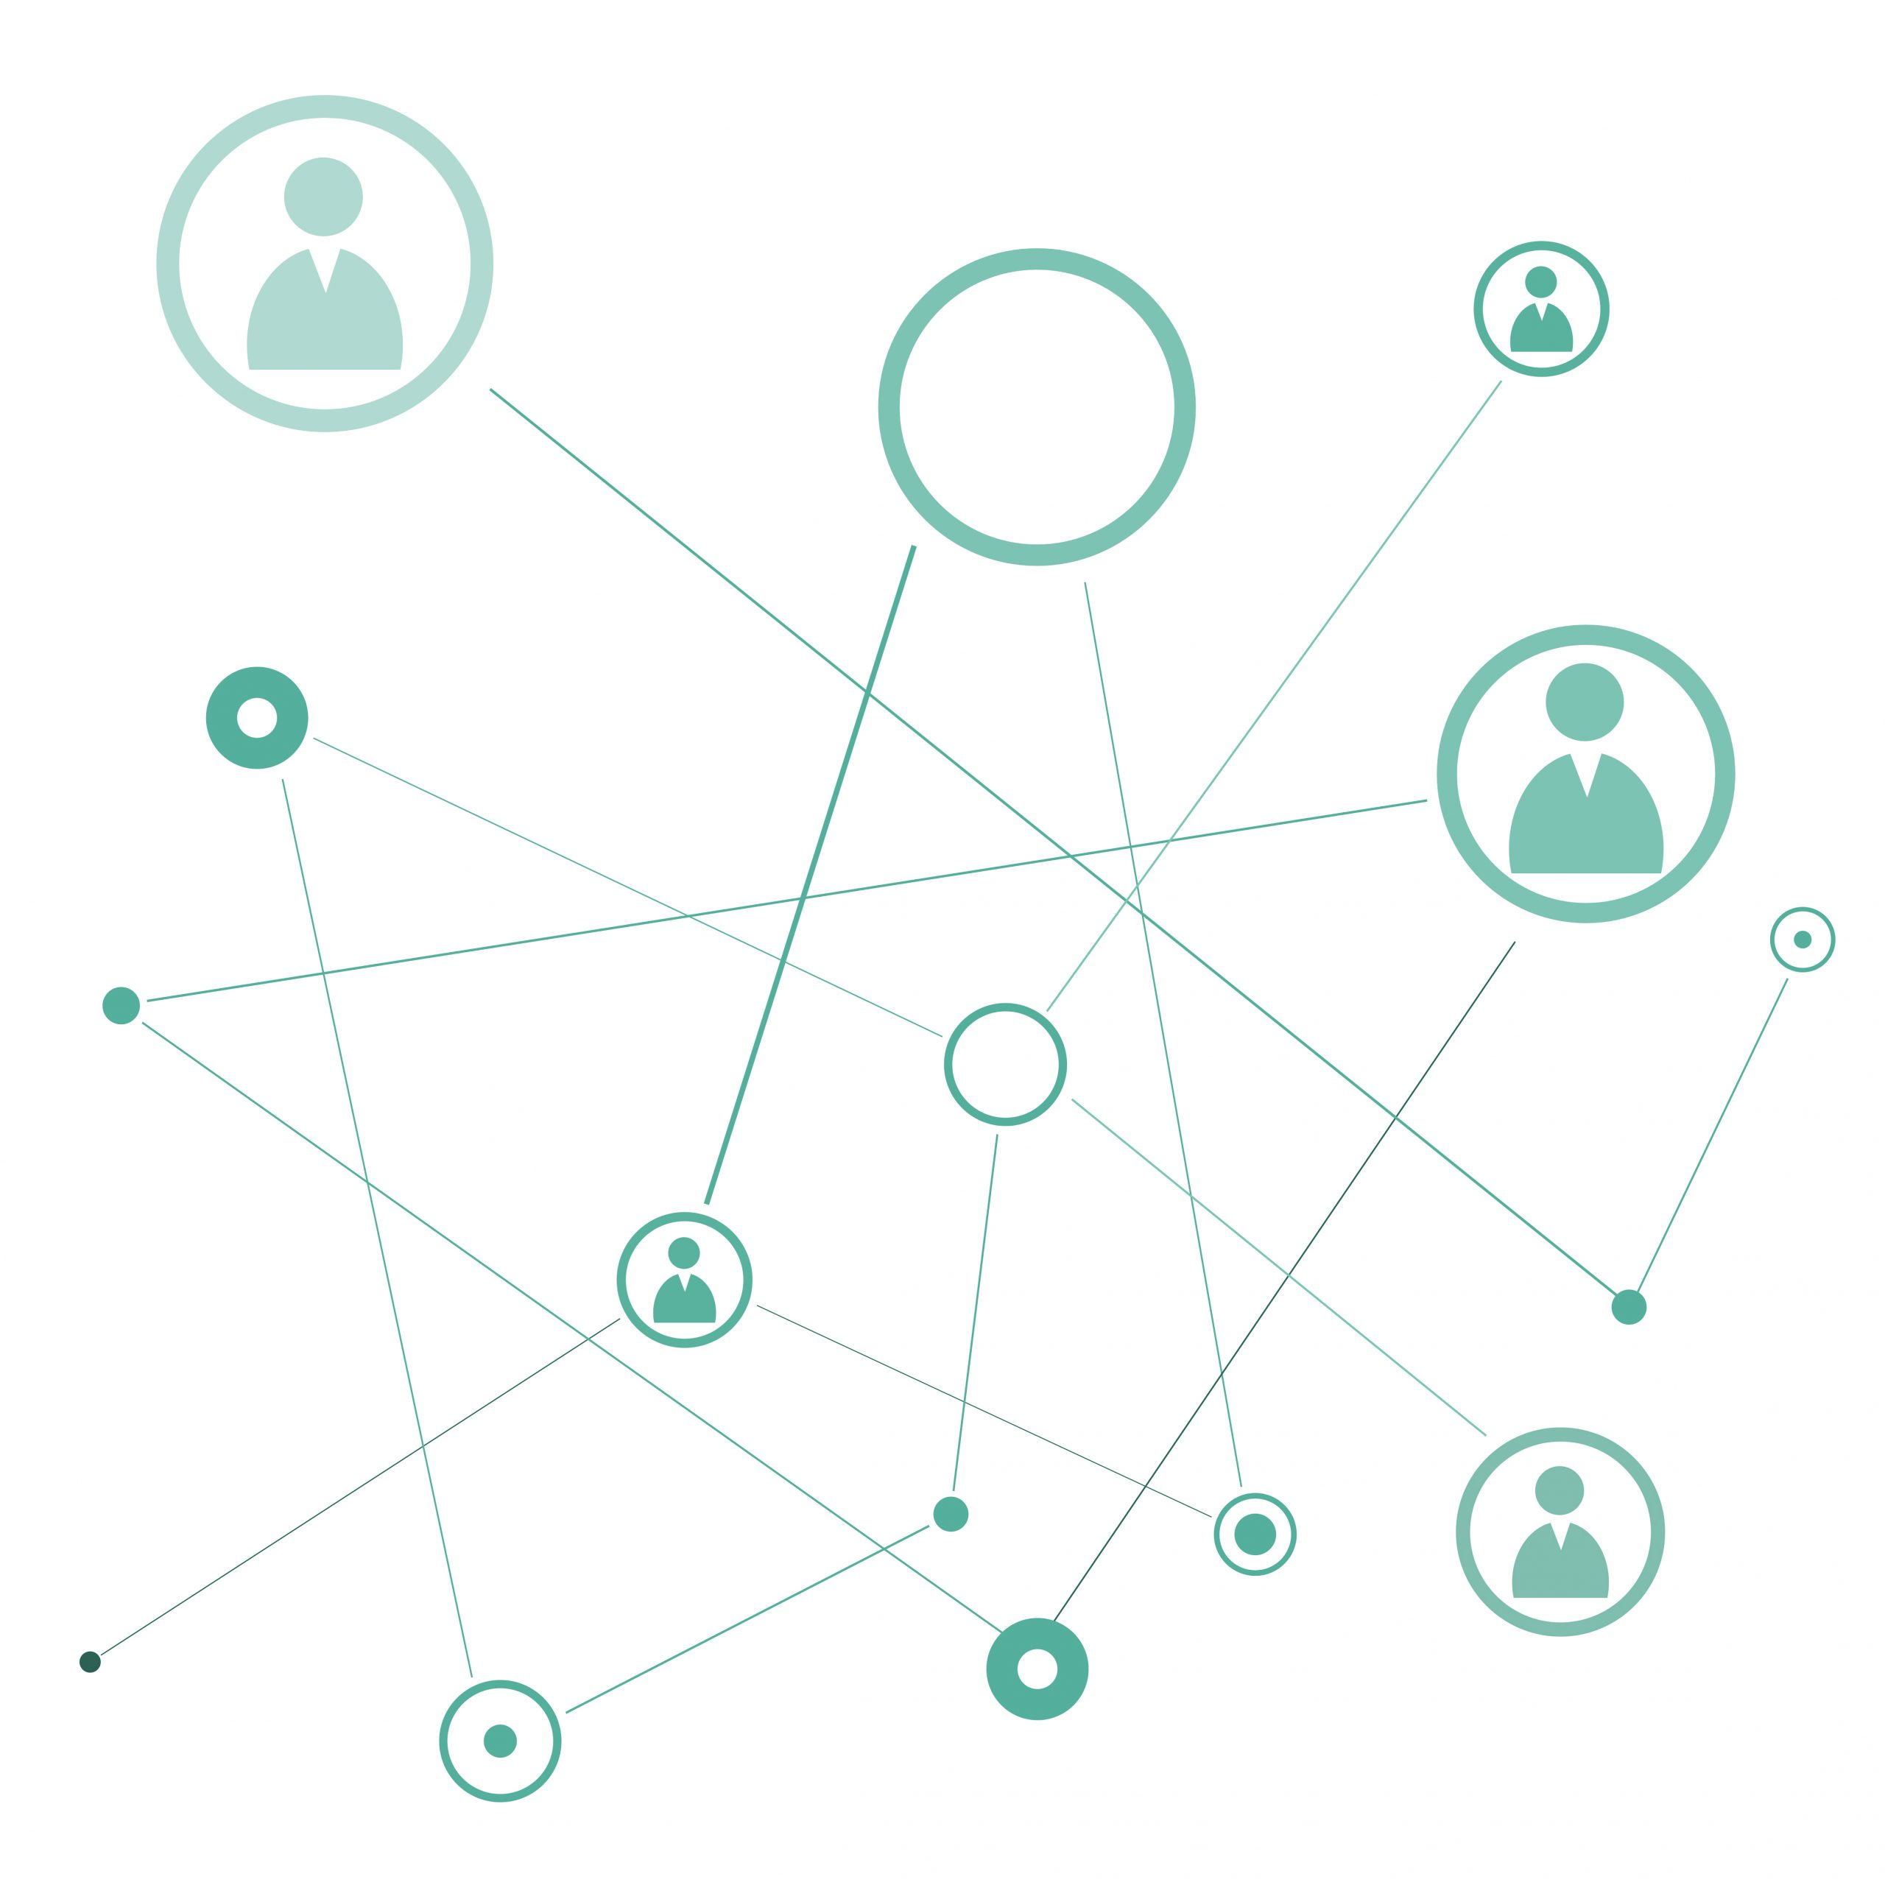







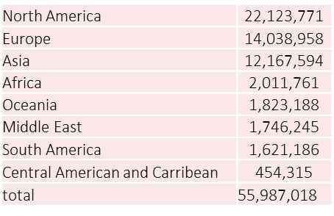
Our B2b data
POWERED BY DATAPLUS
30,500,000+
55,000,000+
3,000,000+
80
150+
30+
COMPANIES
CONTACTS
TECH INSTALLS
GLOBAL DATABASE
INDUSTRIES
JOB FUNCTIONS
Show the counts in a map

Slide 7


Best in class multilingual calling teams
Leads for every stage in the funnel
International Calling Capabilities
Positioning technology solutions
Experienced callers able to identify and engage with senior contacts
Understanding of technology propositions
Covering Europe, USA, APAC and LATAM
Calling Hubs in Ireland, Eastern Europe, The Philippines, network of remote resources to cover all global requirements
B2B technology focus
Native language skills & cultural knowledge
Covering most local languages globally
Programs set up and run based on local culture
Callers experienced in engaging with senior
contacts
Positioning client’s solutions
Full qualification
Nurture programs
Double opt-in expertise
Channel Programs
Experts in Demand Generation
Data-driven approach
Our global file covers 56m decision making contacts
Ongoing maintenance
Data privacy compliant (PDPA, GDPR & ePrivacy, etc.)

Slide 8
Languages supported
We support most languages, including
English, German, French, Italian, Spanish, Dutch, Portuguese
Danish, Swedish, Finnish, Norwegian
Polish, Hungarian, Romanian, Bulgarian, Greek, Turkish, Czech, etc.
Russian
Arabic
We support most Asian languages, including
Chinese (Mandarin and Cantonese)
Japanese
Tagalog
Cebuano
Korean
Thai
English

Slide 9
From contact to customer
Identify
Engage
Nurture
Grow
Creating measurable engagement (MQL’s) with net new customers
Nurturing MQL’s to SQL’s
Growing and retaining of existing customers
Identifying the best accounts to target with clean contact data
Notes:
Identify
Identifying the best accounts, contacts and information for your campaign is essential.
Do you have internal data sources you can use?
How well maintained are they for marketing purposes
Who looks after data management for company xxx
Is it best for customer or prospect data?
Where do you need support?
Our data product and services are tailored to making and keeping your data performance ready.
We can even provide a team to manage your data on an ongoing basis
Engage
How many leads are you tasked with providing
What type of leads
What channels do you most commonly use/work best for you? Ie email, ppc, SEO, social, outbound tele, EVENTS
Do you use partner companies to help with lead generation
Who do your marketing leads go to ( BDR’s, Pre-sales, AE’s?)
How well do they convert?
Do they all get called and nurtured?
Filling your marketing and sales funnel with enough good quality leads to nurture and convert is on every marketers mind.
Whether you need leads to put into your nurture streams, event registrations or highly profiled leads, we give our team of experts our cleanest freshest data to run campaigns on your behalf.
Nurture
Once you have created or bought a lead, what happens next?
Do you have leads that didn’t get the attention they needed to convert to a sales opportunity?
Event registrations that didn’t show up etc
Lots of marketers have a sense of frustration here – how does is work in company x?
We can build you a team of sales development reps, managed by us, that can convert your MQL’s to SQL’s using local language skills to nurture your leads
Grow
Where does customer marketing sit within the org?
Who?
Does the product/ service need renewing?
Size and frequency of the renewal base?
Who does it?
How well do you feel your current processes work/
Where are the top 3 areas you need support in terms it time, resource or expertise.
Understanding and delivering what your existing customers need from you to secure renewals, and cross sell opportunities is vital in todays challenging markets
Let us use work on your behalf to conduct customer satisfaction surveys, undertake seamless renewal programs or create cross-sell opportunities for you.
OBVIOUS PITFALL IS STARTING TO TALK ABOUT OUR SOLUTIONS HERE!! TEASERS ONLY AT THIS POINT!

Slide 10




How we can work with you.
  Our data experts will work with you to make your data campaign ready.
  Using our proprietary data set & network of contact centres we create content led demand generation programs that can deliver leads for any point in your pipeline
  CNC make perfect outsourcing partner for your trickier data and Business Processes.
  .
  Data Plus is our Self service platform where you can filter and download human verified B2B contact data
Notes:
RED
Opportunity to describe and establish data plus in terms if size, scope, quality, recency etc.
Self serve option
PINK
More questions around data availability/clarity etc here
GREEN
Read back the information you have gathered and check if you have missed anything. Opportunity to ask more questions if needed
GREY
Questions around slide 8, should have revealed whether they have resource, expertise or time issues in managing their data or lead follow up functions. Qualify and read back here.
Our expertise in data management together with our in-region teams of BDR’s and SDR’s makes
Working with your data and technology, we work as part of your team providing you with a results driven service
Whether you need your data cleaned, profiled or updated, or even a custom data selection built just for you.

Slide 11
Why work with us?
  We can partner you on every step of your marketing journey
  Our global database of Human verified proprietary data offers unrivalled breadth, depth and accuracy
  We provide localized interactions with your customers and prospects using our well-established contact centers across 8 countries in the Asia Pacific region.
  We have a dedicated team of experts ready to advise, partner and deliver your objectives
Notes:
N.B – if using the longer deck, slides 10 and 11 should go to the back.
Advantages
You don’t need to manage multiple partners
The data is clean, fresh, recent and not overused
Using calling to verify means it is the cleanest type of data you can use.
Let us do the heavy lifting of your non- core activities. We are the experts in our field.

Slide 12
















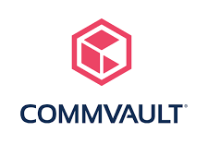























You will be in good company
We are a trusted partner of some of the best known and most ambitious companies
Over 85% of our business comes from repeat customers who have worked with us over multiple years.“
Notes:
*customise for every presso as best practice. Put other slides in the appendix.
Talk about the service infrastructure here.

Slide 13
Most Accurate & Comprehensive Campaign Ready Data In APAC Region
An enterprise level self serve DaaS platform that enables direct access to high quality, hard to reach B2B data in APAC.
Data coverage up to 25 Asia Pacific countries Including ASEAN, ANZ, Greater China, India, Japan, Korea and Emerging Countries.
Users can filter by firmographics, demographics and technographics details.
Records are human validated to ensure utmost accuracy via our contact centers and only qualified and validated records are added to dataplus.
If what you need is more complex, we have a team of data experts ready to help
Cleansing
Profiling
Append
Data Acquisition
Custom Data Acquisition
Notes:
* Focus here on pulling out all the FAB’s for data plus and data services

Slide 14
Demand Generation
We use our own carefully selected data to fuel activity resulting in leads
Lead Type | Description | Your Next Steps
Contact Acquisition | Business Card Details | Qualify and opt in to further communication
MQL | Business Card plus opt in | Marketing/ BDR’s to Re-engage, nurture, score until ready to engage with sales
Event Registration | Business card and opted in contacts who have agreed to attend your event | Communicate to ensure attendance.
BANT/HQL | Business card plus opt in, with additional information gathered. | Marketing/ BDR’s to Re-engage, nurture, score until ready to engage with sales
We can add detail you require using information contained in our data base as well as calling via our contact centers
Cost Per Lead (CPL), Cost Per Account & Dedicated Resource options available for all lead types
Notes:
Think about EDM

Slide 15
Demand Generation
  We offer a range of demand generation programs for every stage of your buyer’s journey – from MQLs to BANT leads
            We understand your audience requirements and identify the ideal target companies and contacts from within our database
            We use a multi-channel approach to engage your chosen contacts and create leads. Calling allows us to properly verify leads and ask the questions you need
            We will ensure your content aligns with the campaign and can fill any content gaps by creating content for you
Defining & building a TAL
Digital & phone engagement
Content alignment and creation
Notes:
Draw out FAB’s

Slide 16
Getting started
Getting started
1.
2.
3.
4.
Identify campaign data
We supply a script for your approval
You supply content
We launch and manage the campaign
LEADS

Slide 17
DEMANd GENERATION
Leads for any stage in the funnel
Lead Offering | Output | Next Action
Contact Acquisition | Business card details | Qualify & Opt-in to further communication
MQL | As above plus Lead opted-in to client contact | Nurture, intent scoring, engagement analysis & programmatic advertising
SQL | As above plus Decision making responsibility confirmed Need / Requirement confirmed | As above plus consider assigning lead to SDR
BANT | As above plus Funding confirmed Timeframe confirmed | Ready for Inside Sales or Partner Delivery
Contact Acquisition
MQL
SQL
MQL, SQL & BANT leads are exclusively generated per client & per campaign
Option to add technographic install information to all leads for additional cost
Cost Per Lead (CPL), Cost Per Account & Dedicated Resource options available for all lead types
BANT

Slide 18


Email Programs
We apply Email engagement mainly to support our demand generation programs to “warm up the audience” or to follow up after a call.
We offer stand alone email broadcasting depending on opt-in requirements.
Our powerful messaging tools and a comprehensive hosted platform
  Build business rules to deliver relevant content dynamically
  Create workflows to power sophisticated drip marketing programs
  Boost response rates with automated AB testing
Extensive strategy and creative team to design digital messaging programs that deliver strong ROI
Integrate email, social and mobile for impactful multichannel relationship marketing

Slide 19
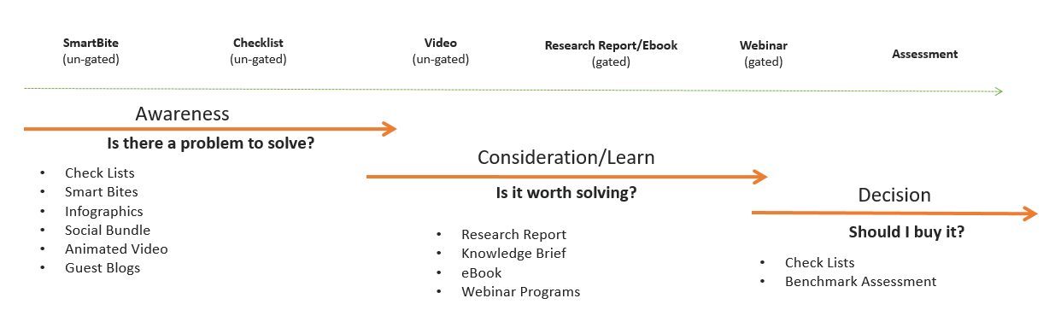
Content strategy & CREATION
    Do you need help in identifying the right content strategy for you?
    Do you need your content to deliver more?
    Do you have the time and resource to create the content you need?

Slide 20
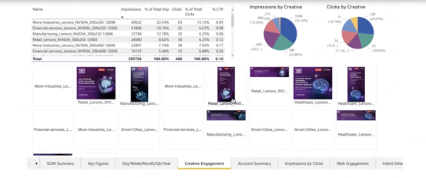
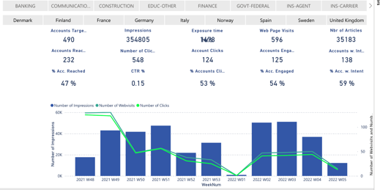



Intent based Advertising
    Intent-Powered Digital Advertising that optimizes spend by reaching qualified prospects at the right point in the Buying Journey
    Third party and first party intent combined with our unique engagement intent signals
    Tracks performance of campaigns in real-time and provides actionable optimization insights
    Sophisticated dashboard to track KPIs
    These types of metrics allow to calculate Cost-Per-Visit, account penetration etc.
    How quickly are accounts visiting your website after seeing your ad

Slide 21
Tailored Advertising
  Formats
  Display: Drive awareness, consideration & purchase through hyper-targeted display media, executed programmatically & running on partner websites
  Native: Use native ads to amplify B2B content where your audience is already engaged
  Video: Drive brand awareness & CTR through high-impact video pre, mid and post-roll
  Content
  On News, Business, Commerce, Education, Entertainment, Lifestyle websites
  Device Categories
  Desktop/ Laptop / Mobile
  Targeting
  Geography, Industry, Company Size, Personas, ABM based or by Market Segmentation
  Ad Sizes
  970x250, 970x90, 728x90, 300x600, 160x600, 300x250, 300x50, 320x50

Slide 22
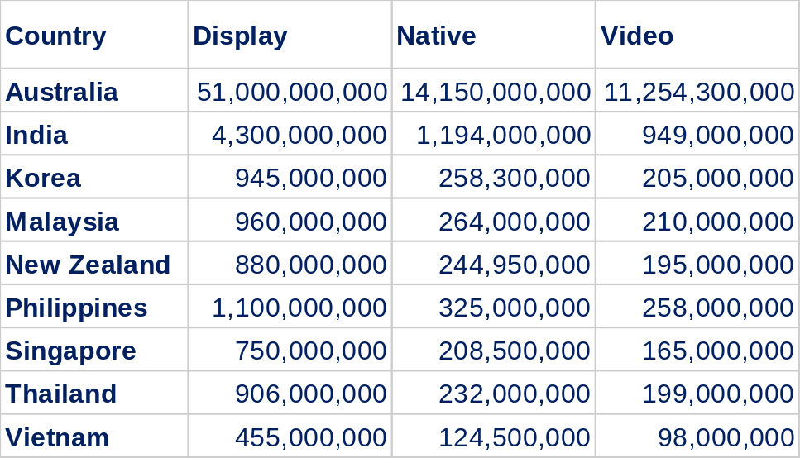
Avails and CPM
We also cover Japan, China, Hong Kong, Indonesia, Taiwan, Pakistan, Sri Lanka, Nepal, Brunei and potentially other countries.
Display: standard filters $25 CPM, ABM $40 CPM
Native: standard filters $40 CPM, ABM $50 CPM
Video: standard filters $50 CPM, ABM $60 CPM

Slide 23
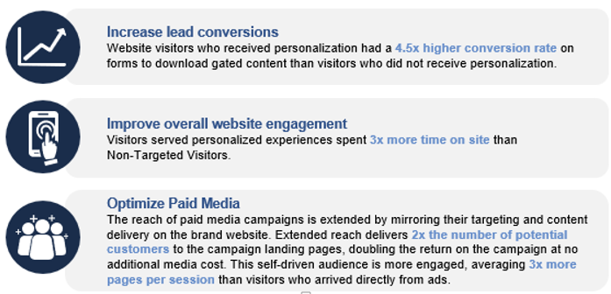
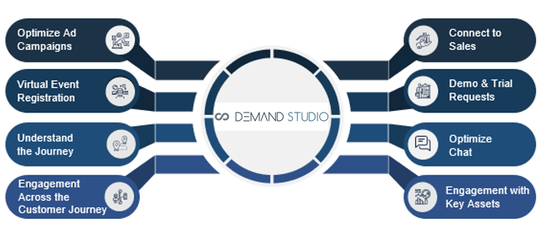

Website Personalization
Even the best targeted campaigns fail because of lack of engagement. We can see who is coming to your site and add in personalized content
Build journeys based on sequences of content consumption
Deliver calls to action and personalized content based on the completion/non-completion of custom events/actions/goals
Precision geo-targeting
Alter your messaging based on visit frequency and frequency
Identify and target visitors based upon customer’s unique data

Slide 24


Business Process Outsourcing
Resource
Expertise
Time
Having the right resource in the right place at the right time is always a challenge, especially when the demands of the business fluctuate
There will always be times as a business grows and changes that we do not have the right expertise when we need it. especially true when running a business function that sits outside our day to day business
Even when we have the expertise, we don’t always have the time we need to dedicate to certain business areas.
Outsourcing

Slide 25






How it works
We are specialists in data management and contact center management
We work with your data,
We follow your process, or one we agree together
We have experienced and pre-trained resource, ready to work for you.
We can work directly into your systems
Spend your time on your core business

Slide 26
Use Cases
Managed Data Services
Contact Center Teams
Our team of experienced professionals are trained to handle each of these activities with professionalism, accuracy, and efficiency Let our experts take care of it
Data Management
Data Entry
Cleaning
Updating
Researching
Processing
Desktop research
Our Outbound Contact Center services are designed to help increase sales revenue, improve customer satisfaction, and streamline customer communication processes.
Contact Acquisition
Account Profiling
Attendee Acquisition
Lead Generation
Customer Research
Market Research
Inbound Contact Center services are designed to help businesses provide exceptional customer service by providing prompt and effective support to their customers. Our team are trained to handle a wide range of customer inquiries, including
technical support
order processing
general customer service.
Notes:
On the other hand, our

Slide 27
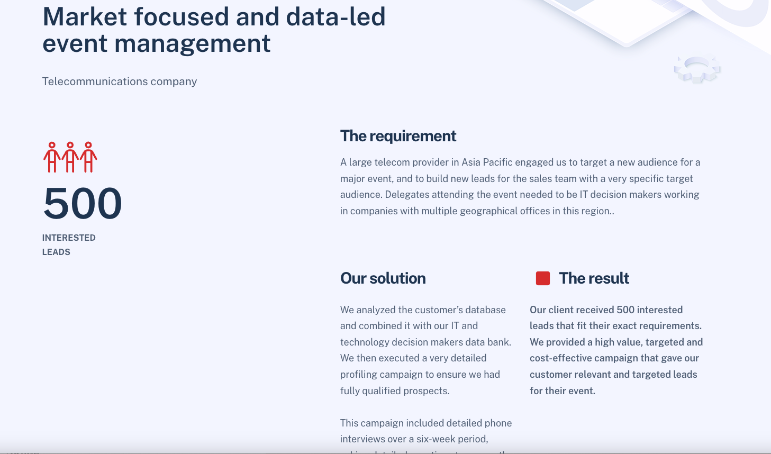
CASE STUDY SLIDE
Example of case study on new website (yet to be fully launched)
https://cncdata.netlify.app/case-studies/#case1
For ppt slides lets keep content template the same=
Description at top
Headline outcome on left – and then
The Requirement
Our Solution
The Result
as sub -headings/sections.

Slide 28
Balanced scorecard slide 1
Thank you slide

