Slide 1
Data Management as a Service

Slide 2
UK DPA 1984
UK DPA 1998
UK DPA 2018
EU-US Safe Harbor
EU-US Privacy Shield
EU-US DPF
PERC
ISO 27001
PCI DSS
SOC2
ISO 27018
Cyber Essentials
ISO 27017
NHS Digital Toolkit
GDPR
DMaaS

Slide 3





DMaaS
Application
Automation
AI
Service
DMaaS

Slide 4


EDRMS
Data Mapping
Assessment
DMaaS
Lifecycle
Classification
Privacy
DMaaS

Slide 5





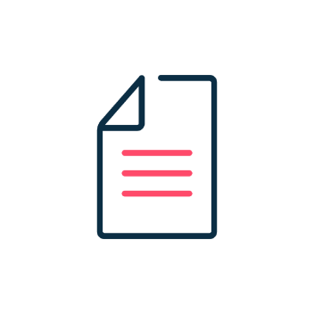










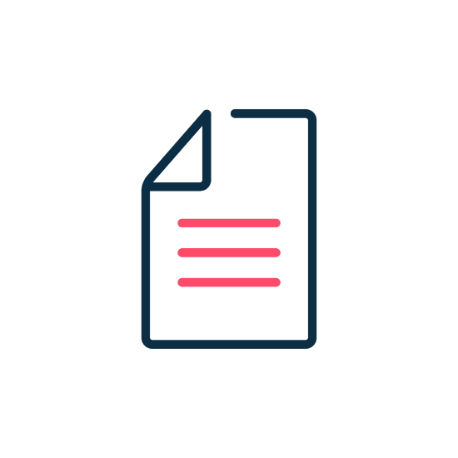



Customer’s Public Cloud
Metadata Reporting
Administration Console
Indexing and AI engine
Customer’s Premise
Metadata Reporting
VM / Physical Appliance
Read source data
Tunnel Encryption
DMaaS

Slide 6




Lifecycle
Storage Vendor Agnostic
ROT Analysis
Automated Remediation
Streamlined, Controlled Data Storage
Unstructured Data Siloes
DMaaS | Lifecycle

Slide 7





Privacy
Collection Silo
E-discovery & Collection
Manual Redaction
Export
Conversion
ID check
Manual process management
DMaaS | Privacy

Slide 8
Privacy
Software Automation
ID check
E-discovery & Collection
Redaction
Export
Self service or managed
request workflow
DMaaS | Privacy

Slide 9
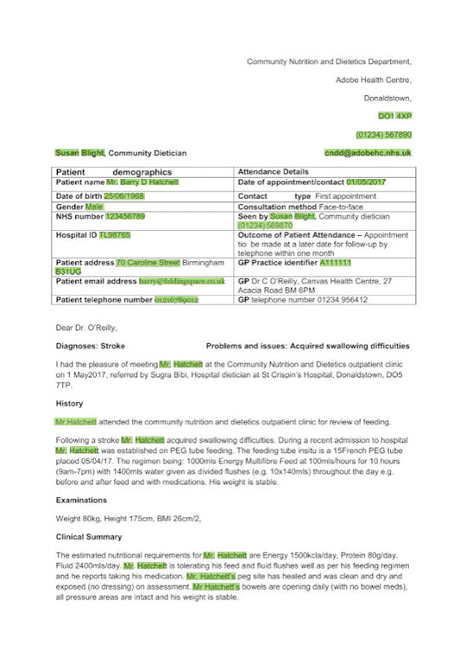
Automated Redaction
Redaction

Slide 10
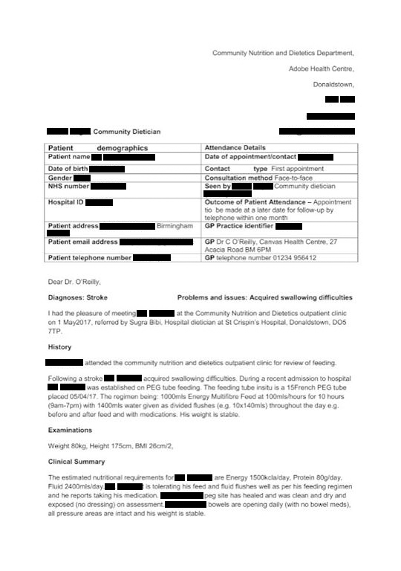
Immutable Redaction
Redaction

Slide 11


Redaction
Redaction
E-discovery
Ingestion
Deduplication
Conversion
Redaction
Export
QA Check
DMaaS | Privacy

Slide 12
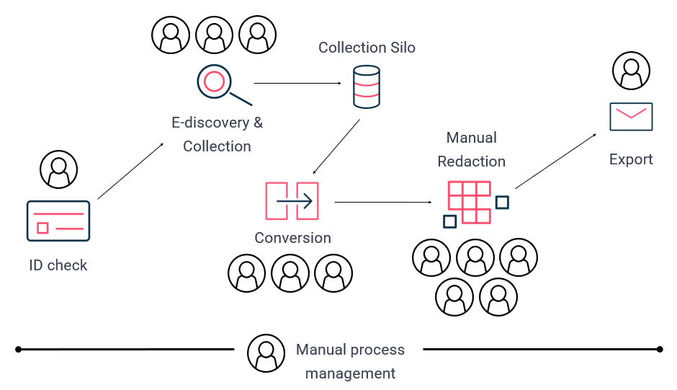

Privacy
Automation
AI
Service
DMaaS | Privacy

Slide 13


Classification
Global E-Discovery
Classify and Tag
Identify and Process Downstream
Unstructured Data Siloes
DMaaS | Classification

Slide 14
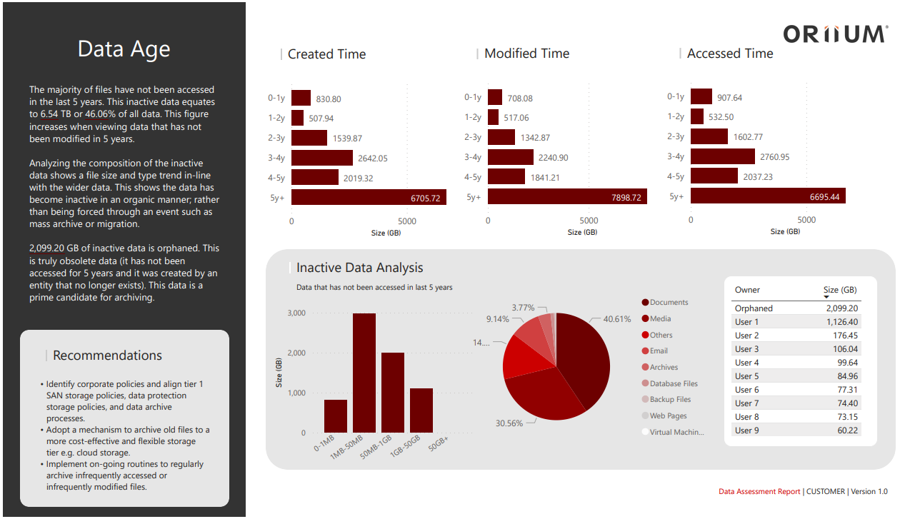
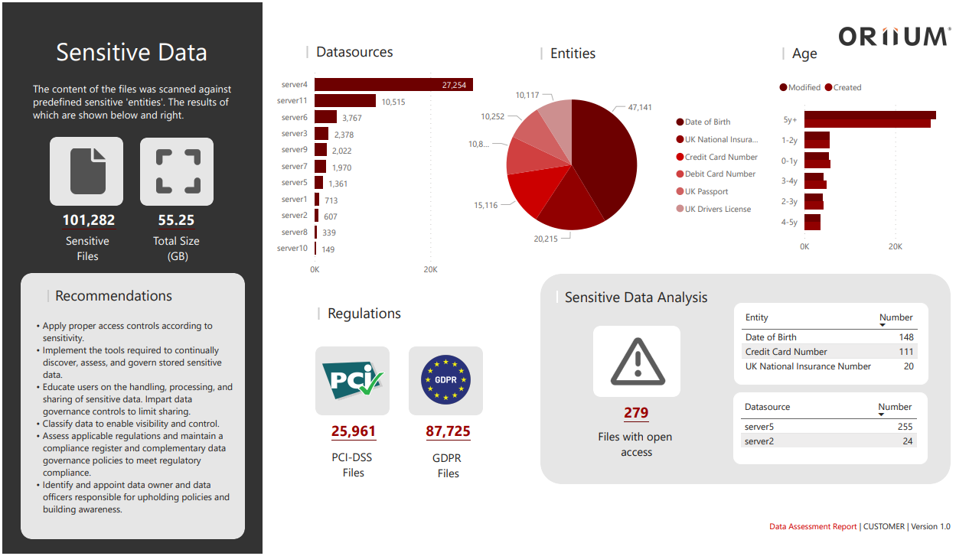
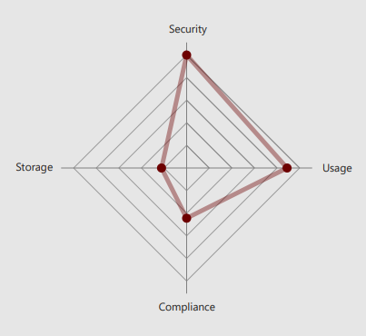
Assessment
Packaged
Data centric storage refresh or cloud migration readiness assessment
Data Owner and Data Access Assessment
Data Classification and Sensitivity Assessment
Generic
Data Management Assessment
DMaaS | Assessment

Slide 15
Thank You

