Slide 1
NESSi GUI
Input to DesignCrowd

Slide 2
The pages below includes our comments and requirements for the application. Please note that the layout is for our testing - It is not a requirement, although it seems to work.
There are several dimensions to the data, including time, assets and mitigation measure.
Our drafts are based on video editing software. They have some of the same challenges as we do, with multiple elements that shall be edited together to form a complete whole.

Slide 3
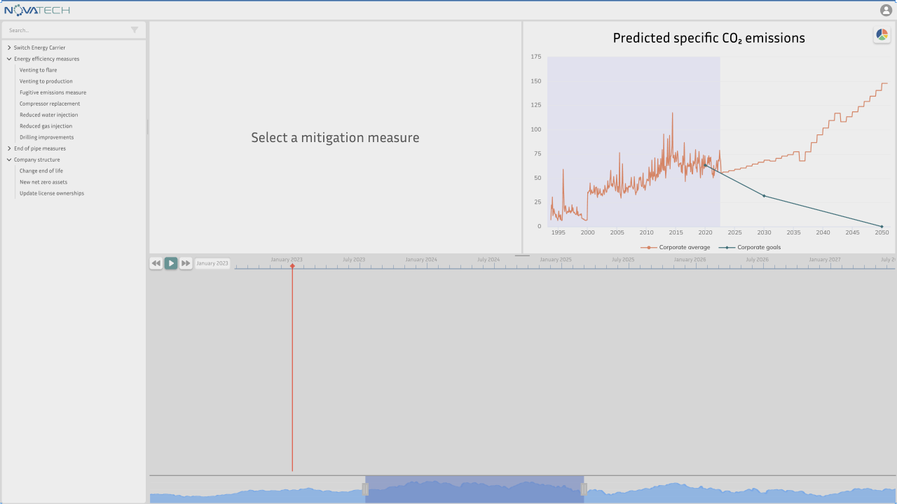
Empty workbench page
This is the workbench page. It should include some way of navigating, selecting, work with details and see the results.
This is the preview pane. It is possible to change charts.
There should be a chart selector, here presented as the pie-chart button in the top right corner.
The details pane shows the details for the emission mitigation measure that was selected to the left. It should include:
Information about the measure
A possibility to select one or assets to implement this measure on
A button/function that add the measure to the timeline for this scenario
This is the emission mitigation measure selector pane.You would work with only one at a time
Draft does not include a filter/selector for assets. It must be possible to work with multiple asset.
This is the timeline pane. It will show the start and period for an emission mitigation measure. More information on the next slides.
This pane must have a switch between presenting the mitigation measures and the assets.

Slide 4
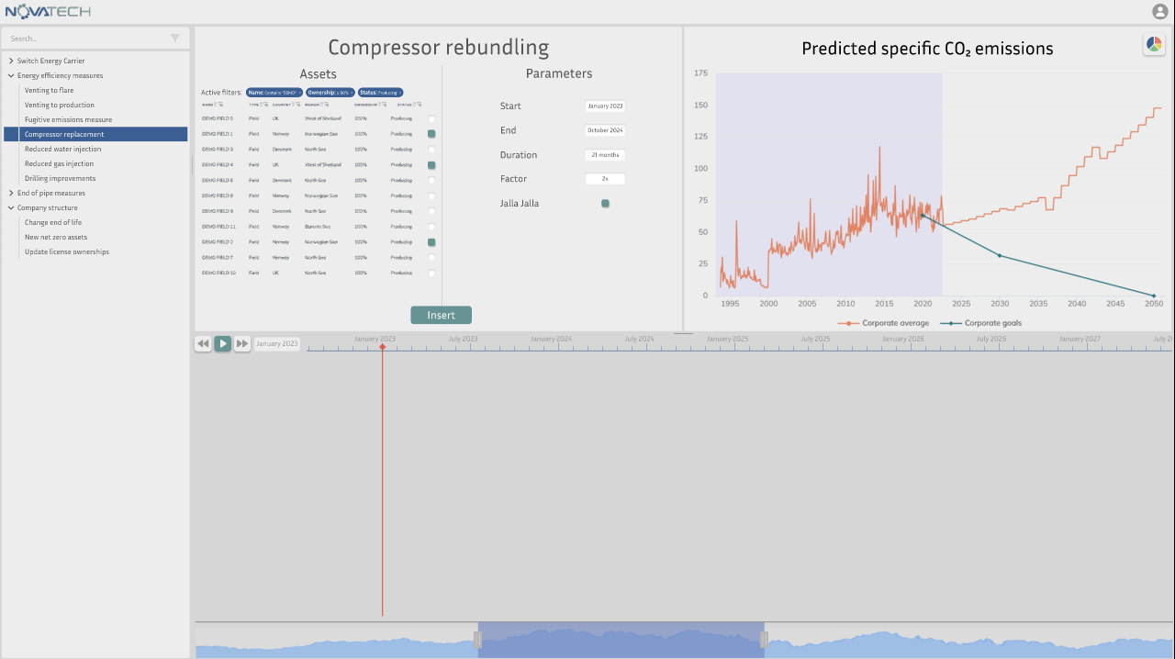
Workbench page
One emission mitigation measure has been selected. The details pane have more information. What should be available:
Information (text)
Asset selector
Some parameters (varies)
Access to an “Advanced” functionality
It is OK to have another solution
The details pane with a poor example.

Slide 5
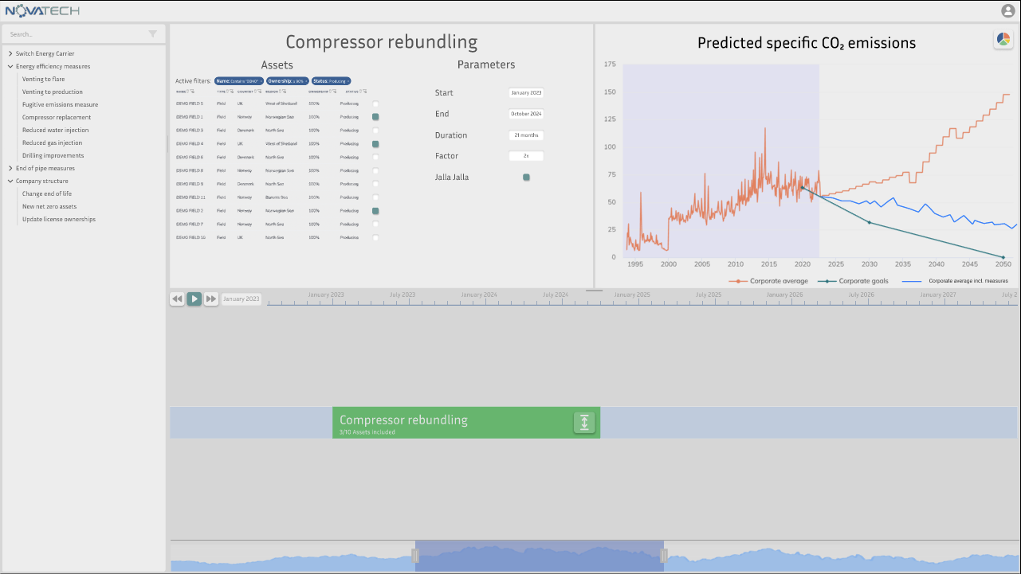
Workbench page
The measure has been added to the timeline.
The emission mitigation measure has been added to the timeline. The chart is also updated

Slide 6
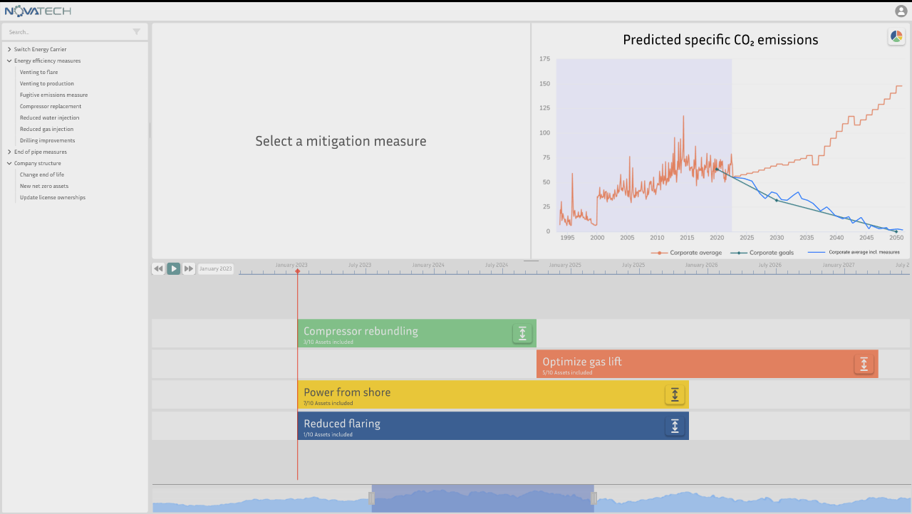
Workbench page
Multiple emission mitigation measures have been added to the timeline.
Please note that we work with multiple assets. There must be a possibility to see the implementation on each asset. We suggested clicking on one of the measures should drill into it. Details on next slide:
Multiple emission mitigation measures have been added to the timeline.

Slide 7
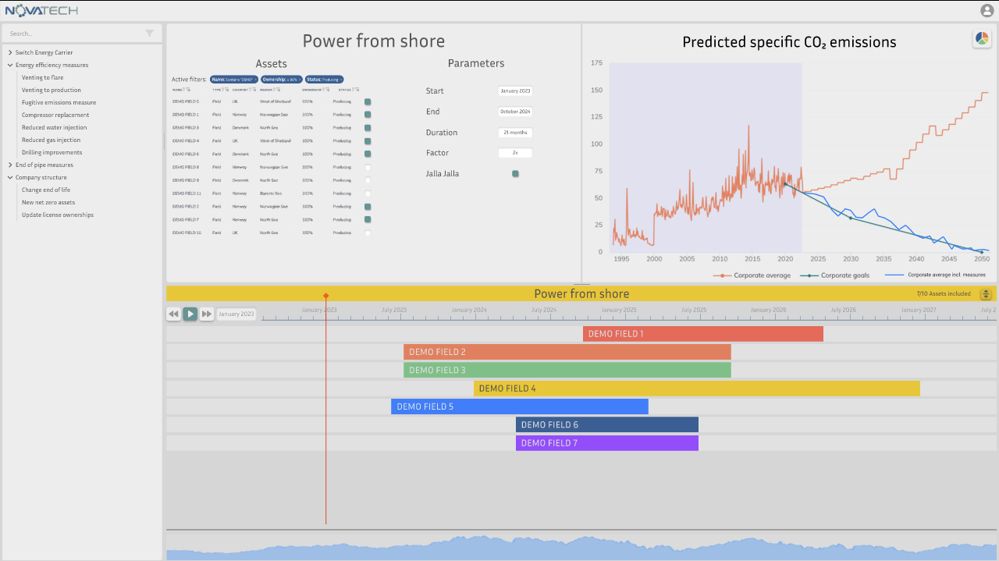
Workbench page
Here is the result.
We are open to another solution on how to show and navigate with through the different dimensions:
Time
Mitigation measures
Assets
Here we have clicked on one of the emission mitigation measures. It shows the other dimension with the different assets.

Slide 8
Colors used by Novatech
This is for help, not intended to restrict creative freedom
#2C6094
Used in logo
#5C9494
Used in logo
#FFF7D6
#9F3E39
#DDA01D
#976BB0
#94602C
#666666
#999999

