Slide 1


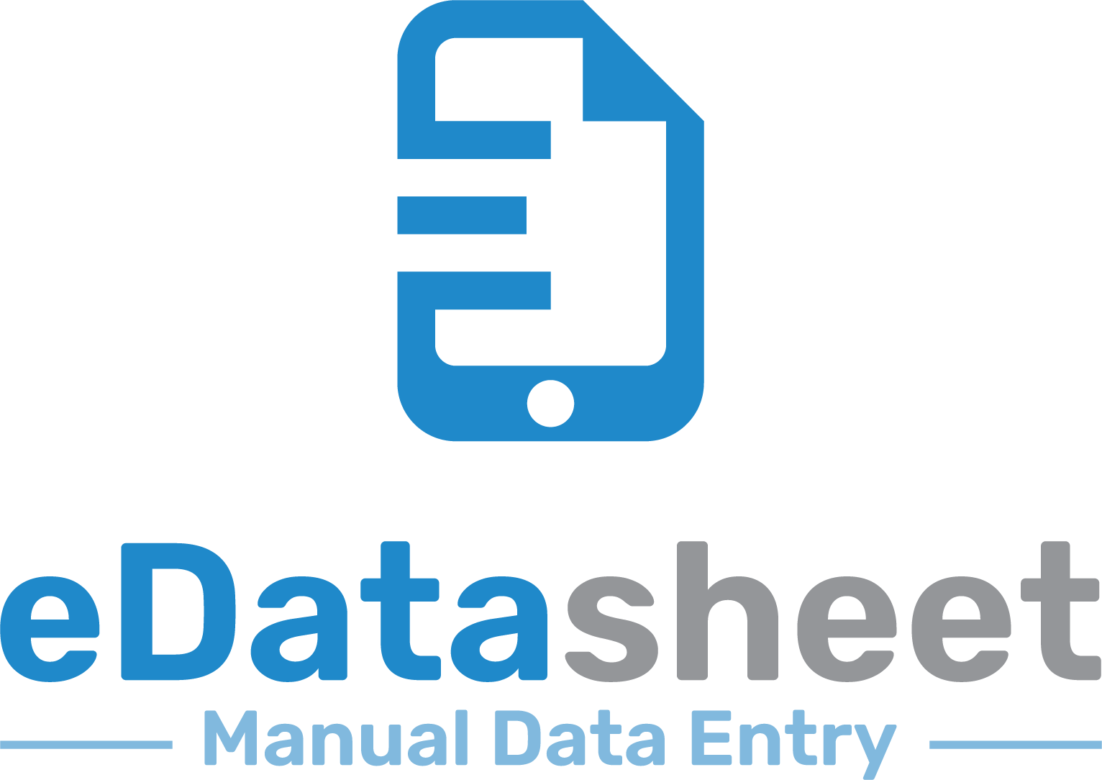


Enabling Your Company’s Digital Transformation
Service Offerings
Mobile Apps
MES Consulting
Software Validation
Cyber Security
System Integration
Operational Intelligence
Quickly Digitize Paper Logbooks and Records
Manual Data Entry into a Historian
-Partners-
30+ Years of Global MES Consulting Experience

Slide 2
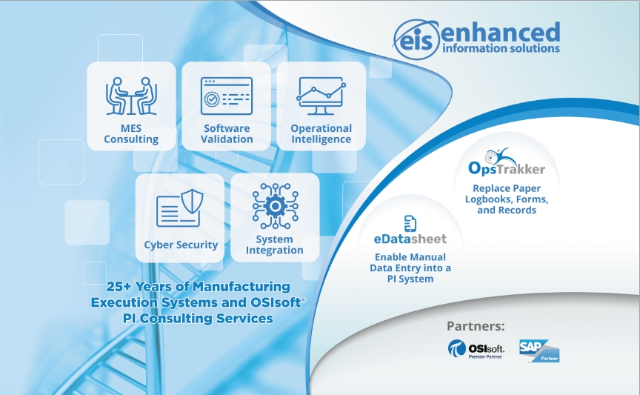
Old Booth
Pros: - Modern Feel
- Shows all relevant information
Cons: - Too much of the content below eye level
- Boxes are too big
- Color Pallet too light

Slide 3
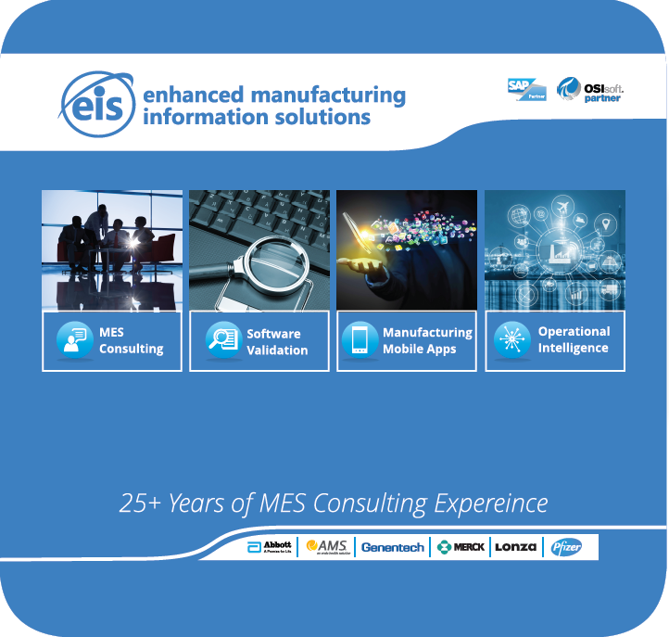
Old Booth
Pros: - All info at eye level
- Not too many words
Cons: - Our booth has more information to show
- Out Dated Design

Slide 4
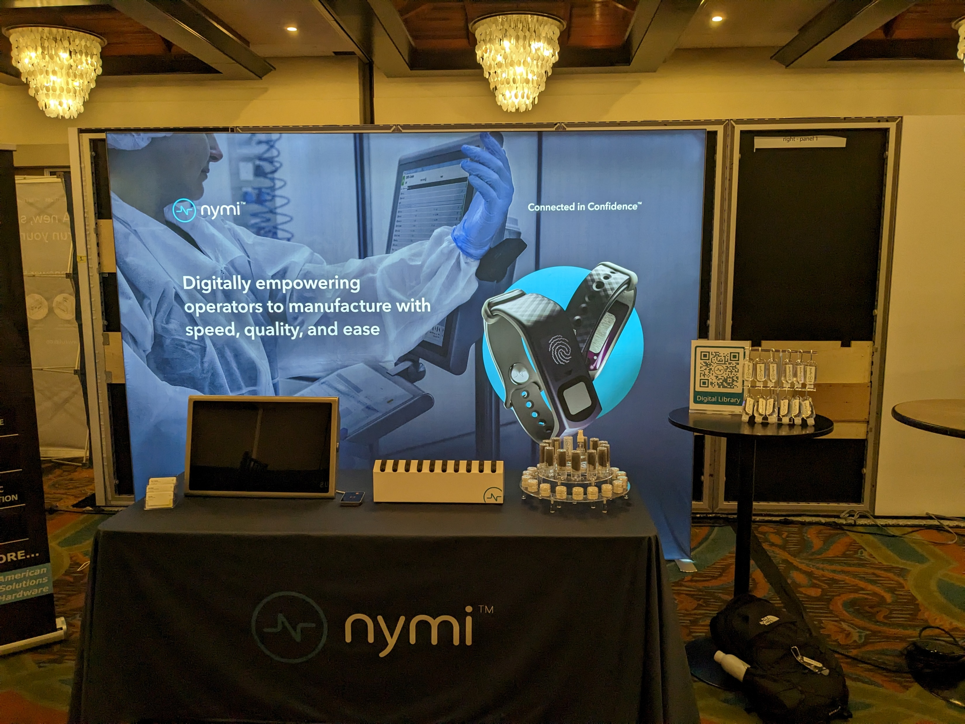
Pros: - Modern Feel
- Not too busy
Cons: - Our booth has more information to show

Slide 5
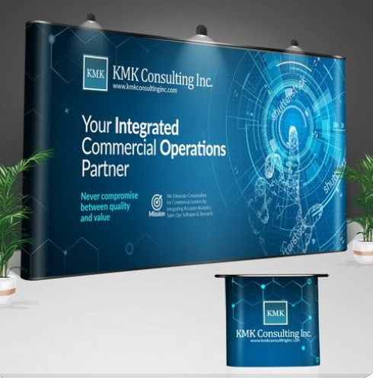
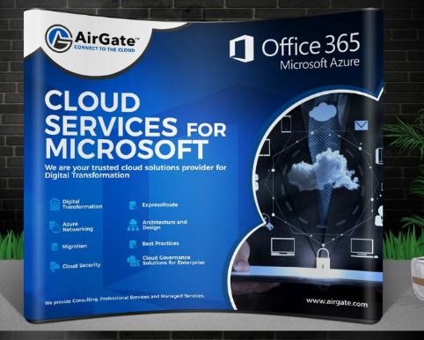
Pros: - Modern Feel
- Open space with graphic
Cons: - Too much below eye level
Pros: - Modern Feel
- Open space with graphic
- Modern looking icons
Cons: - Too much below eye level
- Too many words

Slide 6
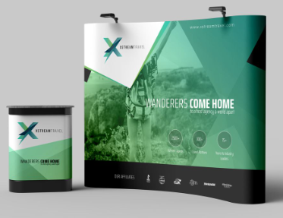
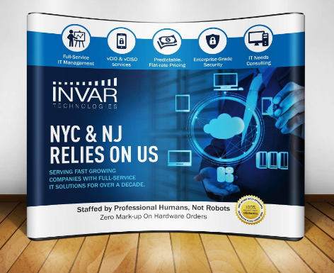
Pros: - Modern Feel
- Open space with graphic
- Bar for sponsors on bottom
Cons: -
Pros: - Modern Feel
- Open space with graphic
- Arrangement of Icons on top
Cons: - Too much below eye level
- Too many words

