Slide 1

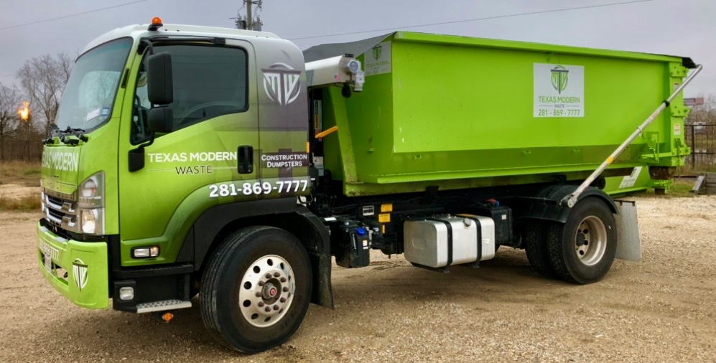

TEXAS MODERN WASTE
THE CONSTRUCTION DEBRIS SOLUTION
WE PROVIDE CITY AND OSHA APPROVED DUMPSTERS FOR EVERY PROJECT NEED
RESIDENTIAL – COMMERCIAL - INDUSTRIAL
SAME DAY SERVICE
LOCALLY OWNED AND OPERATED
BAYTOWN – MONT BELVIEU – CHAMBERS COUNTY
TEXAS MODERN WASTE
GIVE US A CALL FOR SCHEDULING
MONT BELVIEU, TX
281-869-7777

Slide 2
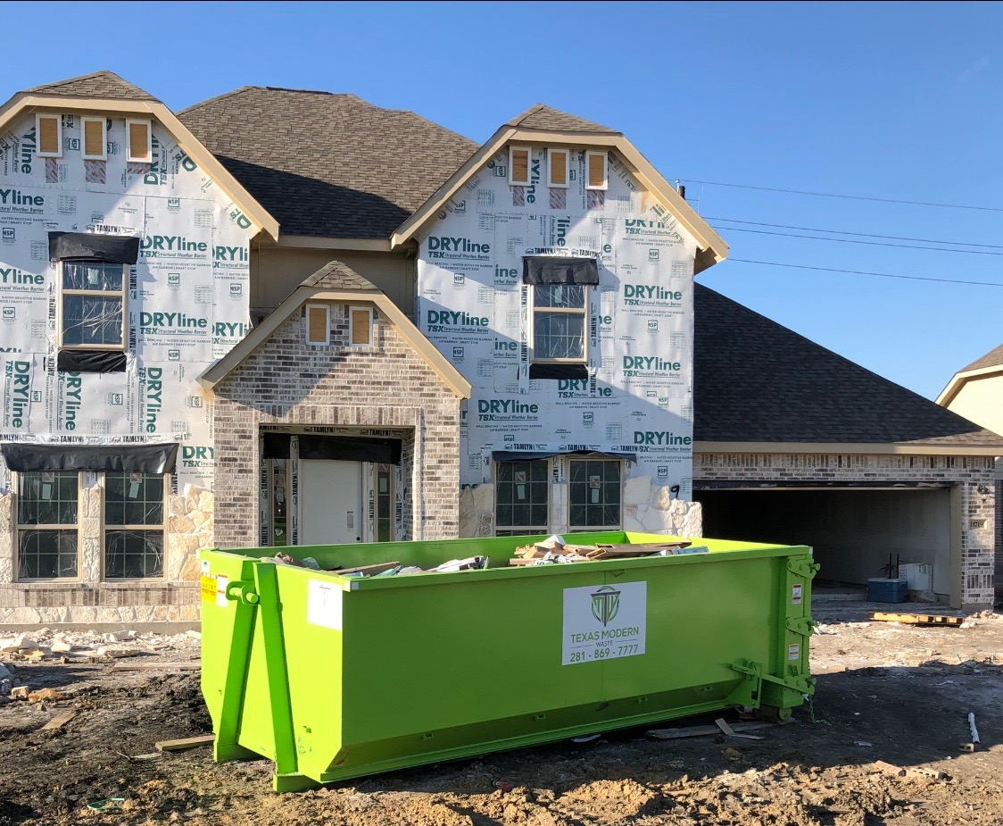
TEXAS MODERN WASTE
THE CONSTRUCTION DEBRIS SOLUTION
CURRENT DUMPSTER PRICING
ONE – TIME DROP OFF FEE - $100
20 YD - DUMPSTER FEE - $495
25 YD - DUMPSTER FEE - $595
VOLUME BUILDER DISCOUNTS
MINIMUM PICKUP 30 DAYS
NO DAILY RENTAL FEES
SAME DAY SERVICE
TEXAS MODERN WASTE
GIVE US A CALL FOR SCHEDULING
MONT BELVIEU, TX
281-869-7777

