Slide 1
Goods 4 Good
Äss-Bar goes online

Slide 2

Global Warming
Foodwaste is one of the main drivers
CO₂ Sources in Switzerland
CHF 15 Billions worth not used
2.4 Megatons of food wasted
2‘900‘000‘000 kg surplus CO₂
Source: WWF Schweiz / Foodways Consulting; https://myemissions.green

Slide 3
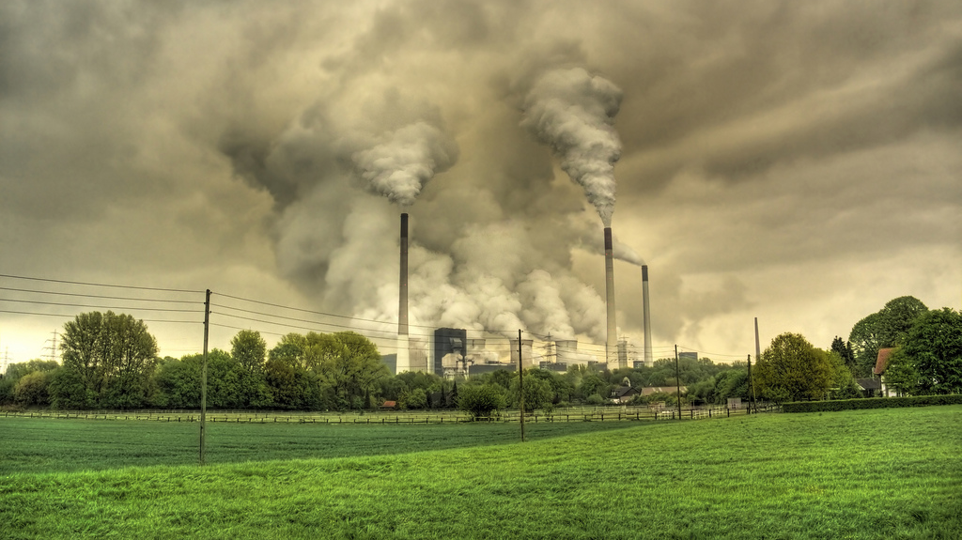

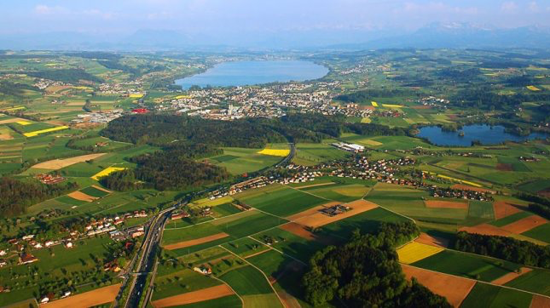
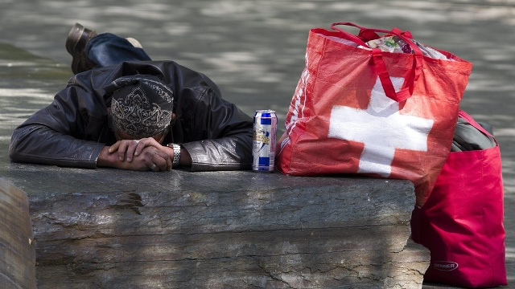
Further ramifications of Foodwaste
Global warming / CO₂
Ressource & water consumption
Urban sprawl, diversity
Poverty

Slide 4

Äss-Bar
The Swiss pioneer against foodwaste
Founded 2013
9 stores in Switzerland
90+ employees
>220 bakery partners, >12 large producers / WS
>1 million customers / year
>1‘000 event deliveries & caterings / year
Workshops, speeches & trainings on foodwaste
Upcycling cooperations: La Flor, Brauerei Oerlikon, a.o.
>80 clippings / year in regional and national media
(newspaper, TV, radio) plus very active SoMe community
800t baked goods = ca. 800‘000 kg CO₂ saved / year
Äss-Bar collects unsold bakery products from our partners and retails them the next day for halve the price via its own outlets

Slide 5
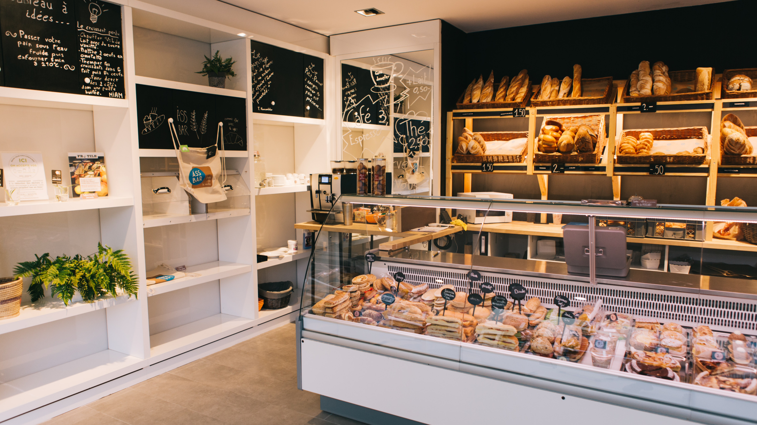
Äss-Bar today (Impression)

Slide 6

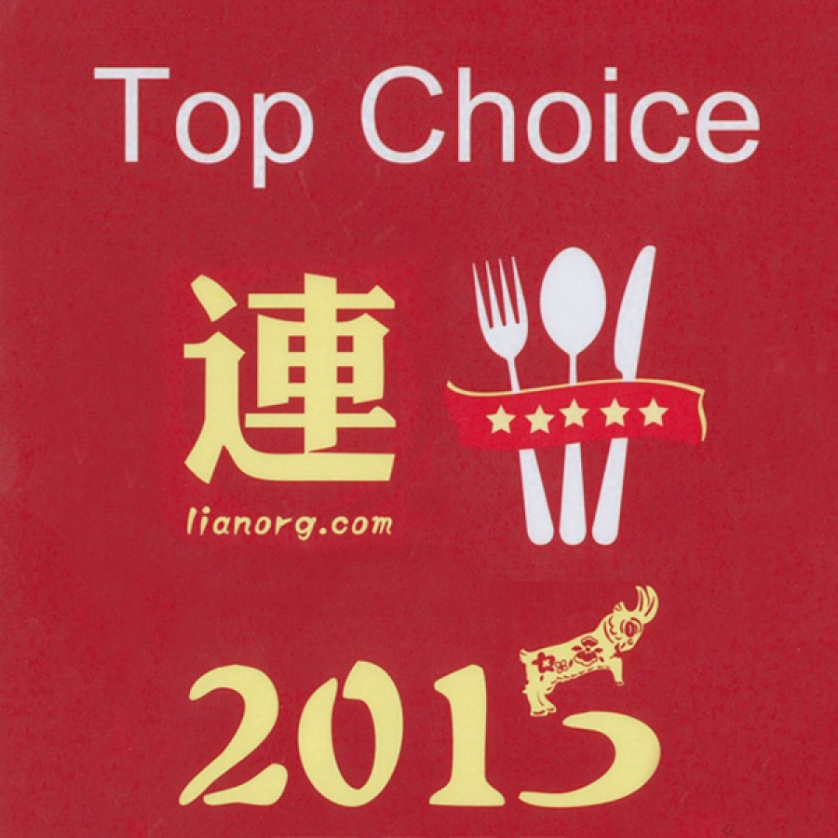




Äss-Bar - Awards & Community
…
Nr. 1 of 402
Restaurants in Bern
Nr. 1
Bakery in Zürich

Slide 7






Benefits for Partners
Revenue share of goods sold
The parnters may participate in the turnover of the Äss-Bar.
Cost-reduction
We organise the transport of the baked goods from the bakeries to the Äss-Bar sales outlet. The costs for discarding leftovers can significantly be reduced
Image / Marketing
According to the motto: "Do good and talk about it", participating bakeries also communicate the responsibility they perceive to their customers.
Corporate Social Responsibility
Careful use of natural resources and support for the less fortunate are in line with the spirit of the times.

Slide 8



Äss-Bar Evolution
Big Potential…
…but not a perfect fit with our point of sales…
…requires new go2market
Through our work we have acquired numerous large food manufacturers and retail / wholesale partners
  Too large quantities of unsold items (>1‘000 / batch)
  Not expected in our „bakery like“ outlets (e.g. coffee beans, honey, chocolate bars, etc.)
  Not from local (small-scale) producers; big brands
  Mostly packaged goods
  Significantly longer shelf life
  Build on existing & trusted brand „Äss-Bar“
  Leverage customer base of owned outlets (>1 Mio pax / yr)
  Possibility to send the goods nationwide
  Mix-and-match different product categories (also non-bakery goods)
  Option to also cater to large events (concerts, conventions, sports events, etc.)
Alnatura
BMC Foodline (Hilcona u.a.)

Slide 9
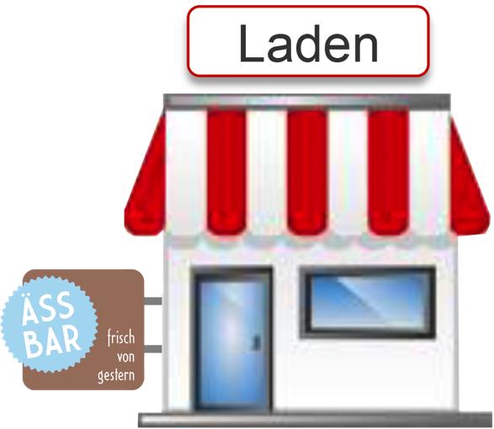
Äss-Bar Online
Today
Expansion
Store
Web Shop
Caterings / Events
B2C
(incl. Subscriptions)
B2B
(restaurants, hotels, camps, etc.)
Mo-Sa 09:00-18:30

Slide 10
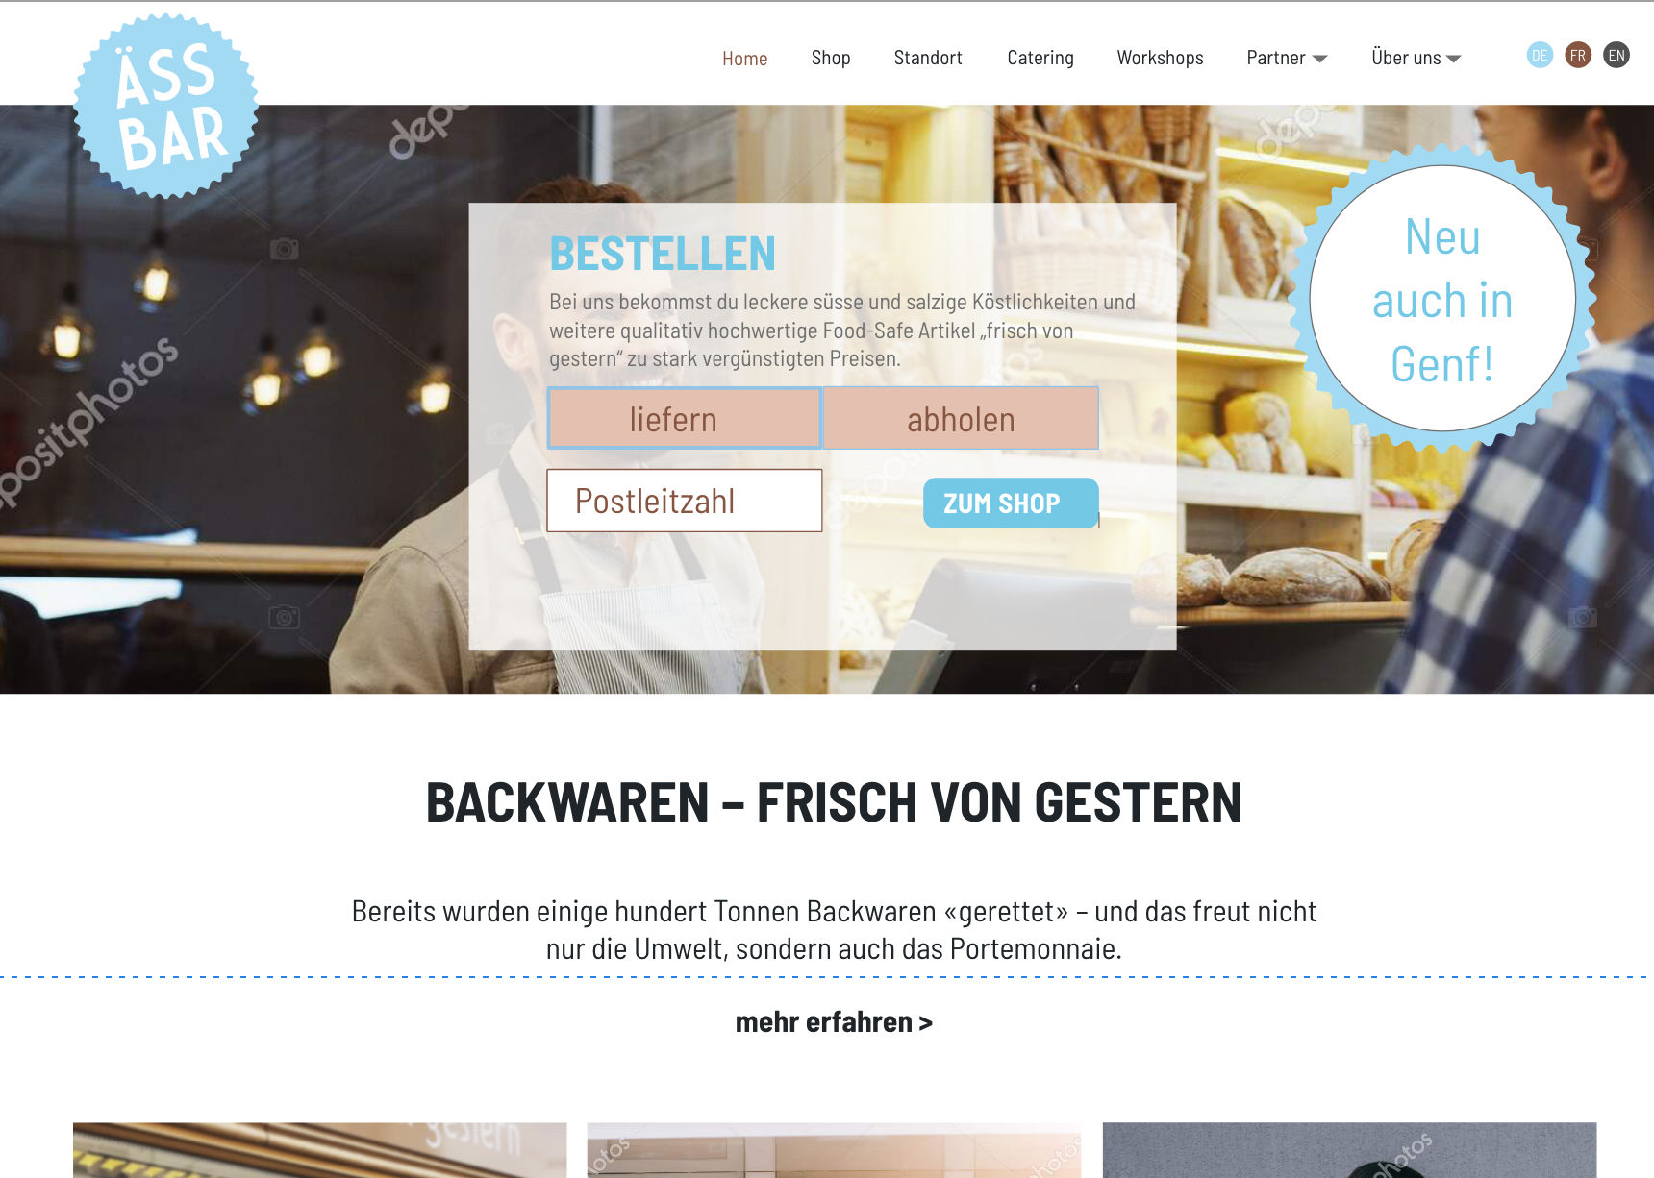
Web Shop | www.aess-bar.ch
1.
Gift vouchers
Merchandising
Books, recipes, etc. about foodwaste, …
2.
Online order tool for delivery service for up to 200 guests: sweet, savory, drinks
3.
B2C Web shop for goods close to the expiry date, faulty & over productions, etc.

Slide 11

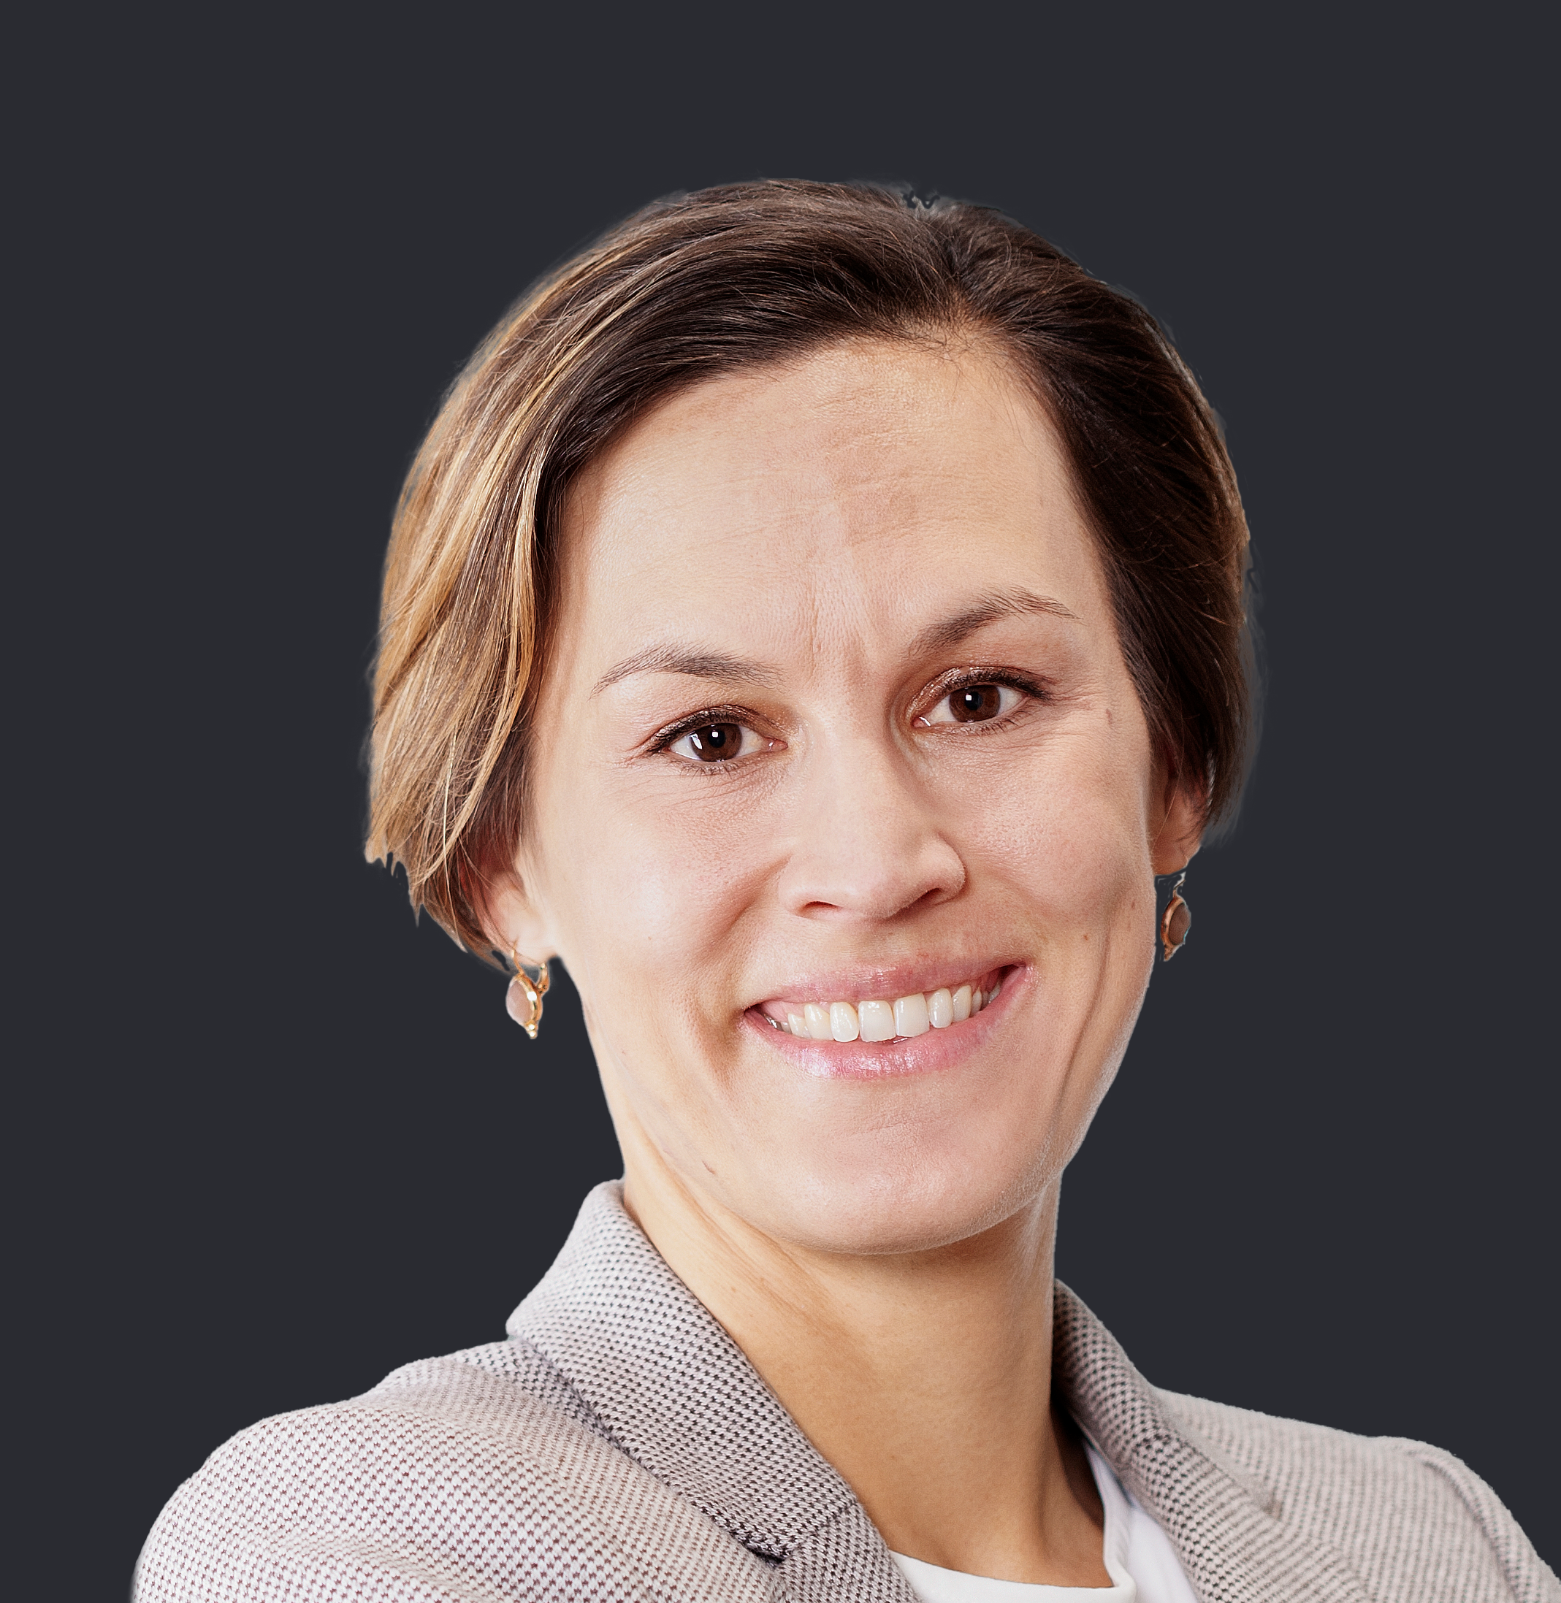









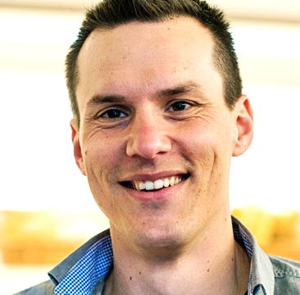
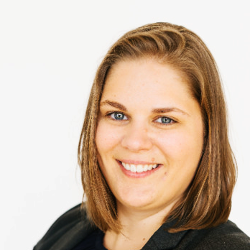

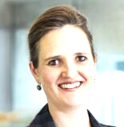
Team of experienced entrepreneurs
Martina Biedermann
MBA Uni BE / New Mexico State Univ.
Executive Director
Corinne Vogel
MBA Uni BE, Dipl. Teacher Uni LU
Supervisory Board
Raoul Stöckle
PhD ETHZ, MBA INSEAD, MSc UKC
Supervisory Board
HEGIAS,
Head Business Development
Pro Juventute,
Head Fundraising & Partnerships
Äss-Bar
Co-Founder, Chairman
Buildigo,
COO
Sharely,
Member of BoD
Switzerland Innovation Park (Biel)
CEO
Mobiliar,
Division Lead Innovation
Mobiliar,
Chief of Staff / Member of Senior Management
Bond Mobility Inc.
Co-Founder, CEO
Sandro Furnari
Stores & Corp. Services
Corina Bauer
Event Delivery
Res Nägeli
Design & Web-Shop
Michèle George
Business Development

Slide 12
Contribute to the initiative!
We‘re looking for additional partners who join the mission to reduce foodwaste
Surplus Foods
  Goods close to the expiry dates
  Faulty productions
  End of season products
  Change of batches
  Etc.
Network (producers, retailers, wholesalers, etc.)
Logistic and storage partners
Financial sponsors

