Slide 1


Digital Transformation Programme
Logo re-design
April 2023

Slide 2
  Background context

Slide 3


Introduction – Building our digital transformation vision of the future
What are we doing and why?
As part of our strategic and business plan, we are putting together a ‘case for change’ for an exciting digital transformation programme
This will include redesigning the way we work from the bottom up, with our purpose at the core and centre, and introducing or replacing a number of new tools and systems to make our working lives easier.
We believe that this digital transformation programme will transform the way we work, freeing up front-line staff’s time by reducing the administrative burden, giving staff and management timely and accurate accessible information that they need to deliver on our purpose and move decision-making closer to the People We Support, and increasing transparency.

Slide 4
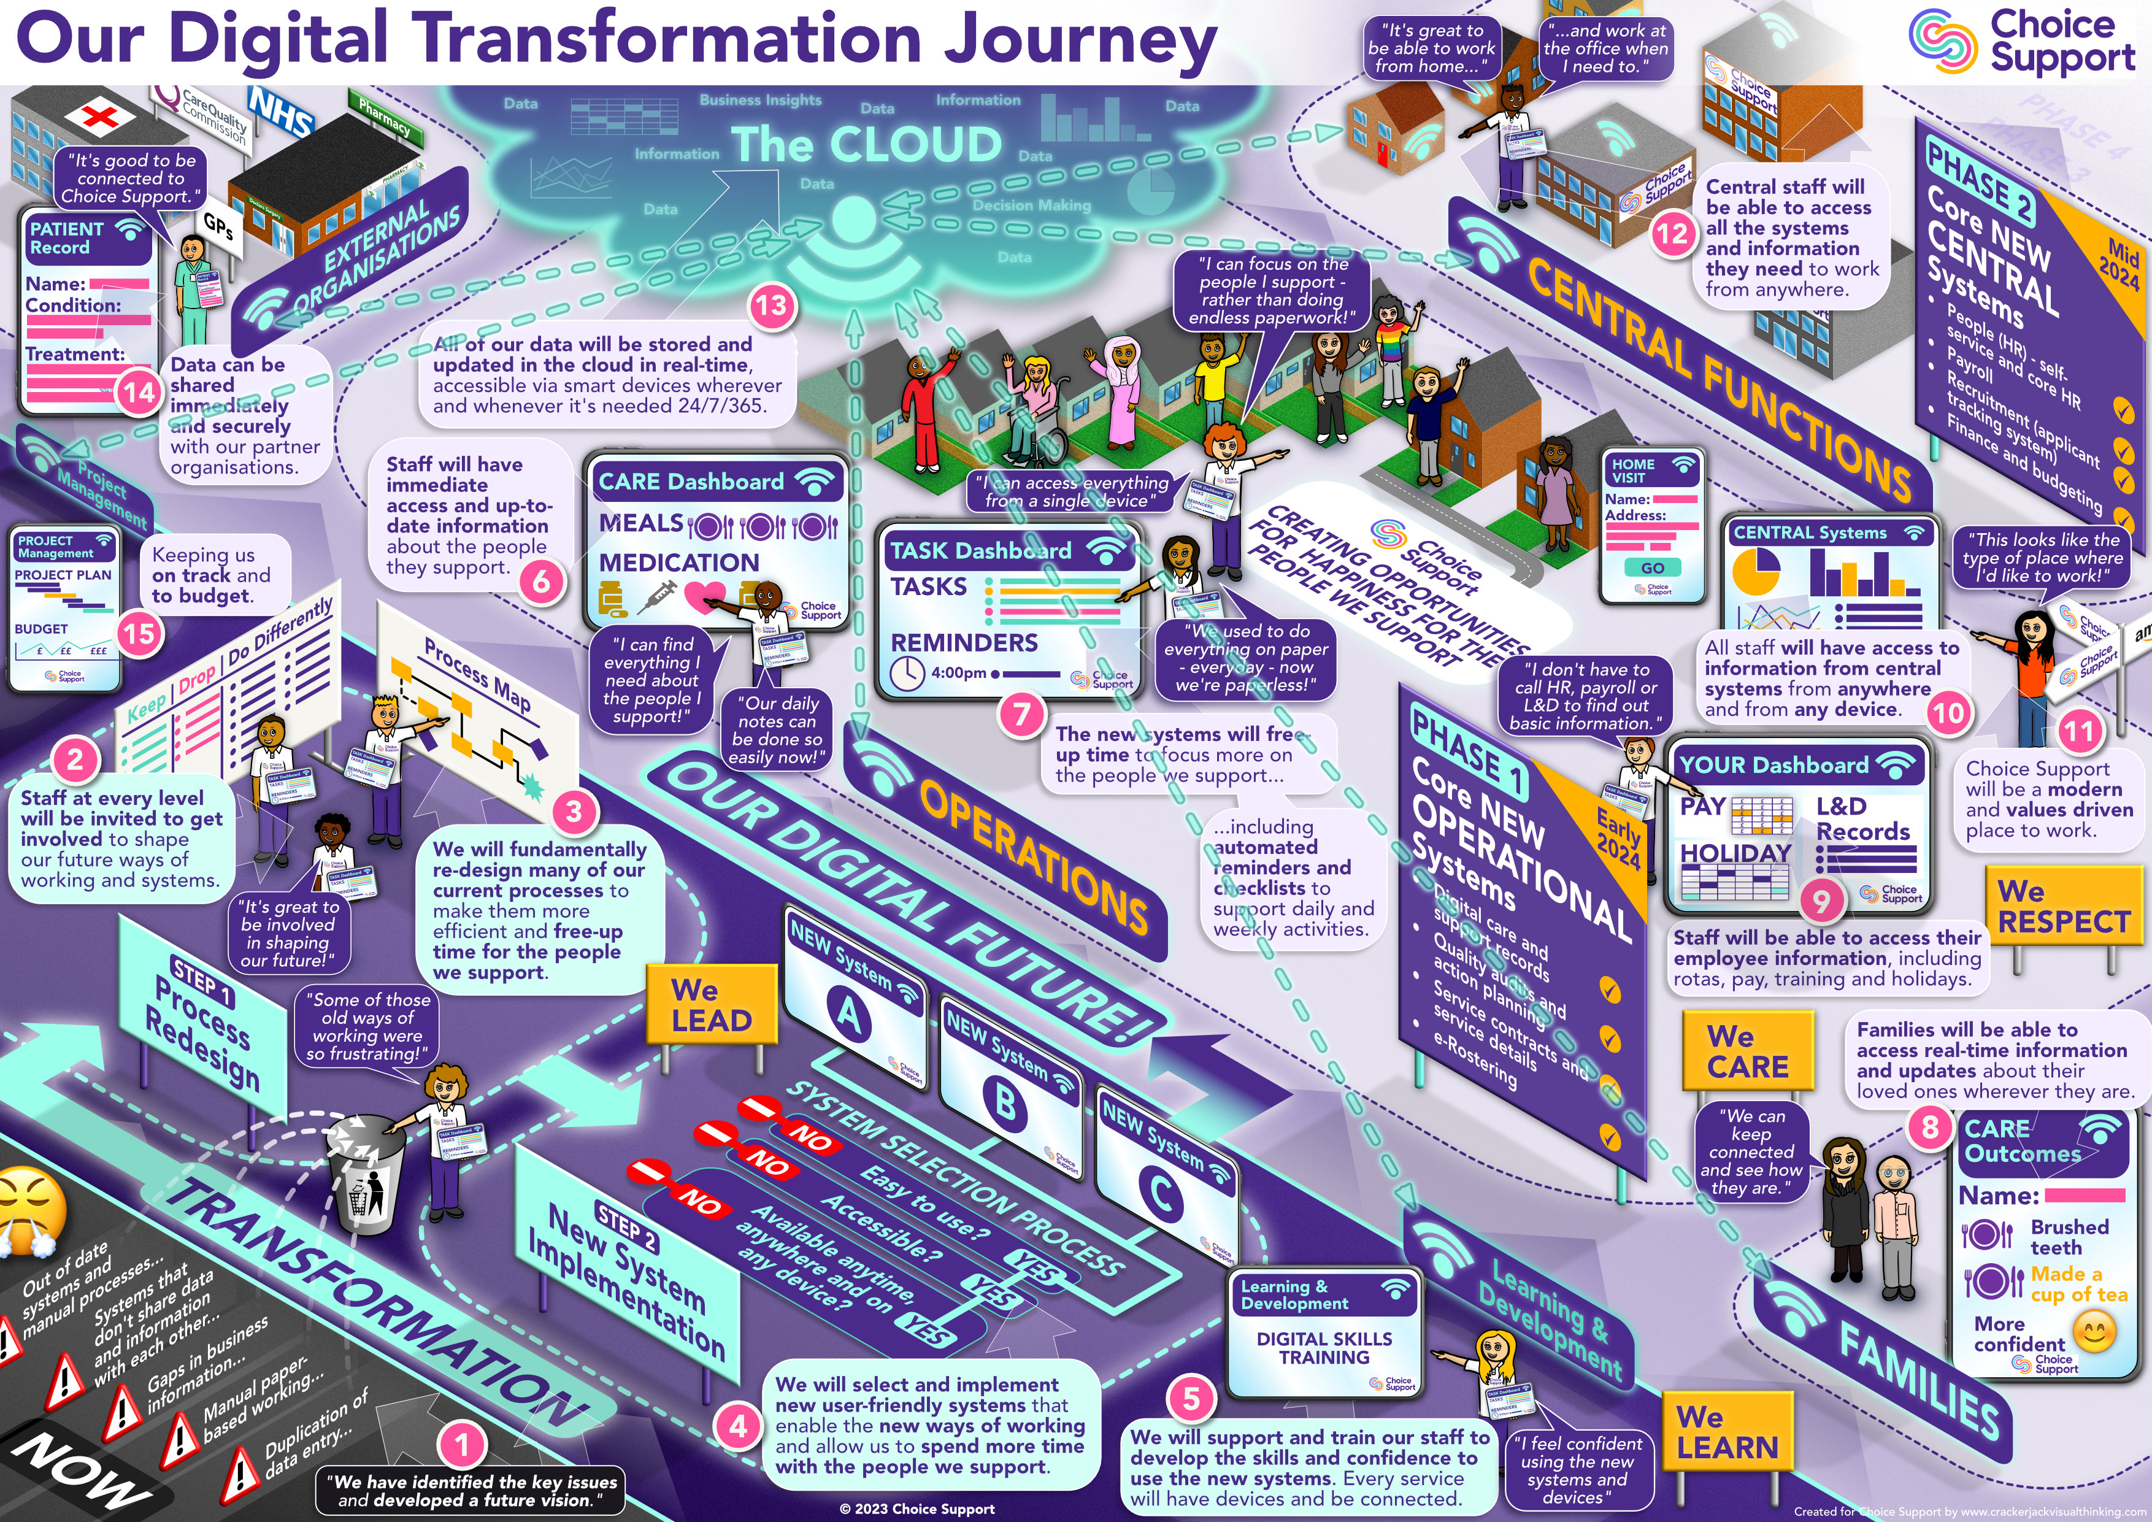
An overview of the Digital Transformation Programme (DTP) rich picture
Based on vision development sessions with ~40 individuals from across all functions (including the SLT), we have translated our Digital Transformation vision into a ‘rich picture’
This includes a number of key elements:
  Where we are now
  The transformation programme
  The digital future(s) for:
    Operations
    Central functions
    Families
    External organisations
    Potential staff
And the journey to get there:
  Where we are now
  What we are going to do
  How we will do it
  And then…
  What the future changes will look like
  The difference the various changes they will make to different groups

Slide 5
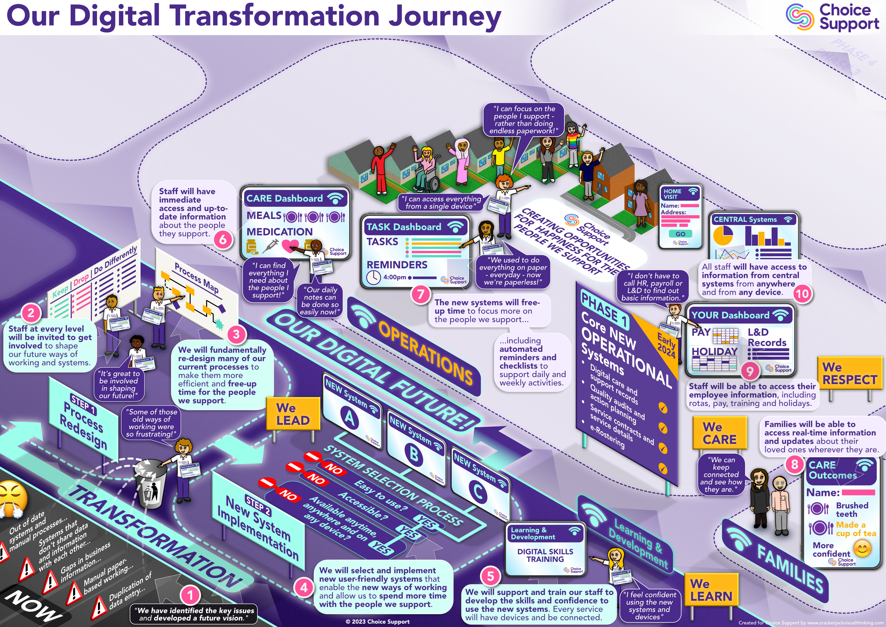

Slide 6
  Design thinking / preferences

Slide 7
Emerging Digital Transformation Programme (DTP) design thinking
Digital Transformation Programme at the centre (“DTP”)
Possibly with 2023+ or with 2023-2025 (likely timelines)
Care sector feel – its’ all about teams and the People We Support being enabled by the new technologies and ways of working
Ring of key elements around it – using the Choice Support colours [6 might work best conscious that this logo will be used in small sizes on programme materials / headers etc.?]
  Primary
  Time savings
  Connectivity (wifi)
  Devices (mobile / hand-held)
  Care / support for the People We Support [love heart - green for health and care]
  Systems / data (that talk to each other)
  Happy staff
  Secondary
  Data and information (2-way)
  Performance improvement
Aligned with corporate branding e.g. “DTP” at the centre with the purple colour, other icons using the other palette

Slide 8
  Example logos / designs

Slide 9

Concept 1

Slide 10

Concept 2

Slide 11
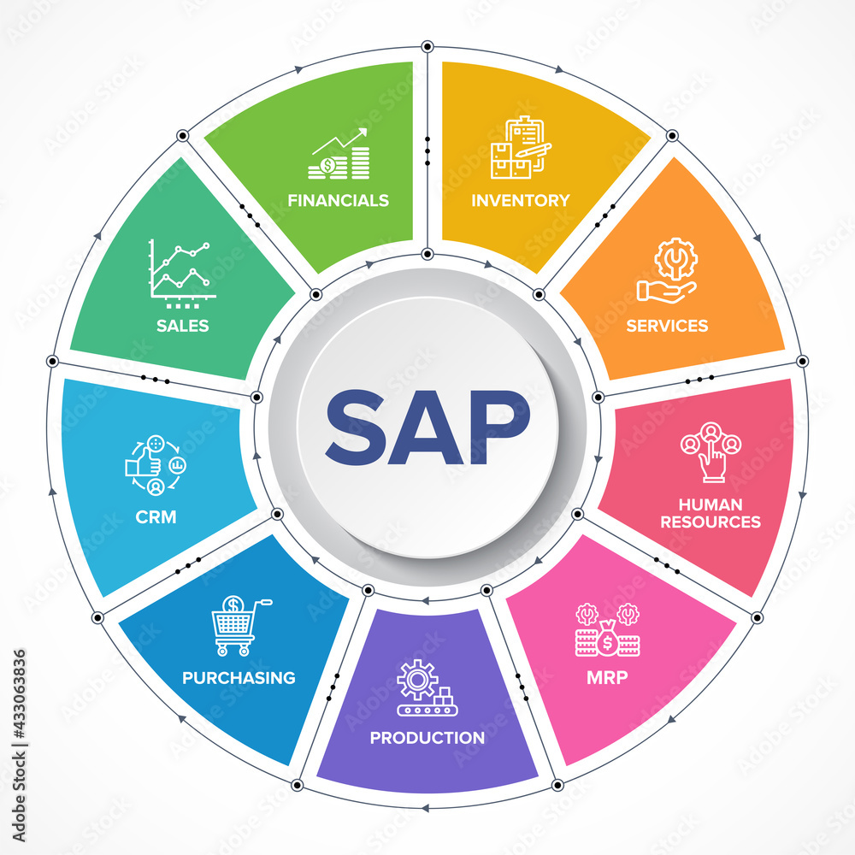
Concept 3

Slide 12












Icon examples: style – www.flaticon.com
All programme materials are aligned with this pastel / soft style of icon – all found on www.flaticon.com for free
  Primary
  Time savings
  Connectivity (wifi)
  Devices (mobile / hand-held)
  Care / support for the People We Support [love heart - green for health and care; possibly ]
  Systems / data (that talk to each other)
  Happy staff
  Secondary
  Data and information (2-way)
  Performance improvement

Slide 13







Icon examples: style – www.flaticon.com
All programme materials are aligned with this pastel / soft style of icon – all found on www.flaticon.com for free

