Slide 1
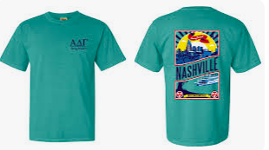
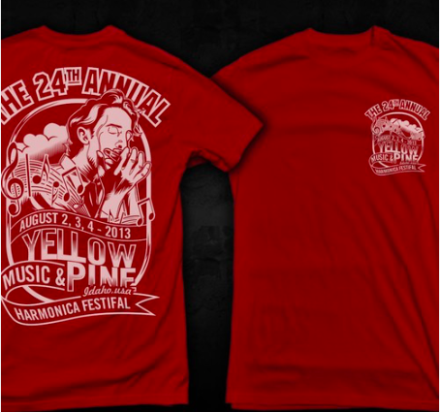
2023 Partner Conference T-Shirt Design Inspiration
Conference logo on front – big design on back

Slide 2
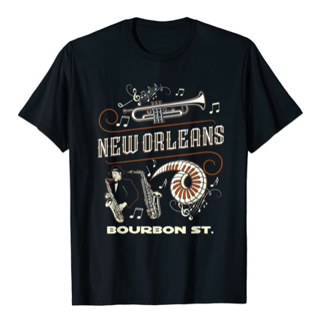
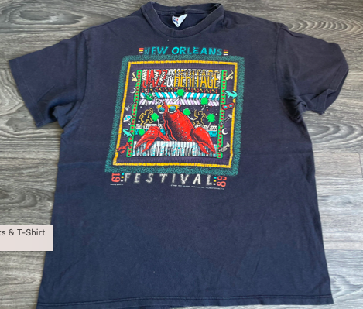
2023 Partner Conference T-Shirt Design Inspiration
Design on back should make it clear event was in New Orleans, graphically depict images associated with New Orleans

Slide 3



2023 Partner Conference T-Shirt Design Inspiration
Back design stylized, packed with visual imagery but also attractive, cool-linking from a distance
If we do decide to include sponsors on the back, maybe we could list them around the outside vs. having all their logos?

