Slide 1
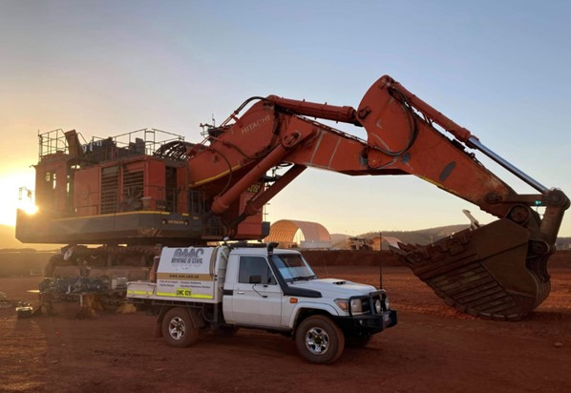
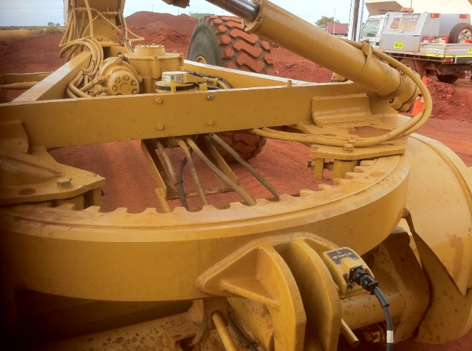
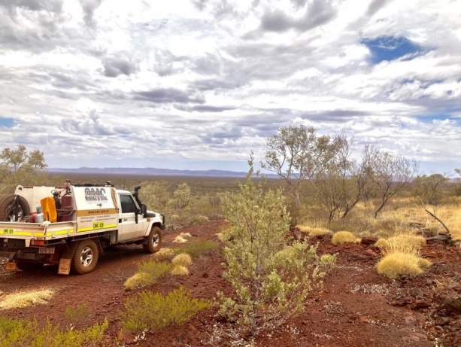

Capability Statement

Slide 2
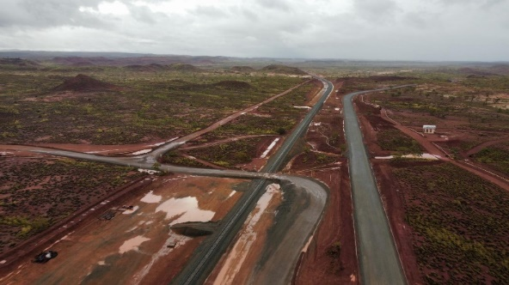
Company Profile
We believe our repeat clients are evidence of our commitment to excellence
Offshore Mining and Civil Pty Ltd (OMC) have a fully mobile workforce as well as an extensive schedule of plant and equipment to support any project.
We are a family owned WA business backed by a loyal team of motivated and skilled individuals who are always available to meet your needs.
We understand downtime can be costly to companies which is why OMC is committed to providing cost effective and efficient solutions for your business. Project objectives are always met with outstanding client service and field excellence.
Since our inception in 2011 clients who engage OMC have become confident that they will receive professional, proficient and qualified people and plant on their jobs.
Some past and present clients include Rio Tinto, Emeco, Atlas Iron, Austral Construction Pty Ltd, BIS Industries, Hamptons Mining, Carey Mining, MACA Mining & MACA Civil

Slide 3
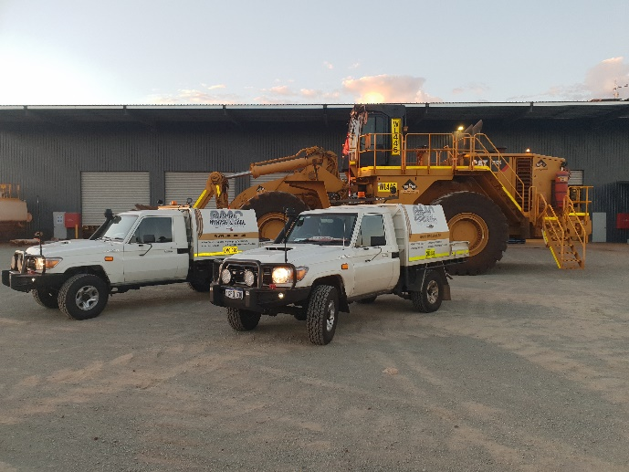
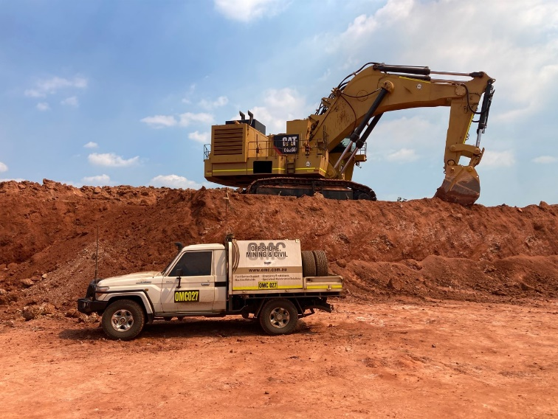
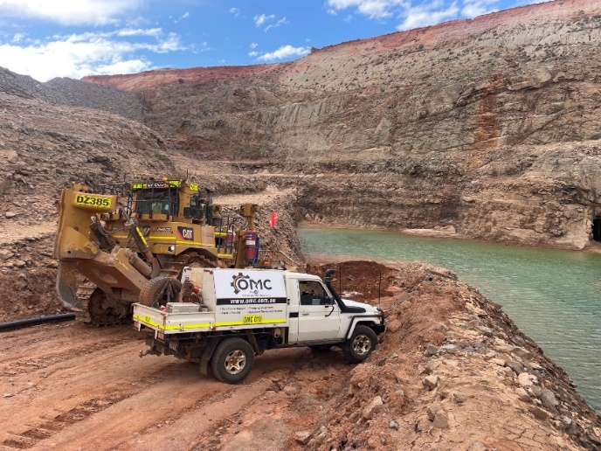
OMC Labour Support & Rapid Response
OMC is available for rapid response, onsite support and maintenance 24/7 to keep your business and equipment powering. We offer full mechanical repairs, component rebuilds and exchanges, digger support and mining vehicle specification fit outs. OMC can source cost effective parts quality parts and OEM standards.
Our dedicated team will ensure all projects are completed within specified timeframes ensuring the highest level of workmanship and safety is maintained

Slide 4
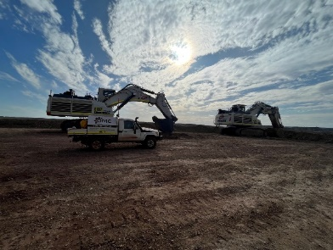
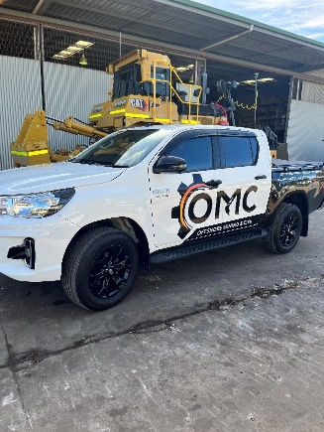
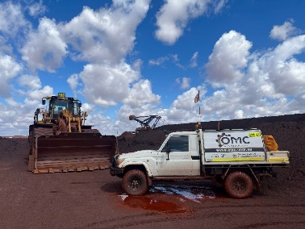
Labour Support Projects

Slide 5
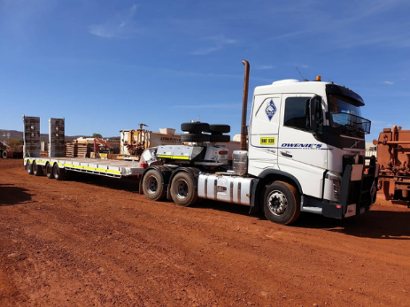
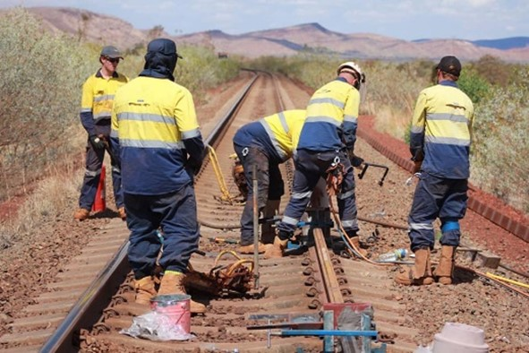
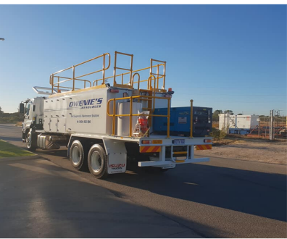
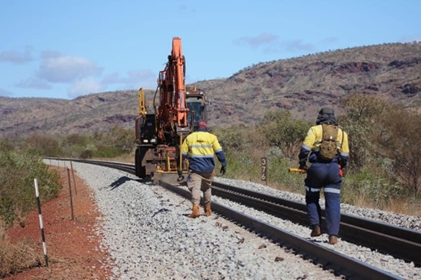
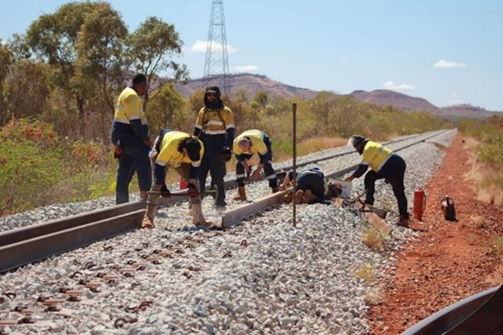
Railforce Resources
Railforce Resources Pty Ltd (formerly Owenie Resources) forms part of the OMC Group specialising in rapid 24/7 response, onsite support and rail maintenance. With a team of skilled tradesmen Railforce Resources is dedicated to delivering high quality track maintenance support with a focus on safety and innovation.
We have the quality equipment and experienced operators to deliver

Slide 6
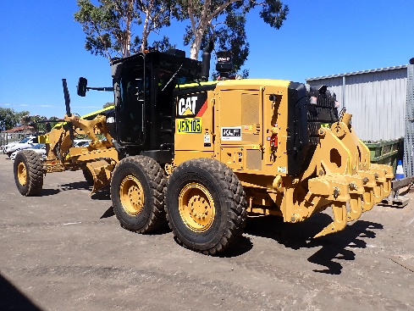
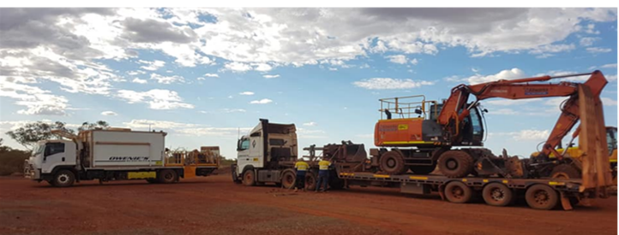
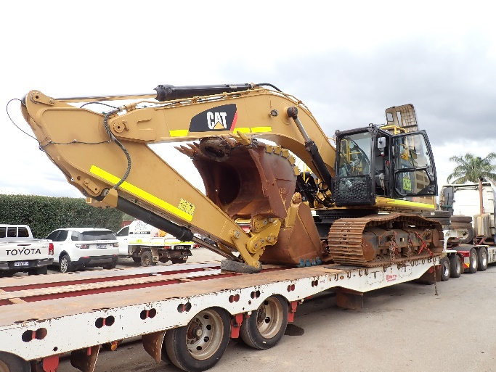
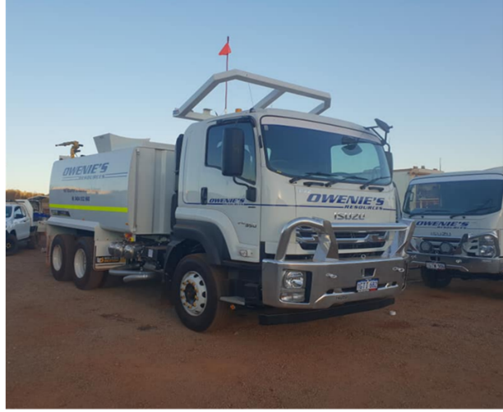
Equipment Hire
JEM Hire has a comprehensive fleet ranging from small to medium civil and mining machinery.
With our alliance partner Toddy’s Plant Hire (BURU) we work together to procure new and low hour machines with OMC providing ongoing maintenance and support throughout WA.
With a vast array of knowledge JEM Hire is available 24/7 to deliver your equipment requirements

Slide 7
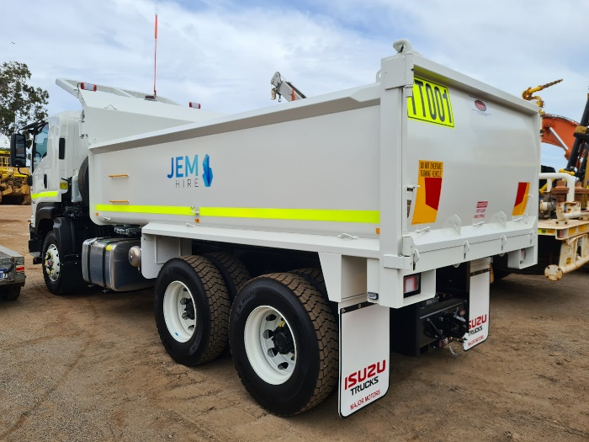
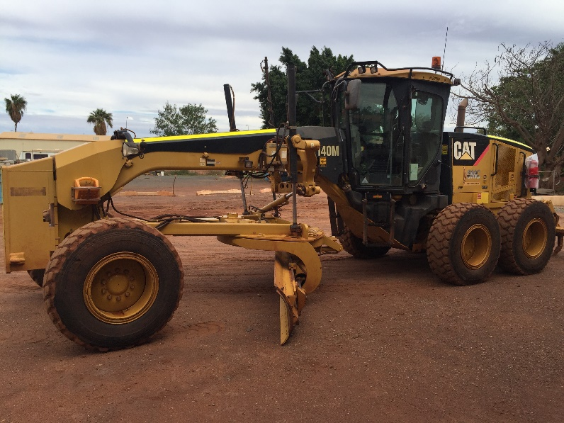
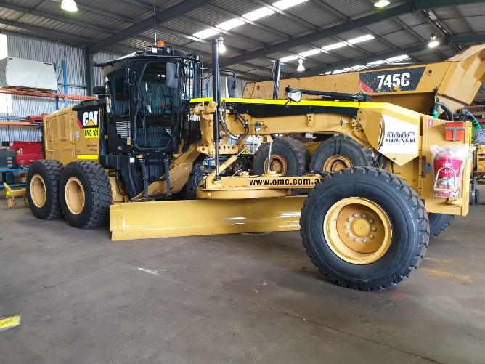
Fleet
Earthmoving Equipment
Graders
12M – 16M
Excavator
5T – 90T
Dozers
D5 – D10T2
Loaders
938M – 988K
Dump Trucks
40T – 45T
Water Carts
6 x 4 – 40T Artic
Service Trucks
6 x 4 – 8 x 4
Support Equipment
Prime Movers, Floats, Dropdeck trailers, Flat top Trailers, Tipper Trucks,
Service Trailers, Hot Wash Trailer

Slide 8
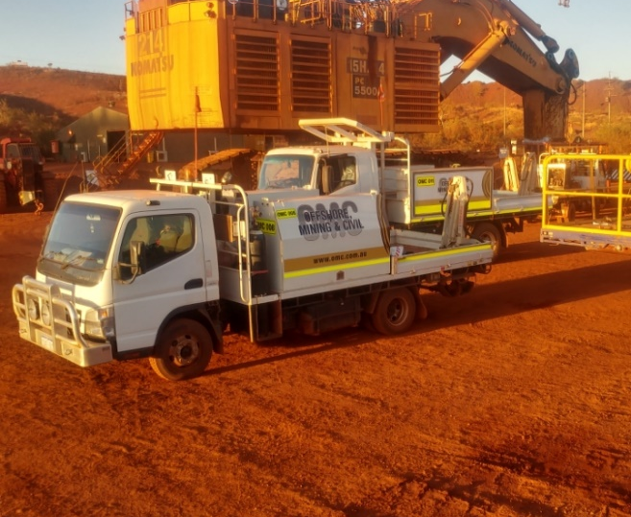
Equipment Hire Projects
Project | Machinery | Client
Mesa A – haul road and highway realignment overpass | 140M Graders 16H Grader 329DL Excavator | Downer
Binduli Mine start up | 740 Dump Trucks D9T Dozer D8T Dozer Service Truck | Cast Civil
Access road maintenance, drill pad / clearing | 140M Graders 150M Grader Padfoot Roller D10T Dozer IT Loader | MIB Traffic / FMG
Brockman 2 & 4 - inter site access road build | 140M Grader 16H Grader 329DL Excavator | MACA Civil
Gold Road mine start up – building access track, haul road and runway upgrade | Watercart D8T Dozer 140M Grader 16H Grader 329DL Excavator | MACA Civil & MACA Mining
Boddington - crushing and screening project | 980M Loader 988K Loader | Centrals Earthmoving
Spinifex Ridge | 740 Artic Dump Trucks | Mulitplant Holdings
St Barbara -tailing dam upgrade and access road maintenance | 50T Excavator 140M | Wolf Contracting
Shay Gap – runway upgrade | 140M Grader 16H Grader | Downer / BHP

Slide 9
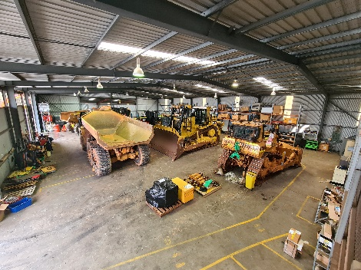
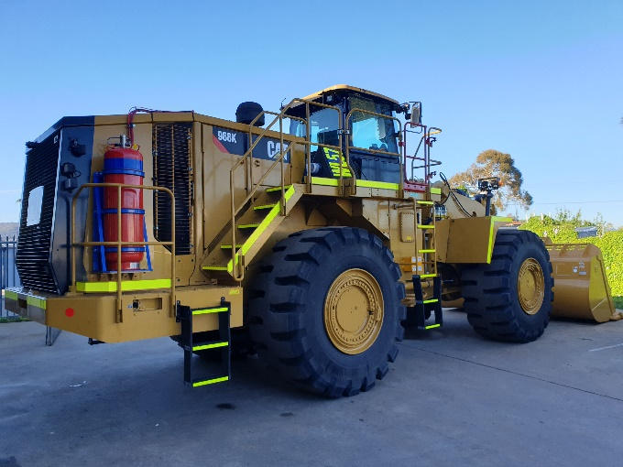
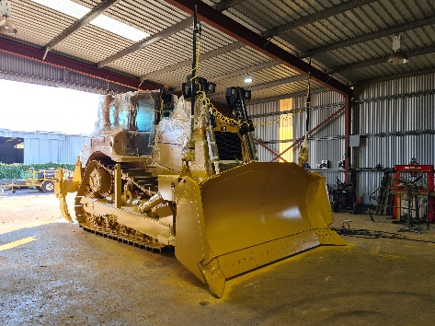
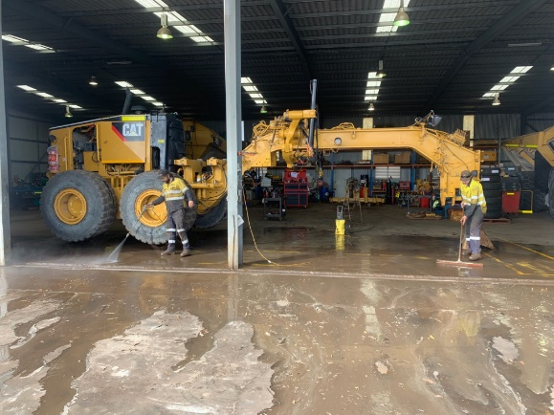
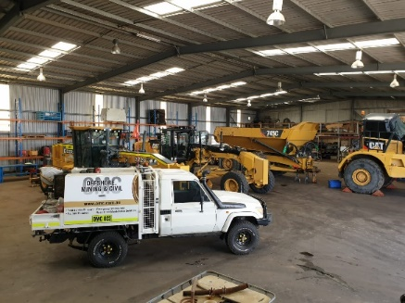
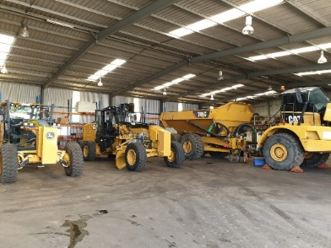
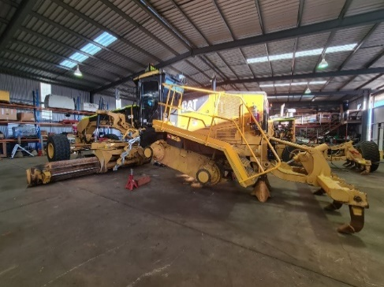
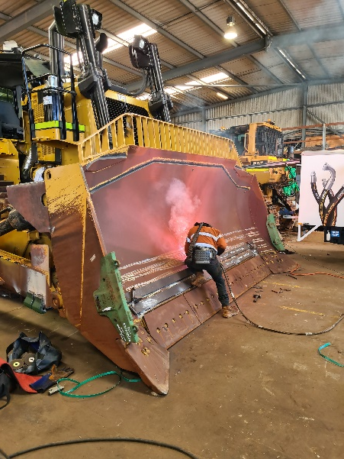
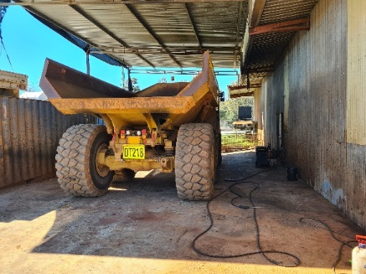
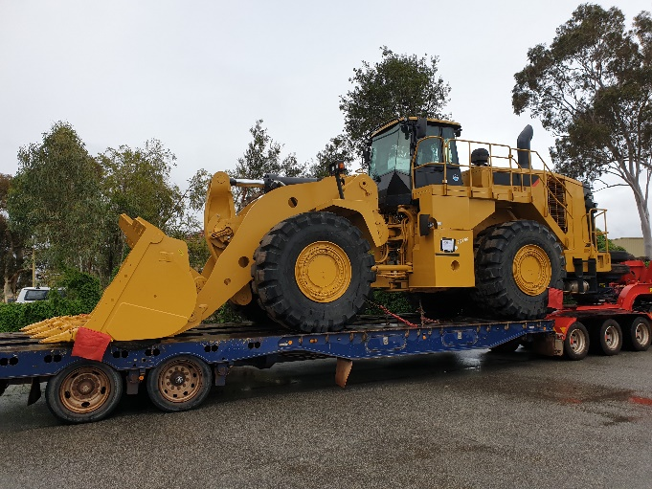
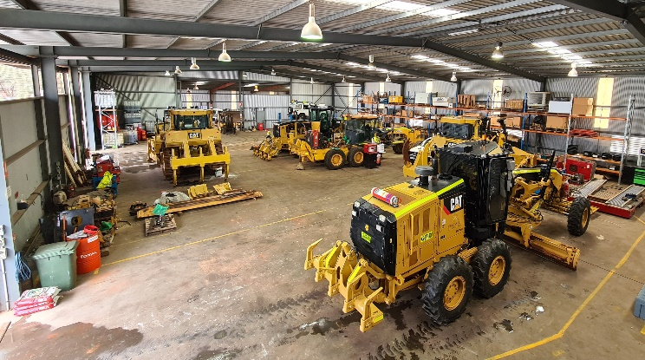
Maddington Workshop
Located at 172 Maddington Road Maddington our workshop is equipped with skilled and knowledgeable staff, with all the required tooling, to perform your maintenance and servicing requirements as well as full machine rebuilds, fabrication works, component rebuilds, mine spec fit outs and much more.
Workshop facility
11000 sqm yard capacity
Certified wash pad
Road train / float access

Slide 10
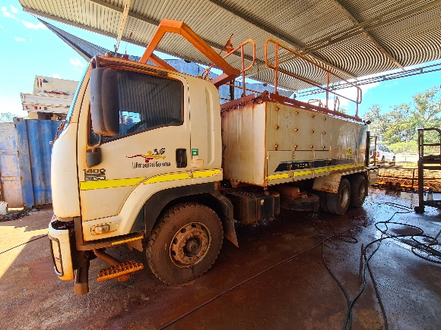
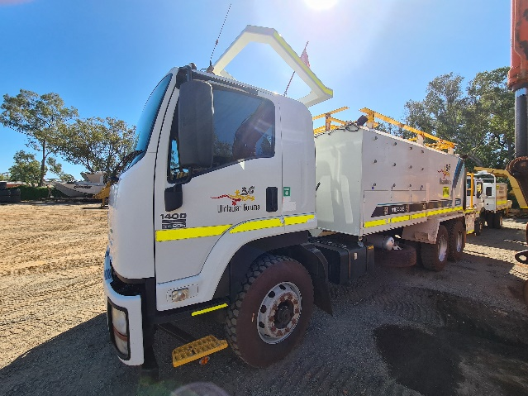
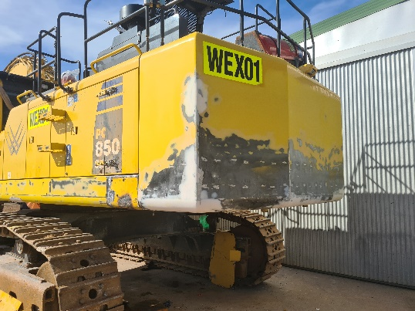
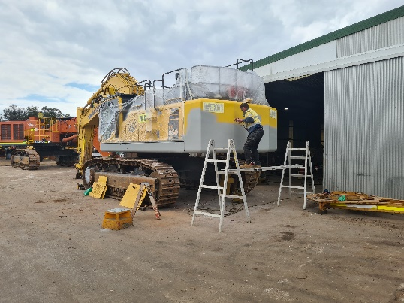
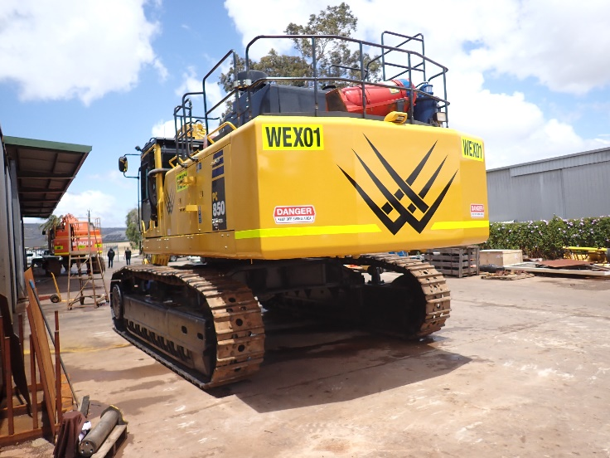
Maddington workshop Before & After
Hino Prime Mover
Off Hire, wash and minor repairs
Komatsu PC850 Excavator
Off Hire, repairs and paint

Slide 11
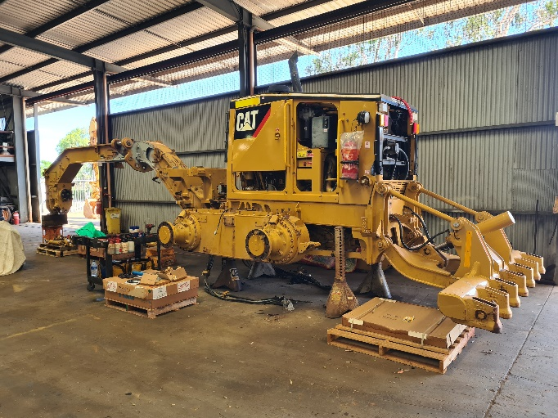
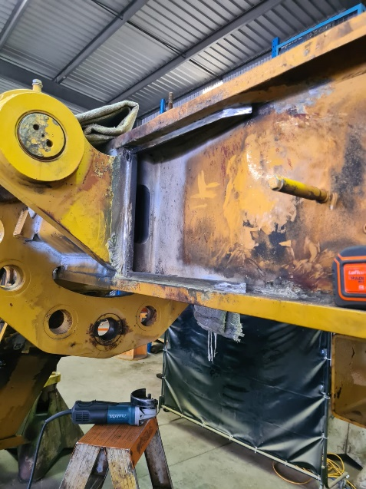
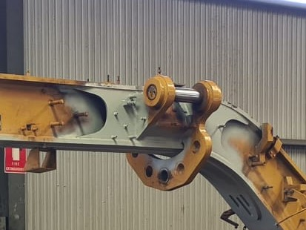
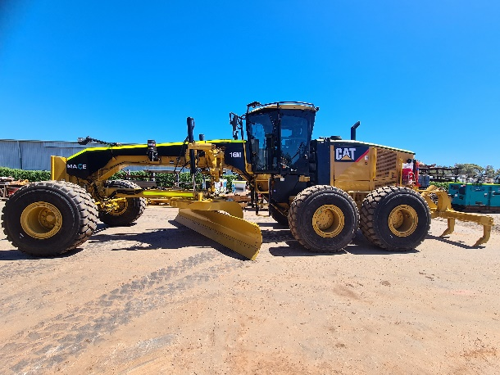
16M Grader
Major overhaul, centre hitch line bore, front axle, circle and blade repairs. PIP updates

Slide 12
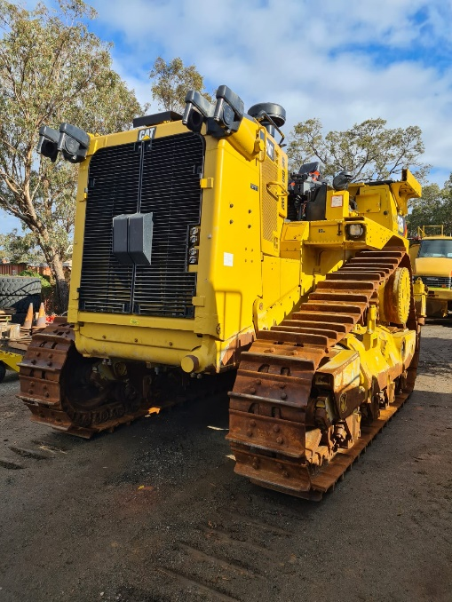
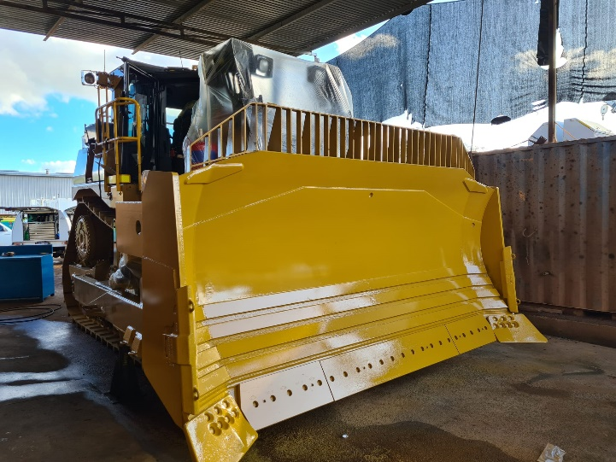
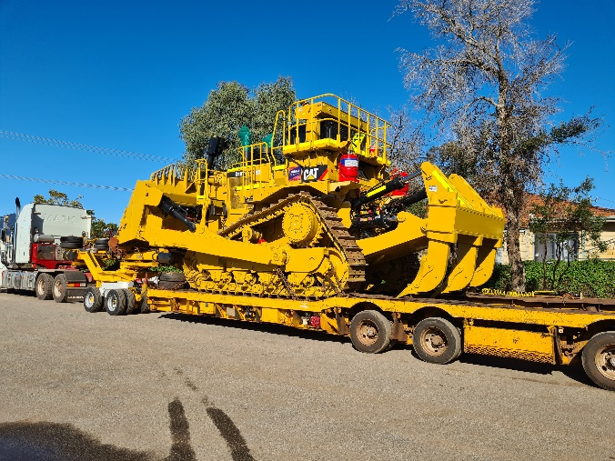
D10T Import
Fit Out, Mine Spec, Wear Package, Repairs and paint

Slide 13
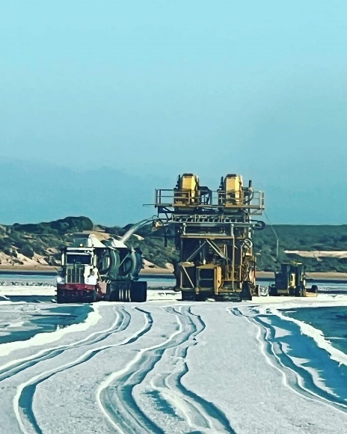
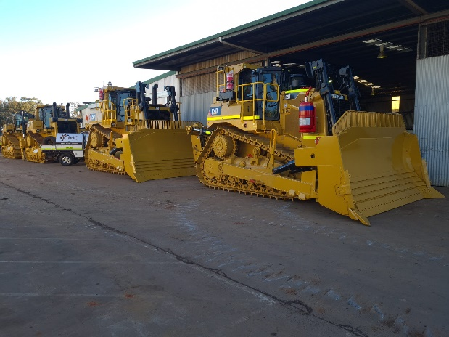
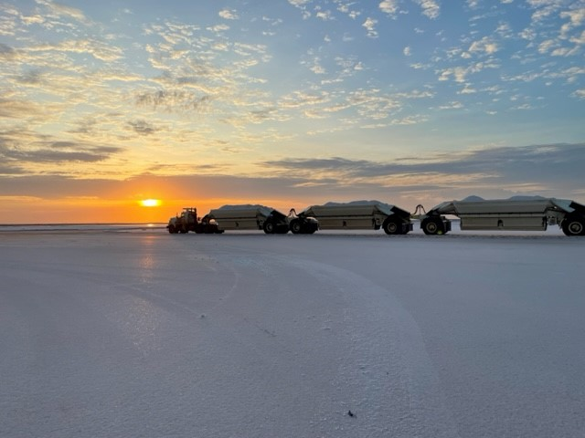
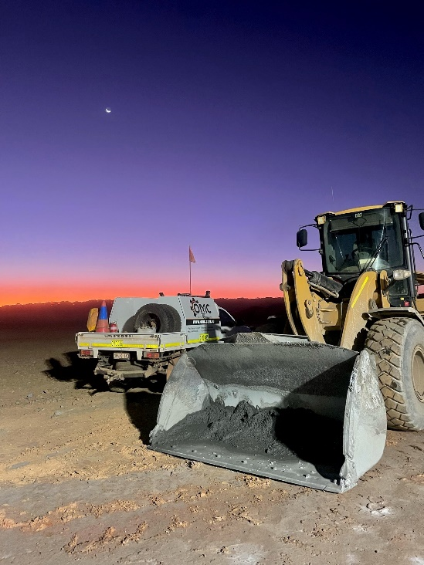


Sample pictures

Slide 14

Key Personal & Contacts

