Slide 1
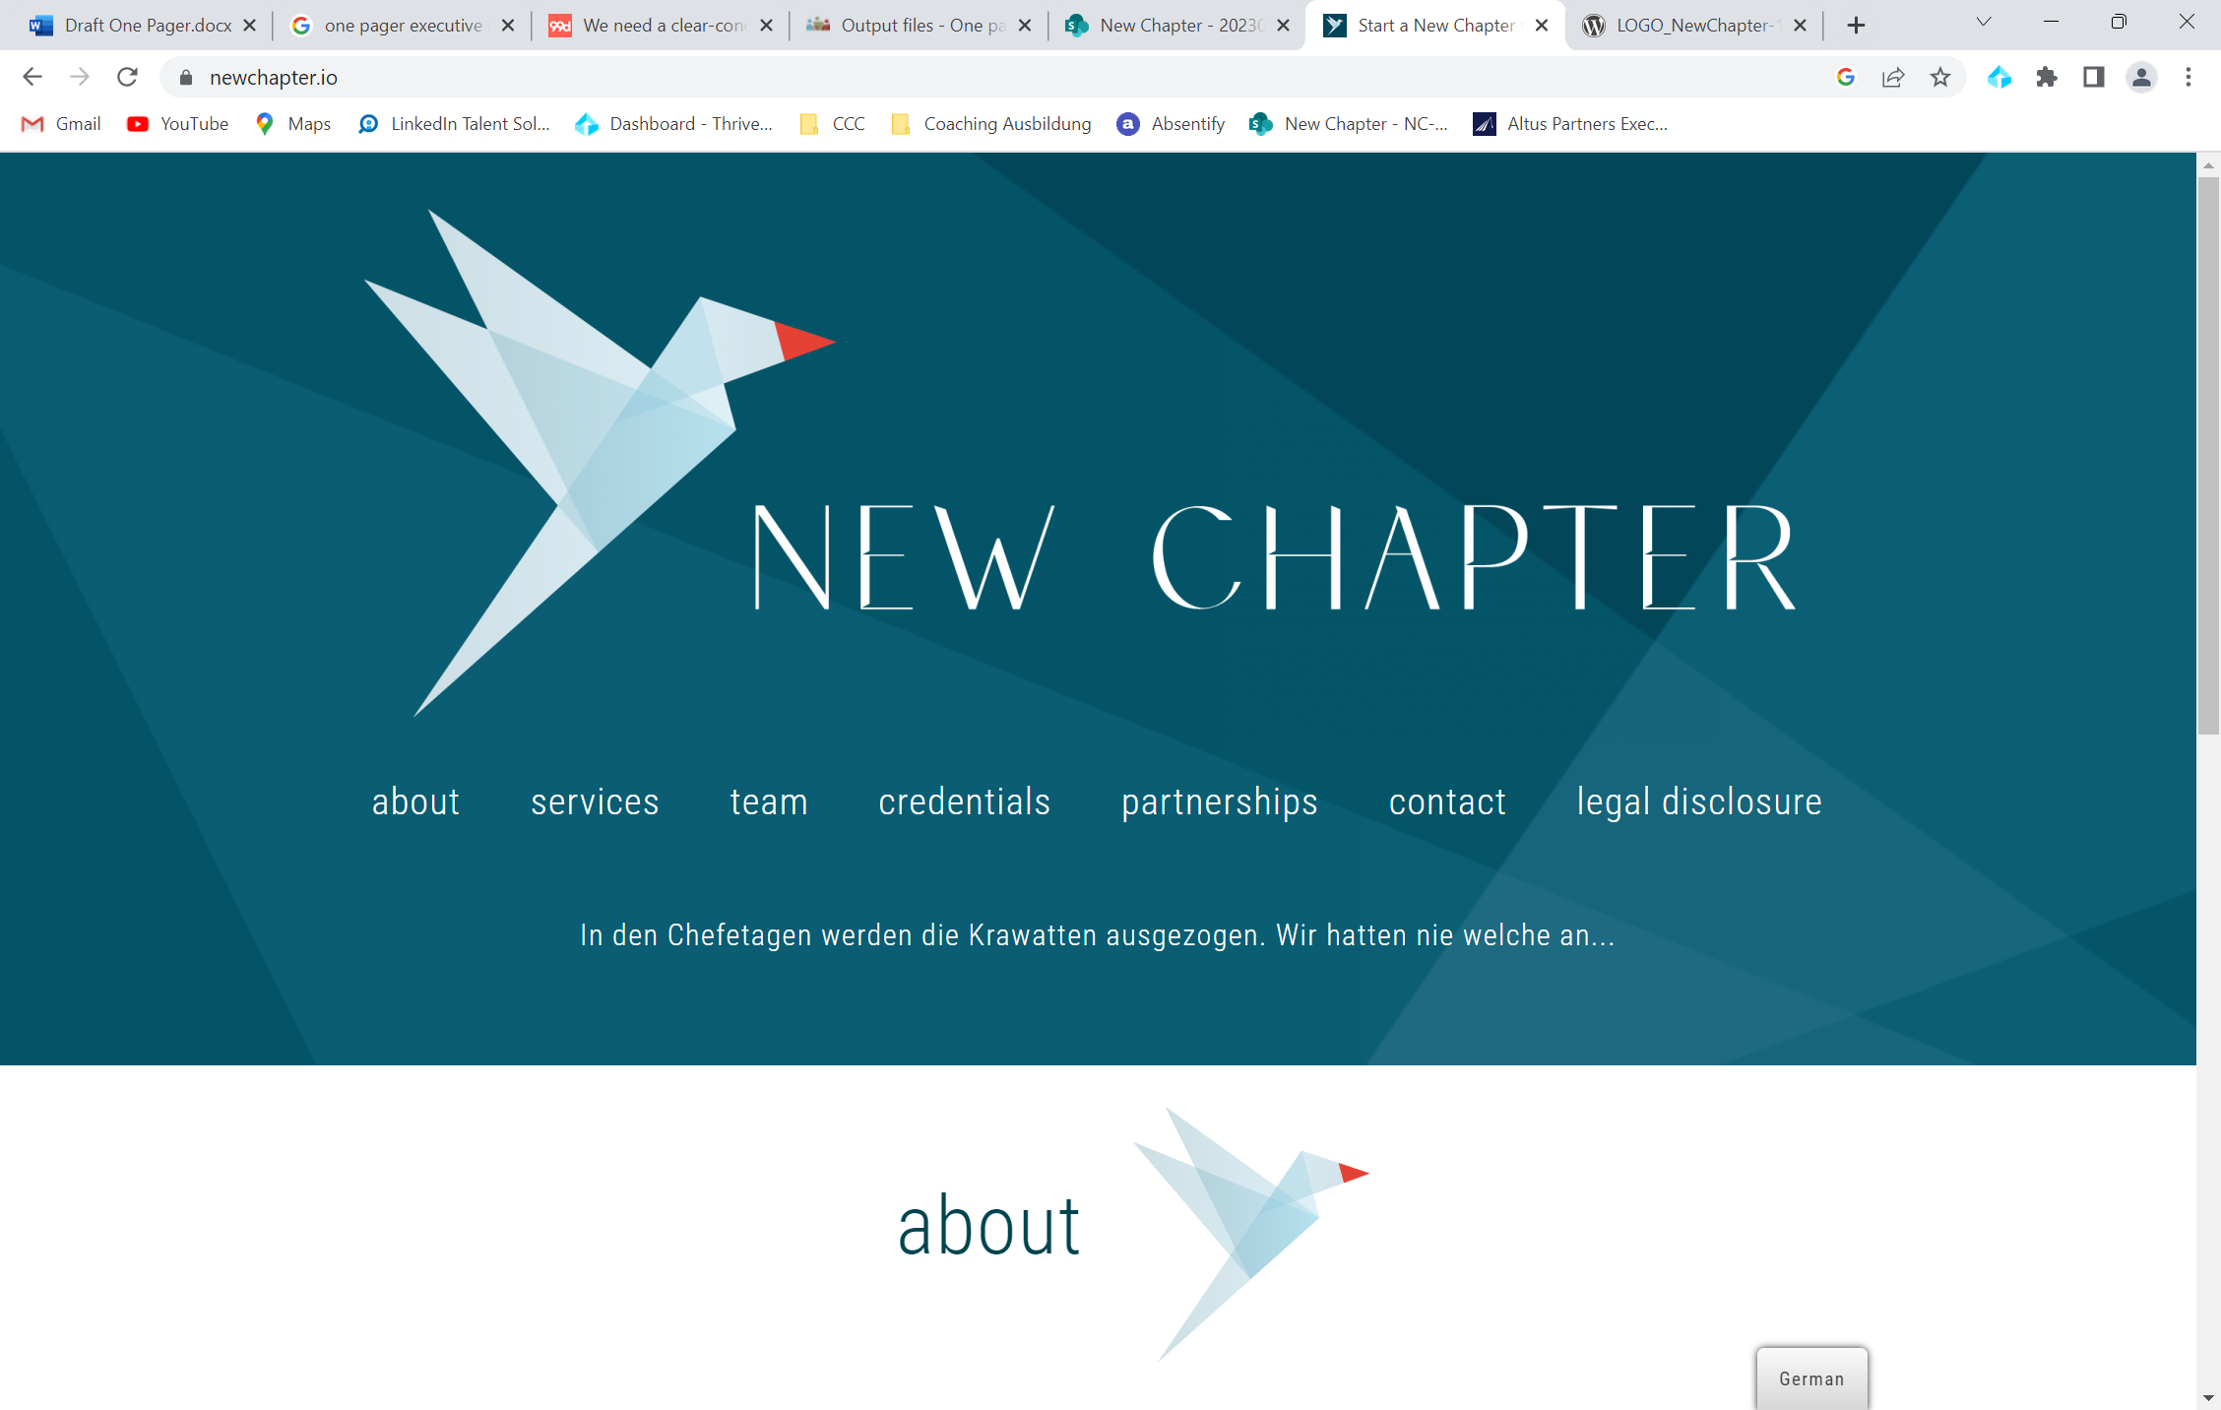


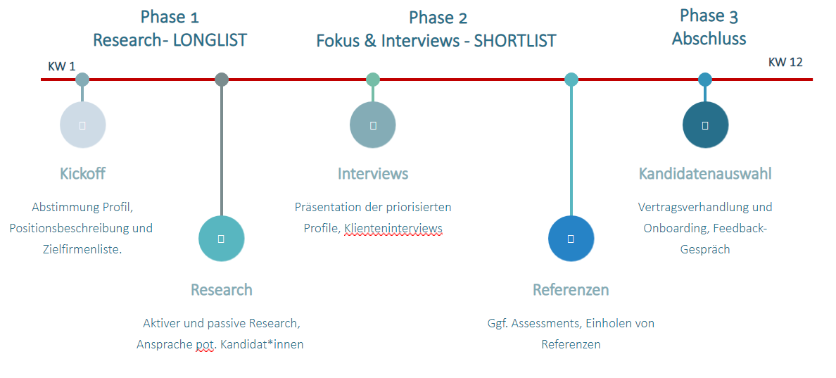



So, they don’t wear ties in the boardrooms anymore. We never did…
Honest
Personal
Pragmatic
Diverse
Services
Executive Search
Leadership Advisory
We are helping you to identify and hire highly qualified and experienced candidates for senior-level executive positions. Our goal is to identify the most qualified candidates and match them with the needs and culture of your company.
Our Leadership advisory services are for Management Teams as well as HR-Professionals and candidates. They are designed to help you, and your organization, to build strong and effective leadership skills and teams that can drive growth, innovation, and success.
Why us?
Industries
Longstanding experience with a passion for placing C-Level Executives
We work with you personally and act as an ambassador for our clients in the market
Engaging in at eye-level discussion beyond just placement and HR topics
Structured, lean and, most importantly, transparent digital processes, with the opportunity of 24/7 self-update on search status in our online tool
Creative search approaches and comprehensive candidate evaluation
Through referencing of candidates as part of the process; psychometrics on demand
Healthcare
Private Capital
Consumer
Education & Administration
Managing Directors
Recruiting Process
Dr. Anne Wichels-Schnieber
Julia Mandl
By the numbers
xx% placement rate
Xx days to placement
95% retention rate over the course of two years
20+ years total of experience in the Executive search sector
Track Record
Locations
HAMBURG
WIEN
MÜNCHEN
DÜSSELDORF
www.newchapter.io
office@newchapter.io
012345/6789
Lets work together:

