Slide 1
Elevance Health Medicare Stars Training Series
Overview: Statement-of-Work

Slide 2
Purpose
The purpose of the training is to educate targeted Elevance Health employees about the Medicare Stars Ratings so they can drive performance improvement and revenue.

Slide 3
Considerations
Brand is not a driving factor
Superhero theme is a stated requirement
Goal is to set the standard for Stars training in the industry
Video production will strive to entertain while not distracting from the educational purpose of the training
The Elevance Health Medicare Stars team will be the primary reviewer and approver of content
The training series will be packaged in a “Stars Month” campaign internally
4,000 employees will be required to complete the entire training, while others may be asked to do select modules (e.g…Overview)
The content may need annual updates over a period of years

Slide 4
Deliverables
Training Series Modules
Promotional Modules
Stars Overview (30 minutes)
Health Equity (20 minutes)
Condition Management (20 minutes)
Post-Acute Management (20 minutes)
Preventative Care (20 minutes)
Patient Experience with Providers (20 minutes)
Member Experience with Plan (20 minutes)
Pricing Accuracy, Tele-sales and Appeals (20 minutes)
Teaser (1 minute)
Video to promote the training series to employees, encouraging them to engage quickly
Delivered via email link to 4,000 employees
Celebration (1 minute)
Video celebrating the completion of training, welcoming them to the superhero team
Delivered via email link upon completion of the training

Slide 5
Process
Create schedule based on stakeholder availability and 48-hour review turnarounds
Define screen content and assemble visual assets to support it
Edit script to integrate superhero theme
Define creative treatment with superhero team and character descriptions
Create character and module styleframes
Research voiceover and music options for review and selection
Produce eight training modules and two promotional videos on a phased schedule

Slide 6

Guiding Principles
The vision is to break new ground in the world of employee training
There is no precedent to follow. Imagination and the courage of a superhero is required.
We are taking inspiration from short-form design and animation and applying similar techniques to a lengthy educational experience
The project will explore the right balance between education and entertainment

Slide 7
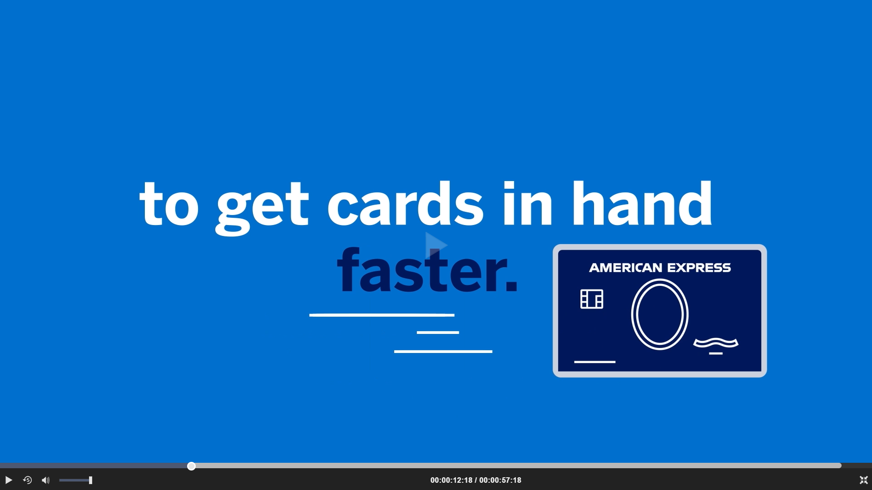


Animation Examples

Slide 8
Sample Schedule
March
|
April
|
May
|
June
|
July
|
August
Creative treatment
Character/module styles
Content approved
Voice/Music
Screen content and graphics
Production
Training
1
2
3
4
5
6
7
8
Promos
1
2

Slide 9
Budget
Total: $793,320
50% deposit ($396,660) invoiced up front (Net 15)
25% ($193,330) invoiced (Net 30) upon completion of 4th training module
25% ($193,330) invoiced (Net 30) upon completion of final training module
Full statement of work document addresses rights, excluded work, client obligations, and payment terms

