Slide 1
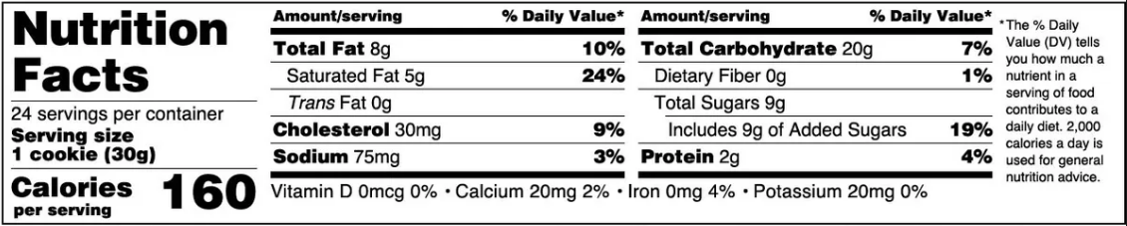
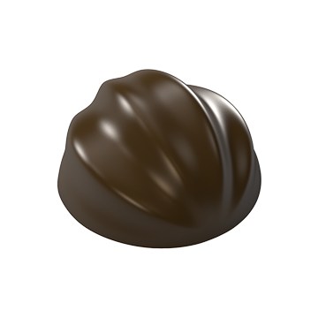

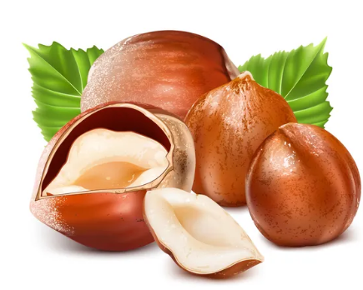

100mm
<< HIDDEN FIN (no text)
Naked Velvet
Kelowna, BC
V1W 3S9
info@nakedvelvet.com
<< AREA “B”
BEST BEFORE:
NAKED VELVET
100mm
HAZELNUT TRUFFLE
TRUFFE NOISETTE
<< FRONT PANEL
30g
(3 pieces)
PLANT-BASED
SMOOTH, VELVETY CHOCOLATES
ENLARGED TO SHOW DETAIL
INGREDIENTS:
COCOA MASS, COCOA BUTTER, RAW CANE SUGAR, HAZELNUTS, COCONUT OIL, REAL MADAGASCAR VANILLA BEANS, SEA SALT
CONTAINS: MAY CONTAIN:
HAZELNUTS, COCONUT TREE NUTS, PEANUTS, SESAME, MILK (DAIRY), EGGS, SOY, WHEAT (GLUTEN), RICE
<< AREA “A”
INGREDIENTS:
MASSE DE CACAO, BEURRE DE CACAO, SUCRE DE CANNE CRU, NOISETTES, HUILE DE NOIX DE COCO, GOUSSES DE VANILLE DE MADAGASCAR, SEL DE MER
CONTIENT DES: PEUT CONTENIR:
NOISETTES, NOIX DE COCO NOIX, ARACHIDES, SESAME, LAIT (LATIER), OEUFS, SOJA, BLE (GLUTEN), RIZ
<< FACING FIN

