Slide 1
Its Showtime!
2D or 3D Letters?
Black or White colors in Letters? Could be Silver or Gold Also! No Other Colors.
I want a Logo that would look good on Instagram and Social Networks. Very Fresh and Easy to Recognize. Letters must read clearly, But Image of People must also be easy to See.
Looking at this Logo will Excite you! Will make you want to Sing, Dance and Have a great time!
The Company or the “GUY” or “STAR” that you want to Hire for your personal events. You want to have a Once in a lifetime-Event, and this is the Chance!

Slide 2
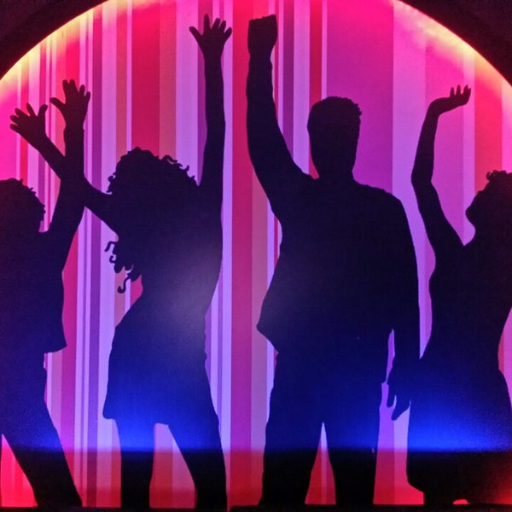




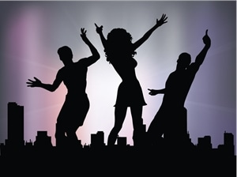

Slide 3
