Slide 1

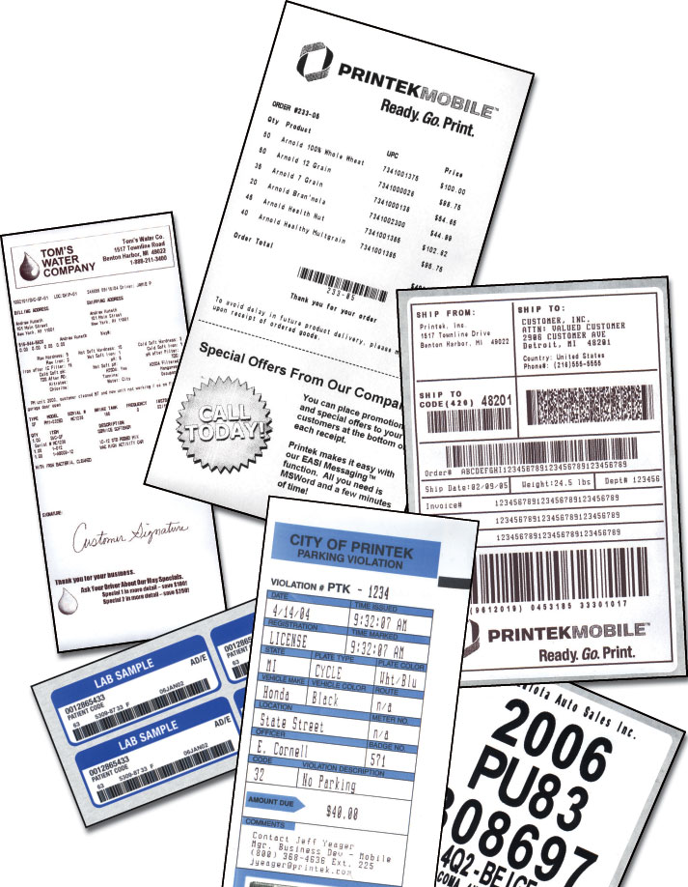
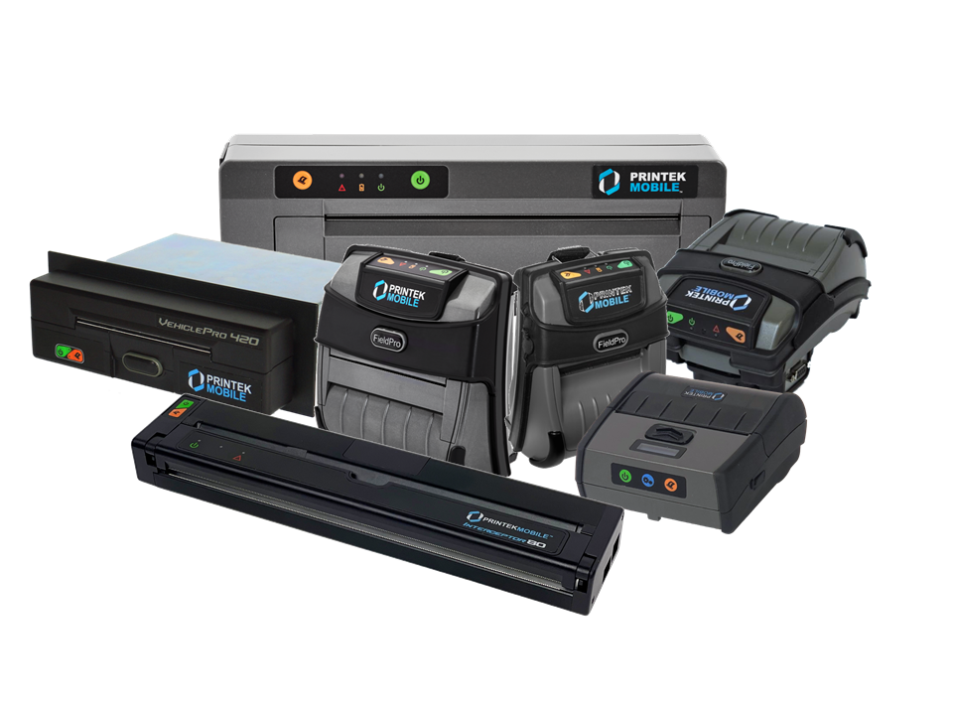
Premier Mobile Printing
Solutions

Slide 2




Printek, LLC
Business Printing Solutions
  Originally designed and manufactured in USA – Benton Harbor, MI - since 1980
    Moved to current location in October of 2017- St. Joseph, MI
  PrintekMobile is owned by DASCOM (they design and sell matrix, desktop thermal, and card printers)
    Printek collaborates with DASOM on new printers and other projects.
  Dependable and innovative printers.
  Reliable printing solutions for major corporations worldwide.
  Supporting integration requirements of partners, small and large.
  Over 16 years in the mobile printer market.

Slide 3
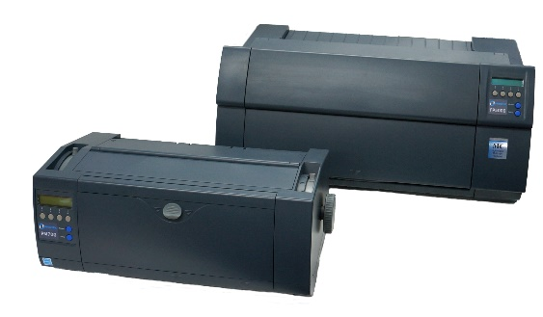
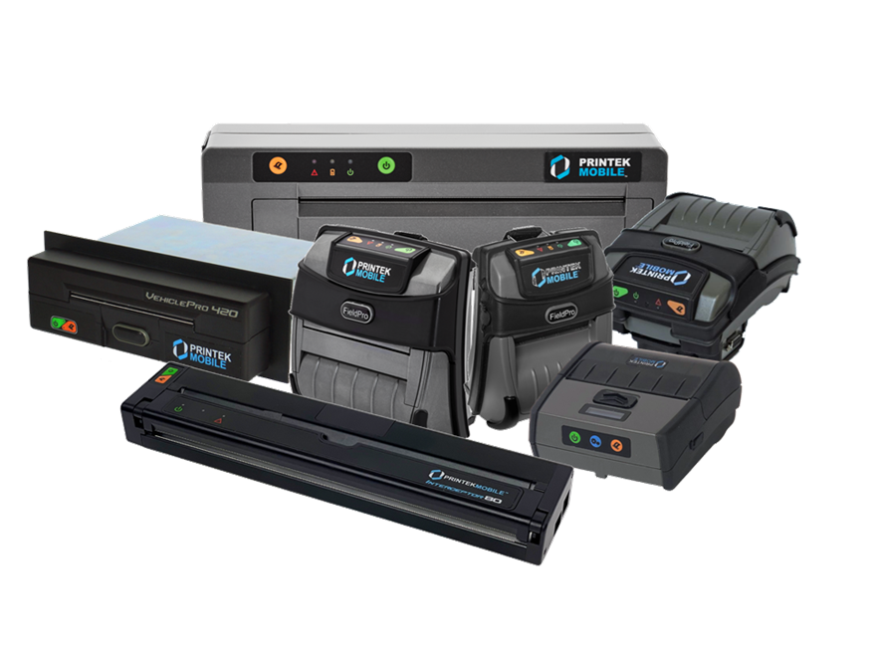
Printek Divisions
Impact Printers
  Printek is a leading global provider of innovative, heavy-duty dot matrix printers. Top companies count on the rugged reliability, superior technology, and advanced forms handling of Printek dot matrix printers.
  Established 1980
Mobile Printers
  Mobile printers for mobile people. Our mobile thermal printers are designed to withstand industrial use in the field and offer reliable, on-demand printing wherever your business takes place.
  Established 2005

Slide 4
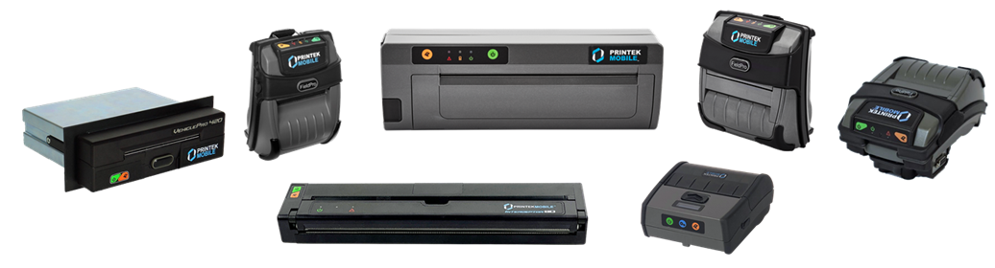
PrintekMobile
Why PrintekMobile versus competition?
  Superior Products with unique, advanced features.
  Excellent customer support and integration assistance.
    Pre and Post-sales support – very important selling point.
  FREE Factory configuration on all orders.
  Competitively priced – best value in the marketplace.
  Printek also sells media to use with the printers.
  BEST warranties – 2-year bumper-to-bumper on printers including battery!
    We offer extended warranties as well.

Slide 5
Mobile Printer Market
Market Segment Definitions
Primary End User Environments
Retail In-Store
Hospital
Field Workforce
Manufacturing Shop Floor
Hospitality/Entertainment
Public Safety
Route Accounting/DSD
Transportation/Fleet
Warehouse D/C
Form Factor
Portable/Wearable
Cart-Mounted
Vehicle-Mounted
Work board
Connectivity
Wi-Fi
Bluetooth
Cable
IrDA
Print Width
2"
3"
4"
8”
Output Type
Forms/Invoices
Labels
Professional Documents
Receipts
Tags/Tickets
Distribution Channels
Direct to End User
Direct to OEM
Dealer/Distributor
VAR/Systems Integrator
Other

Slide 6

Mobile Printers - Applications
Public Safety
Niche Mobile Printer Markets
>Heavy Duty Transportation
>Fiscal Printers
Field Service
Warehousing or Distribution
Specialty Label Printing Applications
Route Accounting/DSD
Notes:
Public safety and warehousing switch

Slide 7














Vertical Markets
Reference Customers
Public safety (police, EMS)
Parking
Public Utilities
Retail
Hospitality
Warehousing & Logistics
Transit & Fleet
Field Services
Route Accounting
DSD (direct store delivery)
Healthcare/Medical

Slide 8












Sample of Police Agencies using PrintekMobile
Michigan State Police
Ottawa PD, Ontario Canada
Grand Rapid Police
Detroit Police Department
Pittsburgh PD
Jonesboro Police Department
Bristol Police Department
Ottawa County Sheriff
New Jersey State Police
Vermont Dept. of Motor Vehicles
Sandoval County Sheriff
Brevard County Sheriff
York County Sheriff
Orange County Sheriff (FL)
Key West PD

Slide 9

Introduction of the PrintekMobile Line

Slide 10
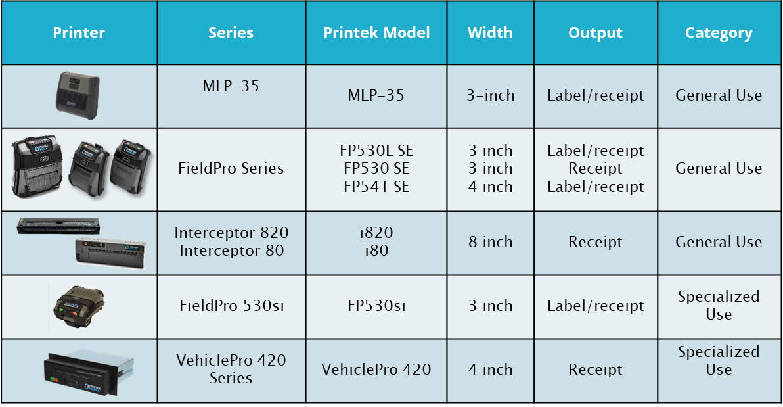
Mobile Printer Lineup

Slide 11
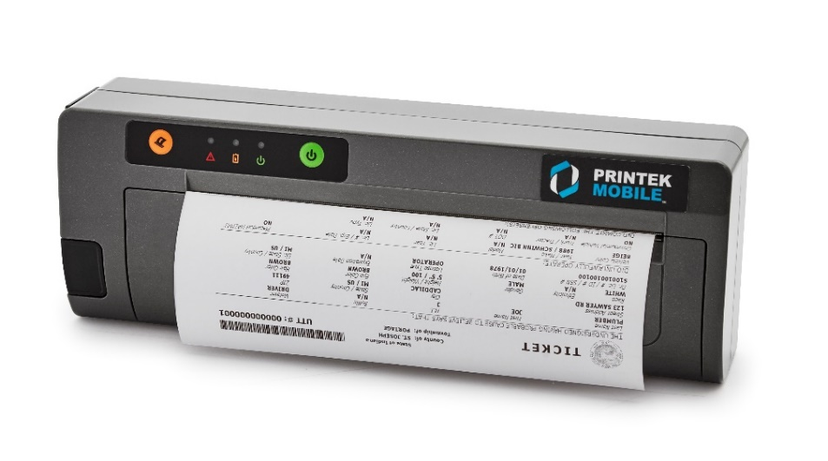
Interceptor 820
Designed for applications requiring a full-size printed page.
  Full page e-tickets, driver exchange, reports, invoices, BOL, and more.
Fully self-contained unit, with drop in paper roll loading.
Compatible with Windows, and Android.
Mounting points on back of printer.
High speed thermal printing up to 11 pages per minute.
“Gas Gauge” on back side to check battery charge.
Dual tear-bars that allow for tearing off in any direction.
Web based configuration page for easy access to settings.
2-year warranty that covers the printer including battery.
USB-C, Bluetooth, Wi-Fi, and battery are optional.
Public Safety
Fire / EMS
Warehousing / Logistics
Route Accounting / DSD
Field Service

Slide 12
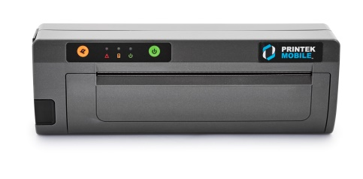
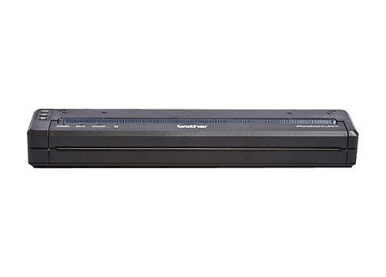
Interceptor 820 Competitors
Only true competitor to the I820 is the BrotherMobile PocketJet 7
Other options include small ink jet printers.
  Not very practical in most applications.
I820 Advantages over PJ7:
  I820 is 11ppm vs PJ7 at 8ppm
  I820 has dual tear bars – PJ7 only has one
  I820 is true drop-in paper loading.
    PJ7 is form feed
    Have to purchase a separate container for paper roll.
  I820 has 2-year warranty – PJ7 one year, 90-days on battery.
PJ7 does have a dedicated following.
PJ7 slightly cheaper
PJ7 smaller and easier to carry and put in a bag.

Slide 13
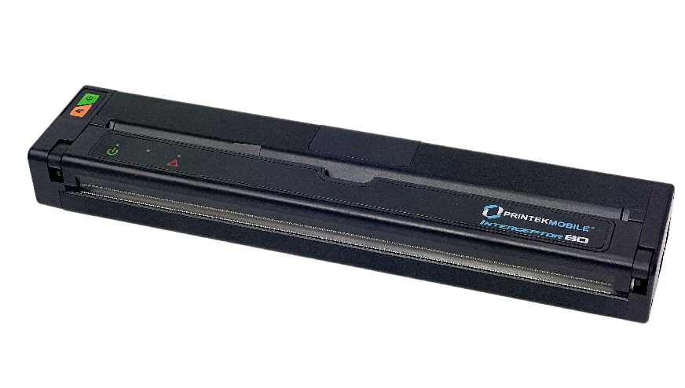
Interceptor 80
Designed for applications requiring a full-size printed page.
  Full page e-tickets, driver exchange, reports, invoices, BOL, and more.
Compatible with Windows, Android, and iOS BT.
Small footprint design for efficient mounting options.
High speed thermal printing up to 11 pages per minute
Dual tear-bars that allow for tearing off in any direction.
Web based configuration page for easy access to settings.
USB-C, Bluetooth, Wi-Fi, are optional. NO battery.
Multiple mounting options available from all major mounting companies.
  Works with any mounting system designed for the Brother PocketJet 7.
Public Safety
Fire / EMS
Warehousing / Logistics
Route Accounting / DSD
Field Service

Slide 14
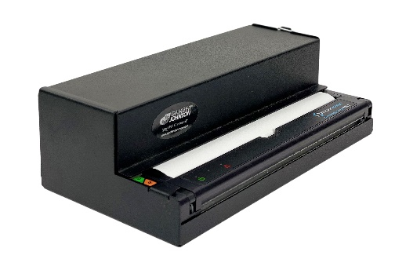
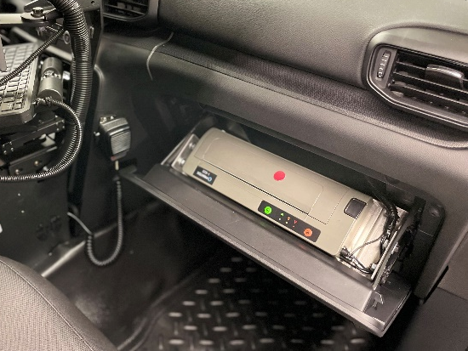
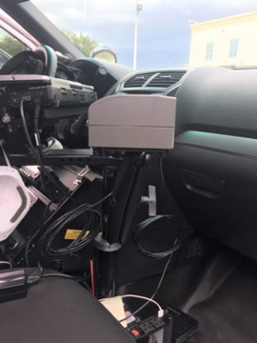
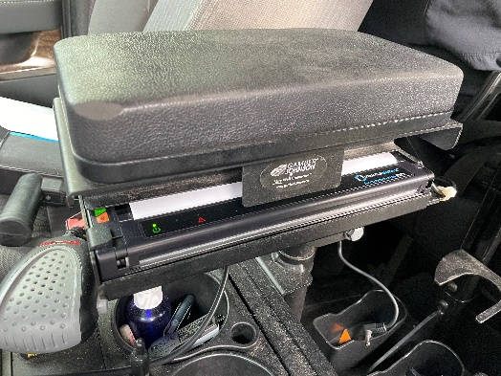
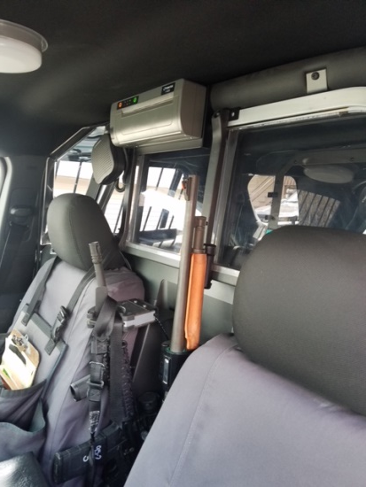
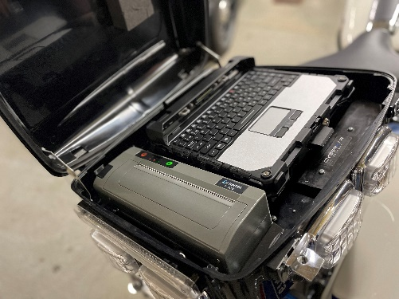
Interceptor 80 & 820
Notes:
Need new photos in action for I820

Slide 15
FieldPro FP541
Print speeds up to 5 ips
Extensive fonts, character sets, bar codes and graphics capabilities.
Compatible with Windows, and Android.
Serrated tear edge for easy receipt/label tear off.
Web based configuration page for easy access to settings.
Mounting points on the bottom of printer.
2-year warranty that covers the printer including battery.
USB-C, Bluetooth, Wi-Fi, and battery are optional.
Drop-in paper loading.
“Gas Gauge” on back side to check battery charge.
A perfect drop-in replacement for Zebra RW420, ZQ520, Brother RJ4030, RuggedJet 4, and other 4” mobile printers.
Public Safety
Fire / EMS
Warehousing / Logistics
Route Accounting / DSD
Field Service

Slide 16
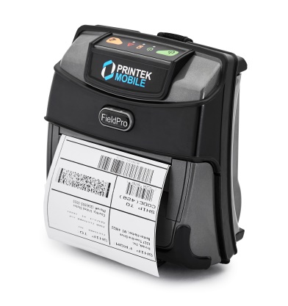
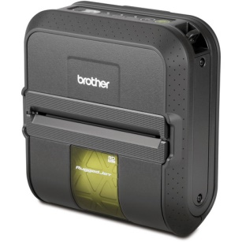
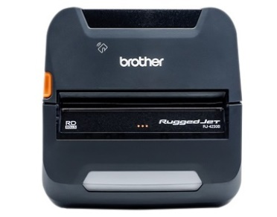
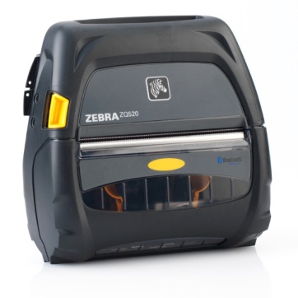
FP541Competitors
In the 4” mobile market, there are a lot of competitors, but in North America, and the markets we focus on, this is who we see the most:
  Brother RuggedJet 4030
  Brother RuggedJet 4200
  Zebra ZQ520
  Others….
Key advantages of FP541
  2 year bumper-to-bumper warranty
  Web based configuration
  Latest battery technology
  PRICE – often times much cheaper than competition.
  Pre- and post sales support

Slide 17
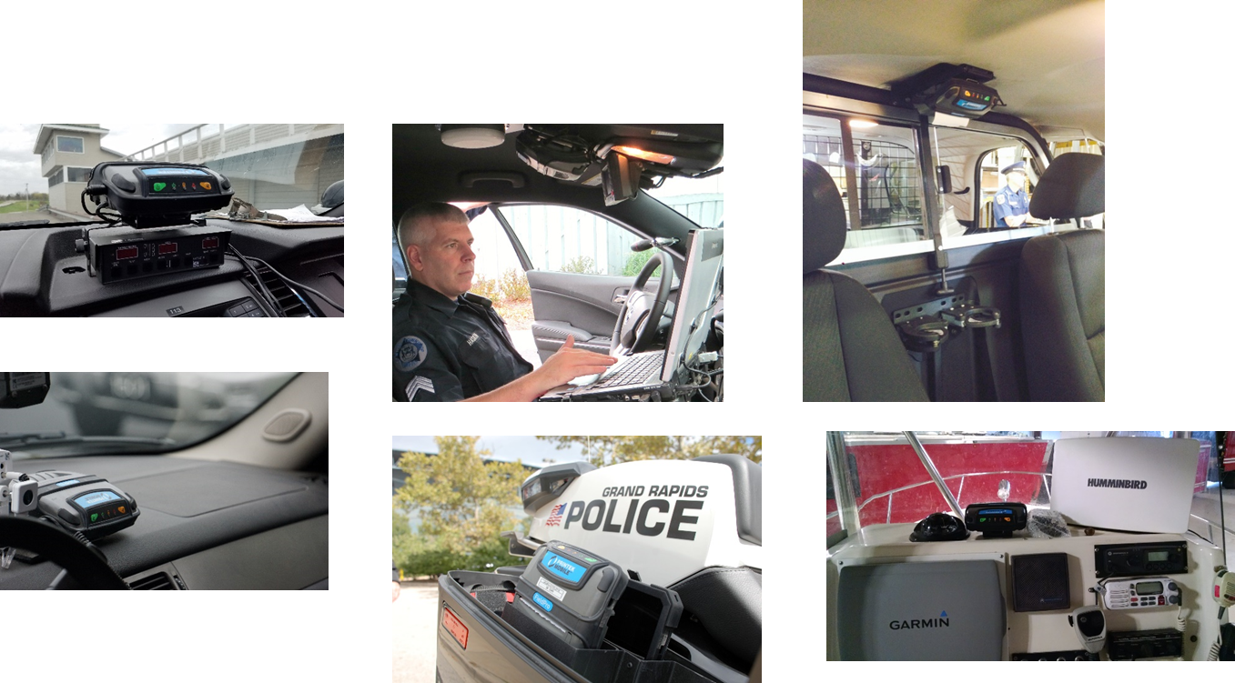
FieldPro FP541

Slide 18
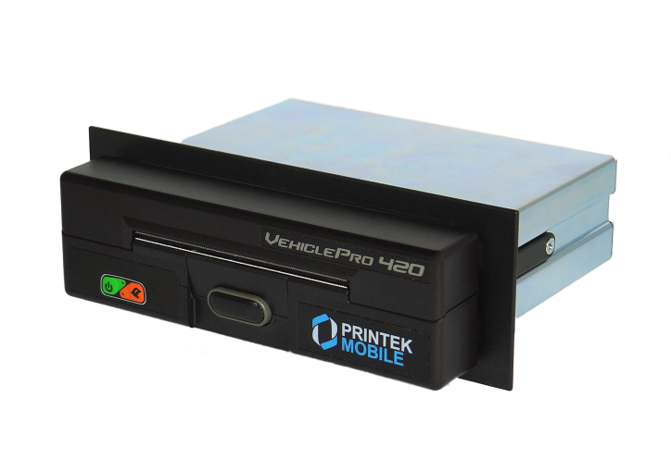
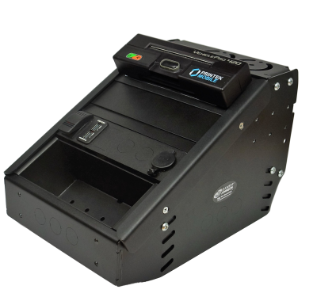
VehiclePro 420
The VehiclePro 420 is a unique, updated design specifically for use in Public Safety Vehicles in either a dash or center console.
  Police Cars, Fire Trucks, or other vehicles
Simple setup - Windows drivers, and all-in-one cable used.
Simple Operation - Door latch, drop-in paper, paper advance, status indicator all on front face.
Up to 5 ips print speeds.
2-year warranty.
Runs from vehicle power; robust, locking power connector.
Auto ON and OFF with vehicle power.
USB standard, Bluetooth, and Wi-Fi optional.
Compatible with Windows, Android, and iOS.
Printer configuration is quick and easy with a web based interface.
Super easy installation in center console with variety of mounting plates for each manufacturer.
NO Competition! No other printer like it in the market.
Public Safety
  E-ticketing
  Parking enforcement
  Code violations

Slide 19
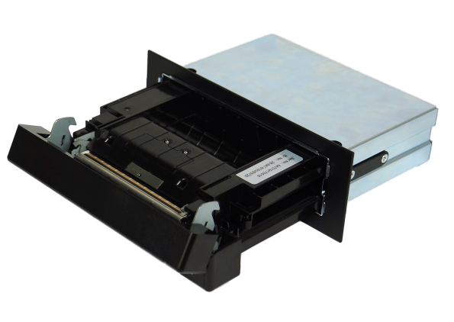
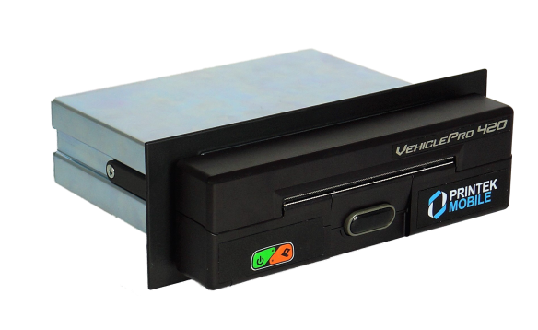
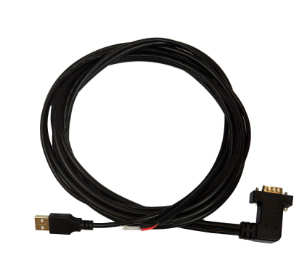
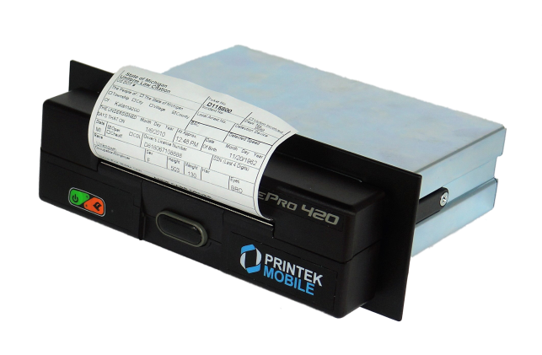
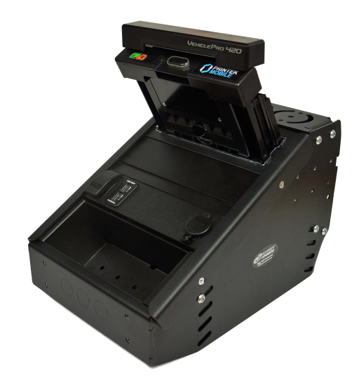
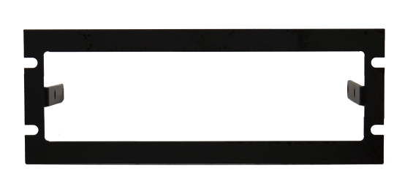
VehiclePro 420

Slide 20
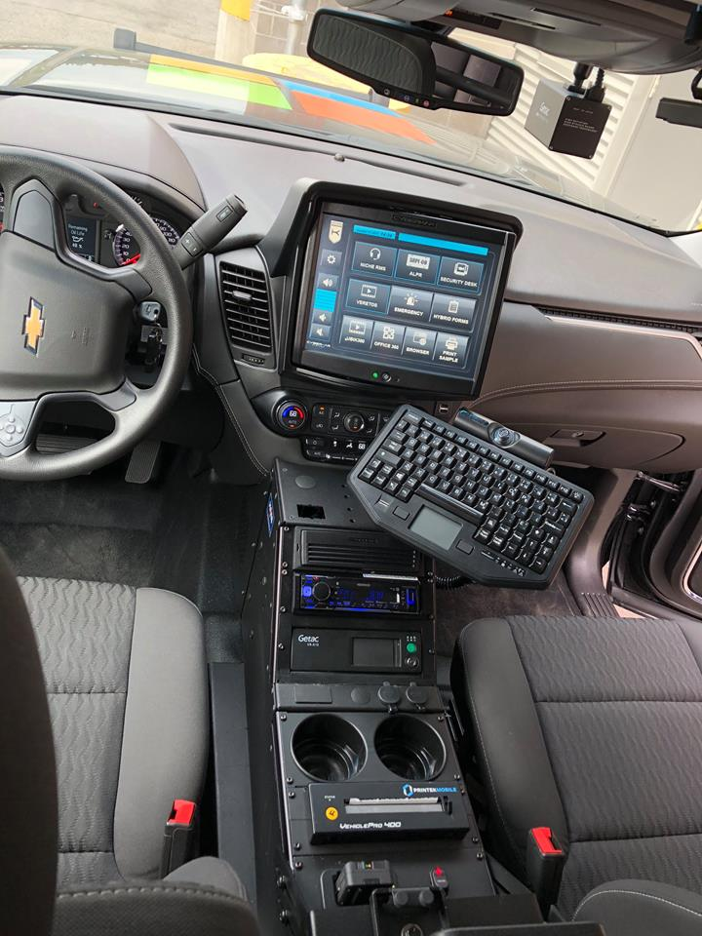
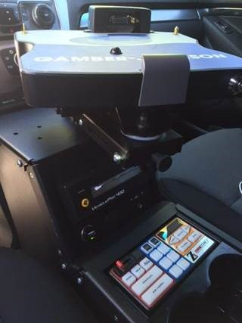
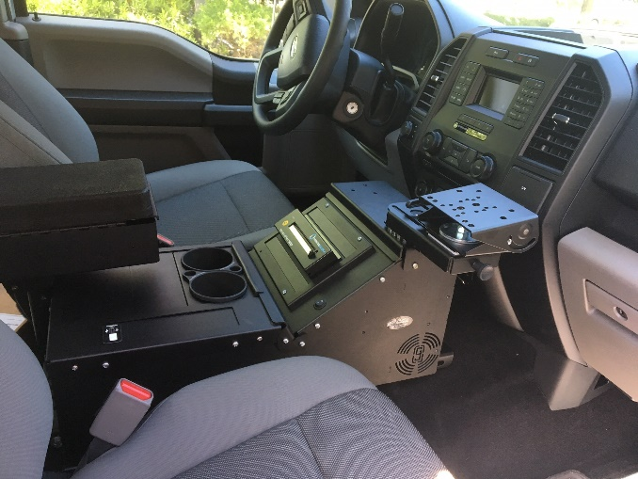
VehiclePro 420

Slide 21
Success Stories

Slide 22
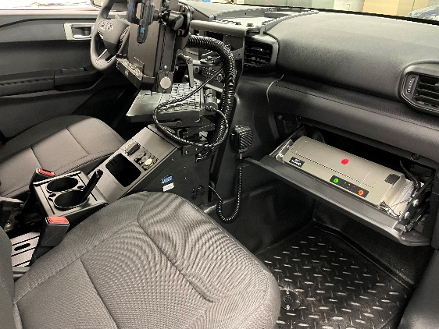

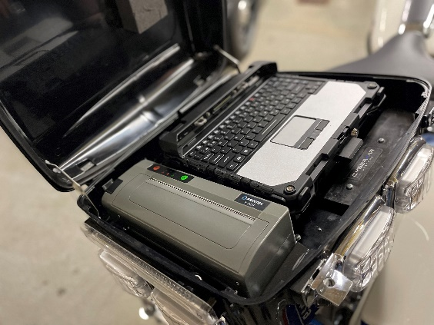
Mobile Printer Success Stories
Ottawa PD - Canada
  I820 USB printer w/o battery.
  Used in police cars and motorcycles for issuing speeding tickets, and other reports.
  Using Panasonic Toughbooks, and mount them in the glove box of the cars, and in the cases on the back of the motorcycles.
  Have installed 350 I820 printers so far, with another 50 more to come.

Slide 23


Mobile Printer Success Stories
Michigan State Police
  I80 USB printer w/o battery.
  Used in police cars for issuing speeding tickets, and other reports.
  Drop-in replacement for current Brother PocketJet 7.
  Using Getac laptops, and mount them in the arm rests.
  Have installed 450 I80 printers so far, with another 1,100 more to come.

Slide 24
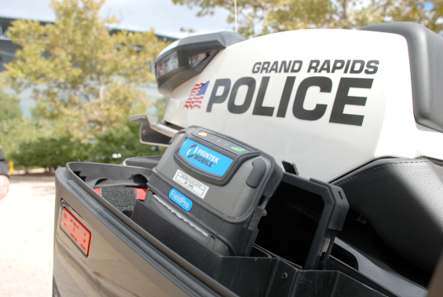

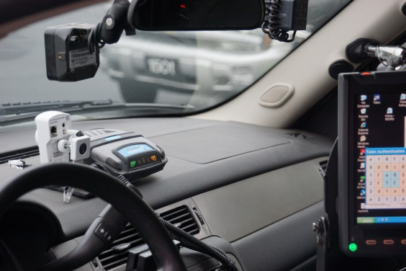
Mobile Printer Success Stories
Grand Rapids Police Dept.
  eCitation application – speeding tickets.
  Has the older RT43 printers in over 100 police cars and motorcycles.
  Switching over to the new FP541 USB w/o battery.
  Uses the printers with Windows based laptops and handhelds along with eCitation software.
  Very common application in Public Safety.
  Michigan State Police and Detroit Police use the FP541on their motorcycles as well.

Slide 25
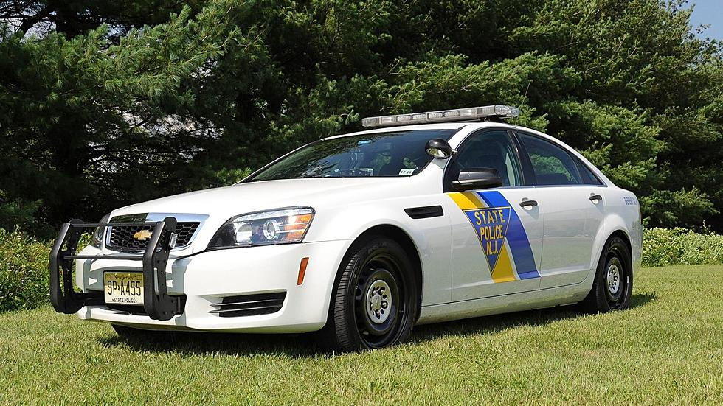

Mobile Printer Success Stories
New Jersey State Police
  VP420 series printer.
  Installed in their patrol cars in the center console
  Print speeding tickets and other violations.
  200 printers installed with more to come.

Slide 26

Qualifying Mobile Printer Opps
What type of document is to be printed? Receipt, Label, etc.
What is the application?
What is the media width/printer size needed?
What is the desired communication method? USB, Wi-Fi, Bluetooth?
What operating system is used? Windows, Android, iOS?
Where will the printer be located while in use?
Will the printer be mounted or used as a mobile printer?
How will the printer be powered? AC, In-vehicle, battery?
What type of handheld / laptop / tablet will be used?
Who is the software provider and what is the purpose of the software?
How many printers are needed and when?
Who is involved in the decision making process?
Is a demo printer needed?

Slide 27
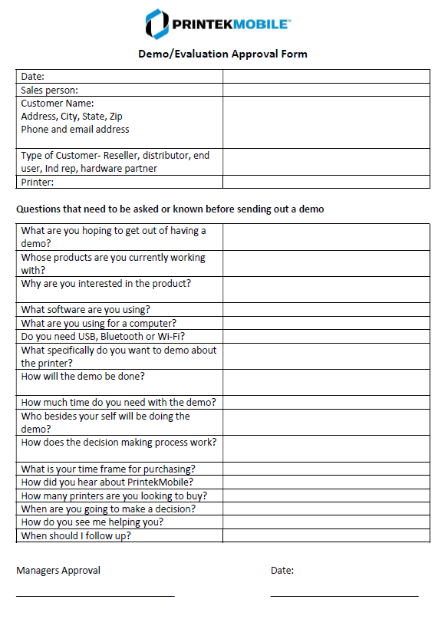
DEMO Qualification
PrintekMobile provides 30-60 day DEMO printers for qualified leads.
We call this our “Test Drive”
A link for the Test Drive can be found on our website: http://www.printek.com/portable-mobile-printers/test-mobile-portable-printers.html
Work with Chris Yeager on setting this up and getting a printer shipped out.

Slide 28
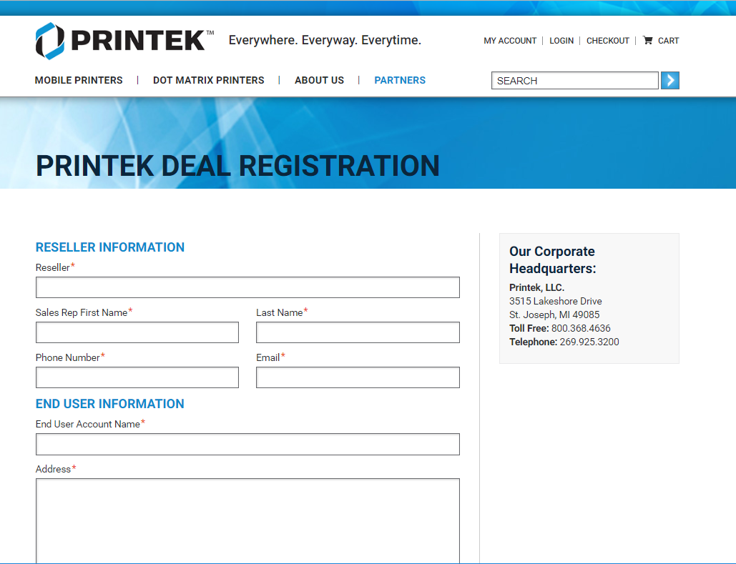
DEAL Registration
PrintekMobile offers Deal Reg for our partners.
NO minimum required for Deal Reg
Deal Reg protects the account for the sales rep
We use SalesForce for our CRM, and keep track of Deal Reg using this.
Visit www.printek.com and click on the “Partners” link, then click on Deal Registration.
Contact Chris Yeager with any questions.

Slide 29
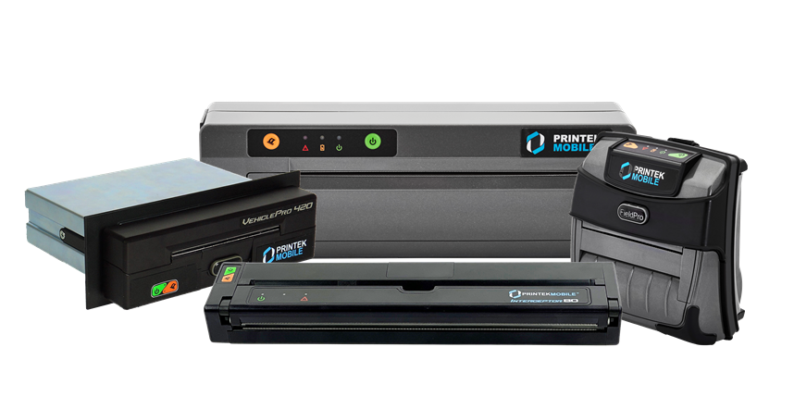
How to Drive Printer Sales
Trade shows
  IACP for example.
  Local Chiefs of Police Shows around the country.
  Other industry shows with partners.
Strong Email Campaigns
Work with distributors/resellers
  Lunch & Learns
  Vendor Day shows
  Email campaigns
  Provide Marketing Dollars for other activities
Strong SEO and Web presence
Free 30-day demos
Occasional Trade-In programs

Slide 30
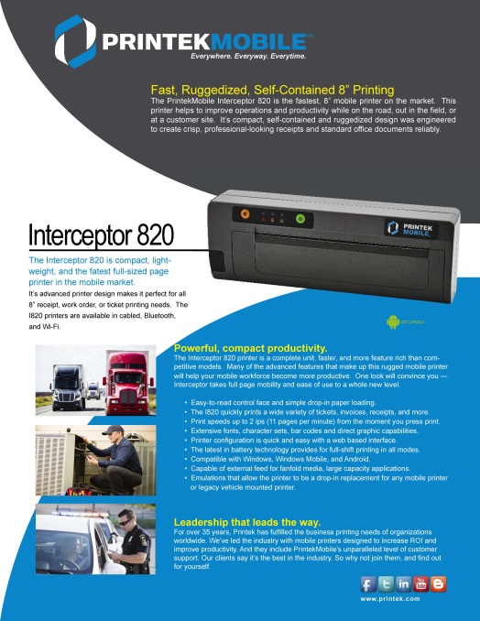
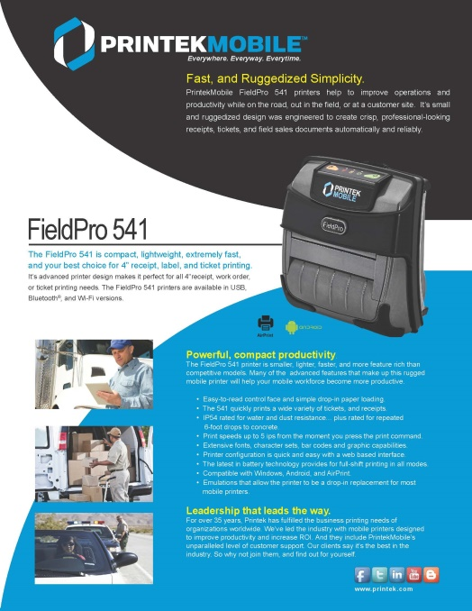
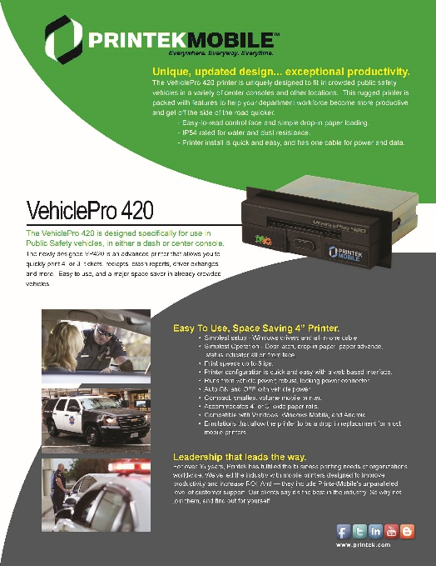
Marketing Material
Printer Spec Sheets

Slide 31
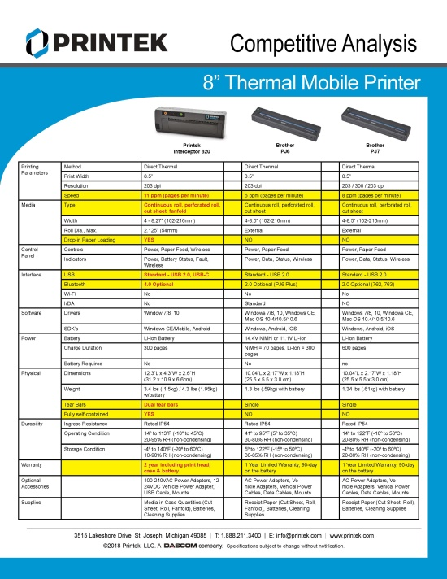
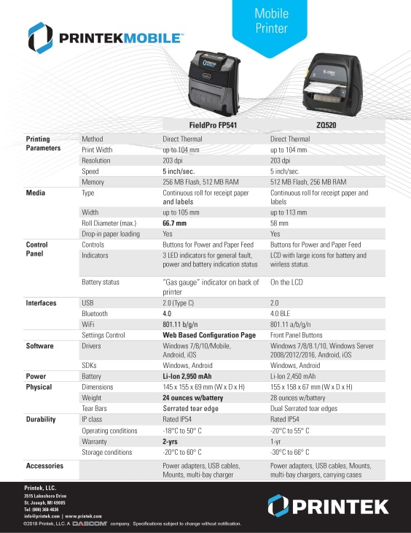

Marketing Material
Other Marketing Pieces

Slide 32

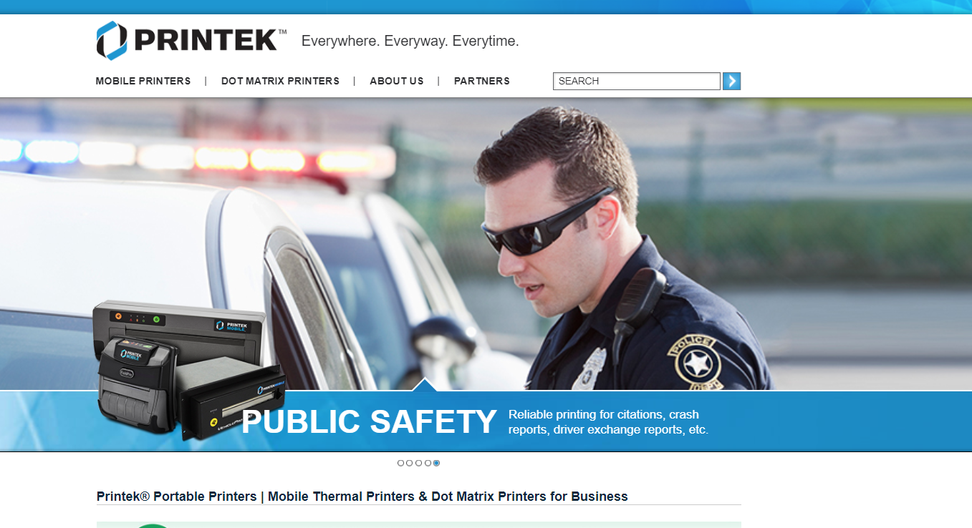



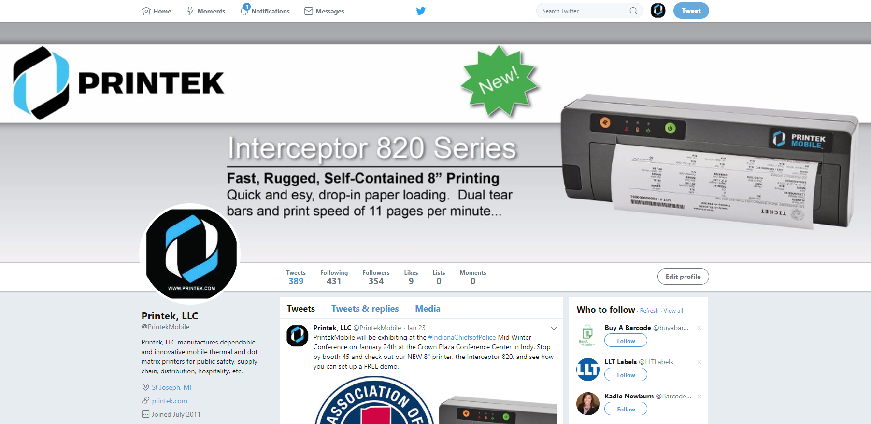
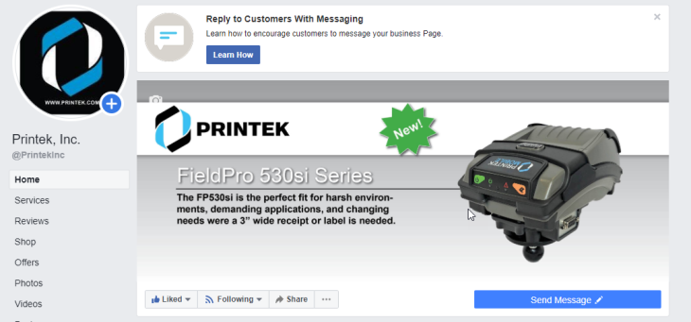
Web Resources
Printek Website
Printek Twitter
PrintekMobile LinkedIn
Printek Facebook

Slide 33
Contact Info
Chris Yeager
Director of Marketing and Mobile Sales
cyeager@printek.com
(800) 368-4636 x570
Cell: (269) 208-4850
Steve Linebaugh
Tech Support Specialist
slinebaugh@printek.com
(800) 368-4636 x208

