Slide 1
Just ask her™
A multigenerational approach
to solving major barriers women face in the workplace today
JustAskHer.org
Notes:
Women lack role models in the workplace, so why not lean in at home?
Namaste: the divine in me solutes the divine in you……..
Title Ideas??
“Just ask her”
“She knows the way”
“What does she think”
“Our daughters deserve more”
“100 years, not an option”

Slide 2






We don’t have another 100 years to wait!
As of 2021, women in America represented¹…
  23% OF C-SUITE POSITIONS
  (this number has made significant strides)
  48% OF THE WORKFORCE
  AND ONLY 6% OF CEO POSITIONS
  Women advancement remains significantly behind their male counterparts.
  Advancement from SVP to CEO has never accelerated, only stalled
  The continued lack of female representation at the C-Suite leave todays’ workforce with few women role models and impossible gender equality timelines.
The latest estimates are stating that it will take ~100 years for women to achieve true gender equity²

Slide 3
Key Barriers

Slide 4




Key barriers to focus on:
1
2
3
4
  “Burnout”
  Gaining the right experience
  Competence In Question
  The “only” experience creates compounded barriers for women

Slide 5

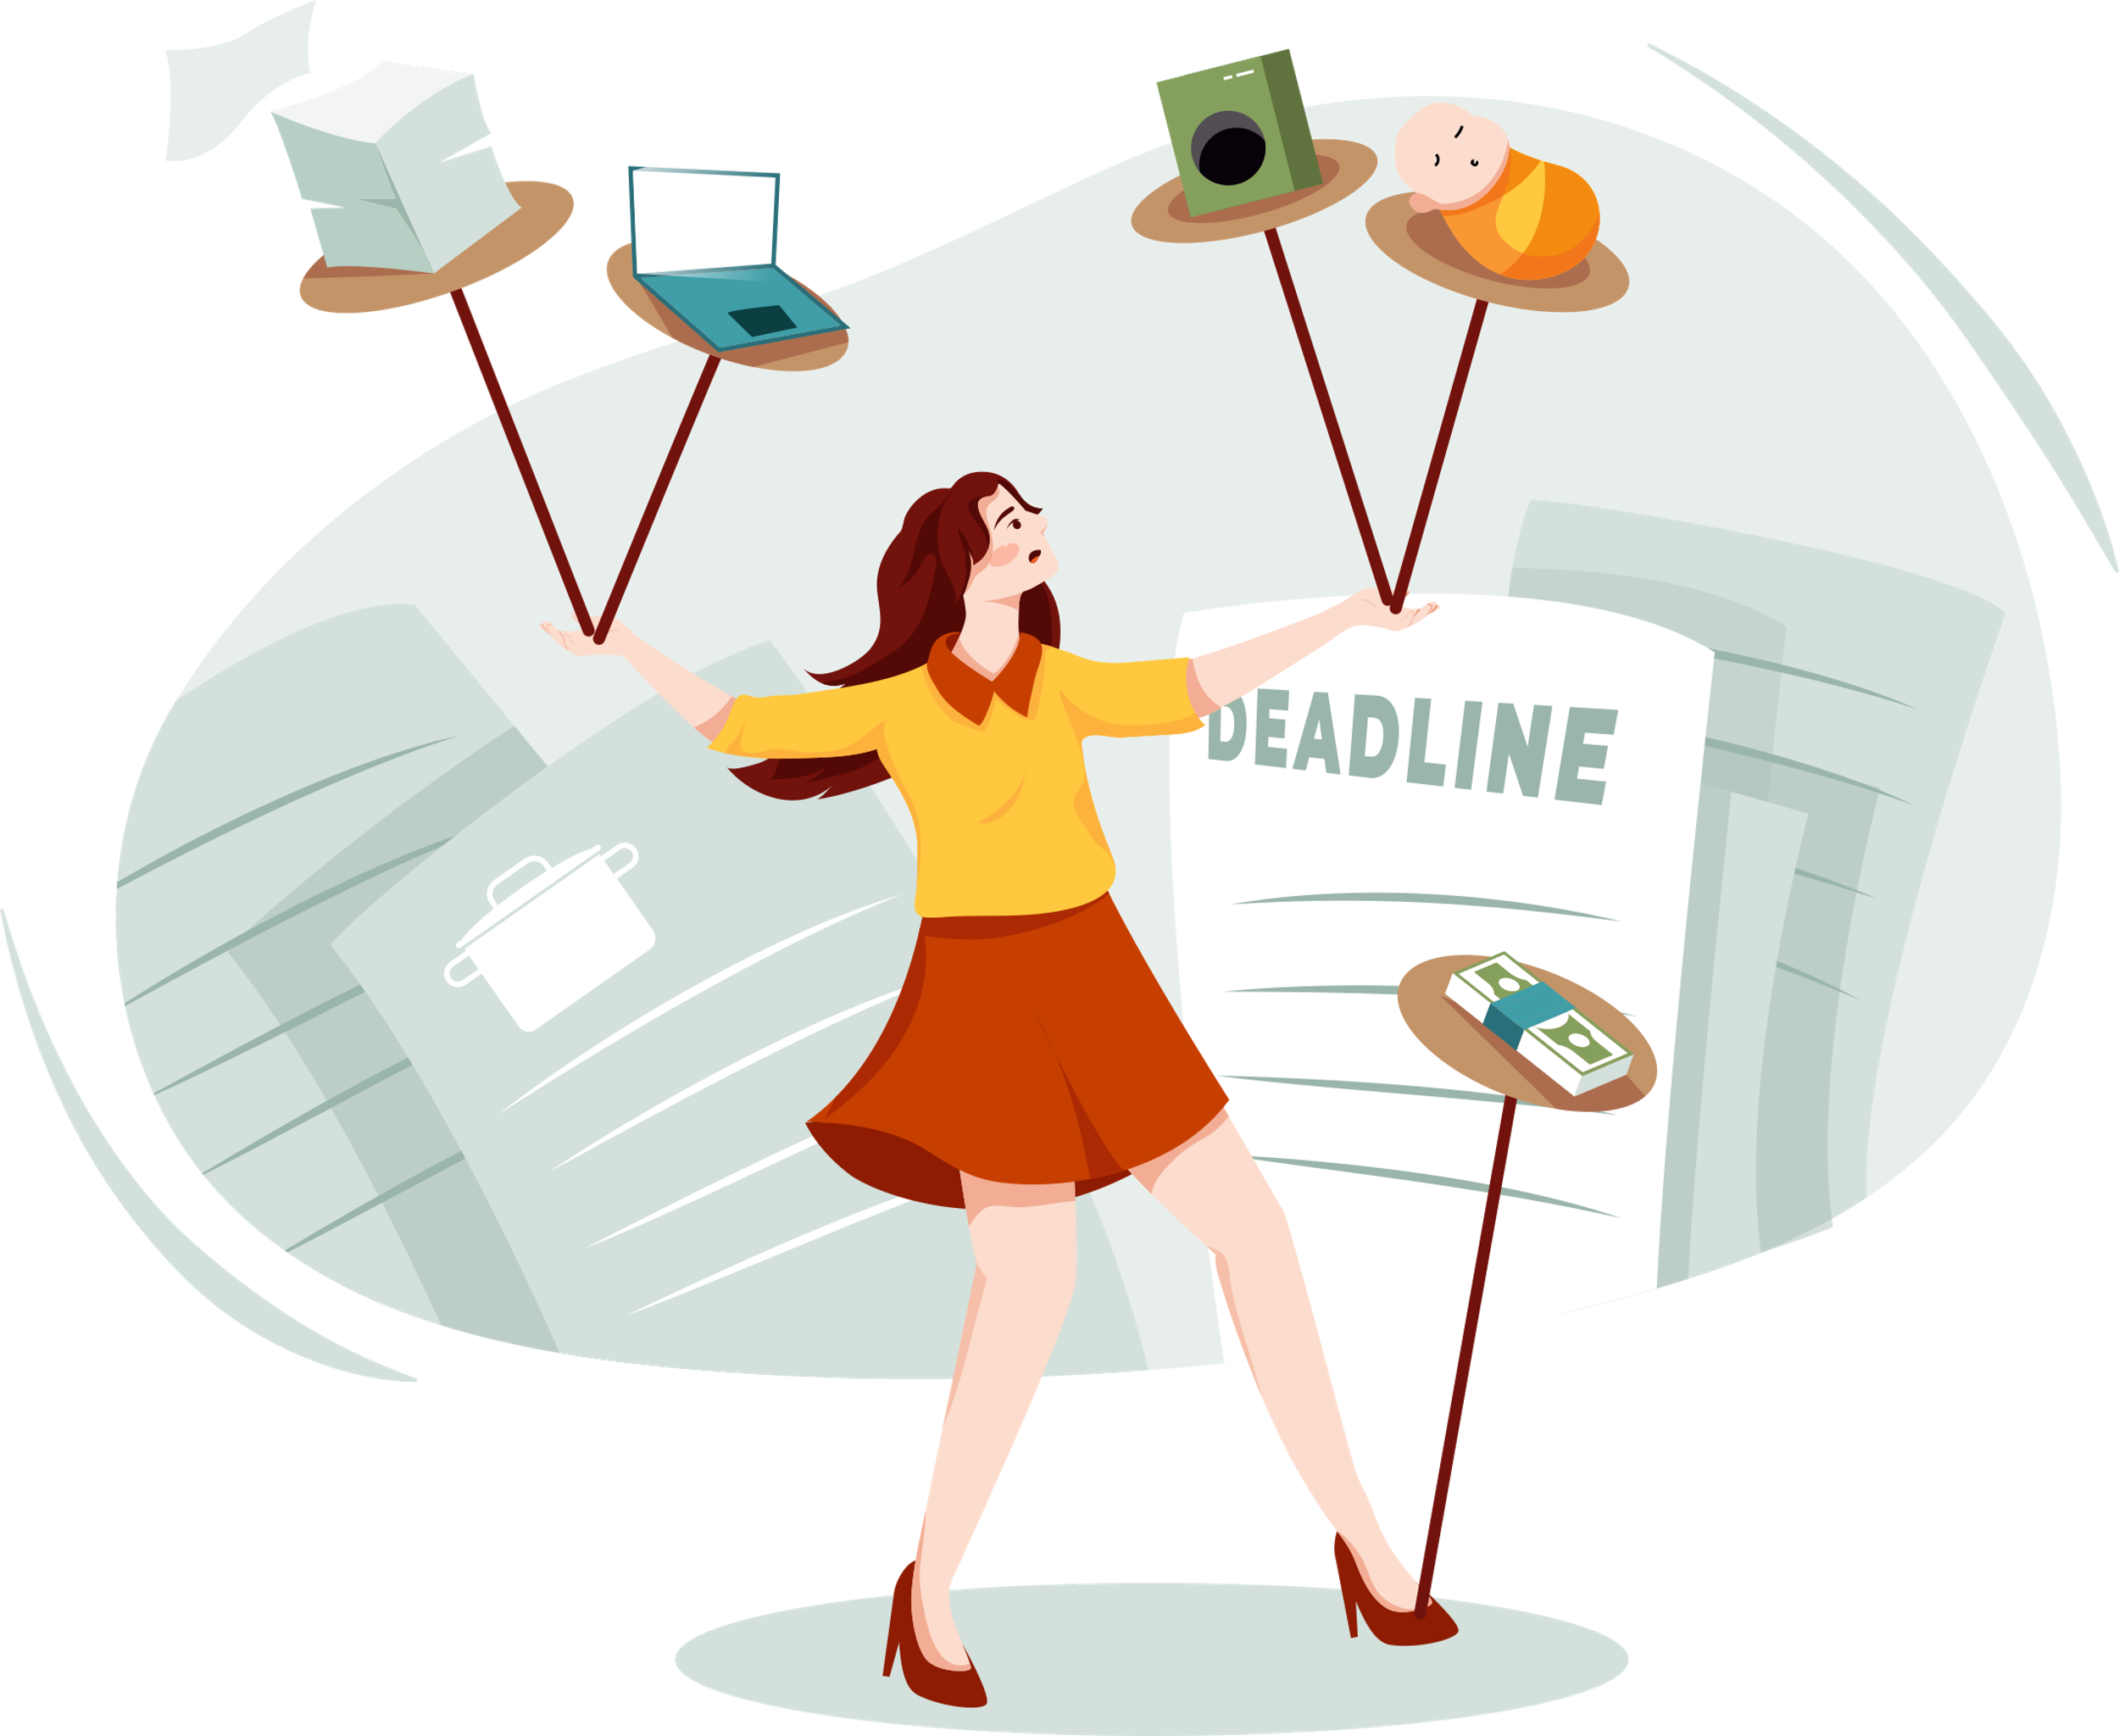

1. Burnout on the upswing for women more than men
Burnout is hitting senior-level women the hardest, with fully 50 percent saying they are burned out
at work. In 2020, a quarter of women in senior leadership roles said they wanted to leave the workforce or downshift their careers.¹
Women are working more. They are working more at home (the “second shift”), and they are doing more work outside their normal hours and formal roles (the new “third shift”) than men.²
It is unsurprising, then, that women in both the
public, social, and
private sectors feel
more burned out
than ever, and
more so than their
male counterparts.¹
COVID-19, working from home only further exacerbated burnout for women, creating significant setback

Slide 6



2. Gaining the right experience is paramount
Right place?²
According to another study (reported in the Wall Street Journal), women were one-third as likely as men “to have been encouraged to consider a P&L role,” and men were “twice as likely to have been promoted or selected for leadership training in the past two years. Nearly half the men reported getting detailed advice at work on how to chart their path to a P&L job, compared with 15% of women surveyed.”¹
  More women have become executives in supportive roles, but their share of jobs with profit-to-loss (P&L) responsibility—considered stepping stones to the CEO—has been flat.
Roles without P&L responsibility
P&L roles
Lack of P&L responsibility is a “knock out” for CEO opportunities

Slide 7
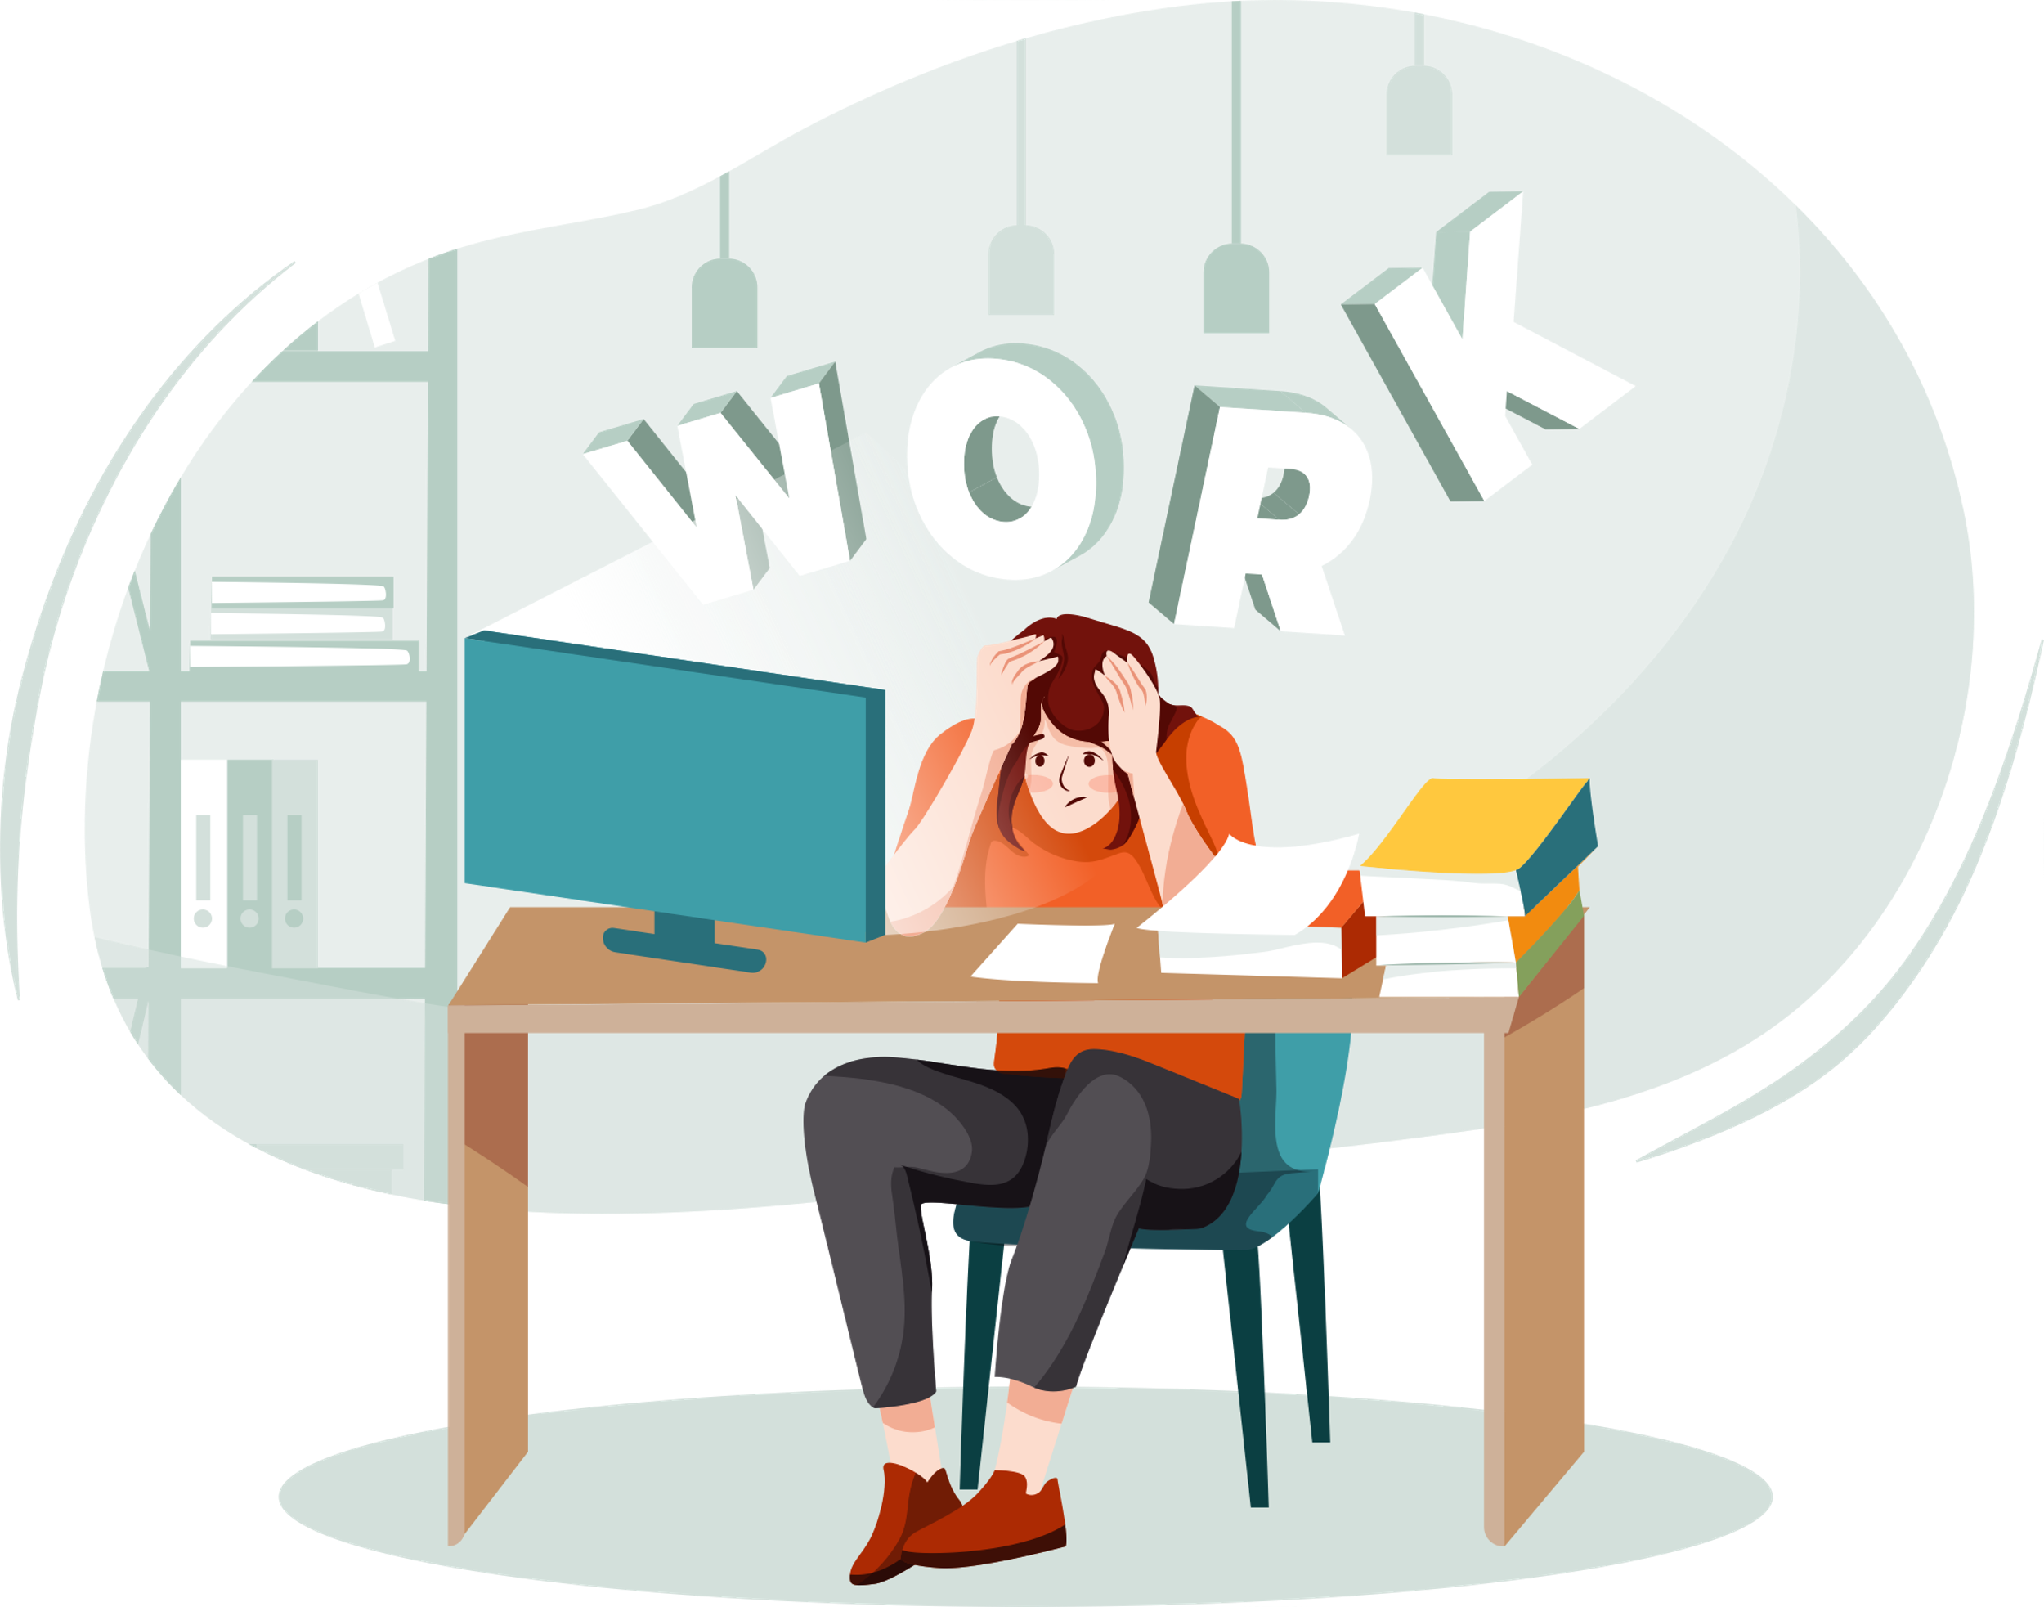
3. Competence in question
Although significant gains have been made over the last five years, women are still significantly underrepresented at all levels of management. On top of this, women continue to have a worse day-to-day experience at work.
Women are more likely than men to have their competence questioned and their authority undermined. Women of color and other women with traditionally marginalized identities are especially likely to face disrespectful and “othering” behavior.¹
  Is it a linguistic style that men equate to competency?
    Girls learn to downplay ways in which one is better than the others and to emphasize ways in which they are all the same. From childhood, most girls learn that sounding too sure of themselves will make them unpopular with their peers—thus girls learn to talk in ways that balance their own needs with those of others.²
  Are women too concerned about “being polite” to speak out? Are they too afraid of being wrong?
  When is it valuable to be a “bitch”?
  Do women self promote? Do women know how? Should we???

Slide 8
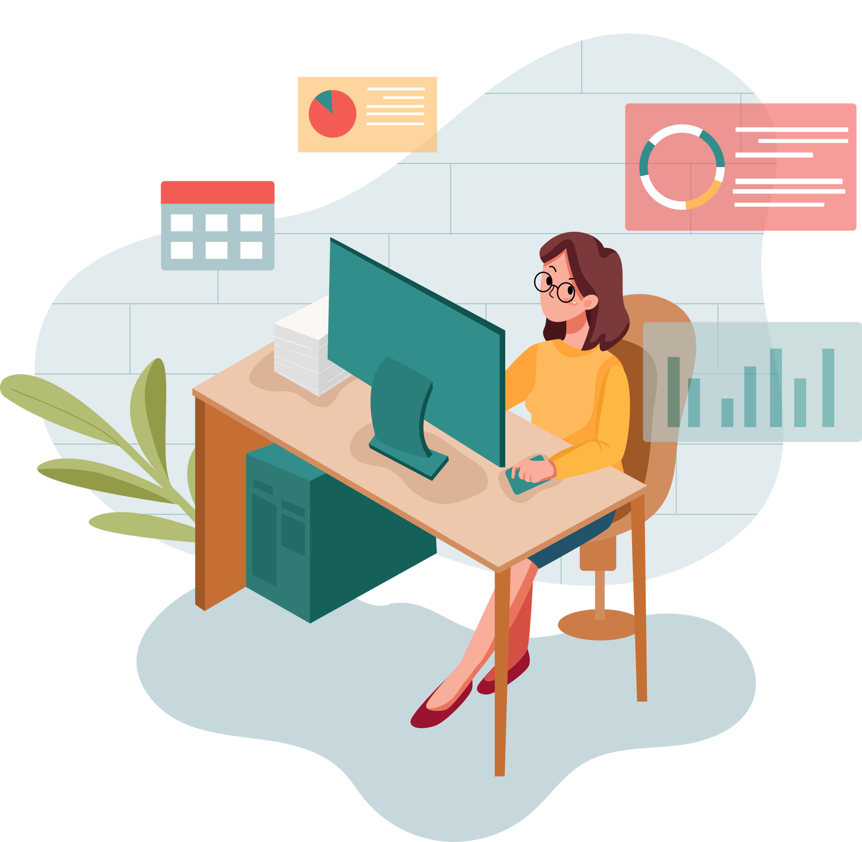
4. Being the “Only”
“Even in 2020, many women in tech still face the very real possibility of being the only woman on their team. And being the only woman on a team full of men can sometimes mean having to fight harder to have your voice heard and ideas honored.”¹
Women who are “Onlys”—meaning, they are often one of the only people of their race or gender in the room at work—have especially difficult day-to-day experiences.
Onlys stand out, and because of that, they tend to be more heavily scrutinized. Their successes and failures are often put under a microscope, and they are more likely to encounter comments and behavior that reduce them to negative stereotypes.²
When they do achieve VP/SVP status, they are more likely to be exited more rapidly than their male counterparts (need to validate)

Slide 9
Our Goal & Approach

Slide 10
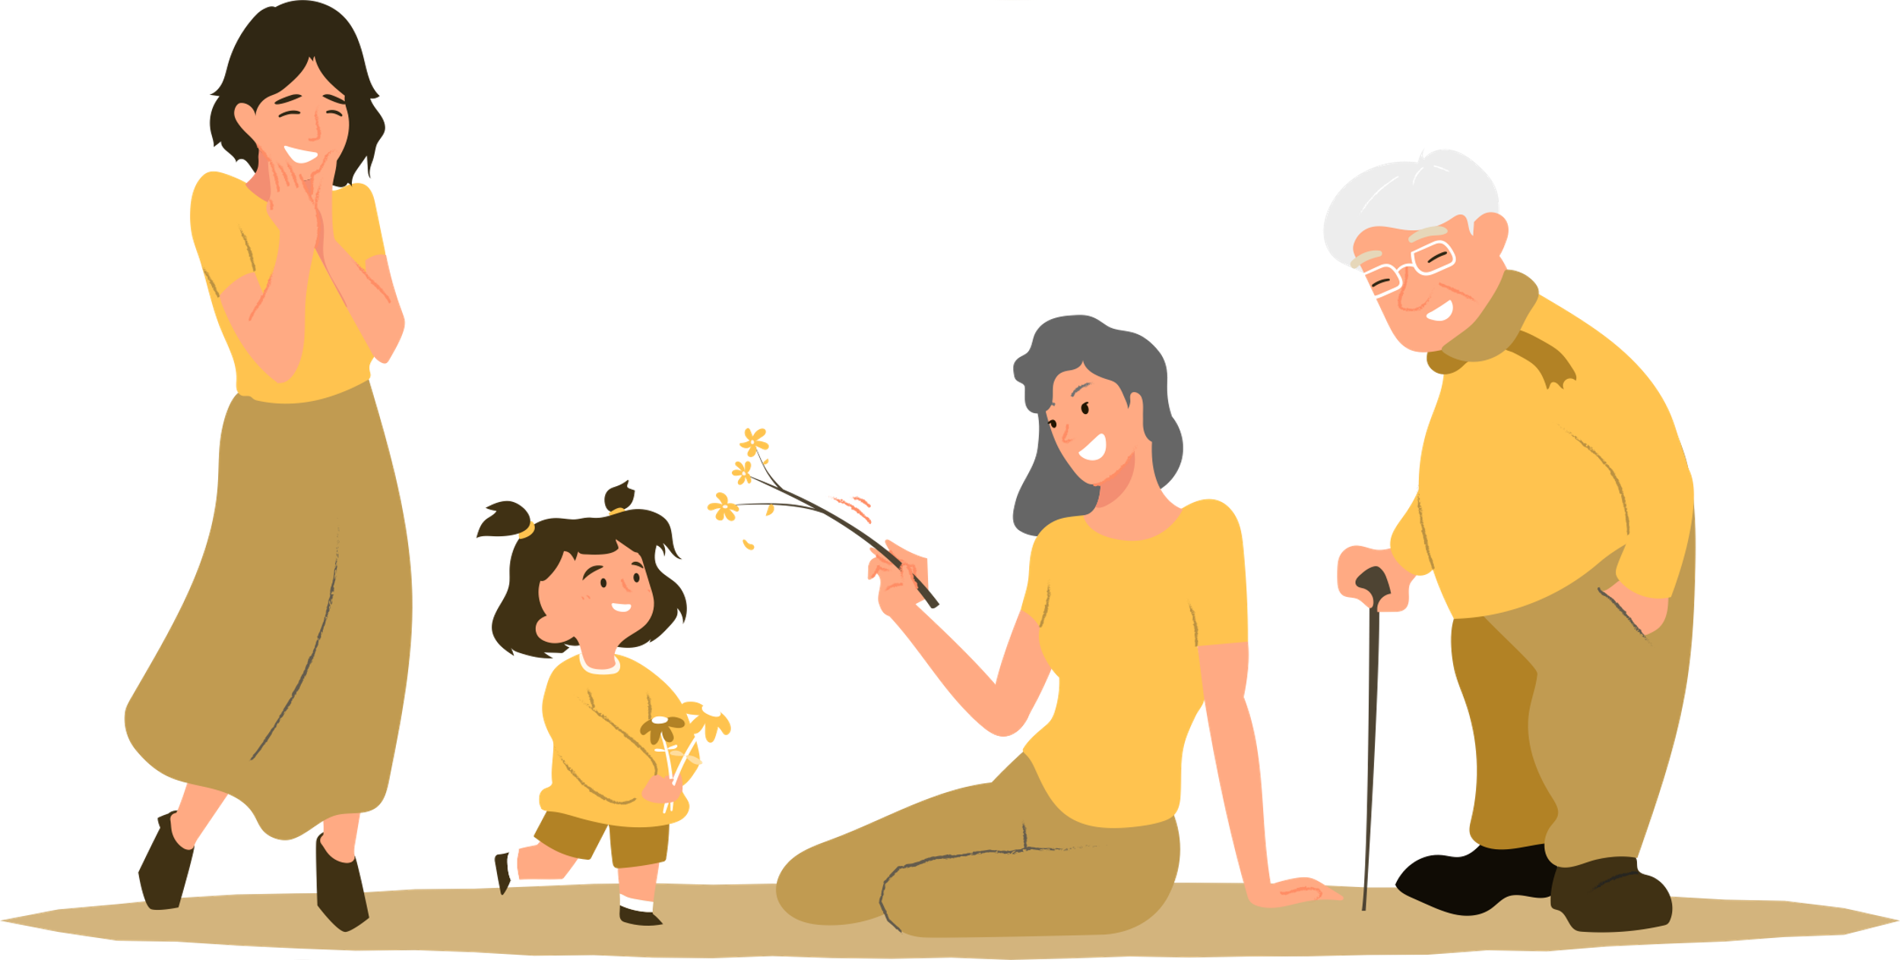
We now have multiple generations of females in the workplace
2021 marks the first time in the US workforce, that we have four generations of women.³
Women lack role models in the workplace, so why not look to home?
  We want uncover through valid research combined with collating courageous, actionable advice from people we know and trust; our grandmothers, mothers and daughters.
  Our project will engage multi-generational families of women to inspire and share meaningful, real-life wisdom, hope, and ultimately, accelerate the gender equity time.
  We will do this by creating the conversation focused on the top barriers that to stand in the way of real progress; burnout, gaining the necessary experiences, unwavering confidence & strength when faced with being “the Only”.

Slide 11
Hypothesis: useful solutions can be unearthed right at home
Create awareness of current timelines (if nothing changes, woman have another 100 years before gender equity) and the 4 major barriers that contribute to this timeline. Spread the word through example that useful solutions can be unearthed right at home through multi-generations of real-world experience, lessons learned and advice.
  Ideal Outcome:
  Generate a collection of stories/advice captured via Podcasts and publications. This will create a viral sensation empowering woman of all generations to accelerate their and others’ careers to significantly condense the “time to gender equity” so that true gender equity will be realized in our daughters’ lifetime.
    Men and woman become aware and outraged of current corporate gender equity timelines and lean in to make a significant difference within their homes, organizations and communities.
    Woman of all ages are armed with the knowledge and tools to break down existing barriers at home and in the corporate world.
    ”Just Ask Her” becomes a statement that has multiple meanings supporting awareness and enhanced gender equity
  Minimum Outcome:
  We inspire women enrolled in the ”Just Ask Her” project such that they will carry the message and drive awareness within their personal sphere of influence
Notes:
By using real women’s stories, we will capture people’s attention because the sentiments will be relatable.

Slide 12
Achievable/ Reasonable OutcomeS
Achievable Outcome
We secure a BOD of successful women committed to the JAH vision and mission
They operate as the nucleus for the project contributing to strategy and execution
Connect personal and professional networks and partnerships to accelerate and strengthen project
Record and publish minimum of 20 (5 per identified barrier) Video Podcasts that generate a meaningful initial followership within first 12 months of project launch
Complete a Series of Focus groups that analyze key findings from Podcasts and generate published whitepapers and PR opportunities
Gain significant followership with a presence on social media platforms such as Twitter, Facebook, and LinkedIn
Implement metrics and milestones that can measure impact of JAH over time
Notes:
Is

Slide 13

Target Audience
  Families of three/four generations of working women
  Will require representation from of multiple industries: Engineers, business/finance, life sciences, law, & entrepreneurial
  Easiest to find multigenerational families by targeting working women 25-30 who’s mother (possibly grandmother) are still actively working (easiest to find through social media)
How best to engage?
  Discussion guide for consistency
  Zoom and in person (in person ideal)
  Retreat environment for Focus Groups
  Video Podcasts
    Generate snackable videos from recordings for viral uptake
Leverage Social Media
  Create presence and share content social media platforms
  Release series of interviews and key soundbites with consistent cadence

Slide 14





Asprirational “partners” for publications or sponsorship
Top 15 Online Women's Business Magazines & Publications
Professional Woman’s Magazine | The Working Woman’s Magazine
Lioness Magazine | For The Female Entrepreneur
Diversity Woman Media
THE BUSINESS MAGAZINE FOR WOMEN
Women Entrepreneur Magazine
Bizwomen | The Business Journal
Global Woman Magazine
HER Magazine | Women's Business Magazine

Slide 15
First things first…
  Trademark (submitted for approval 9/22)
  Secure Social Media Platforms: LinkedIn, Facebook, Twitter Handle
    JustAskHer.org secured 9/22
Sept ‘22
  Hold “Ideation” Virtual Focus Group” (✓)
    Solidify Vision, Mission and Goals (✓)
    Build out high level strategy and tactical plan
    Gain commitment
    Generate initial target list and strategy to identify and secure
  Identify BOD to guide and invest in JAH project
  Develop a series of discussion guides for each Barrier
  Social Media, Publication and Communication Strategy & Plan
  Develop Comprehensive Launch plan with Timeline and Milestones
  March ‘23
  “Just Ask Her” Generational Pilot Conversations

Slide 16
March – JuLy ’23 Pilot Phase
1. Branding & Marketing Campaign Jan-Feb
  JAH Brand Identity workshop (✓)
  Positioning, Messaging and Creative Concepting (✓)
  Competitive Landscape Assessment
  JAH Brand Logo
  2. Secure Trademark & URL (✓) October ‘22
  3. Legal Consultation
  Consent Forms
  Non-Compete & NDA
  3. Complete 3 Sessions Focused On Competence in Question June/Jul
  (Finding your voice, Imposter Syndrome, Finance Experience)
  Discussion Guide
  Identify Pilot Group
  Determine video capabilities ( ask Zack )
  Set Dates/Venue & Confirm Participants for 3 sessions
  Share w/ BOD and Advisors
  Funding??
  Executive Summary of Amazing Discussions

Slide 17
Aug – Dec ’23 Vision becomes Reality
1. Conduct 9 additional sessions Aug-Oct
  August: 3 sessions on “Burn Out”
  September: 3 Sessions on “ The Only”
  October: 3 Sessions on “ Career Path& The right Experiences”
2. Create executive Summary for each of the 4 Barriers/12 Interviews Nov
3. Retreat to share exec summary & planning Dec
3. Determine Social Media Plan Dec
4. Create Website to House content and Network w/ Interviewees Dec

Slide 18
Pilot Discussion: Competence in Questions
Discussion Framework:
Introductions & Consent
-need a legal consent document
-Define JAH Project, Rationale and Goals
-Share “ Competence In Question” Concept
  Is it a linguistic style that men equate to competency?
    Girls learn to downplay ways in which one is better than the others and to emphasize ways in which they are all the same. From childhood, most girls learn that sounding too sure of themselves will make them unpopular with their peers—thus girls learn to talk in ways that balance their own needs with those of others.²
  Are women too concerned about “being polite” to speak out? Are they too afraid of being wrong?
  When is it valuable to be a “bitch”?
  Do women self promote? Do women know how? Should we?
Key Questions:
Do you or have you ever experienced this?
What have you learned? Do you have any stories or “ best practices” on how you have handled or over come this and what were the results?
What advise would you give other women and men?
Any “game changing” tools, resources or tips & tricks you would recommend?
What can you do to make a difference?

Slide 19
JAH Advisors/Mentors/network
Mary Pietryga
Erin Slattery
Mackenzie
Edelyne, Danielle, Linda, Eder, Kayla, Julia
Day & Ashley
Quita ?
Ayana ?
Kathi, Mary and Kara

Slide 20
      Branding Ideation

Slide 21
the JAH positioning statement
TARGET AUDIENCE | Families of three/four generations of working women Representation from of multiple industries Working women 25-30 who’s mother (possibly grandmother) are still actively working (easiest to find through social media)
BRAND | A collection of courageous, actionable stories/advice captured via Podcasts and publications. Designed to create a viral sensation empowering woman of all generations to accelerate their and others’ careers. This work will be designed to significantly condense the “time to gender equity” so that true gender equity will be realized in our daughters’ lifetime.
CATEGORY | Self-Help/Activism
POINT OF DIFFERENCE | For the first time, creating a body of work to uncover how multi generational women within their own family can support each other on the crusade to improve gender equity in the United States
END BENEFIT | to capture the hearts and minds of the general public that will spark action in a meaningful/ sustainable manner that rapidly improves gender equity
REASON TO BELIEVE | By using real women’s stories, we will capture people’s attention because the sentiments will be relatable and actionable

Slide 22
What, Who and Why?
”Just Ask Her” is a movement driven by a group of motivated, strong women who are committed to the advancement of gender equity in the workplace
Their goal is to create awareness of current timelines (if nothing changes, woman have another 100 years before gender equity is achieved in the United States) and the 4 major barriers that contribute to this timeline.
Driven by viral marketing to share useful solutions that were unearthed right at home through multi-generations of real-world experience, lessons learned and advice from the people we trust the most.
A collection of courageous, actionable stories will be captured via Podcasts and publications. Designed to create a viral sensation empowering woman of all generations to accelerate their and others’ careers to significantly condense the “time to gender equity” so that true gender equity will be realized in our daughters’ lifetime.

Slide 23
WHY—the JAH brand vision
”Just Ask Her” ignites meaningful conversations and positive change driving accelerated progress towards enhanced gender equity in the U.S.

Slide 24
The JAH brand identity expression
Inspirational
Each Other
Courageous
Being Ethical
Equal Opportunity
Aspirational
Achieving true gender equity, now
Personal Choice
Purposeful
Collaboration
Authentic
Individuality
Daring

Slide 25
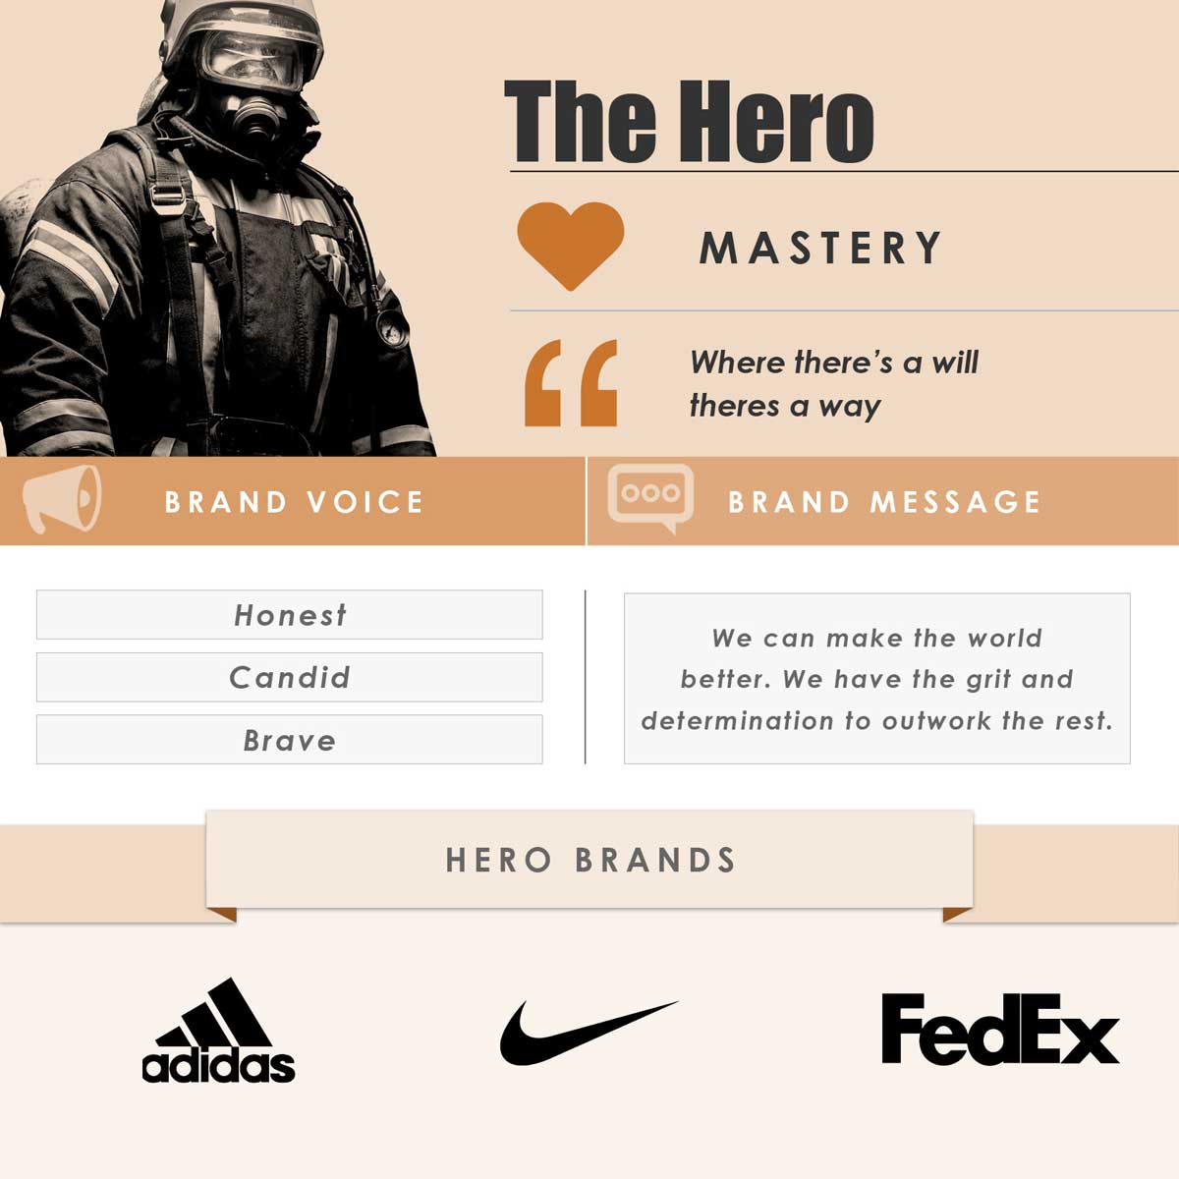
The Hero Personality
The Hero’s main motivation is to prove their worth through courage and determination.
They work hard in order to have the skills they deem requirements and take pride that their work rate sets them apart from the rest.
They need to meet challenges head-on and carry defeats or failures until they are corrected.
The Hero wants to save the day to prove their worth to themselves but also so the world knows of their ability.

Slide 26
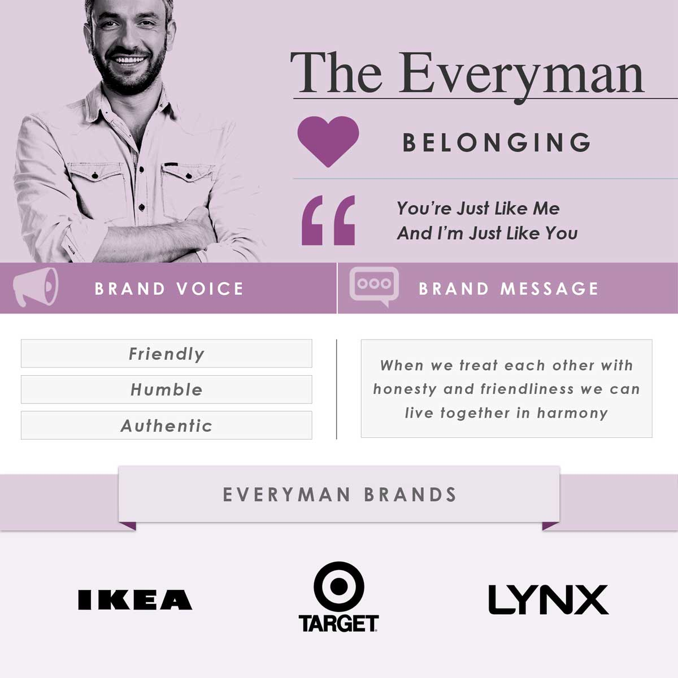
The Everyman Personality
The Everyman above all wants simply to belong. They tend to blend into society as ‘everybody” and don’t like to stand out in the crowd. They’re friendly and easy to talk without being overly funny or overly rude or overly loud.
They lend their trust easily though they fear being rejected. They are relatively positive and strive to fit into the group. They tend to have a liking for most things without being overly passionate about one. The Everyman can be quite liked but can also be easily forgotten.

Slide 27
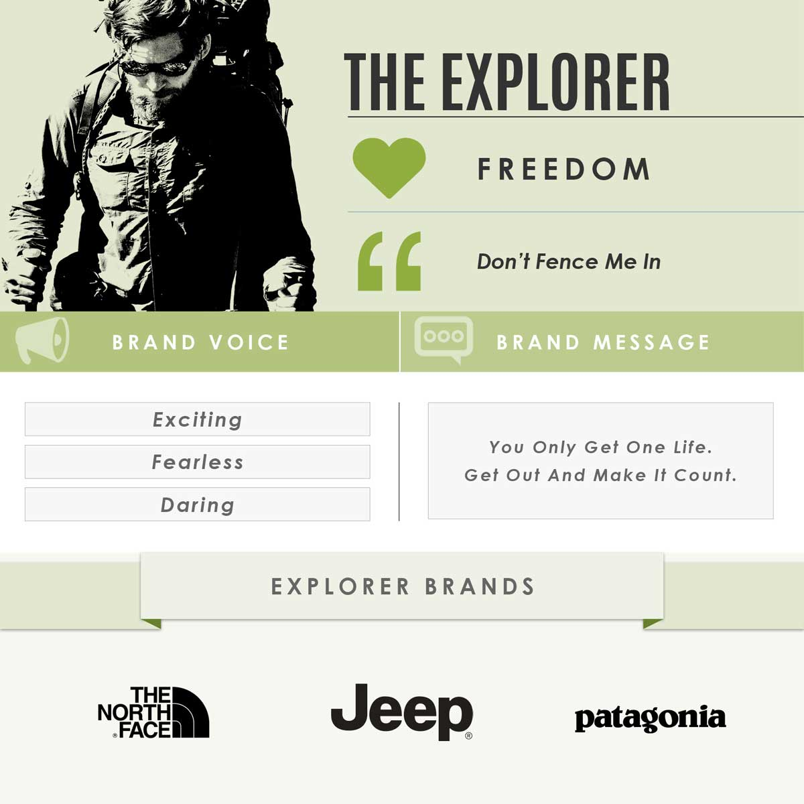
The Explorer Personality
The explorer has a palpable inner drive to push themselves outside their comfort and conformity of everyday life; into the rugged environment they feel at home in. They are brave, adventurous and love a challenge. The challenges are more about understanding themselves more than proving to others and they are on an everlasting journey of discovery.

