Slide 1




Pre-Validated Packaging
PACKAGING

Slide 2
What is required of a fully Validated Sterile Barrier Packaging System?
Package Design
Microbial Barrier properties
Sterilization compatibility
Process Validation
Develop Sealing Parameters
Sealer IQ, OQ and PQ
Package Performance Transit Testing
Environmental Conditioning
Box: shelf and shipping carton (protective packaging)
Distribution Simulation
Aging (accelerated & real time)
Aseptic presentation
Biocompatibility/toxicity attributes
Compatibility of device and package materials
Compatibility with labeling
Which of these benchmarks can be Pre-Validated?

Slide 3

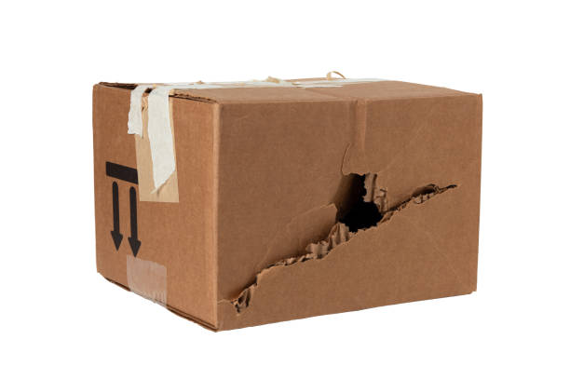
What’s available currently on the “Pre-Validated” market?
Generic sterile barrier systems
Accelerated aging
Compatible with various sterilization modalities.
Sealer Validations
Packaging Materials in stock

Slide 4

Pre-Validated really means “partially validated”.
What is still required?
Distribution testing
  Environmental conditioning
  Distribution simulation
  Sterile barrier testing
Sterilization validation
Device-specific requirements:
  Accelerated aging
  Real-time aging
  Label design
Missing critical components of a ‘World-Class’ packaging system:
  Label abrasion test
  Human factors testing
  Documentation of process risk assessment
  Preconfigured shipping carton
  Submission-ready data set

Slide 5
How is the timeline affected?
Traditional Packaging Validations take 26 – 30 weeks to complete
Package Design
Sterile barrier
Packaging System
Process Validation
Sealer settings
OQ, PQ
Stability Studies
Real time aging
Labeling
Distribution Studies
Environmental conditioning
Transit simulation
✓Pre-Validated
✓Pre-Validated
Currently available Pre-Validated packaging eliminates 10 to 12 of those weeks

Slide 6
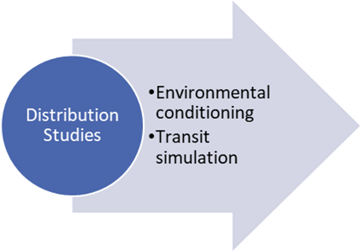
Potential Failures
Packages can fail in a variety of ways
Product Damage
Puncture
Void
Creep

Slide 7
Cautionary Advice
Consider packaging EARLY in product development
Concurrent packaging validation and sterilization validation has risk
Package too large – allows too much movement, pouch material folds are asking for sterile breach (pin holes)
Aging studies: With or without product? Air is easy to validate, but what about product interactions and affects of geometries? World Class studies include the device.

Slide 8

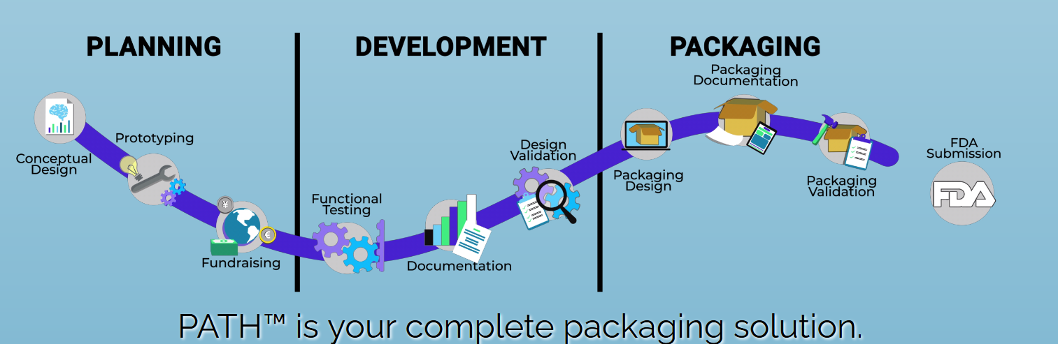
Let us introduce you to an alternative PATH

Slide 9
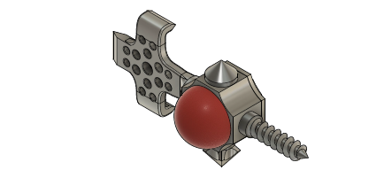
The PATH Difference
A Worst Case Proxy Device & More…
ISO 11607-1:2019 Speaks to a “Worst-Case”.
Its built into the PATH Program
Has something for everyone (plate, screw, trocar, etc.)
PATH provides a worst case proxy device to create an Engineering rationale for adoption.
Built With:
Co-Cr
Titanium
Tantalum
UHMW PE
PEEK
Additive simulation

Slide 10

The PATH Level OF ACCELERATION
PATH Submission
Finish
Pkg Design
Double sterile barrier system
Box and labeling (Protective packaging)
Process Validation
Sealer settings validated
IQ, OQ, PQ for sealer equipment
Distribution & Aging testing
Environmental Conditioning & Distribution Simulation
Accelerated (Proxy device)
Product Rationale
Create Engineering rationale for product adoption against proxy device
Use provided drop and vibration testing results from actual device to provide additional data.
Qualified Supplier (inventory in stock)
Human Factors
Human Factors/Aseptic Presentation Study
OEM responsibility
Label abrasion test
Process risk failure mode analysis
Adds 10 – 12 weeks
Std. “Pre-Validated”
Submission
Finish

Slide 11
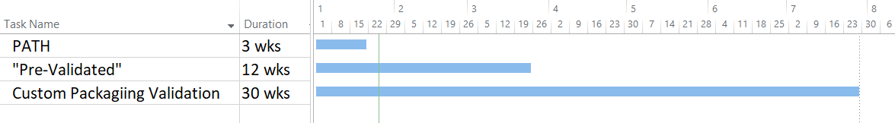
Time to submission-ready document set

Slide 12
How is the timeline compressed?
Traditional Packaging Validations take 26 – 30 weeks to complete
Custom Package Design
Sterile barrier
Packaging System
Process Validation
Sealer settings
OQ, PQ
Distribution Testing
Environmental Conditioning
Distribution Simulation
Labeling
Aging Studies
Accelerated
Real Time
✓True-Validated
✓True-Validated
✓True-Validated
✓True-Validated
True-Validated packaging is completely validated including distribution and aging studies. The only remaining task is to write the adoption rationale and submit to the FDA

Slide 13
What data is provided with PATH?
Data Package to complete adoption rationale:
  Package design data (material specs, biocompatibility)
  Label formats
  Proxy Representative Device worst-case characteristics
  Sample size rationale
  Sealing Process PFMEA (with FDA Masterfile Reference included)
  Distribution Simulation Protocol/Report of test results
  Defined shipper configuration of 4-up carton
  Accelerated Aging test results
  Aseptic Presentation/Human factors test results
  Real device - drop and vibration test results
  Rationale guidance document

Slide 14

The PATH To…
Lightspeed
Eagle Medical has created an alliance partnership with eQMS superstars Greenlight Guru.
By providing a world-class Quality Management System at the front end, and a True-Validated packaging system on the back end, the PATH to market suddenly happens at LIGHTSPEED!

