Slide 1


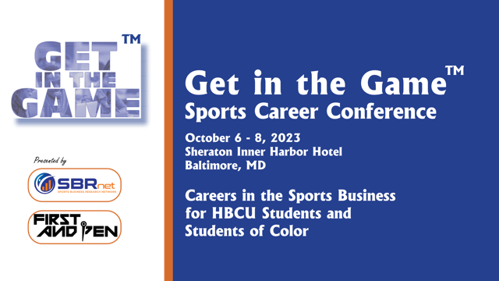

Get in the Game
Sports Career Conference
Baltimore, MD
October 2023
Careers in the sports business for students at HBCUs
Notes:
"Careers in Sports Business for HBCU Students and Students of Color"

Slide 2
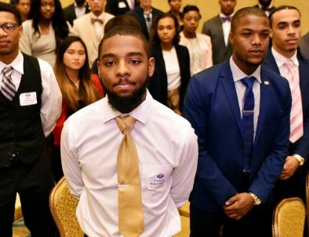
What Is
Get In The Game?
Get In The Game is a three-day event in October 6-8, 2023 that provides HBCU students and college students of color with opportunities to learn more about the business of sports.
The sports industry is one of the most competitive industries around, yet many don’t truly understand the business of sports the vast amount of opportunities, or what to do to make it happen.
WE AIM TO CHANGE THAT

Slide 3
Why Get In The Game?
Get In the Game creates a unique experience for students to learn about the sports business through:
  Brand & Retailer Keynotes and Case Studies
  Panel discussions with Industry Professionals
  Interactive Workshops
  Networking and More
Get In The Game enables companies to connect with students:
  Educate them about your company and employment opportunities
  Recruit and build a candidate pipeline
  Teach students about operations, process, strategic planning marketing, sales, finance

Slide 4

October 6 – 8, 2023
Sheraton Inner Harbor, Baltimore, MD
Baltimore is an ideal location to reach HBCU students as it is surrounded by a number of HBCU institutions:
  Bowie State
  Morgan State
  Coppin State
  Maryland Eastern Shore
  Howard University
And with the success of the 2022 CIAA Tournament, and its proximity to Philadelphia, Washington DC and Virginia, Baltimore is a perfect destination for HBCU students and students of color who want to Get In The Game!

Slide 5

October 6 – 8, 2023
Sheraton Inner Harbor, Baltimore, MD

Slide 6
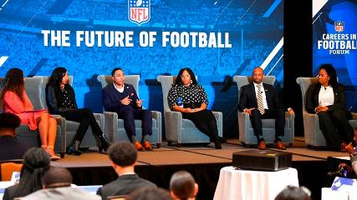
What is Get in The Game
Keynote Sessions with Industry Leaders
Breakout Sessions and Workshops
  How to create an effective resume
  Interview skills and career development
  Case studies (brand and product development, launching a sports program and more)
Individual meetings between companies and students
Stadium and venue visits
Networking and social events

Slide 7
Sponsor Activations & Partnership Opportunities
  Title and Presentation Sponsorships
  Pre-and post event promotion
  Individual event/panel sponsorship
  Conference Participation (panelists, keynote speakers)
  Hospitality Suites for networking and meetings
  Meal and Networking Breaks
  Resume Database Access
  On-Site marketing and promotion
  Inclusion in registration bags
  Media across First and Pen & SBRnet
  Registration scholarships and more

Slide 8


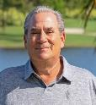
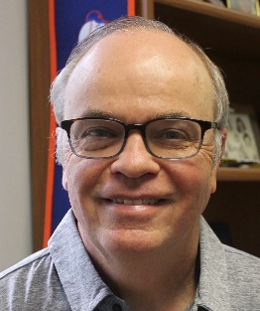

Connected to the College and University Community
Comprehensive online platform of nationwide sports marketing analytics, using syndicated and custom proprietary research for the professional and college sports, consumer research, industry reports, and licensed industry articles.
Extensive research and custom reports covering sports participation, the fan market and behaviors, venues, sponsorships, and expenditure on sporting goods, brand preference and more.
Neil Schwartz has more than 25 years of marketing & consumer research experience in the sports, fitness and active lifestyle categories. He has worked for SportScan from SportsOneSource in addition to heading the research team at the Sports & Fitness Industry Assoc. (SFIA) Neil has been a featured speaker at many industry conferences and events. He is also well respected for his work with leading financial and investment firms and top brands in the sports footwear and apparel
SBRnet has prioritized the ability to share industry knowledge with students & young professionals. The My First Job Web and Podcast provides guidance for students to a career in sports. Professionals share how they broke into the business and what they wish they knew while they were in college. This podcast and web series aims to provide inspiration and education.
Mark Sullivan is a former editor and publisher in sports business and one of the founders of The Running Event, the largest B2B conference and trade show in the world for running. He sold The Running Event in 2018 and is now an adjunct professor of sports marketing at Montclair State University.
Notes:
I am your host, Neil Schwartz, President and Chief Data Officer. 26 years of market research

Slide 9

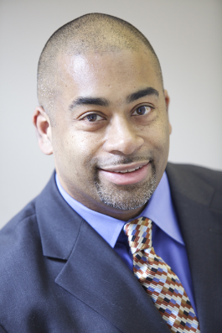
“First And Pen” is the sports media vertical from The Khanate Group; a media, tech, and eCommerce company fully committed to supporting and investing in underserved and overlooked communities, individuals, and voices of color.
Our Mission: “To inform, inspire and connect audiences through voices of color in sports.”
Yussuf Khan has over two decades of experience in the fields of sports and multicultural media. After beginning his career at ESPN, he invested the last 18 years of his career in start-up ventures, building a successful track record at companies such as CSTV (now CBS Sports Network), Interactive One (now Urban One), Big Lead Sports and The Shadow League. His latest start up venture is founding digital sports media publisher, First and Pen. The media veteran has a unique and diverse career path with a long history in the fields of multimedia sales, marketing, communications, journalism, and content creation.
His love for the industry fueled his desire to teach and help cultivate the next generation of media talent, so he moved into the classroom. He is currently an adjunct professor of sports marketing, management and communications at LIU, Rider University and Union College (NJ). He was recently nominated for an Excellence in Teaching Award for his work at Union College.
His belief in giving back extends to community service. He has been a team leader at the annual New York Cares Clean Up Day for over two decades. In 2019 he was awarded with the Community Service Award by the Bronx Borough President’s Office for his efforts in, and service to, the borough.

Slide 10


FOR MORE INFORMATION
SBRnet, Inc
mark@sbrnet.com
646-319-7878
First & Pen
yussuf@thekhanategroup.com
917-754-0928
Notes:
Thanks everyone

