Slide 1





CREATIVE ATTENTION PREDICTION
Dragonfly AI uses cutting-edge neuroscience to instantly predict what your audience sees during the first few critical seconds of the customer journey.
This instant insight helps us optimise the performance of content across any channel.
DEC 22 PERFORMANCE REPORT FOR

Slide 2
QUICK GUIDE TO STUDIO METRIC LAYERS
Dragonfly AI’s indices predict attention using a combination of heatmaps and metric scores commuting these to Probability of Perception (POP) score. Dragonfly AI has identified that the human brain can contend with 5 items of content in the initial instance, the platform scores content regions and identifies the content engagement sequence.
There is also evidence that when the range of scores between highest and lowest regions of information are relatively narrow the content produces better engagement. High scores over important content are good (75+); low scores over important content (50 or less) mean that the content is likely to be missed.
Natural attention regions (how the brain articulates the content into areas of interest)
POP Scores (predicted % of audience attention for each region)
Gaze path sequence (the order in which the brain sees the regions)
Overall clarity score (how well is this content performing in terms of clarity and digestibility)
Notes:
MB

Slide 3


1. ORIGINAL VERSION A
2. BASIC HEATMAP
LOW
SALIENCY
HIGH
SALIENCY

Slide 4
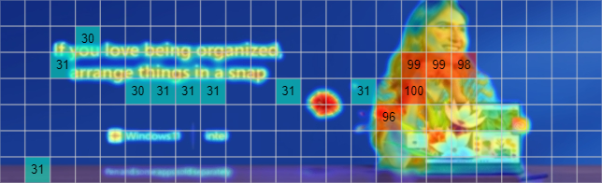
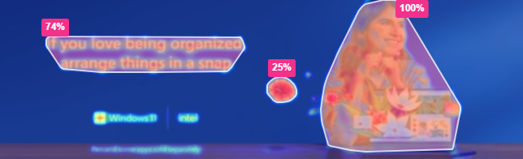
3. GRID MAP
4. HOTSPOTS MAP
LOW
SALIENCY
HIGH
SALIENCY

Slide 5
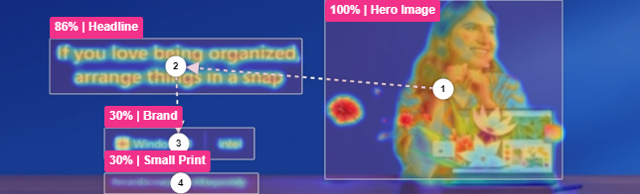
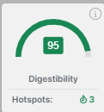
STUDY: AREAS OF INTEREST
HERO IMAGE 100%
HEADLINE 86%
BRAND 30%
SMALL PRINT 30%
STUDY: VERSION A
High overall digestibility of the ad concept 95% POP with 3 primary regions
Most key elements are identified as Hotspots, other brand logos and small print.

Slide 6

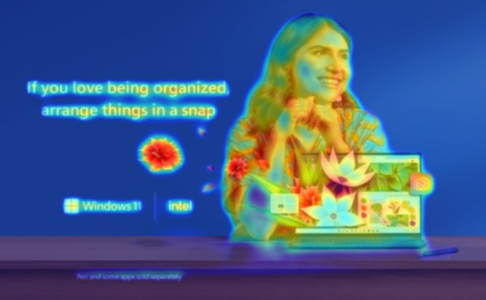
1. ORIGINAL VERSION B
2. BASIC HEATMAP
LOW
SALIENCY
HIGH
SALIENCY

Slide 7

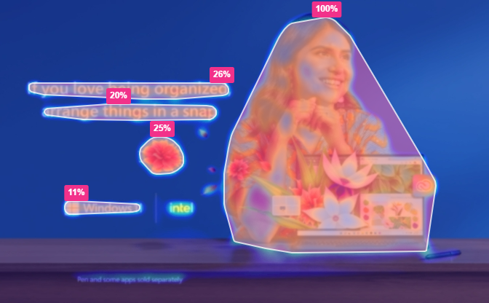
3. GRID MAP
4. HOTSPOTS MAP
LOW
SALIENCY
HIGH
SALIENCY

Slide 8
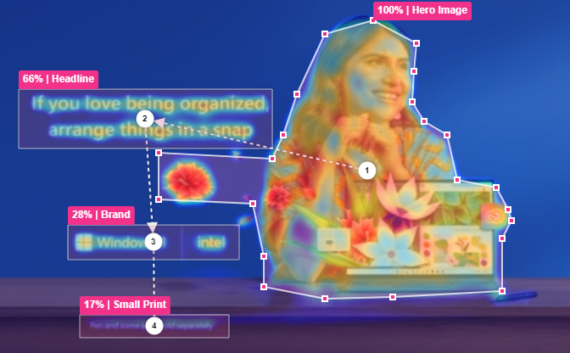
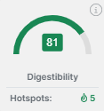
STUDY: AREAS OF INTEREST
HERO IMAGE 100%
HEADLINE 66%
BRAND 28%
SMALL PRINT 17%
STUDY: VERSION B
High overall digestibility of the ad concept 81% POP with 5 primary regions
All elements other than the Intel logo were identified as hotspot regions, windows logo is scoring low at 11% POP

Slide 9


1. ORIGINAL VERSION C
2. BASIC HEATMAP
LOW
SALIENCY
HIGH
SALIENCY

Slide 10
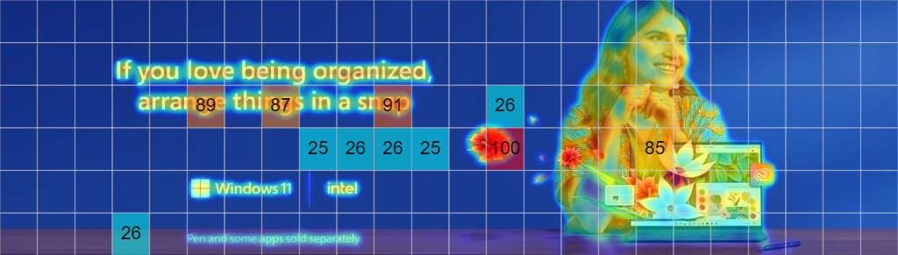

3. GRID MAP
4. HOTSPOTS MAP
LOW
SALIENCY
HIGH
SALIENCY

Slide 11
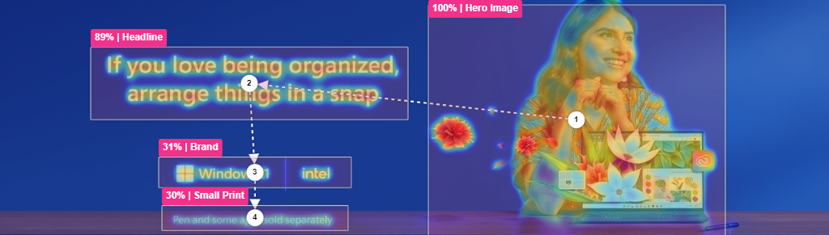
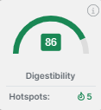
STUDY: AREAS OF INTEREST
HERO IMAGE 100%
HEADLINE 89%
BRAND 31%
SMALL PRINT 30%
STUDY: VERSION C
High overall digestibility of the ad concept 86% POP with 5 primary regions.
All elements other than the Intel logo were identified as hotspot regions with the windows logo achieving inly 15% POP.

Slide 12

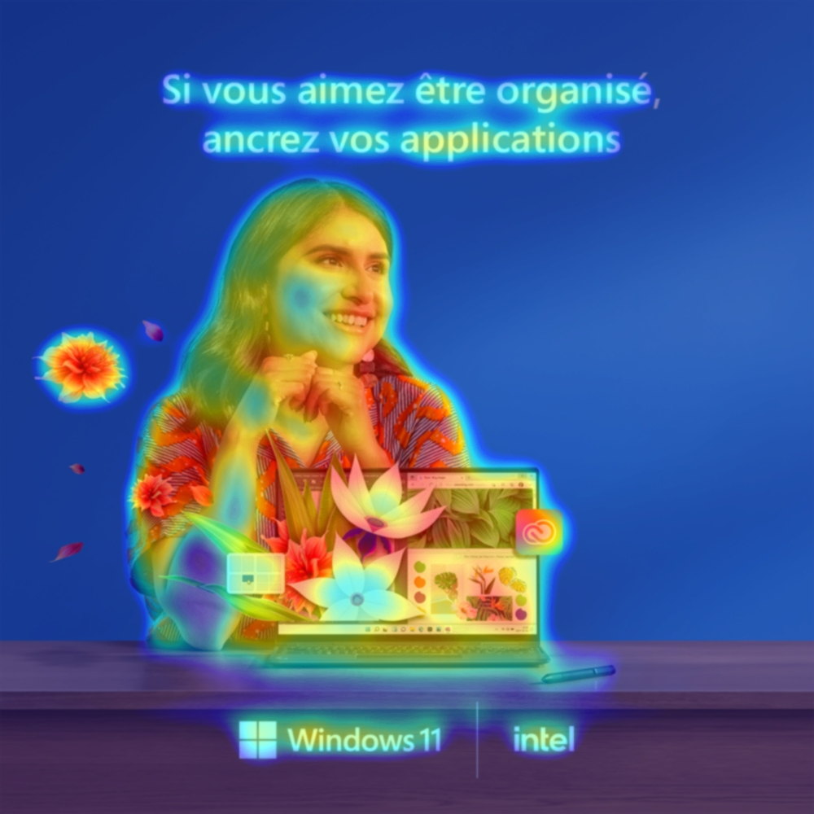
1. ORIGINAL VERSION D
2. BASIC HEATMAP
LOW
SALIENCY
HIGH
SALIENCY

Slide 13


3. GRID MAP
4. HOTSPOTS MAP
LOW
SALIENCY
HIGH
SALIENCY

Slide 14
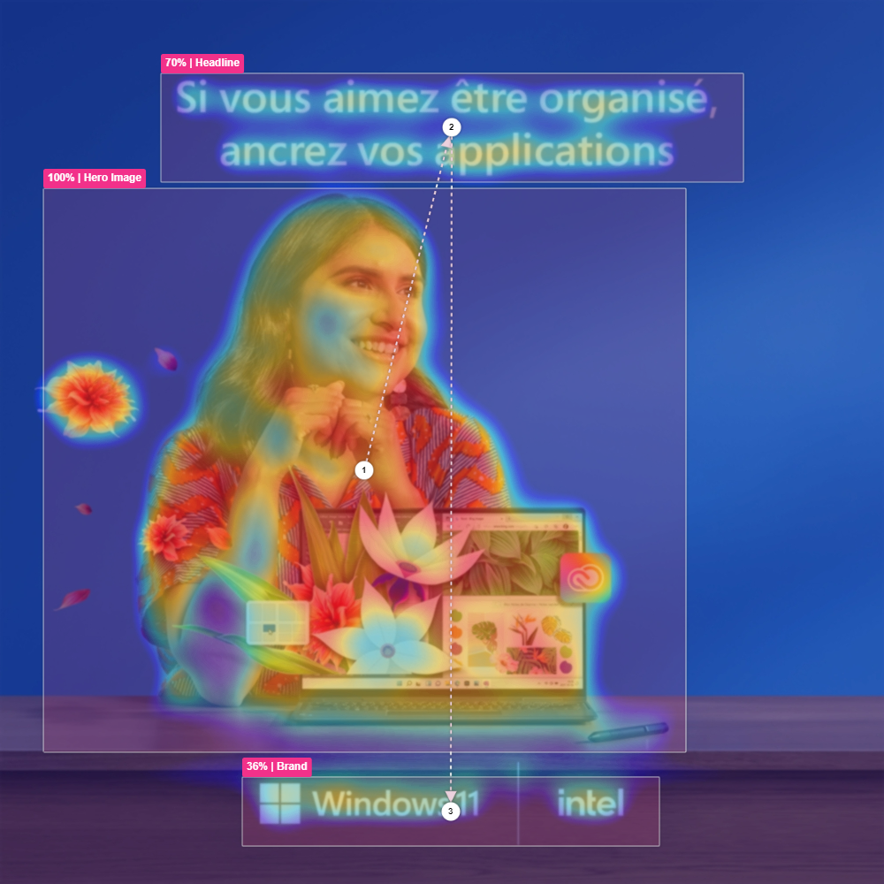
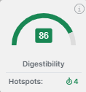
STUDY: AREAS OF INTEREST
POP IMAGE 100%
POP HEADLINE 70%
POP BRAND 36%
STUDY: Version D
High overall digestibility of the ad concept 86% POP with 4 primary regions.
All key elements other than the Intel logo were identified as a Hotspot.

