Slide 2

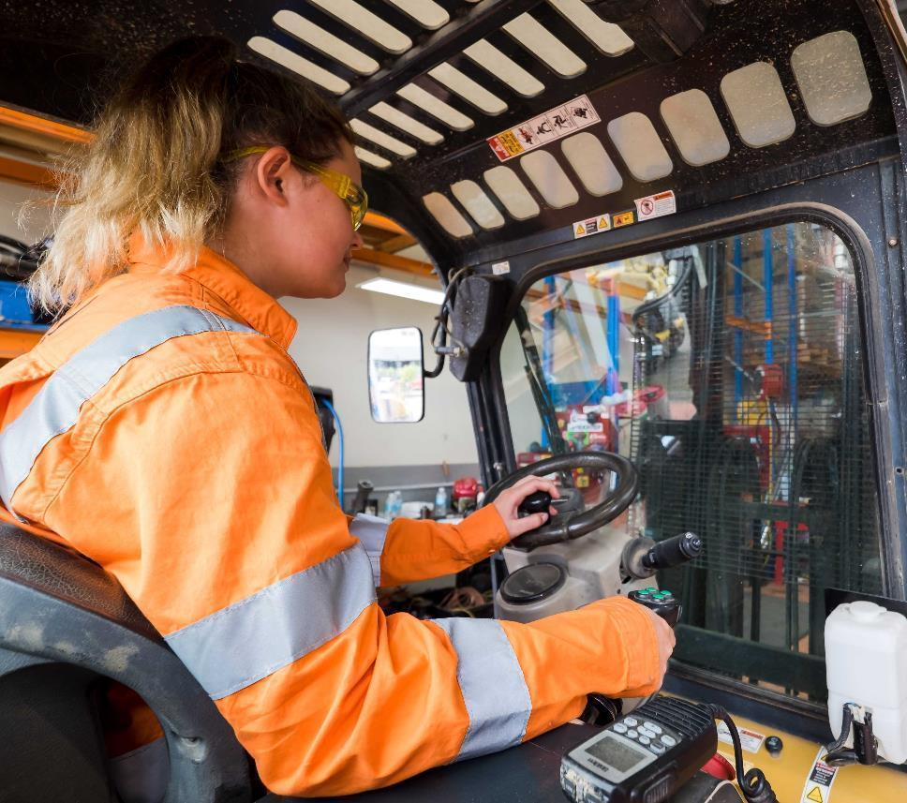
Reference Slides
Notes:
The Victorian unemployment rate grew slightly to 4.5% in July 2021, up from 4.4% in June 2020. This rate is still below the unemployment rate at the beginning of the pandemic, which was 5.2% in March 2020.
The number of employed people grew by 0.5% in Victoria between June and July this year.
However this data precedes the most recent lockdown.

Slide 3
Insert VSA logo
Gray circle – schooling – community ed etc can go as a shadow across the background.
The overall shape can change from circle to adjusted triangle sympathetic with logo
Attracting students
The 7 segments eg Engagement and Collaboration Frontdoor are of equal size.
Flow is designed to be read lest to right
Provision Planning Victorian Skills Plan
Student Acquisition and Guidance
Skills Feedback Employers and Students
Building Future Skills
Skills data and insights
Quality workforce
course design
recognition
Planning for Skilling
Community education
Community
Engagement and Collaboration Front door
Industry
Government
Schooling
Skills
Planning
Vocational
education
Skills innovation
Higher
Education
Students
Future Skills
Skills
Renewal
Feedback
Productivity
Quality

