Slide 1
PAGE 1
Home

Slide 2
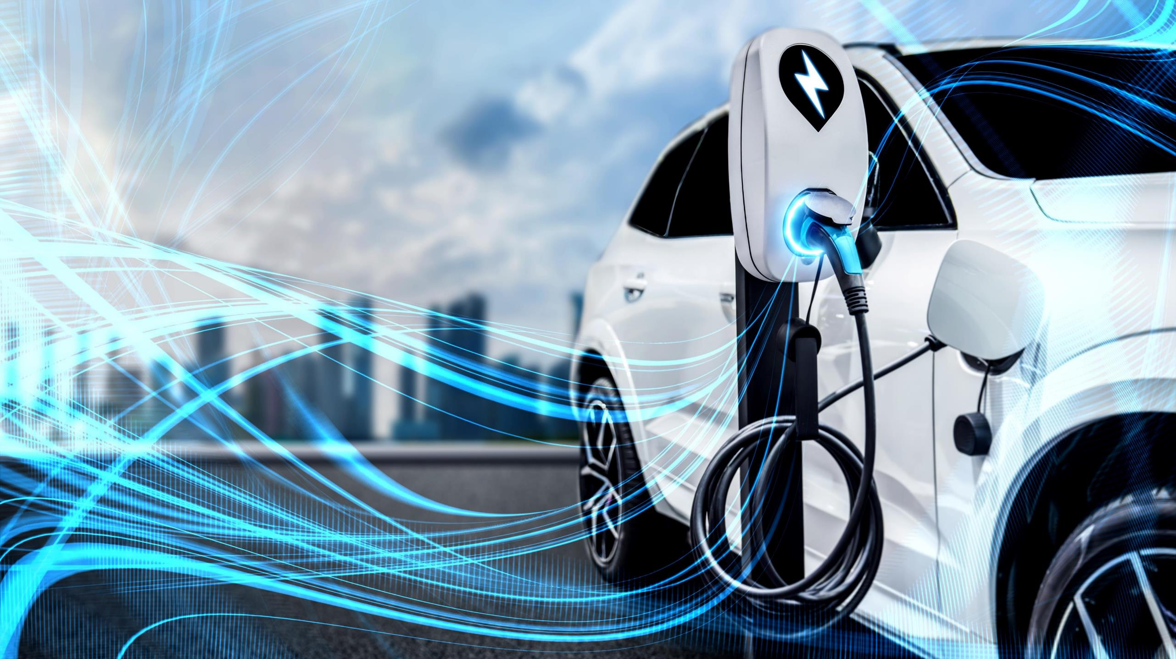


Enabling fast and integrated EV charging networks

Slide 3
About Alyath
Why us?
Best of breed
ECOSYSTEM
SCALABILITY WITH
LITTLE to NO INVESTMENT
SUSTAINABLE
INNOVATION
We plan, design, and deploy EV⁽¹⁾ charging Solutions as a Service by leveraging a best-in-class multi-vendor and partner network with expertise to deliver EV Hardware, Software and Services as Turn-Key and Agnostic solutions
We offer the ability to charge in minutes making for a scalable and nationwide application. The EV platform is delivered via consumption-based models allowing cities and enterprises to outsource the EV solution without prohibitive upfront investments
We enable a new, smart and high-power EV charging solution and consumer lifestyle powered by Al⁽²⁾ with sustainability in mind. We incorporate solar and other CO₂ reducing technologies into our solution platform to augment power-limited grids when needed
Electrical Vehicle (2) Artificial Intelligence

Slide 4


Our Vision
eV⁽¹⁾ anywhere & everywhere
Enable access to EV charging stations on every city corner, interstate highways as well as rural and underserved areas
FAST & INTEGRATED SOLUTION
Provide high-power, open access EV charging networks and pay systems fueled by smart energy technologies
Sustainability
Deploy citywide ESG⁽²⁾ solutions that leverage green technology and help reduce carbon footprint, fossil fuel residue and harmful gas released back into the environment
Electrical Vehicle (2) Environmental, Social, and Governance

Slide 5
PAGE 2
The Problem

Slide 6
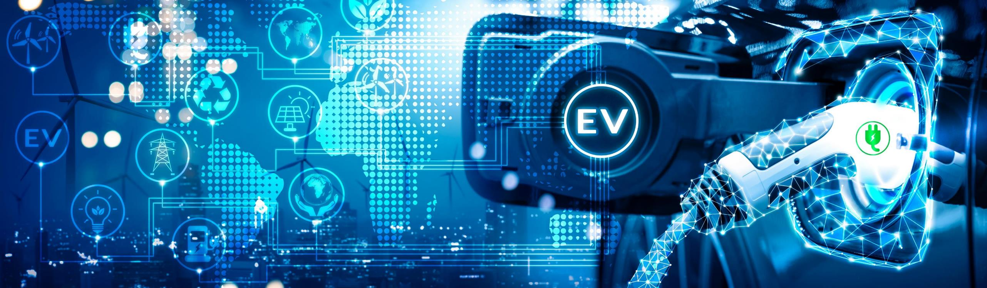
Limited fast and high-power (Level III) charging infrastructure
Range anxiety causing stall in EV purchases and keeping drivers close to home
Lack of industry payment standard causing confusion
THE PROBLEM
Massive growth in EV sales fueled by new models entering the market (Rivian, Lucid, etc.)
Leverage Smart City projects to bridge the gap between EV sales and charging logistics
Ability to augment 2030 U.S. carbon emission goals
THE Opportunity
THE SOLUTION
Public, Hybrid and Private deployments via Smart City & developer agreements
AI driven EV Solution capturing all levels of charging infrastructure
Standardized payment structure across the industry and cities
Access to 1.2M charging stations eliminating range anxiety

Slide 7
The Problem
Current EV charging network is 70 miles apart. Primarily planned in cities and interstate highways, excluding rural, small cities and underserved areas.
Most EV chargers deployed today are Levels I and II, which are very slow and impractical for city fleets.
Current grid would cost billions to upgrade.
Existing EV charging networks have multiple payment systems.
Each vendor has its own proprietary app that caters only to their specific charging station.
The Nature Conservancy suggests that the average carbon footprint for a U.S. citizen is 16 tons. This is one of the highest rates in the world, leading to new policies implemented to reduce carbon footprint
LIMITED
CHARGING INFRASTRUCTURE
SLOW
CHARGING STATIONS
LEGACY
PAYMENT
SYSTEM
SURGE
Of Carbon
footprint

Slide 8
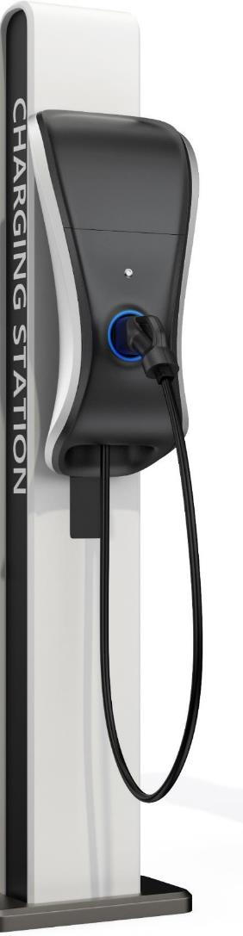

Limited Charging Infrastructure
CURRENT STATE
Charging stations are sponsored and deployed by a limited number of EV vendors on private properties or restricted public sites
Current EV infrastructure is for Levels I & II stations requiring multi-billion-dollar grid upgrade for fast charging (Level III)
Most EV chargers have limited outreach due to proprietary technology and support only Tesla vehicles
As of 2020
By 2030
GAS
EV
Vs.
1.2 Million
Pumps
88,000 +/-
Outlets
Up to 9 Million
Outlets Needed
Vs.
155,000
Stations
27,000
Stations
Public Investment: +500,000 Charging Stations (2020 U.S. infrastructure bill)

Slide 9
PAGE 3
The Solution

Slide 10
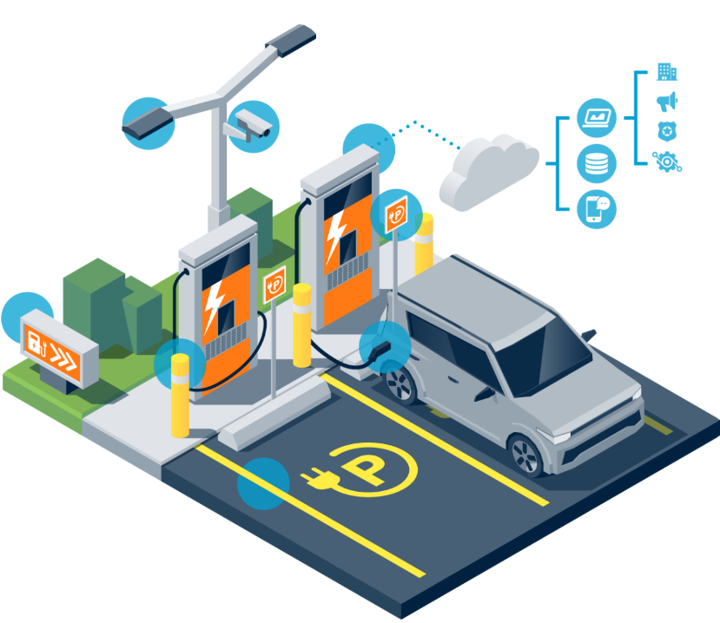

The Solution
End-to-End deployment and integration of EV charging Solution as a Service
Cities and enterprises outsource the EV infrastructure, billing and on-going maintenance
Real Estate
Concession
Funding, Implementation,
Operations & Maintenance
PUBLIC
SECTOR
Smart City Projects
Municipal areas & ROWs
(parking lots, sidewalks, airports and seaports, etc.)
HYBRID
Public Private Partnerships (PPP)
High traffic private real estate
(Retail, Banks, etc.)
PRIVATE
Enterprise Businesses
Real Estate Investment Trust (REIT)
(Hotels, apartments, malls, etc.)
EV charging
Solution as a Service with
Consumption Payment ⁽¹⁾
&
Revenue Share ⁽²⁾
(1) Consumption Payment associated to funding and deployment of turn-key EV charging station network.
(2) Revenue Share associated to use of real estate concession as well as from clients that might use the private EV facility.

Slide 11
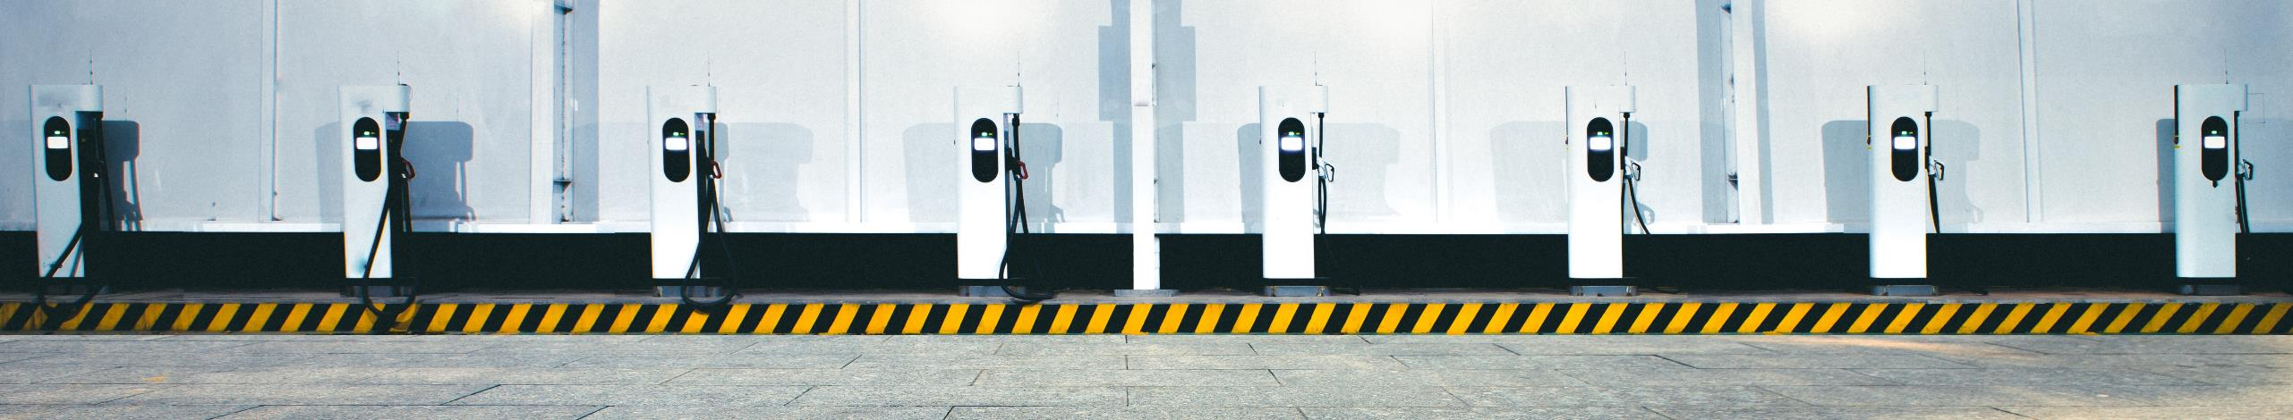
Alyath’s Solution as a Service
Connects EV drivers, charging stations and electricity providers into a single and easy to use platform
EV Charging STATIONS
EV DRIVERS
PLATFORM IMPLEMENTATION
PLATFORM MANAGEMENT
USER APP
Site selection and survey based on traffic projections and demographics
Design and installation of all hardware and software technology needed for a turn-key EV platform
Provide optimized financial solution (Revenue-Share, OPEX and CAPEX)
Provision of Charge Point Operator (CPO) software with integrated operational capabilities to manage data collection, billings and on-going maintenance
Collect real-time data from each EV station and provide insights on station utilization, carbon credits, and driver information
Nationwide open access to EV charging stations by level and operational status in both Alyath’s and 3rd party networks
Al-driven route planning + Safe Route assistant with unified payment system
2-way communication for charging reservations & notifications and much more

Slide 12

Our Approach
Public Private Partnerships (PPP)
 | RESEARCH | CONCEPT | DESIGN | FUND | DEPLOY / O&M
Alyath | Access public funding allocated by municipalities Engage partner network with signed municipal agreements to deploy public Level 3 | Match private real state list with geographies where subsidies are available | Identify optimal solution providers to deploy the EV charging platform | Alyath and its investor partners provide the equity and debt capital to fuel the consumption-based model | Alyath and its solution providers implement the EV charging platform, as well as on-going operations and maintenance of the network
Public and/or Private Entity | Identify franchises/branches/offices which own their real estate | Select restaurants/branches/offices with highest traffic and most suited EV site and demographics | Lease private real state for EV charging infrastructure deployment

Slide 13
Contact Info
Email: info@alyath.com
Phone: 954-XXX-XXXX

