Slide 1

Tri-M Industrial Supply
Request for Proposal

Slide 2
Company overview
We are American Reseller and/or installer of metal related products, both theirs and mark up reseller of manufacturer products.

Slide 3
scope
Scope 1: Design logo
Scope 2: Design all website, backend and user screens (UI/UX)
Scope 3: Programming/development, payment processing
Scope 4: API connections to manufactures (take orders on site/manufacturer drop ships)
Scope 5: ongoing site support

Slide 4
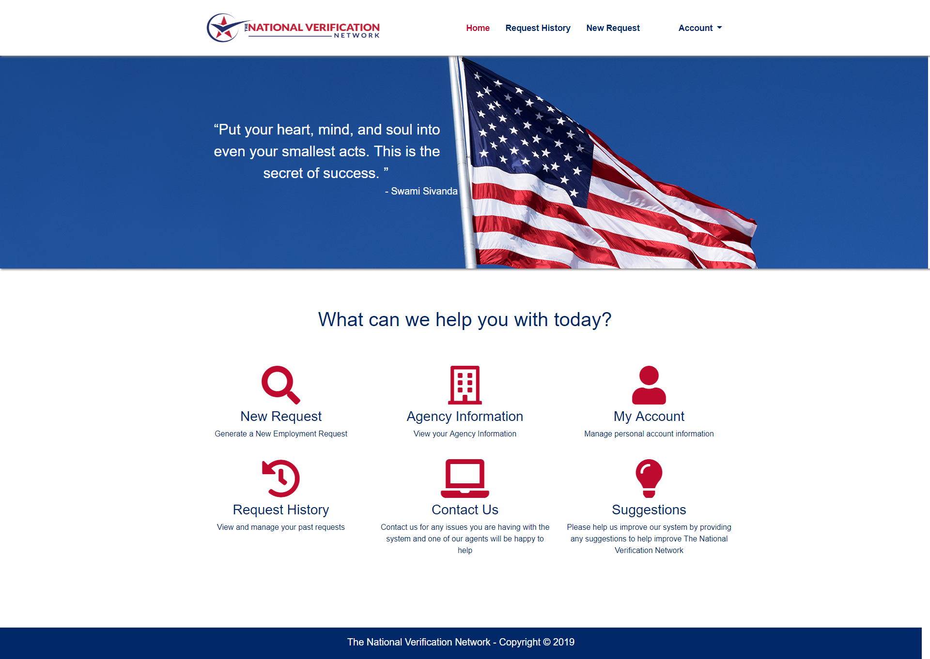
Color scheme for logo and site
Red white and blue
America theme

Slide 5
Similar site
https://www.metalsdepot.com/?gclid=Cj0KCQiA1sucBhDgARIsAFoytUveeDR1xlpuDYuDghcsCh4Ke4vNoTGitVSpRmIha9Fsl4v0N_IqQNsaAtAmEALw_wcB

Slide 6
High level
Ability for products to sort and break out into types (the sample site steel, aluminum for example)
Customer can create an order/shopping cart, go to payment page and buy; order sent to API manufacturer to drop ship
Ability for company to add their own products and services that would flow to them
Customer can request a quote, whereas they choose products and services to request a special quote
Web pages TBD: Home page, Products and Services, Request a Quote, Contact Us/schedule a call, About Us, landing page for marketing campaigns

