Slide 1
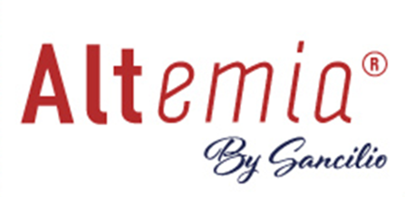


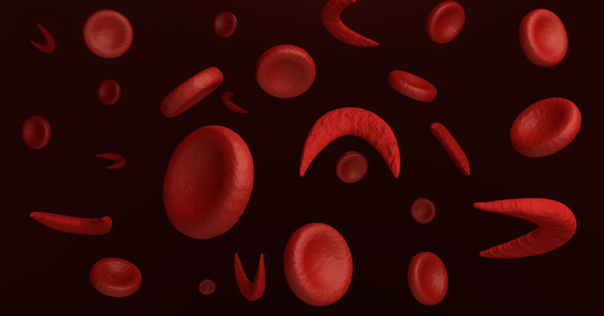
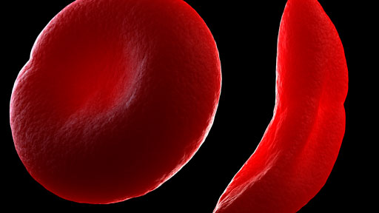



Coming Soon: A Medical Food for the Dietary Management of Sickle Cell Disease in Pediatric and Adult Patients
What is Altemia About SCD How Altemia Works Insurance Coverage Patient Support
What is Altemia
About Sickle Cell Disease
How Altemia Works
Insurance Coverage
Patient Support
Ask your doctor or dietitian for more information about Altemia®.
Use under medical supervision.
The Congress of the United States enacted Orphan Drug Act (21 U.S.C. 360ee(b)(3)) which stated in section 5(b)(3) that a new category of treatment for a small number of diseases, one of which was sickle cell disease, is now allowed. These treatment modalities require clinical and scientific evidence before they can enter commerce, but the Act also allows such products to become available through an abbreviated process, avoiding the high cost of a New Drug Application. The term medical food, as defined in section 5(b) of the Orphan Drug Act is "a food which is formulated to be consumed or administered enterally (by mouth) under the supervision of a physician and which is intended for the specific dietary management of a disease or condition for which distinctive nutritional requirements, based on recognized scientific principles, are established by medical evaluation." Sancilio and Company, the creator of Altemia®, began research on sickle cell disease in 2011. From over a decade of work, Altemia® was created and will soon become available globally in 2023. Altemia® is a Medical Food that is intended to restore the balance in the cellular membrane of people with sickle cell disease and may have a significant beneficial effect.

Slide 2

What is Altemia About SCD How Altemia Works Insurance Coverage Patient Support
Altemia is a medical food emulsification formulated to provide a high concentration of triglycerides of certain fatty acids, to replenish the those consumed by the hemoglobin (HbS) characteristic of SCD. In clinical trials conducted under a US Investigational New Drug Application, a similar consumption of these fatty acids provided data indicating an impact on the cascade leading to vaso-occlusive events. Altemia® was formulated to provide the same fatty acids used in these trials in a good tasting oral formulation highly that bioavailable.
Features and Benefits
Formulated for Enhanced Absorption¹
Manage VOC Events²
Lower C-reactive Protein (Inflammation) Levels³
Key ingredients
Enriched docosahexaenoic acid triglycerides, egg yolk (lecitin), and d-limonene
Contains egg and fish (anchovy, sardine)
References:
1) Susan K. Raatz et al., J Am Diet Assoc. 2009 June ; 109(6): 1076–1081
2) Ahmed A. Daak et al., Am. J. Clin. Nutr. 37, 37-44 (2013)
3) Data Submitted for Publication; Phase 2 Study of a Food Enriched with Docosahexaenoic Acid in Adults with Sickle Cell Disease
Altemia is designed to prevent the initiation of the cascade effects that occur in VOC episodes and other disease complications in SCD patients. Ask your doctor or dietitian for more information about Altemia. Use under medical supervision. This information is subject to change. Please refer to the product label for the most current ingredient, allergen, and nutrient profile information.
Ask your doctor or dietitian for more information about Altemia.
Use under medical supervision.
To report suspected adverse reactions, contact the FDA at 1-800-FDA-1088 (1-800-332-1088) or www.fda.gov/medwatch.
About Sickle Cell Disease
How Altemia Works

Slide 3
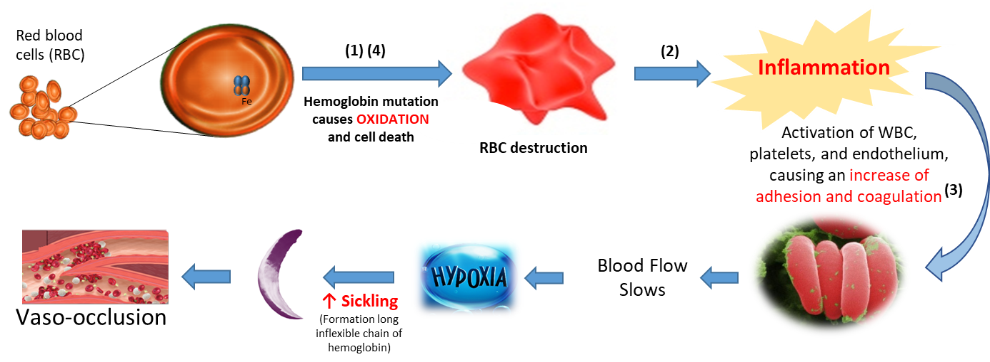
What is Altemia About SCD How Altemia Works Insurance Coverage Patient Support
Sickle Cell Disease (SCD) is a genetic disorder in which there is dysfunctional hemoglobin (HbS) protein. Approximately 100,000 cases of SCD exist in the United States.
HbS can oxidize fatty acids located in the cell membrane of RBS, leading to “ridged cells” and cell death.
Inflammation associated with SCD triggers red blood cells to stick together, slowing them down in blood vessels, and causing them to release their bound oxygen.
Once they become de-oxygenated the cells deform, clogging blood vessels and resulting in intensely painful and damaging episodes, bouts of anemia, dizziness, and fatigue, known as sickle cell crises.
Blood, Vol77, No 2 (January 15). 1991: pp 214-237; Free Radical Biology & Medicine, Vol. 24, No. 6, pp. 1040–1048, 1998; Clin Exp Med. 2015 Aug;15(3):397-40; Prostaglandins, Leukotrienes and Essential Fatty Acids 72 (2005) 415–421; Ann Hematol (2005) 84: 578–583; Journal of Lipids. Volume 2011, Article ID 718014, 8 pages.
Cardiovasc Hematol Disord Drug Targets. 2009 December; 9(4): 271–292; Microcirculation. 2009 January ; 16(1): 97–111.
Blood Cells, Molecules and Diseases 55 (2015) 48–55; Blood Cells, Molecules and Diseases 52 (2014) 183-188; Thromb Haemost 2001; 85: 966–74; Thromb Haemost 2001; 85: 966–74: Haematologica July 2015 100: 870-880: Microcirculation. 2009 January ; 16(1): 97–111.
Prostaglandins Leukot Essent Fatty Acids. 2013 Oct;89(5):305-11.
Ask your doctor or dietitian for more information about Altemia.
Use under medical supervision.
What is Altemia
How Altemia Works

Slide 4
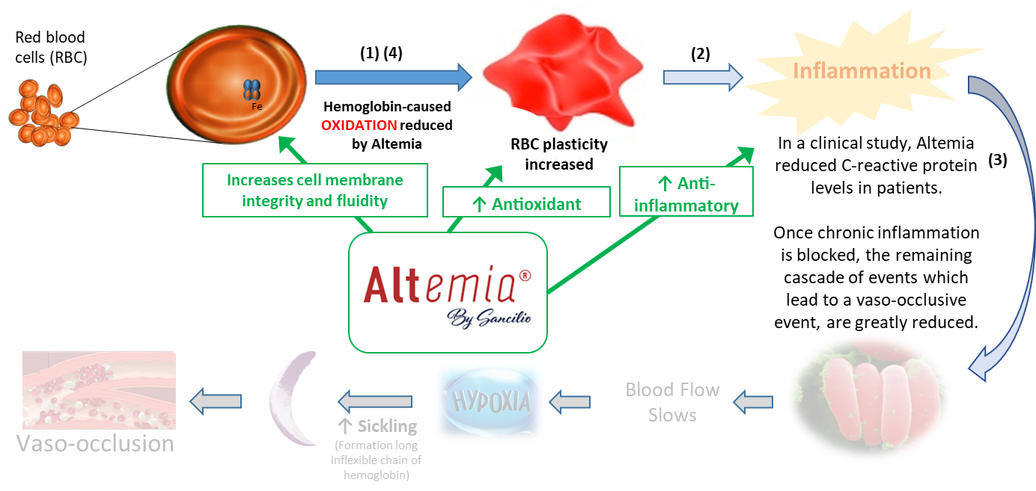
What is Altemia About SCD How Altemia Works Insurance Coverage Patient Support
References:
1) Susan K. Raatz et al., J Am Diet Assoc. 2009 June ; 109(6): 1076–1081
2) Ahmed A. Daak et al., Am. J. Clin. Nutr. 37, 37-44 (2013)
3) Data Submitted for Publication; Phase 2 Study of a Food Enriched with Docosahexaenoic Acid in Adults with Sickle Cell Disease #CTRI/2022/06/042963
Ask your doctor or dietitian for more information about Altemia.
Use under medical supervision.
What is Altemia
About Sickle Cell Disease

Slide 5
What is Altemia About SCD How Altemia Works Insurance Coverage Patient Support
The staff at Altemia, and its parent company Sancilio and Company, are dedicated to offering the best products and services, at the lowest prices possible. We are currently exploring options for reimbursement and methods to reduce costs, so that we can pass these savings on to our customers.
Coverage of nutritional products varies depending on many things, including the type of insurance plan, the coverage policy, the care setting, patient diagnosis, and route of administration (oral or tube-fed). Out-of-pocket costs such as deductibles, co-pays, and co-insurance also vary depending on the insurance plan. Altemia is currently working with various State Pharmacy & Therapeutics Committees to identify insurance reimbursement opportunities.
Need help with the purchase of Altemia? We are providing substantial pricing concessions to patients in need of this product but have a financial constraint. We are also seeking several hundred patient volunteers to try Altemia at no charge but to consent to sharing their experience with us and others. Contact us directly for more information.
Some useful links to patient support networks can be found below:
Altemia Patient Support Services
Sickle Cell Disease Health Equity Fund
Each healthcare provider is ultimately responsible for verifying codes, coverage, and payment policies used to ensure that they are accurate for the services and items provided. Providers should consult with the insurance plan for complete and accurate details concerning documentation for claims. Altemia does not guarantee reimbursement by any third-party insurance plan and will not reimburse physicians or providers for claims denied by third-party insurance plans.
Ask your doctor or dietitian for more information about Altemia.
Use under medical supervision.
What is Altemia
Patient Support

Slide 6
What is Altemia About SCD How Altemia Works Insurance Coverage Patient Support
Sign up for Altemia Patient Support Services
Start benefiting today with Altemia savings and support. Just fill out the form below. Once you are enrolled, you’ll have access to all product savings offers for Altemia.
Come back and log in to access your personal account page and learn about any current savings offers for your next Altemia refill, then check back before each refill for additional money-saving opportunities that may be available. We may also contact you every now and then with helpful information related to your condition.
Enroll now for Altemia Patient Support Services
*All fields are required
First Name
Last Name
Username
Password (Confirm)
Email (Confirm)
City/State
By signing up, I agree to receive money-saving offers and information to help me manage my condition.
By submitting, you agree to our Terms of Use
Ask your doctor or dietitian for more information about Altemia.
Use under medical supervision.
What is Altemia
Insurance Coverage

