Slide 1
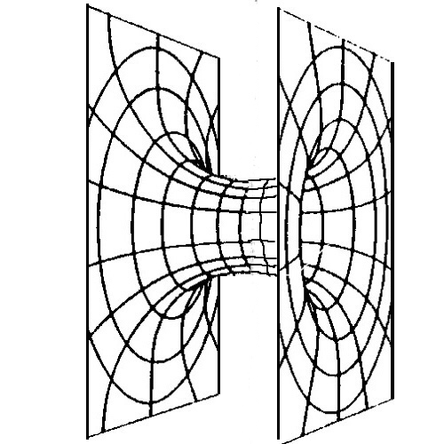
Proposed Concept – A “wormhole” connecting two ends forming a letter “H”
Just need to create the new symbol / ogo
Fonts and colors should remain the same
Sample logo here. Feel free to iterate/modify as needed

Slide 2


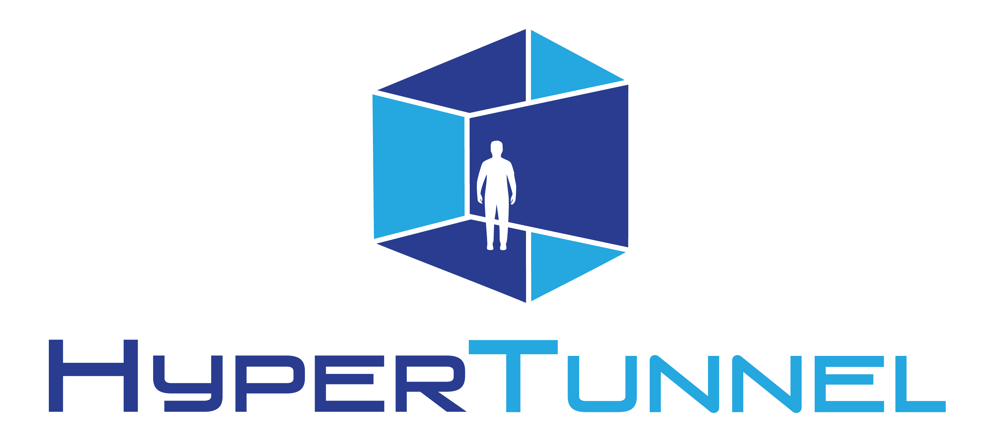
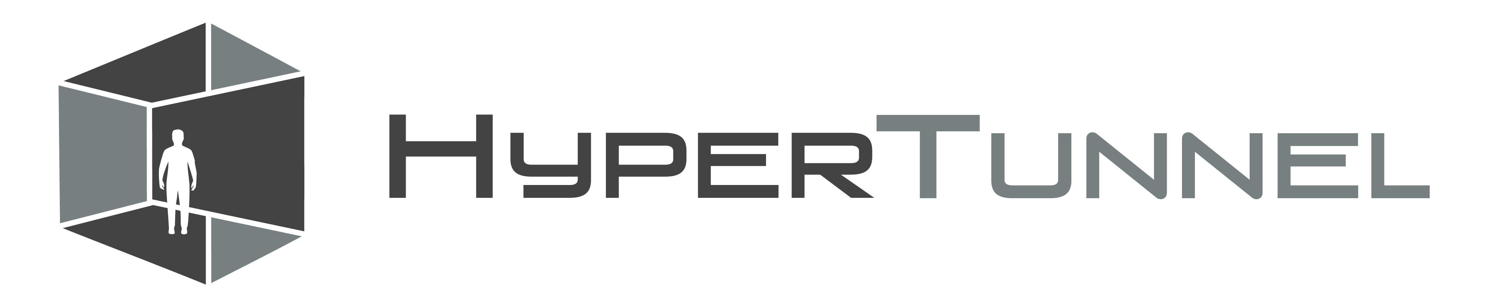
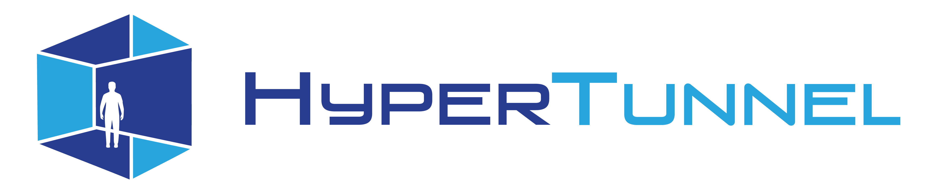
Current Logo Colors / Fonts
Concept: One person inside a VR environment
Color Mode : CMYK Color
Color Code :
Dark Blue : #2B3C8F
Light Blue : #28A6DF
Dark Grey : #737677
Font Name :Venus-Rising
Font Size : FVR - around 22pt
Font size : actual - around 17pt

