Slide 1

Paine
Communications
Informing, Influencing, Inspiring

Slide 2

Paine Communications is inspired by Thomas Paine, the nation’s first influencer. His Common Sense convinced a nation to declare its freedom, and America in Crisis inspired an army to victory.
More than 250 years later, words still matter.
Your ability to inform, engage and inspire your people and customers can be the difference between good or great revenue, a known or loved brand, or a “job” vs. a great place to work for employees.
Words still matter. Let’s choose them together.

Slide 3
Paine Communications
Why it matters
“Communication is a new core competency. When handled well, communication creates transformation. If not, you get chaos. We have to equip people to navigate turbulent times and communicate amid disruption if they are going to be able to marshal organizations toward positive outcomes.”
-- Eric McNulty
                associate director of the National Preparedness Leadership Initiative
                Harvard University

Slide 4
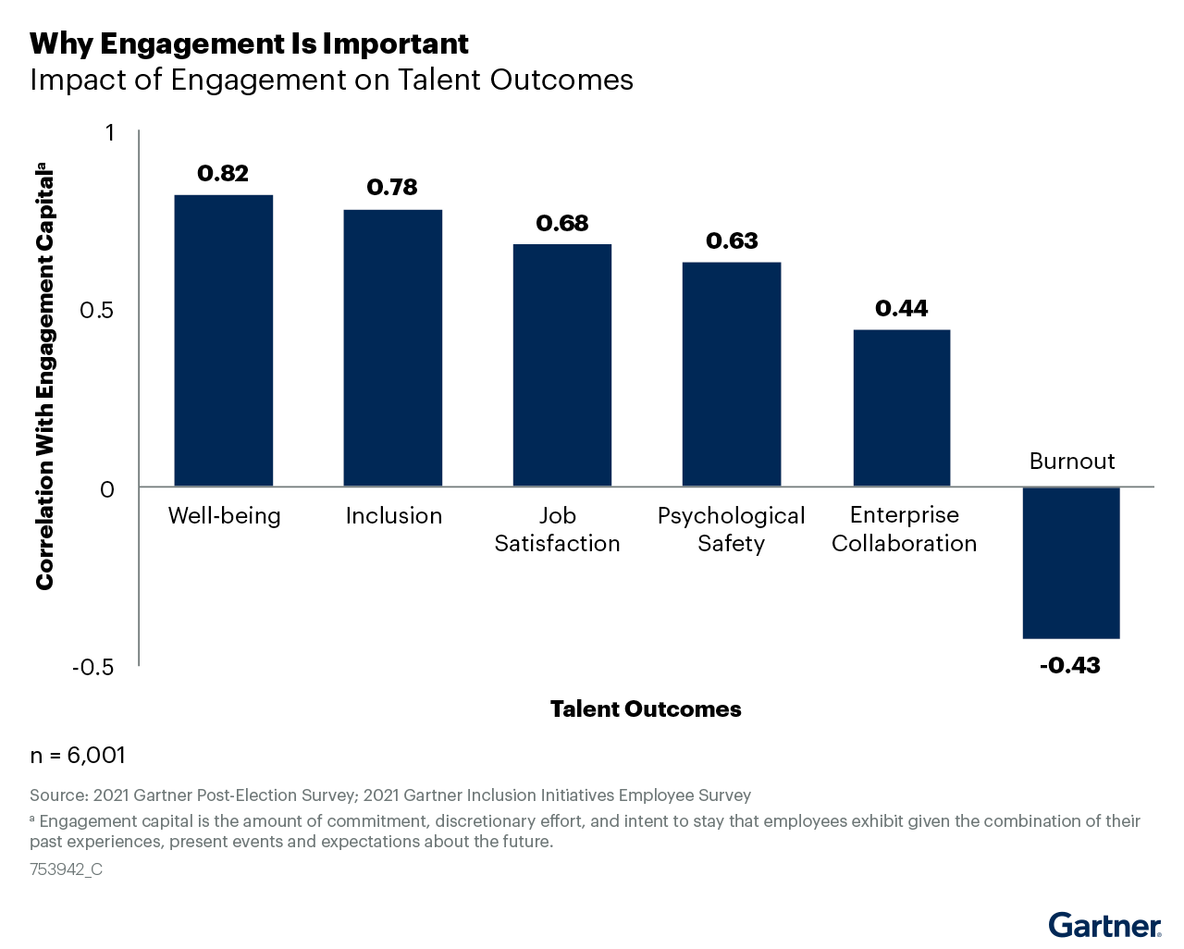
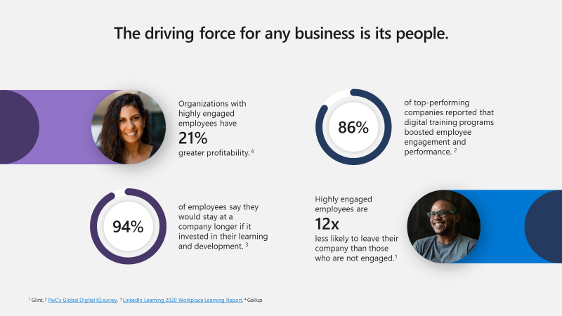
Paine Communications
Why it matters
Companies with highly effective internal communication strategies are 3.5 times more likely to outperform their industry peers than organizations that do not effectively communicate internally. -- Gartner 2021 Communications Effectiveness Report

Slide 5
Paine Communications
My Mission
I’m your senior communications partner & ally when it matters most – to help you maximize important opportunities & turn your challenges into advantages.
Be A Trusted
Advisor
  Provide strategic communications counsel, partner with you in a crisis or during M&A
Develop Impactful Strategies
  To communicate the company’s business objectives, product/service launch, major initiative
Perspective
Expertise
Story
Telling
  Tell compelling stories, make the ordinary interesting; reinforce Purpose, Vision and the growth strategy.
Share Meaningful Insights
  Use data to analyze how effectively we’re achieving outcomes and how to better reach our audiences in the future
Experience

Slide 6
Paine Communications
What I can do for you
Strategic Planning & Team Building
Company & Executive messaging
Business Plan rollouts
Product/Service launches
M&A integrated planning – messaging, audience segmentation, timing in alignment with all business entities and government regulatory offices
Crisis preparedness & response
Public Affairs relationship development
White paper development
Counsel & support to build a world-class communications team

Slide 7
Paine Communications
What I can do for you
Internal and External Communications
Company & Leadership messaging
Corporate videos
Town Halls
Intranet stories
Message development for major initiatives
Planning & messaging for or changes & people announcements
PR strategy & media outreach
External message creation
Press releases & media statements
Social Media strategy & messaging
Public Affairs strategic communications

Slide 8








Paine Communications
Let Me Put My Experience to Work For You
… 25+ years successfully communicating opportunities and informing, influencing and inspiring audiences.
… 25+ years of communicating opportunities

Slide 9

Let’s chat…
Paine Communications

Slide 10
For strategic communications planning or implementation, contact Nelson Mumma painecommunicationscorp@gmail.com
404.242.1450

