Slide 1
Bank of New York Mellon Call
December 16,2022

Slide 2
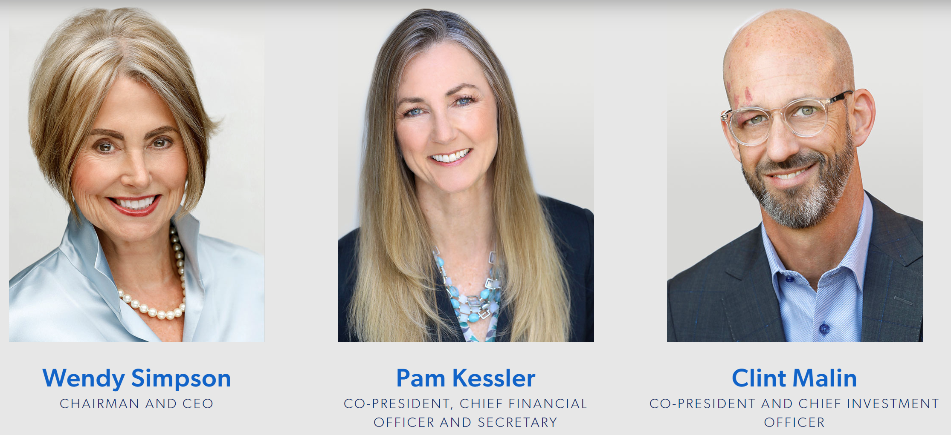
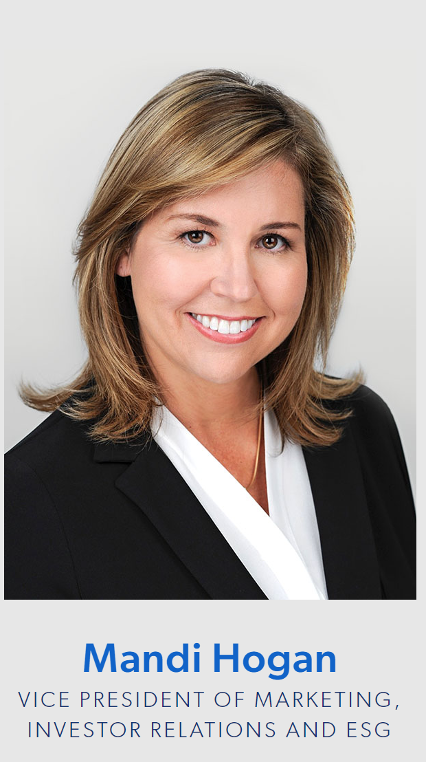
Purpose of Today’s Call
Introduce our teams since we last met pre-COVID
High-level overview of LTC
LTC’s ESG Initiative
Proxy Voting
LTC Team (images on the website - https://www.ltcreit.com/about/)

Slide 3

About LTC
LTC is a real estate investment trust (REIT) investing in seniors housing and health care properties primarily through sale-leasebacks, mortgage financing, joint-ventures and structured finance solutions including preferred equity and mezzanine lending.
Established 1992 – NYSE: LTC
Investment grade NAIC 2C rating (insurance industry’s rating agency for debt investments)
Current Market Cap – $1.55B
Current Enterprise Value: $2.33B
Debt to Enterprise Value⁽¹⁾: 34.1%
Debt to Annualized Adjusted EBITDAre⁽¹⁾: 5.9x
(1) at September 30, 2022 using September 30, 2022 closing stock price

Slide 4
Portfolio Overview
Health Care REIT investing in Seniors Housing and Care
  204 Properties | 29 States | 32 Operating Partners
  Independent Living | Assisted Living | Memory Care | Skilled Nursing
  Approximately 50% Seniors Housing and 50% Skilled Nursing

Slide 5

(1)
202o
Committed to ESG Initiative
Appointed Cornelia Cheng as new Board member
Please re-design this page
Board established an ESG committee to oversee practices and performance
Created and published an Environmental Sustainability Commitment and Human Capital Management and Labor Rights Guidelines
2021
ESG journey
PEOPLE. PLANET. INTEGRITY.
Enhanced our disclosures to highlight ESG initiatives
Aligning with the Sustainability Accounting Standards Board (SASB) reporting framework and adopting select United Nations Sustainable Development Goals (SDGs) in guiding us to provide shareholders with relevant information on our environmental impact
Visit our website to learn more about our ESG initiatives. www.ltcreit.com/esg
Implementing corporate stewardship through socially responsible and sustainable practices.
2022
ESG I
Notes:
New slide emailed by Mandi on 7/19/22.

Slide 6
ISS Score Progress
 | December 2020 | December 2021 | December 2022
Environmental | 9 | 10 | 8
Social | 9 | 5 | 4
Governance | requested | 4 | 3

Slide 7
Proxy Voting
2022
  Voted against Jim Pieczynski
    2014 – 2022 Nominating and Corporate Governance Chairman
    Currently: Investment Committee Chairman
What are your concerns?
What can we do?

Slide 8
Thank You

