Slide 1
Board game name: DINO
Background:
Basics are:
  Players take turn to throw a dice. Aim is to get to the food first
  Landing on a Brachiosaurs (green field) will send you forward, landing on a T-Rex (red field) will send you back
Players: 2-6
Age 3+
Contains:
Game board: A3 (297mm (height) x 420mm (length))
  Each numbered field should be able to hold 2 game pieces comfortably
  Each field should be numbered
  Red field sends you back, green sends you forward, grey is where you are being sent to
6 game pieces
Game box (310x210x53mm)
6 piece holders in plastic (20 mm in diameter)
Dice
Format
Design should be available also in Adobe In Design (for easy printing)
In scope for design project

Slide 2

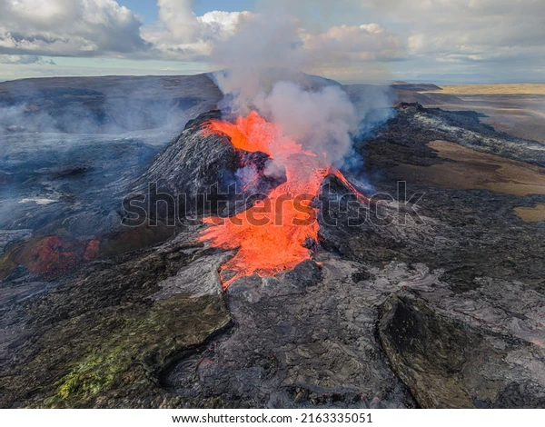
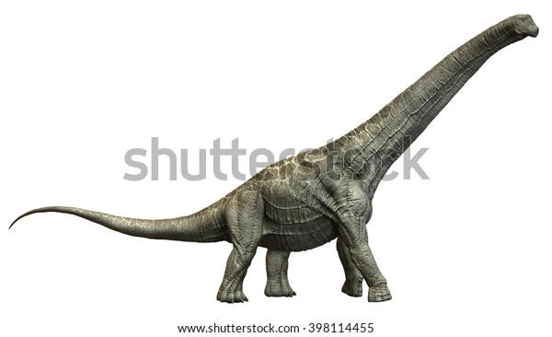
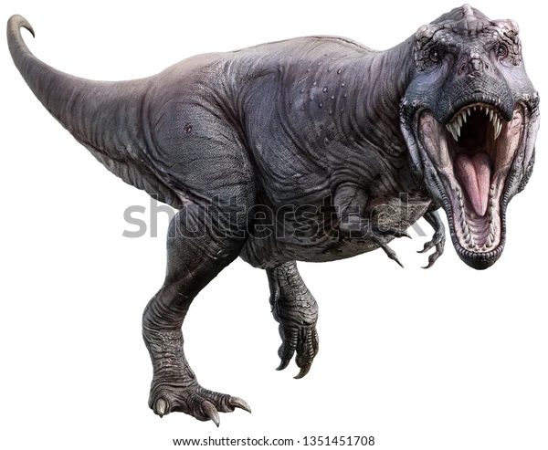
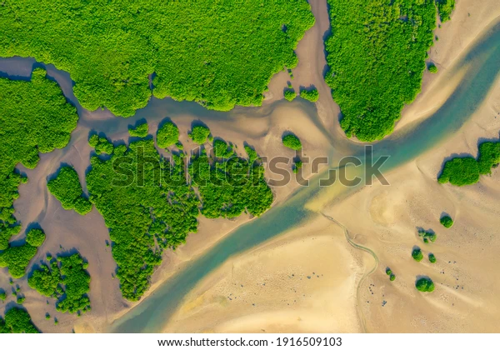
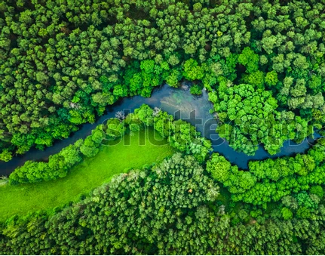

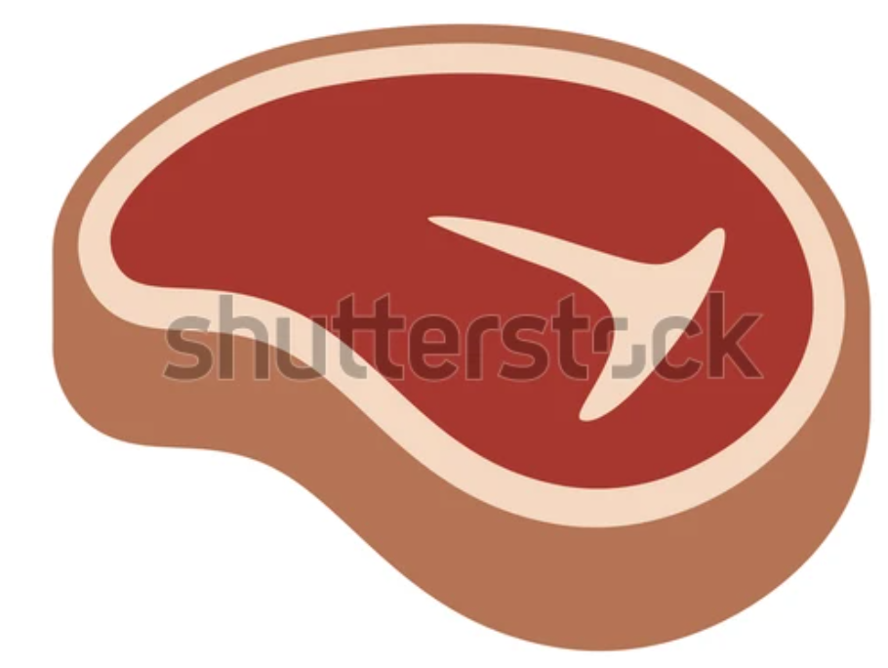
11
33
54
12
10
13
32
53
55
34
9
14
31
35
52
56
8
15
30
36
51
57
7
16
29
37
50
58
6
17
28
38
49
59
5
18
27
39
48
60
4
19
26
40
47
61
3
20
25
41
46
62
Game piece
2
Game piece
21
24
42
45
63
1
22
23
43
44
Game piece

Slide 3
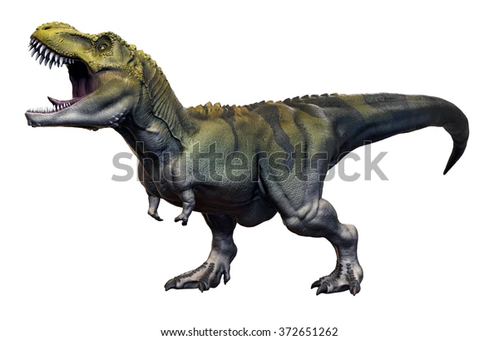
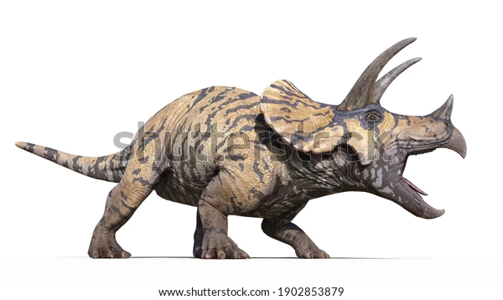
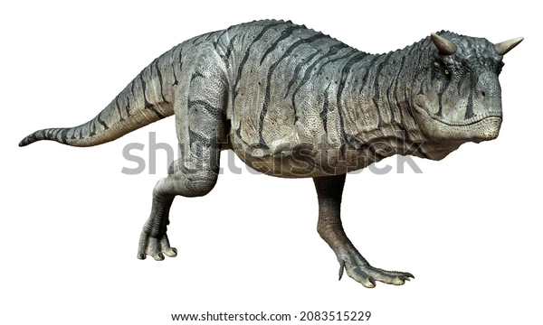
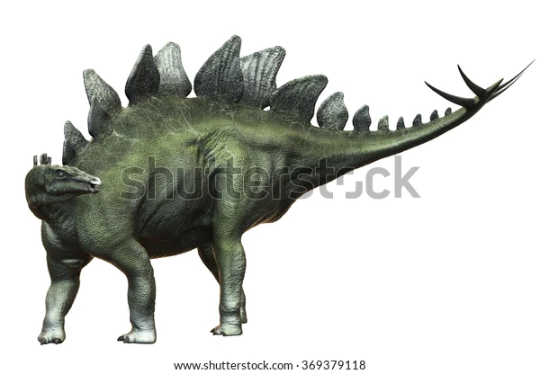
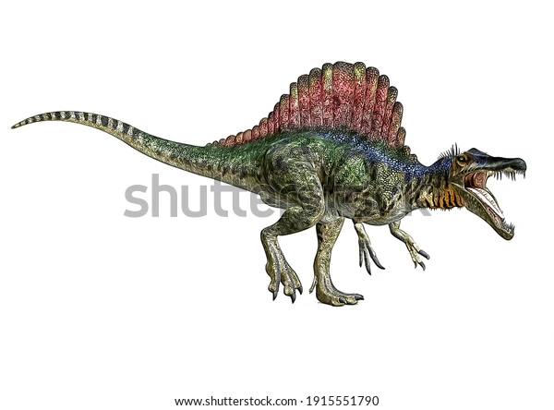
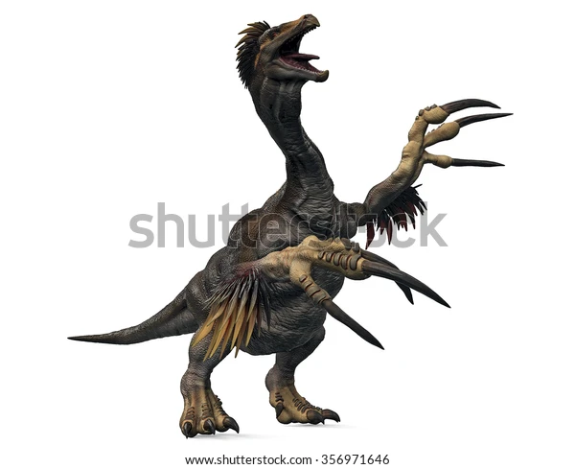
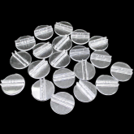
6 game pieces (to be contour cut)
Apprx. 50mm
Front
Back
Front
Back
Apprx. 40mm
Tyrannosaurus Rex
Triceratops
Carnataurus
Stegosaurus
Spinosaurus
Therizinosaurus
Piece holders (for reference only)

Slide 4
Game box
53mm
DINO
210mm
53mm
310mm
53mm

