Slide 1





Slide 2


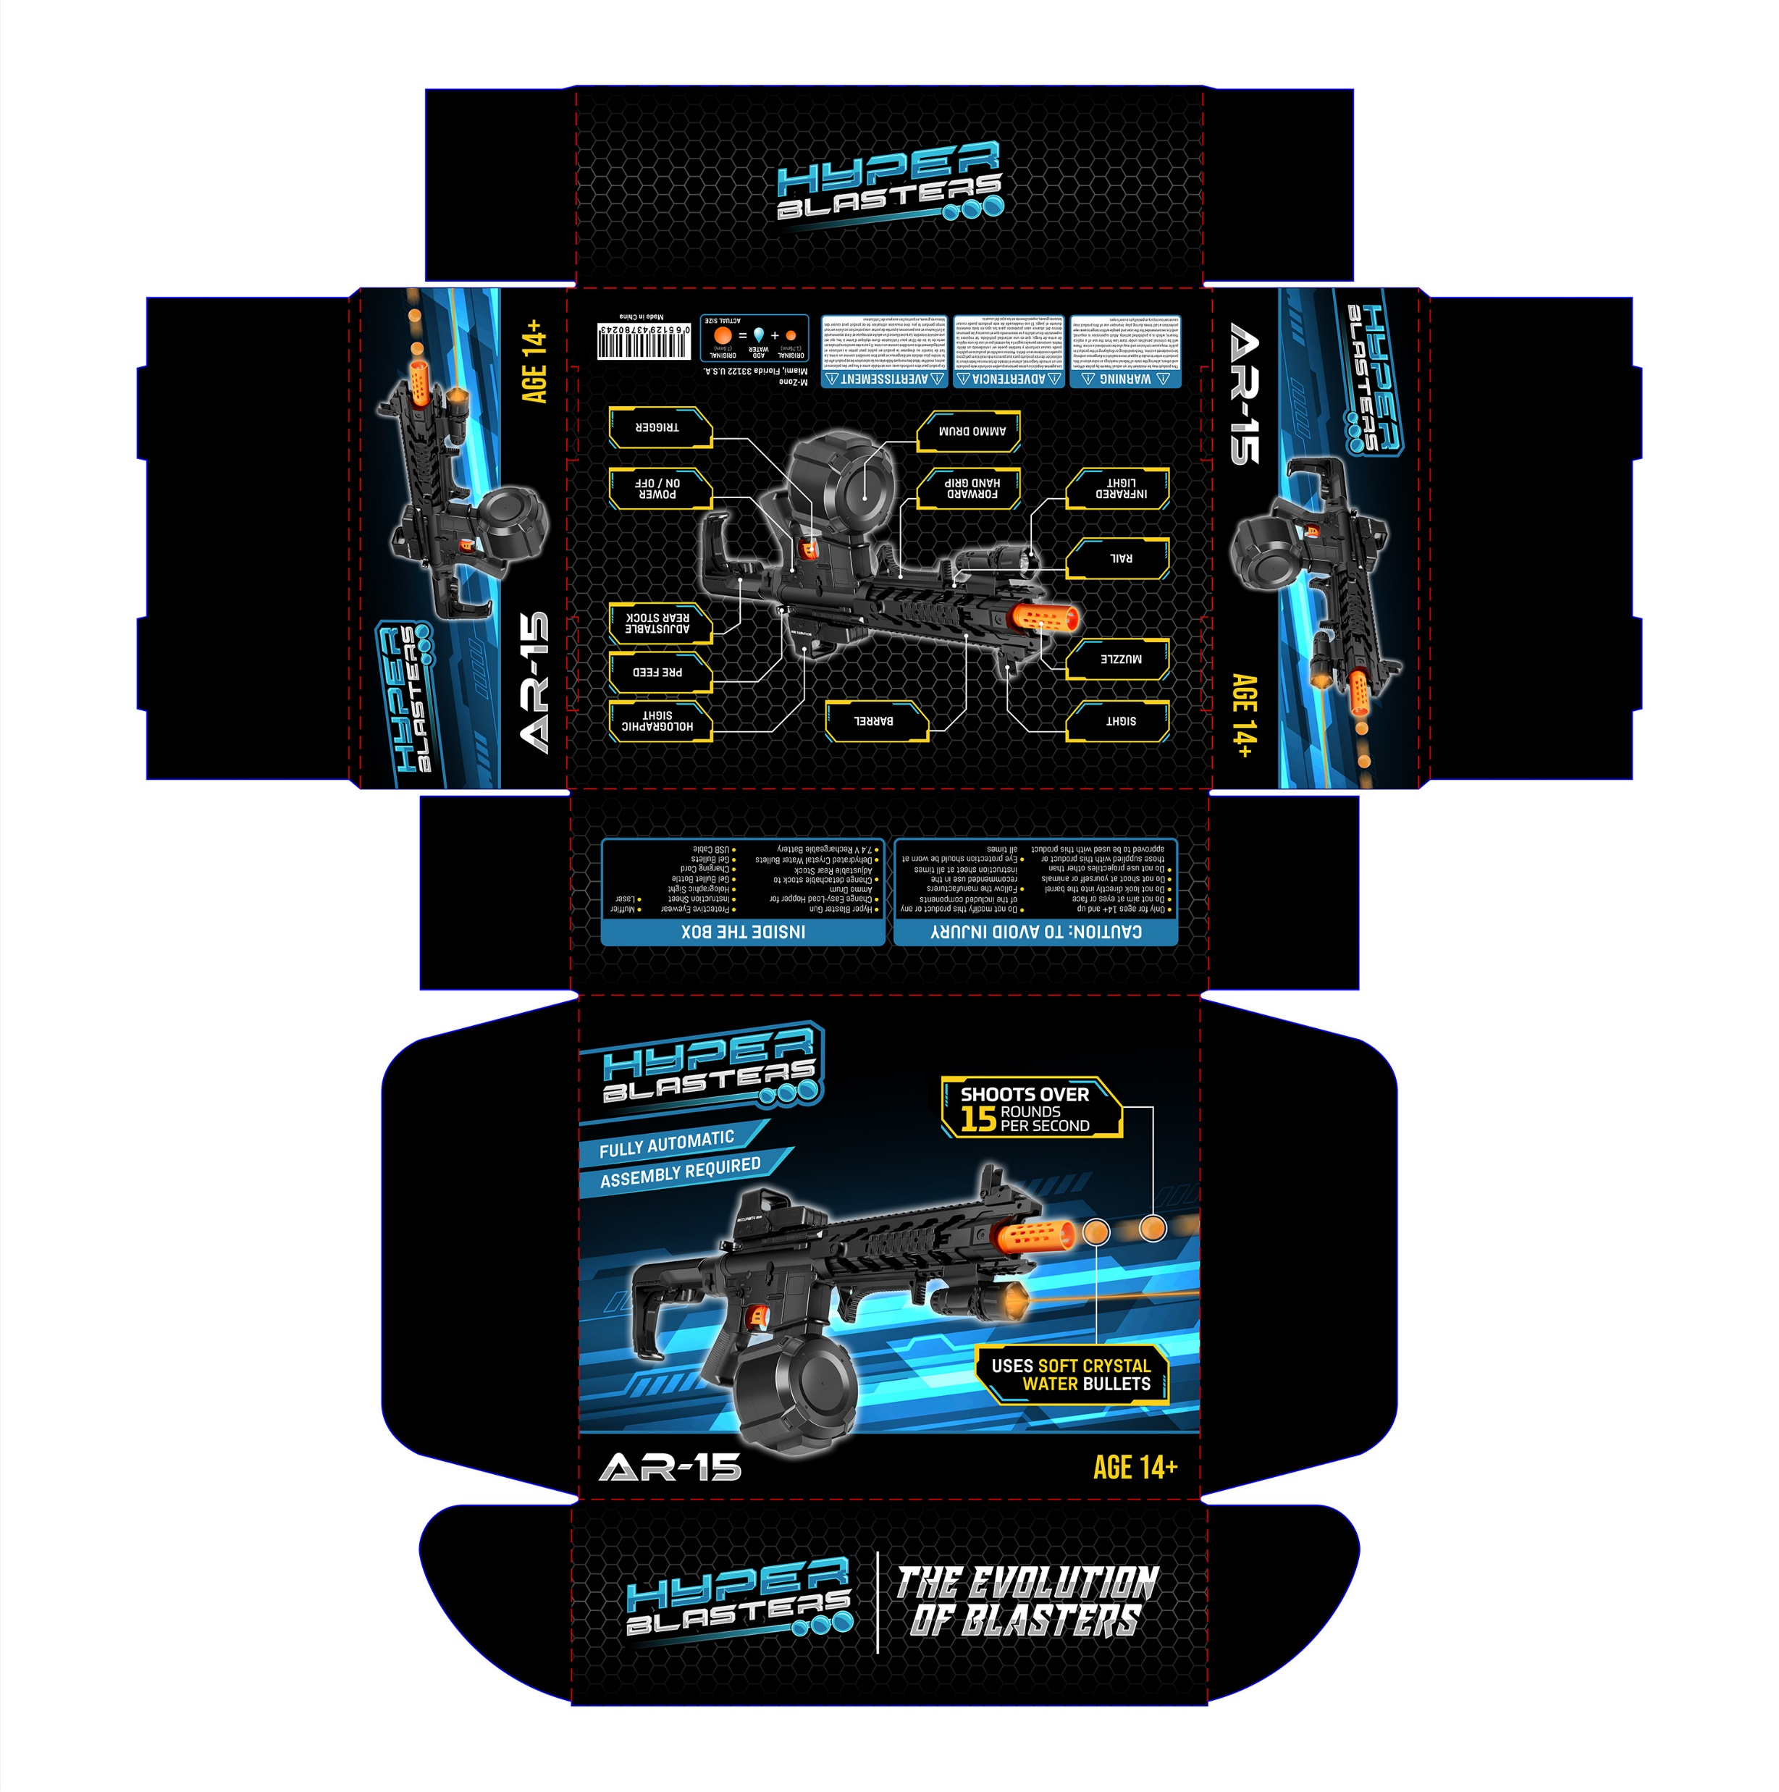

Slide 3
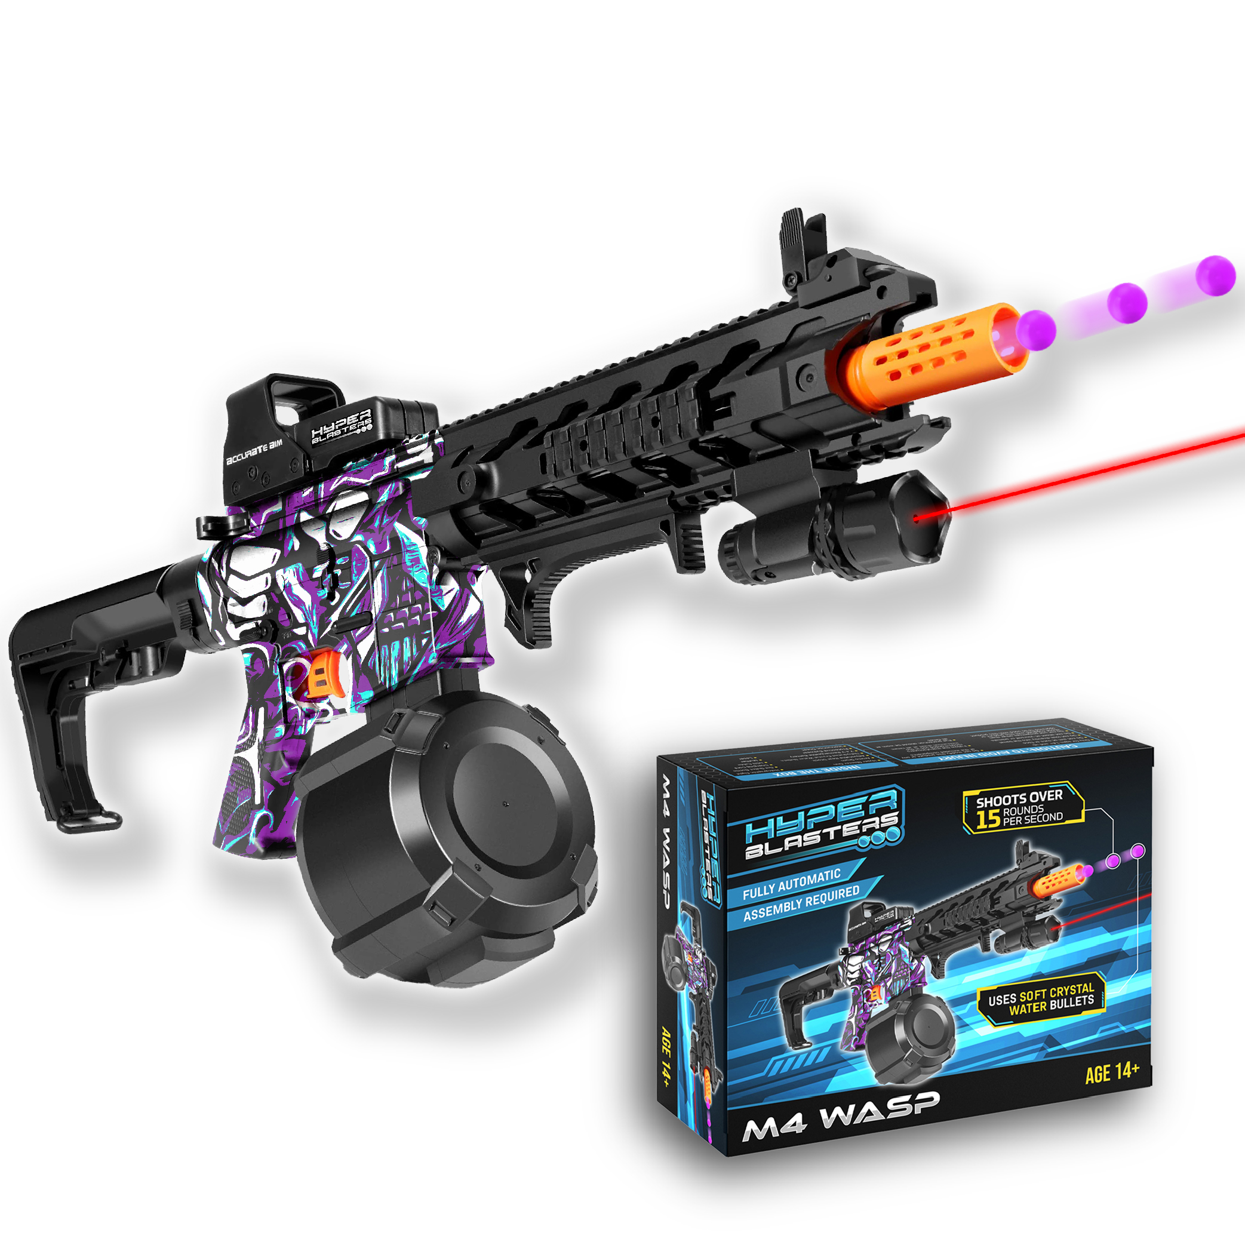


Collect them all

Slide 4

