Slide 1
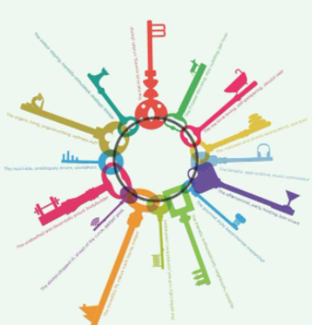
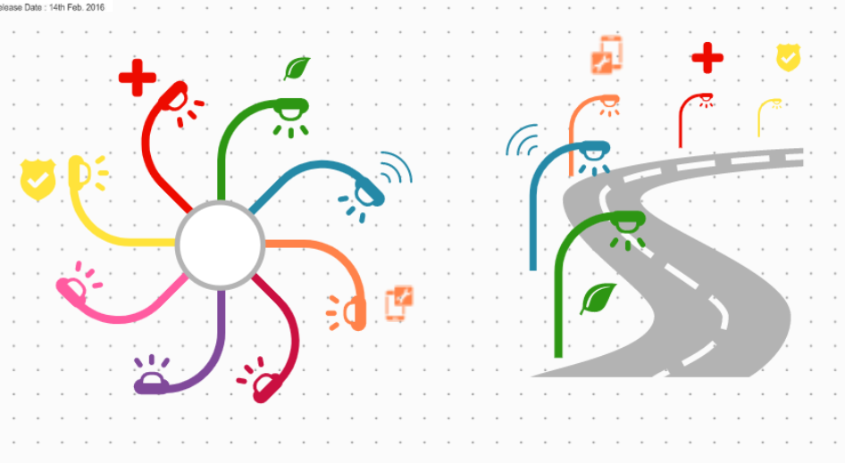
Theme ideas:
*Unlocking Connections * The Connection Track
*Unlocking next level connections * Connection is Key
*Unlocking to the next level of growth * Connected. Unlocked. Winning.
Design references and initial drafts – need other approaches

Slide 2
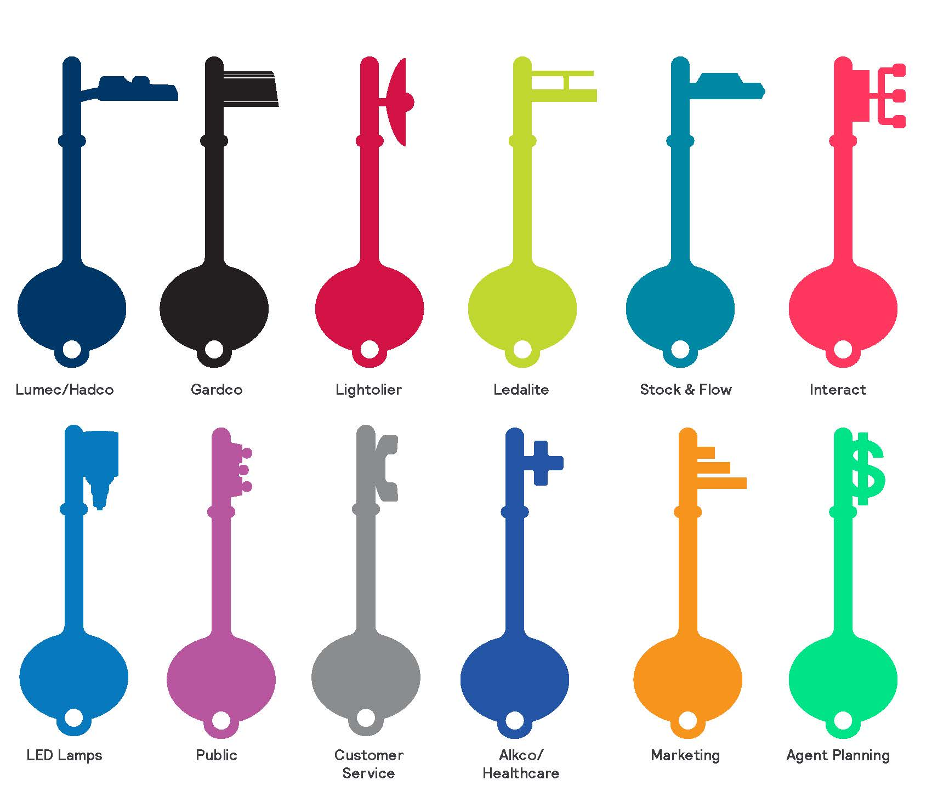
Key icons created by Kim Person :

Slide 3

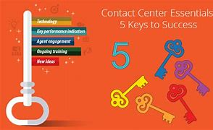
Other key references per 12/7 Market lead call

