Slide 1
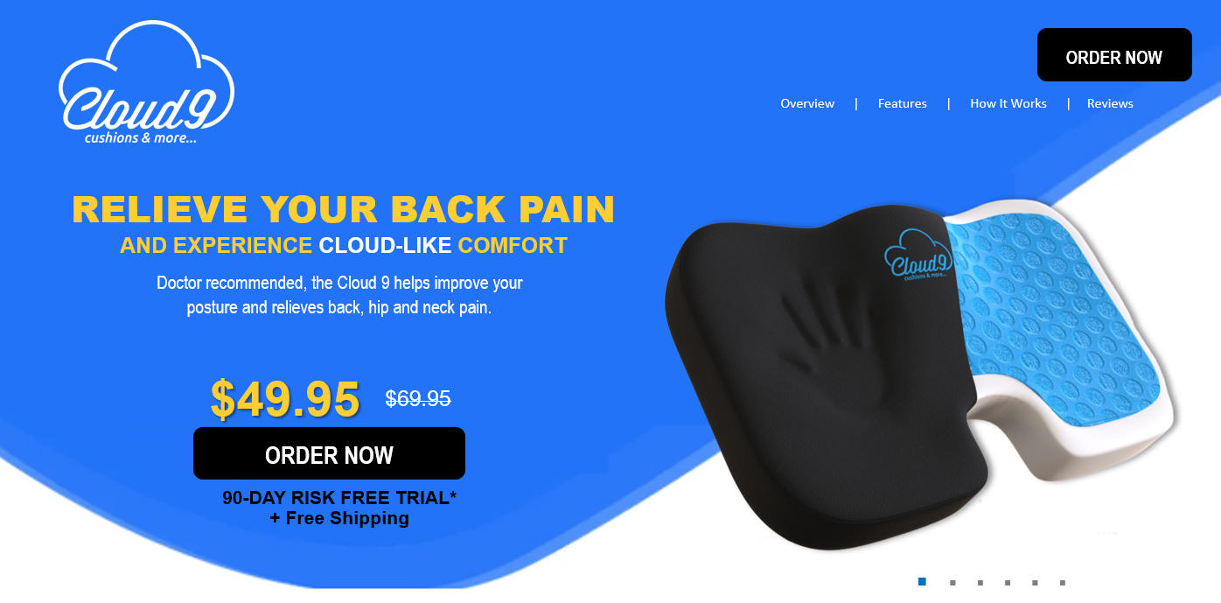
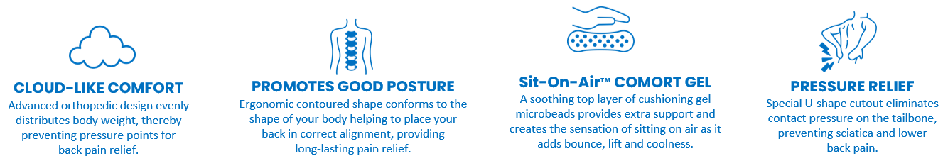

Tired of nagging back pain?
Tired of nagging back pain?
You’re not alone… nearly 80 million Americans experience back pain symptoms every year.
As we age, our spines go through changes that make it more delicate and prone to pain. Poorly designed chairs and improper body mechanics are the main culprit of recurring back issues. Whether it’s moderate or severe, back pain can seriously put a damper on your life.
Start Your Journey To Back Pain Relief With Our 90 Day Risk-Free Trial.
Experience HEAVENLY Bliss
Back Pain & Sciatica Relief
Relieves Stress & Boost Energy
Doctor Recommended
Try Cloud 9 Risk Free

Slide 2
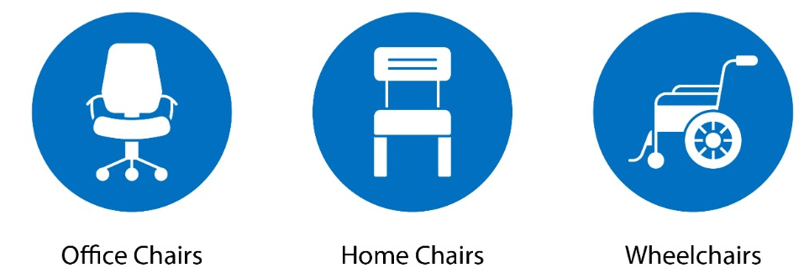
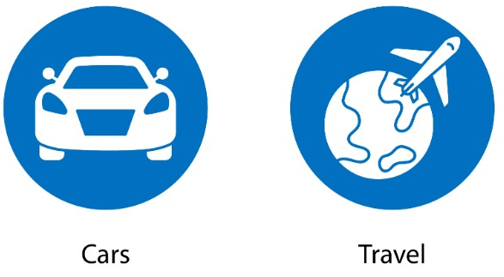
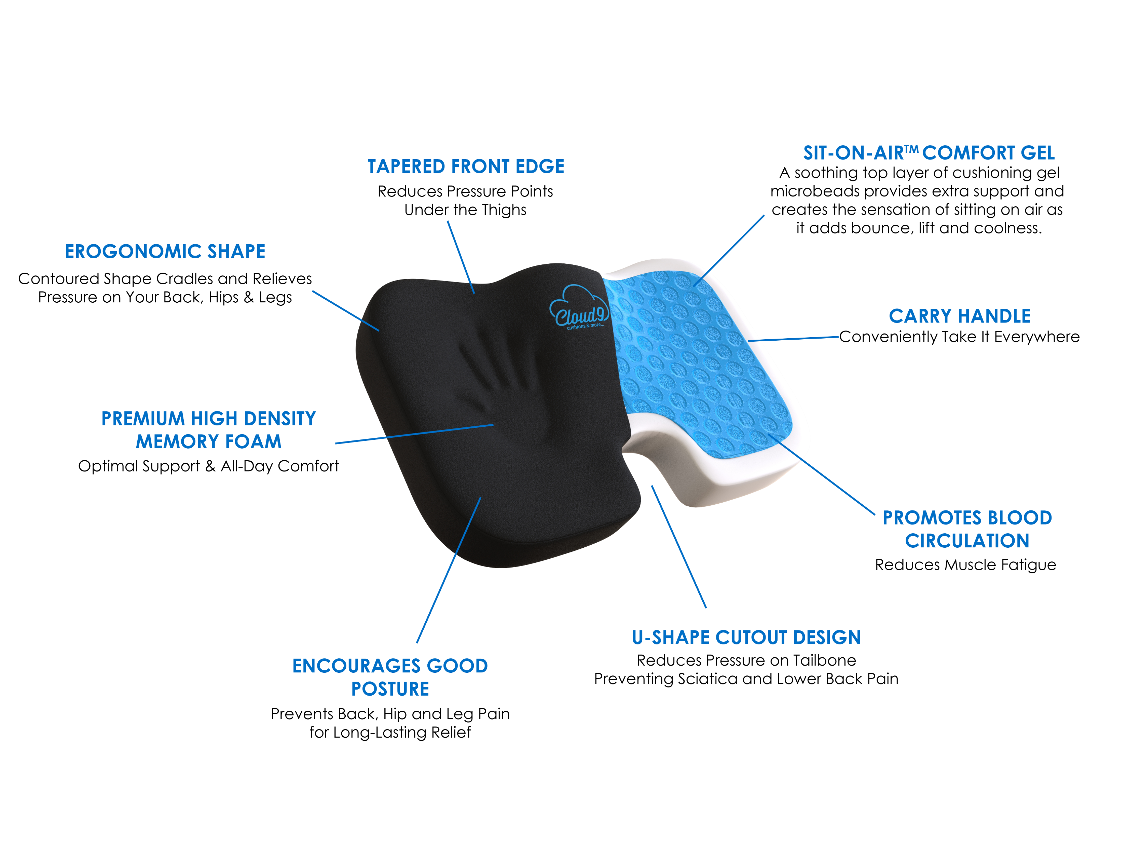
QUICK, EASY & AFFORDABLE WAY TO
Transform any Chair into a Comfortable Seat
What People Are Saying
<
“I have been using the Cloud 9 seat cushion for about a month now and can’t believe something so inexpensive could provide such incredible relief for my back pain. Totally worth the money.”
- Debi W.
Ft. Lauderdale, FL
>
BENEFITS & FEATURES
ORDER NOW
90-DAY RISK FREE TRIAL*

Slide 3

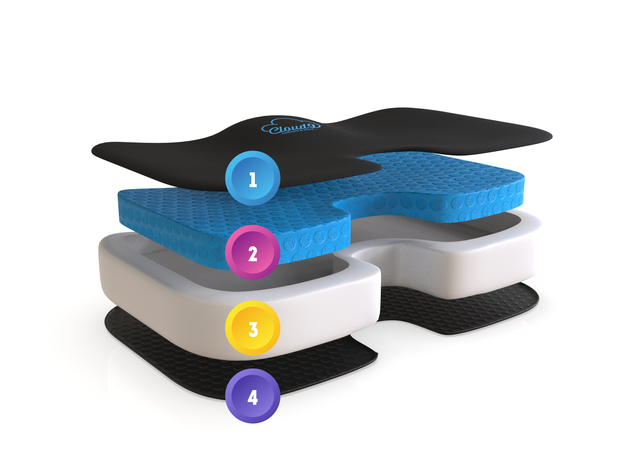







4-LAYERS OF CLOUD-LIKE COMFORT
Soft Removable Cover
The cushion’s cover is made of soft velour fabric that provides a breathable and durable surface. Premium zipper allows easy removal and washing.
Sit-On-Air™ Comfort Gel
A soothing top layer of cushioning gel microbeads provides contouring support and creates the sensation of sitting on air as it adds bounce, lift and coolness.
Space-Age Technology
Originally developed by NASA, this premium high density memory foam base provides stability and support for a sturdy foundation and hours of pressure relieving comfort.
Non-Slip Bottom
The non-slip bottom is made of fabric with rubber textured dimples, keeping the cushion in place to ensure optimal safety and support on all surfaces.
Imagine Sitting All-Day in HEAVENLY Bliss
GIVE YOURSELF THE GIFT OF HEALTH
ORDER NOW
90-DAY RISK FREE TRIAL*

Slide 4
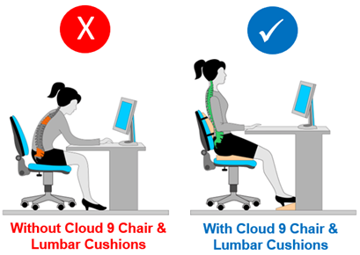
How does Cloud 9 work?
It’s simple. The secret to Cloud 9’s success is its advanced Sit-On-Air™ Comfort Gel. This cutting-edge technology will make you feel like you’re sitting on air as it adds bounce, lift and coolness for cloud-like comfort. With this incredible technology, millions of soothing gel microbeads are infused into the top layer of the cushion creating a cooler surface, with less pressure and better support. Virtually eliminating all pressure points that cause poor blood circulation. And that means you will sit cooler, longer and more comfortable than ever before.
At the heart of every Cloud 9 is a base made of premium high density memory foam that was originally developed by NASA to make the astronaut’s seats more comfortable. This shock-absorbing memory foam serves as a great foundation that maintains its shape for long-term dependability. Its specially designed contoured shape instantly molds, comforts and cradles you for fantastic pressure-relieving support and comfort. Plus, this amazing cushion features a special therapeutic U-shape cutout, eliminating contact pressure on your tailbone. Preventing sciatic and lower back pain.

Slide 5
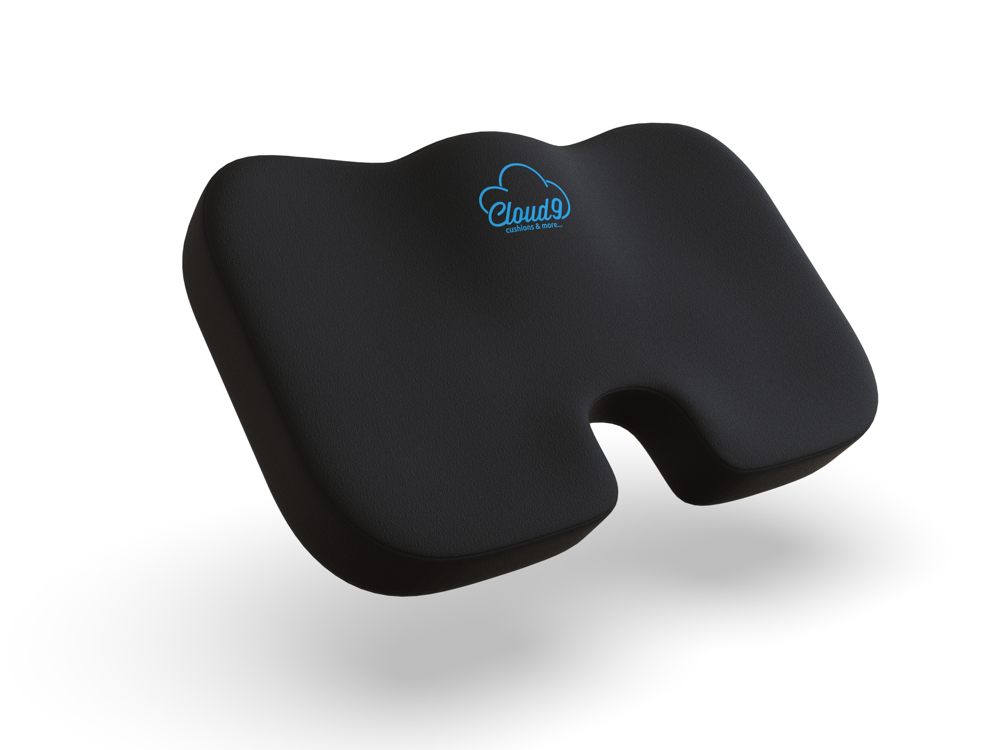
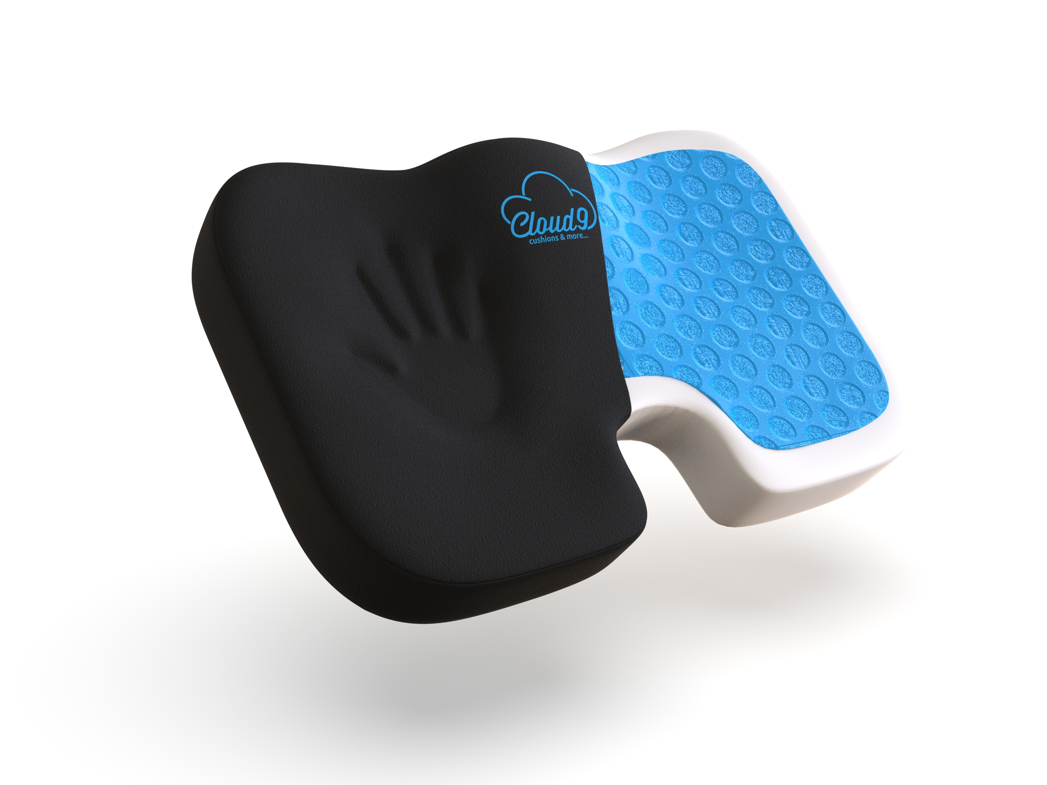
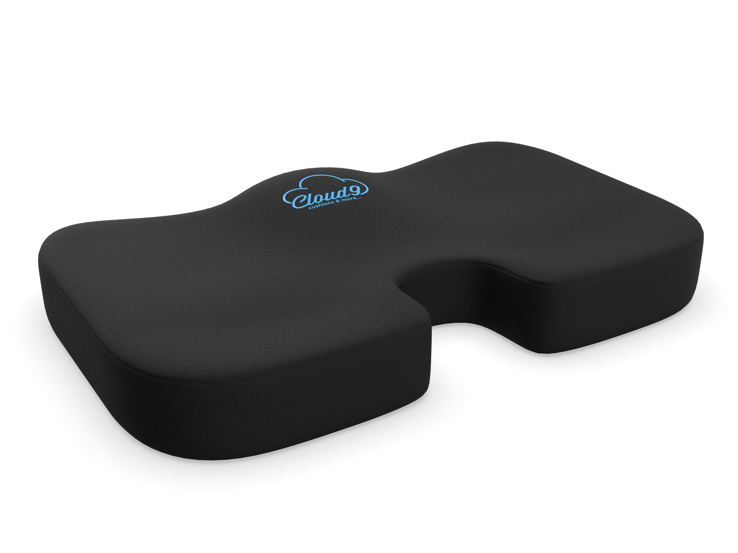
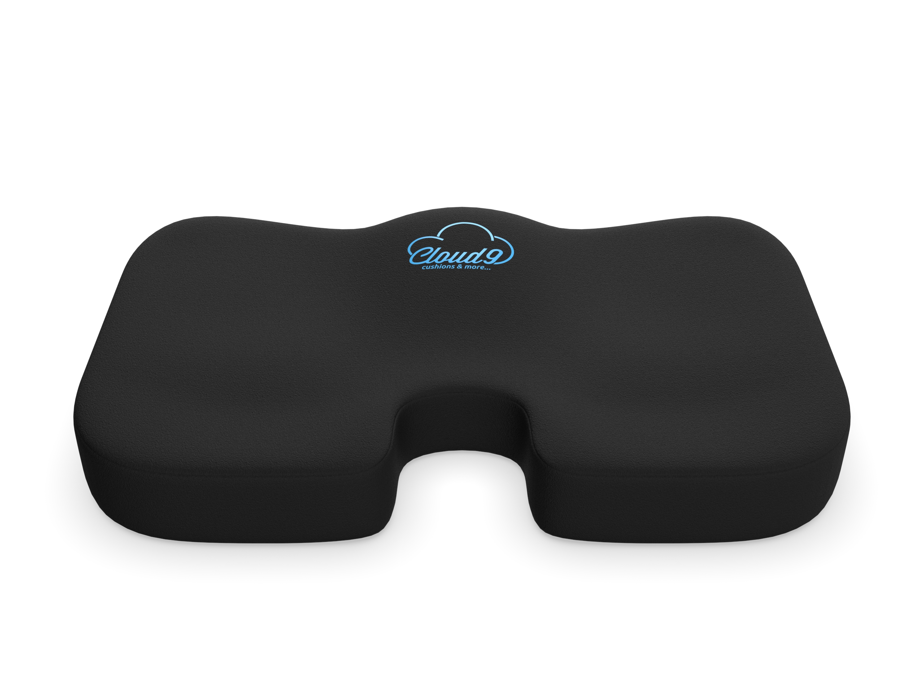
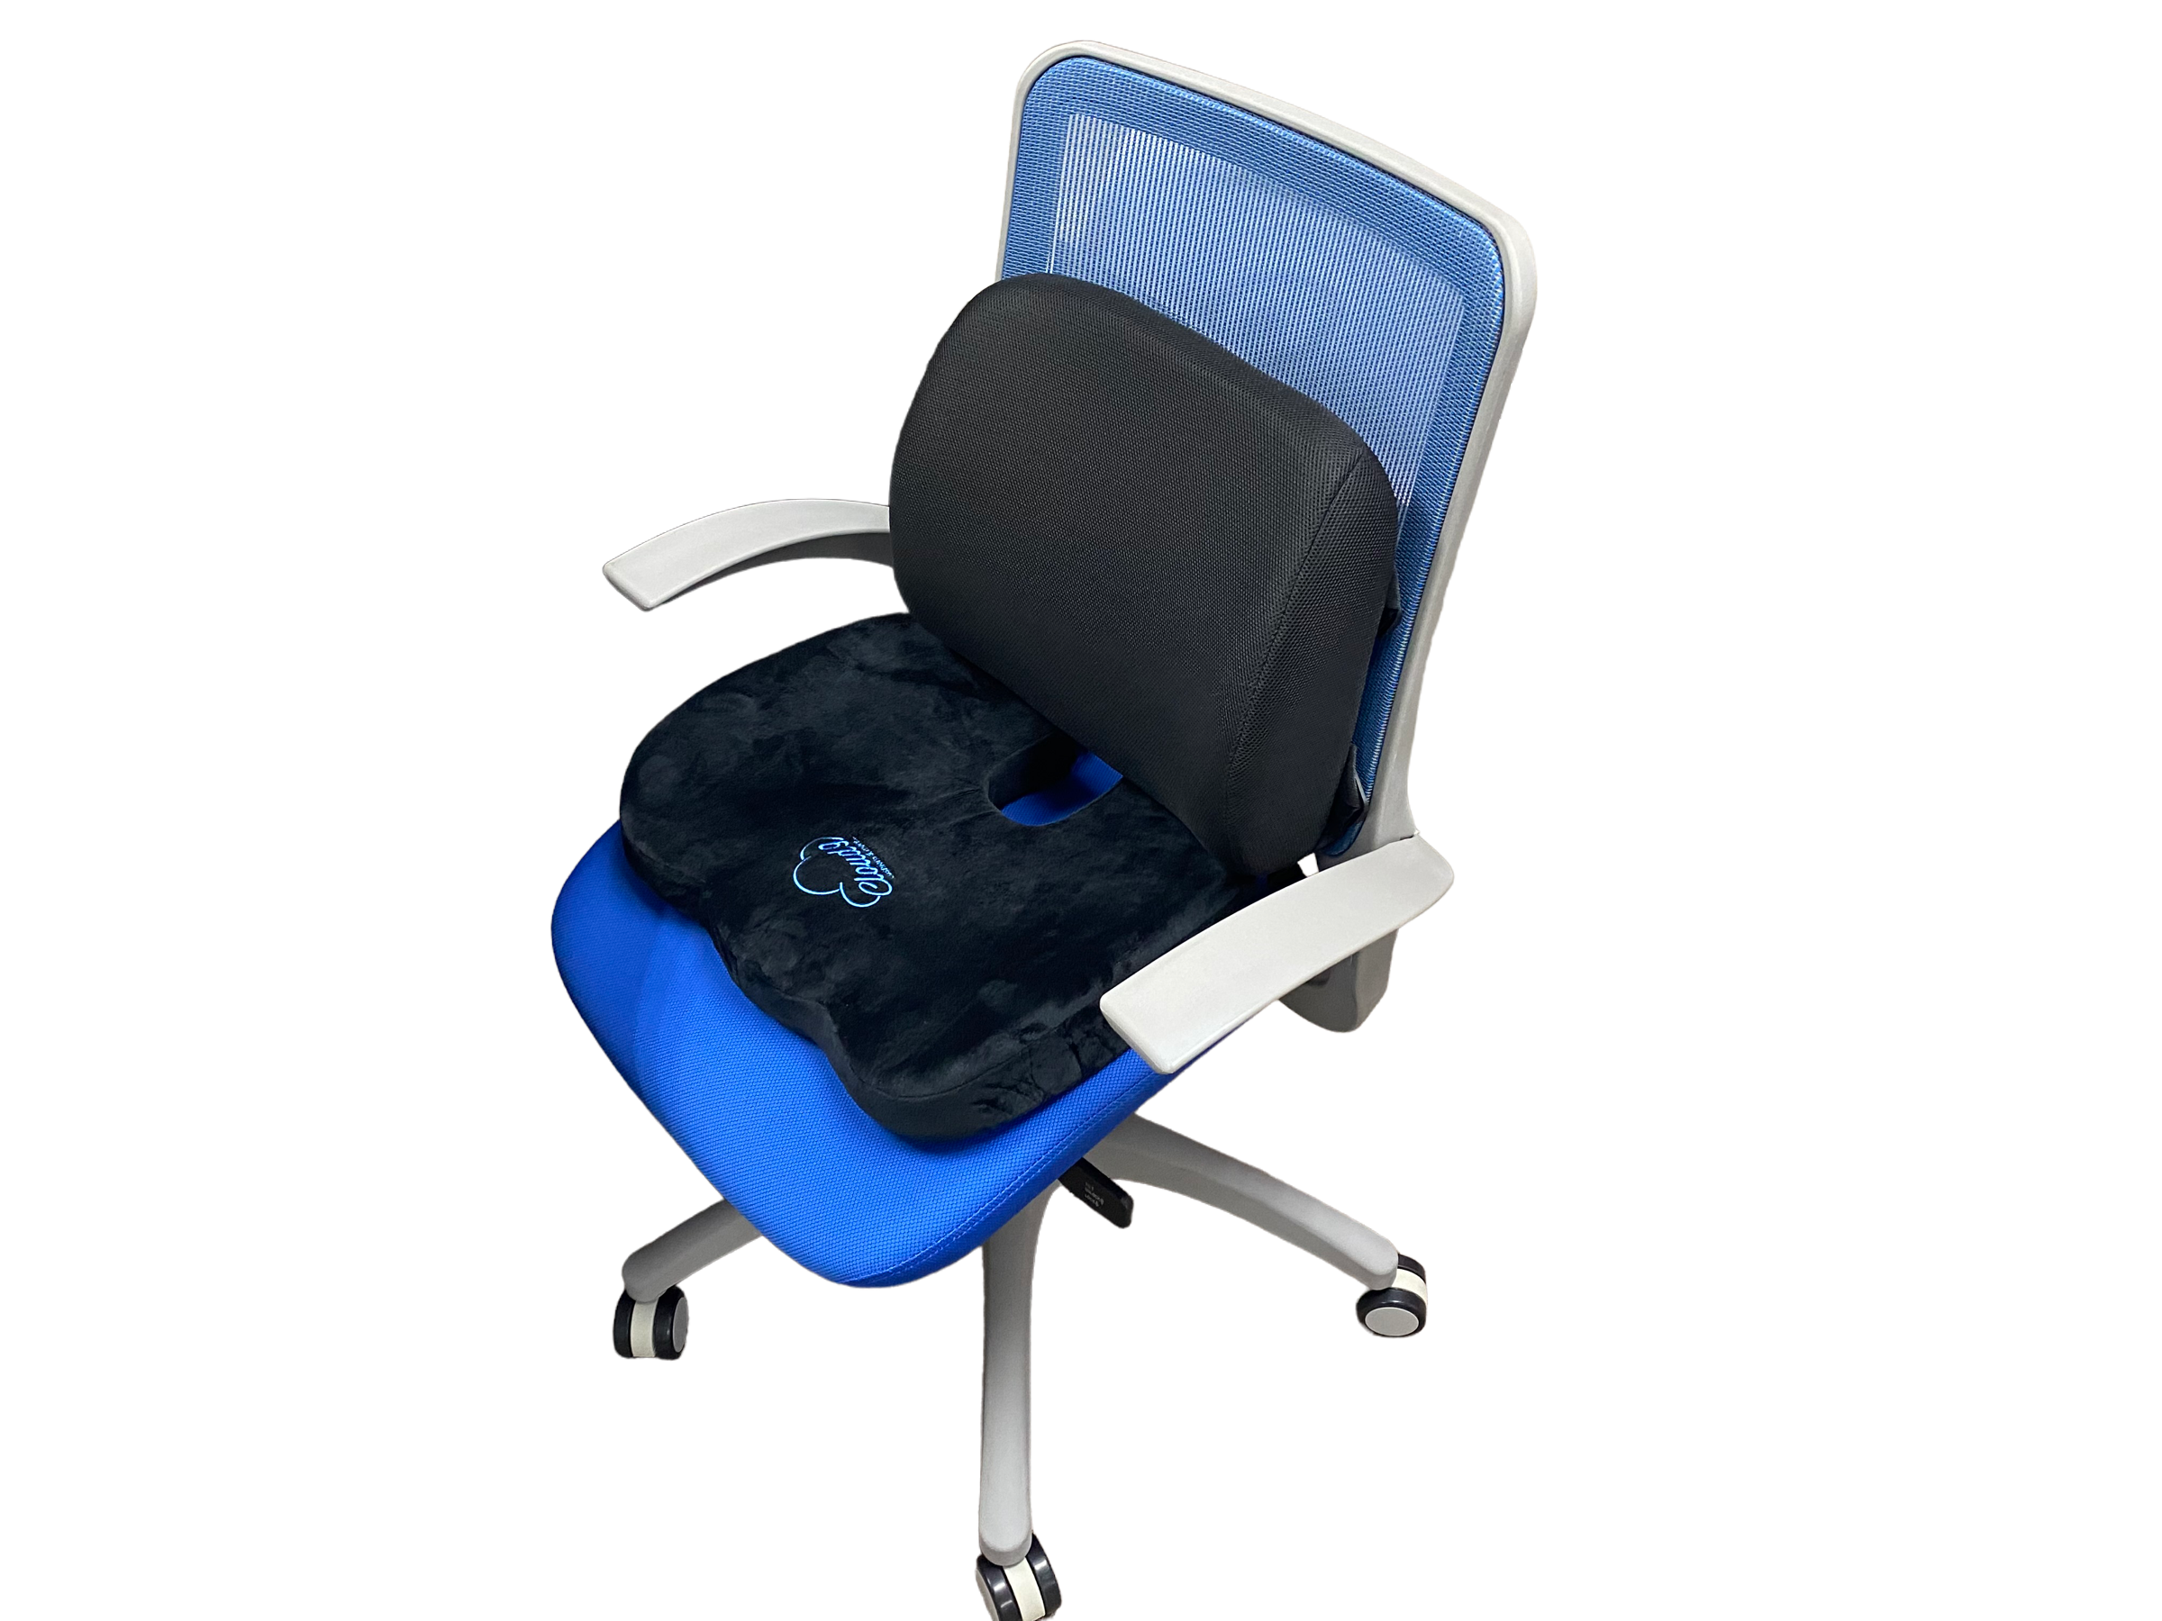

CLOUD 9 SEAT CUSHION
Super comfortable. Super affordable.
The Cloud 9 helps relieve pressure on your lower back when sitting on hard surfaces. It’s the Quick, Easy and Affordable way to transform any chair into a comfortable ergonomic seat. It comes with a Tailbone cutout for Sciatica & Back Pain Relief. The Cloud 9 features Sit-On-Air™ Comfort Gel that adds Bounce, Lift and Coolness for all-day comfort. The special ergonomic design promotes good posture while maintaining the natural curve of your spine. Its contoured shape instantly molds, comforts and cradles you for fantastic pressure-relieving support and comfort. Lightweight and portable, it works great on office chairs, home chairs, car seats, airplane seats and wheelchairs. Machine-washable soft velour cover for easy cleaning and it has a non-slip bottom that provides optimal support on all surfaces.
$49.95
$69.95
Add to cart
Back Pain & Sciatica Relief
Promotes Good Posture
Improves Blood Circulation
Relieves Stress & Boost Energy
Doctor Recommended
Our mission is to enrich people’s lives by creating affordable products that promote better health and well-being
.

