Slide 1
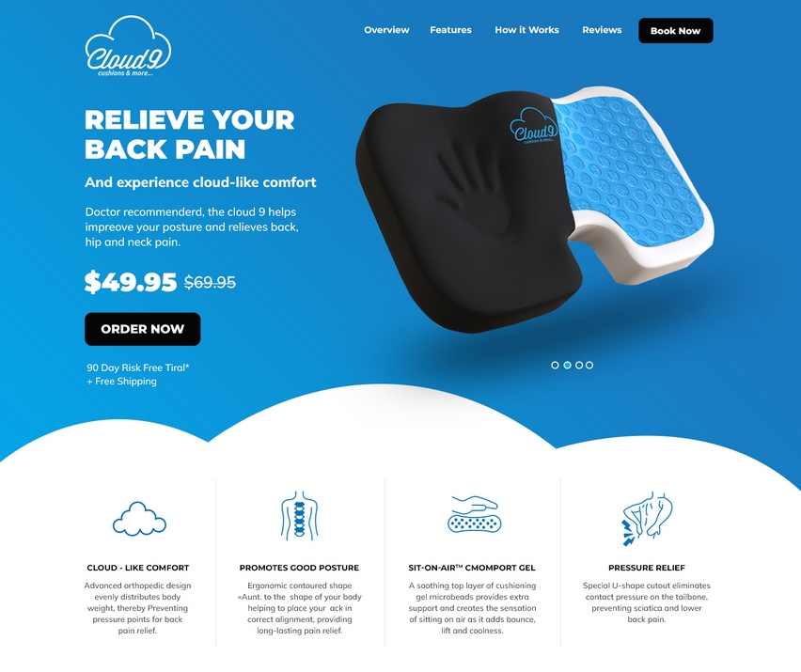

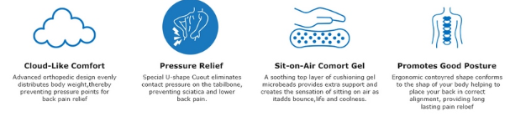

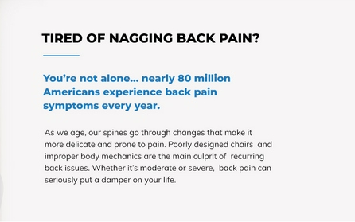






Can you insert clouds?
Capitalize
Change to View Video
Featuring Sit-On-Air™ Comfort Gel, the Cloud 9 Seat Cushion helps improve your posture and relieves back, hip and neck pain.
How The CLOUD 9 Works
Tired of nagging back pain?
You’re not alone… nearly 80 million American’s experience back pain symptoms every year.
Bolder font
Experience HEAVENLY bliss with the
CLOUD 9 SEAT CUSHION
CLOUD 9 SEAT CUSHION
Start your Journey To Back Pain Relief With Our 90 Day Risk-Free Trial
90 Day Risk-Free Trial.
The quick, easy and affordable way to transform any chair into an ergonomic seat.
Back Pain & Sciatica Relief
Promotes Good Posture
Improves Blood Circulation
Relieves Stress & Boost Energy
Try Cloud 9 Risk Free
So comfy, feels like you’re sitting on a cloud!
Change to this.

Slide 2
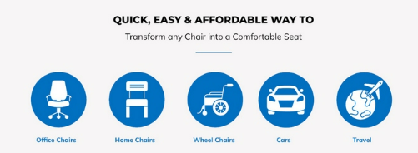
Replace with:
Transform Any Chair Into An Ergonomic Seat

