Slide 1



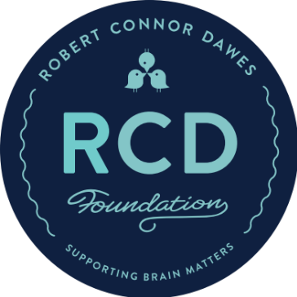
CONNOR'S RUN
2023
THEME BRIEF
CONNORSRUN.COM​

Slide 2

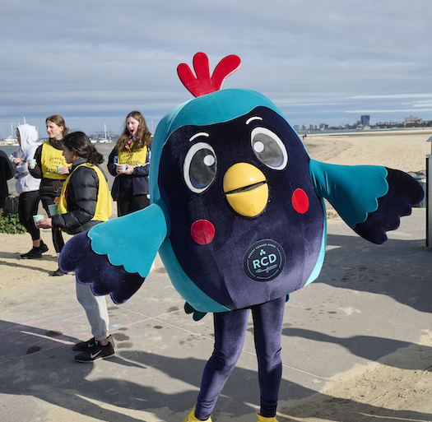

We need you to design the theme for Connor's Run, Australia’s largest event for paediatric brain cancer.
YOUR WAY, ANY DAY
Month of September, anywhere in the world.
FUN RUN AND PARTY
Sunday 10 September 2023, Melbourne

Slide 3

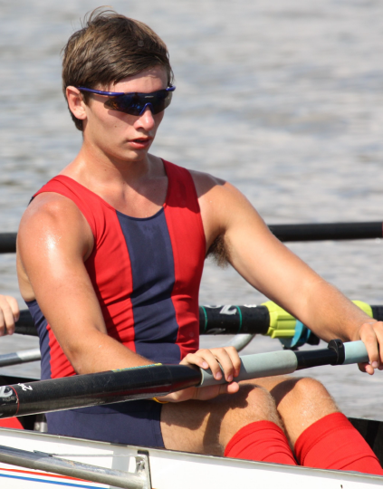
A STORY
TO RUN FOR…
In September 2011, 17-year-old Robert ‘Connor’ Dawes ran from his home in Sandringham to the boat sheds on the Yarra. Connor was determined to complete the 18.8km, he was training hard as he hoped to make the Brighton Grammar 1st VIII rowing team. Little did Connor know, he was about to enter the fight of his life. Two months later, Connor was diagnosed with brain cancer.
Major surgery resulted in loss of movement to his right side, impaired vision and severe short-term memory loss. His body was broken, but his mind was not. Connor spent hours each day on his physical and mental rehabilitation. Intense radiation and chemotherapy followed, but Connor never stopped smiling. He stayed positive, philosophical and true to his mantra: “I will be awesome”. After a 16-month battle, Connor passed away on April 20, 2013.
Determined that no family go through what theirs did, the Dawes family founded the Robert Connor Dawes Foundation, and have been on a mission to end brain cancer ever since.

Slide 4
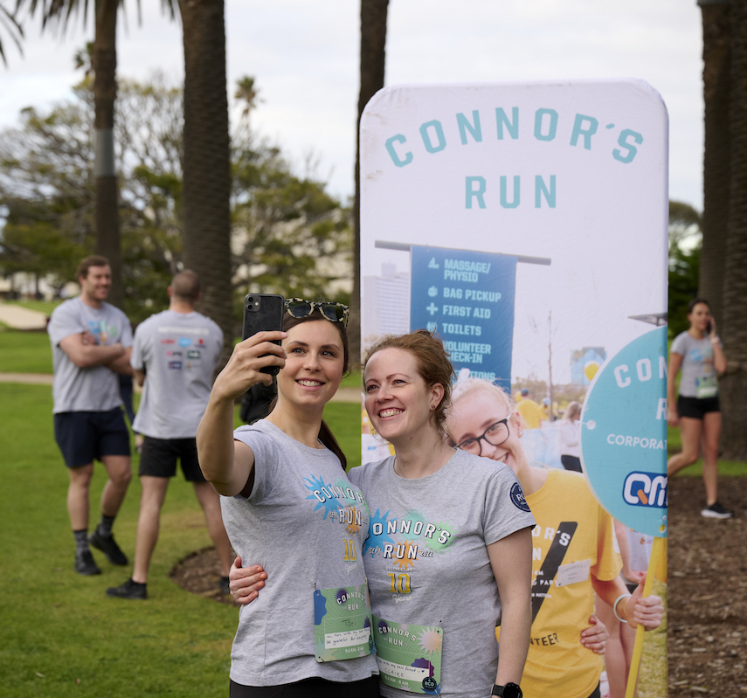
SUPPORTING
BRAIN MATTERS
Brain cancer is the #1 disease killer of young people.
Despite this fact, paediatric brain tumour research remains critically underfunded. Few new effective treatments mean that 80% of children diagnosed with high grade tumours will lose their battle within 5 years, and survival rates have barely changed in 30 years.
We think it’s time to change these odds.

Slide 5
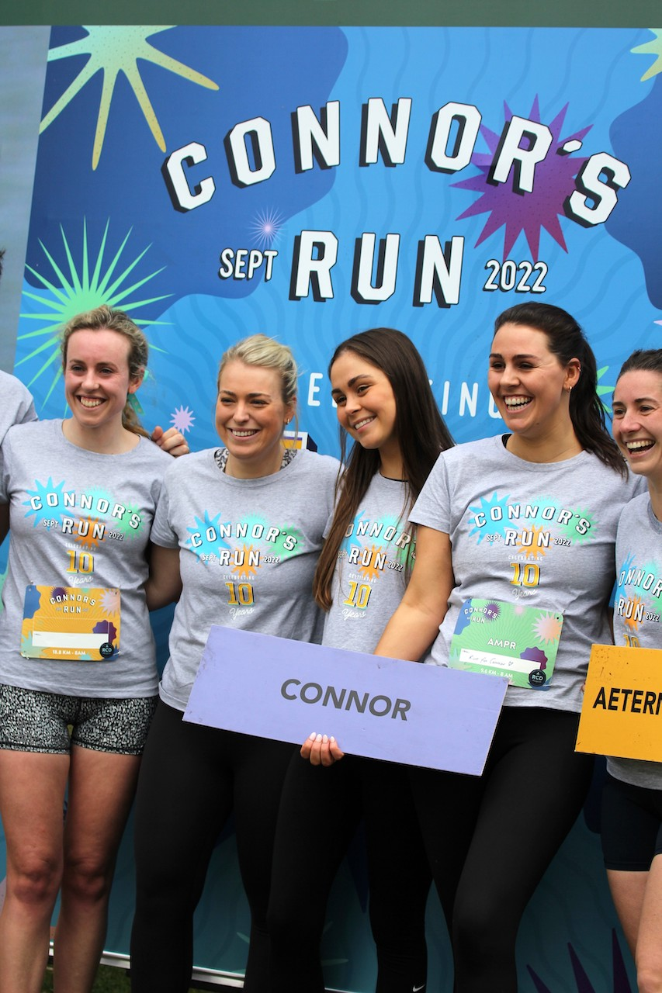
A VIBE YOU
CAN’T DESCRIBE…
Each year we promise ‘more fun than run’…
and we always deliver!
We are are a fun run that isn’t about winning (or even running).
Since inception, the RCD Foundation has raised a total of $12 million for brain matters, with close to $10 million raised over the last 10 years of Connor’s Run. In 2022, we raised over $2 million

Slide 6
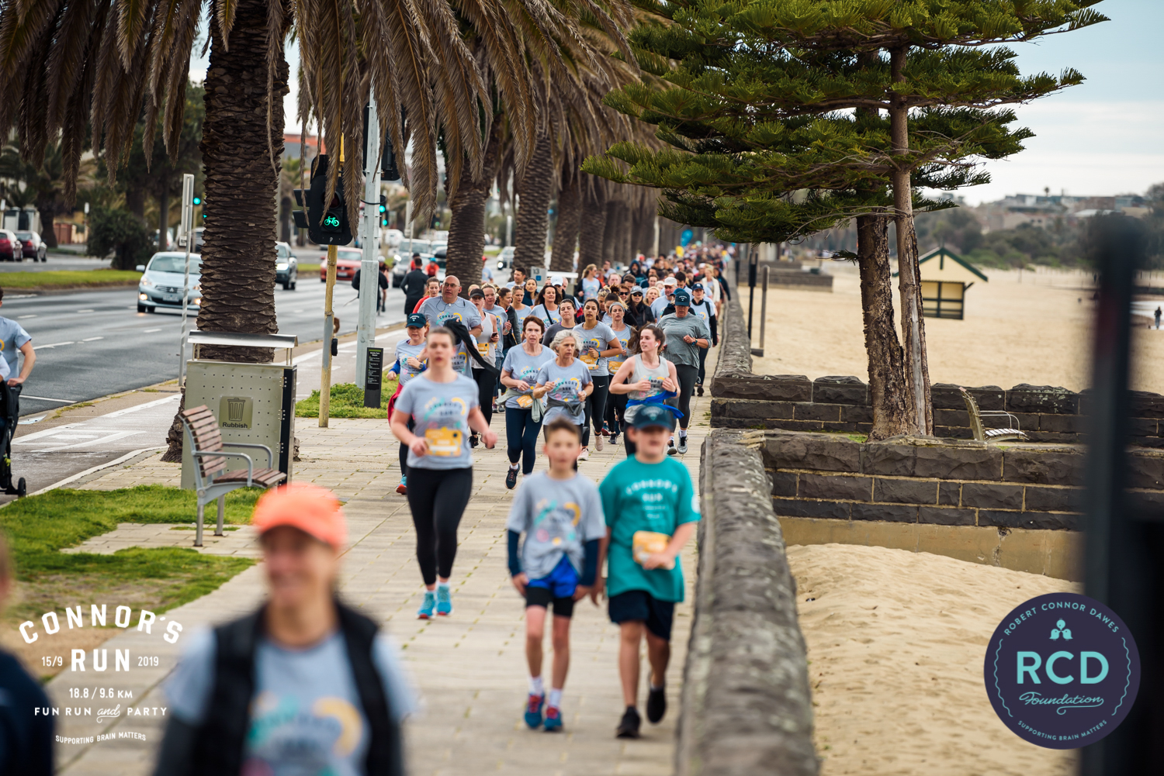
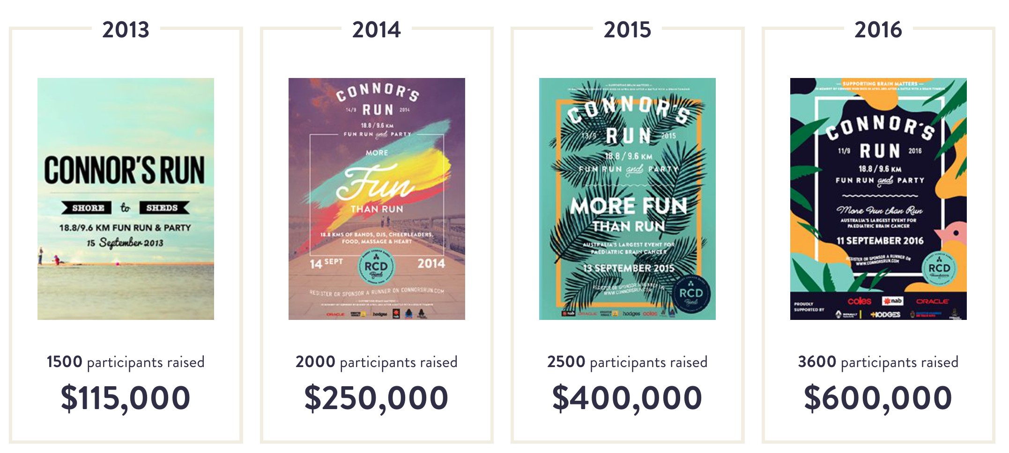
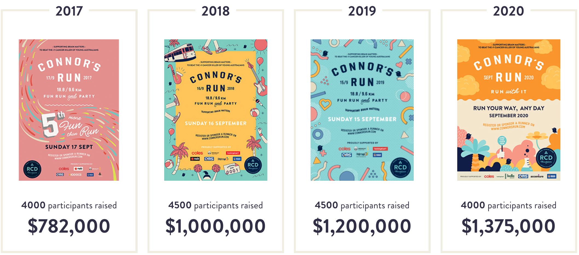
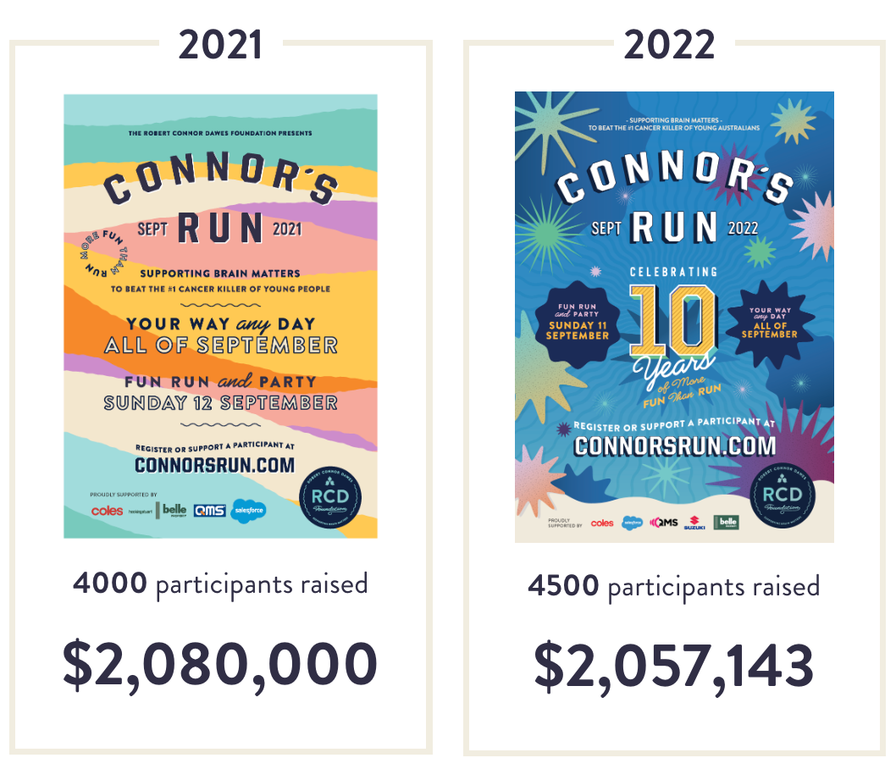
10 YEARS OF
MORE FUN THAN RUN
We are needing a new poster for 2023!

Slide 7
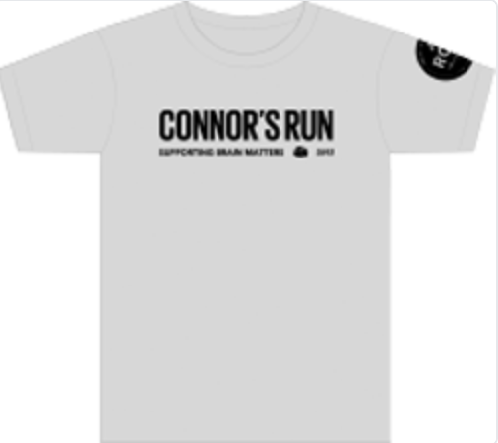
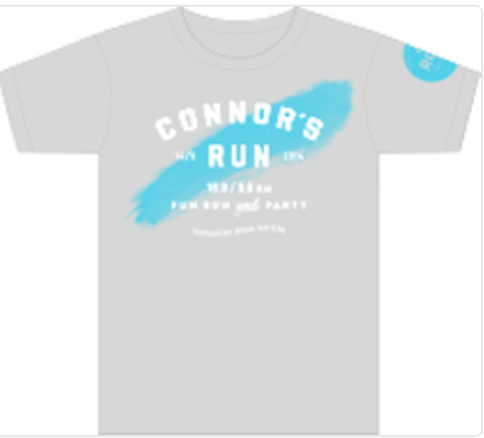
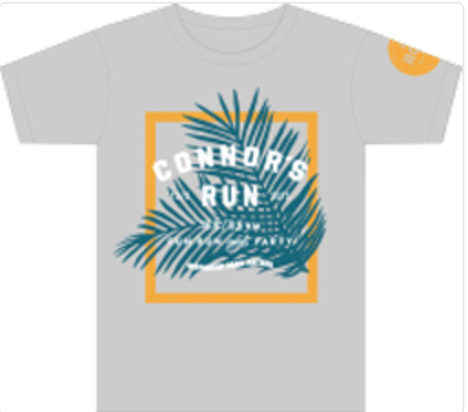
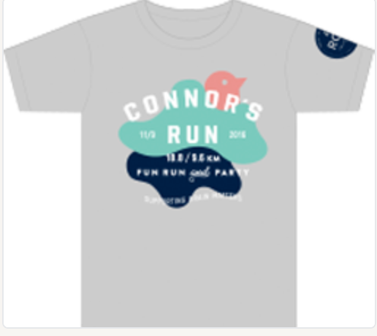
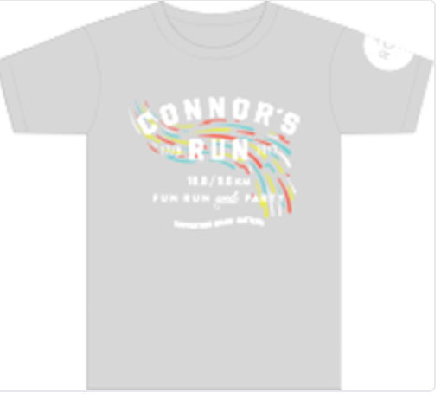
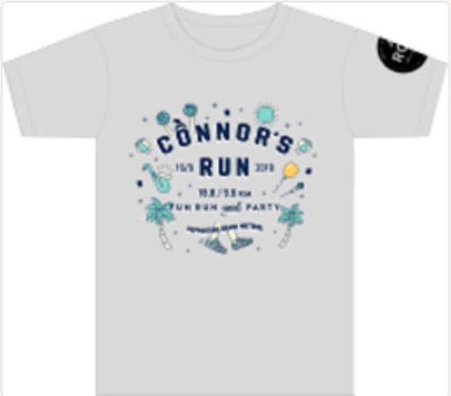
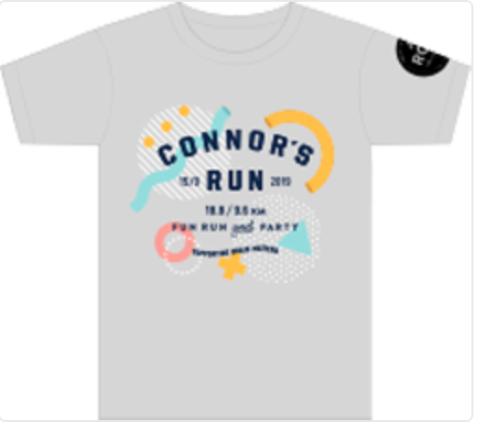
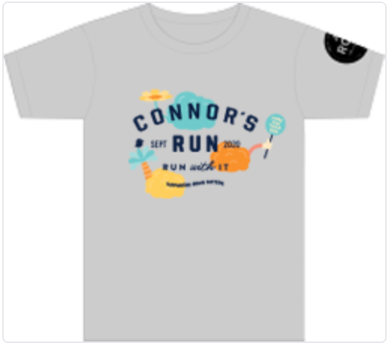
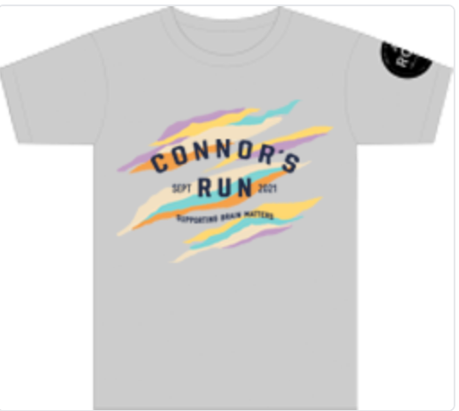
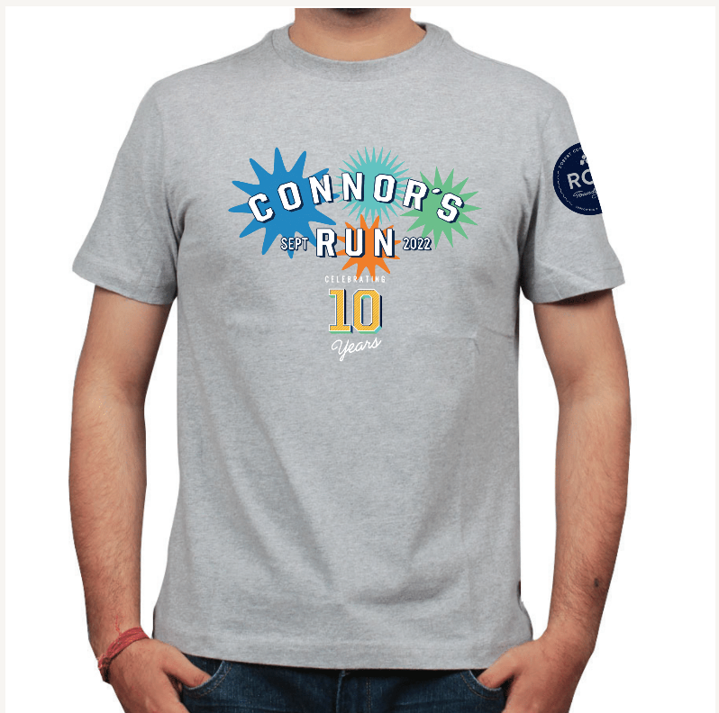
CONNOR’S RUN TEE
Along with the poster, each year we have a different tee that incorporates the theme.

Slide 8
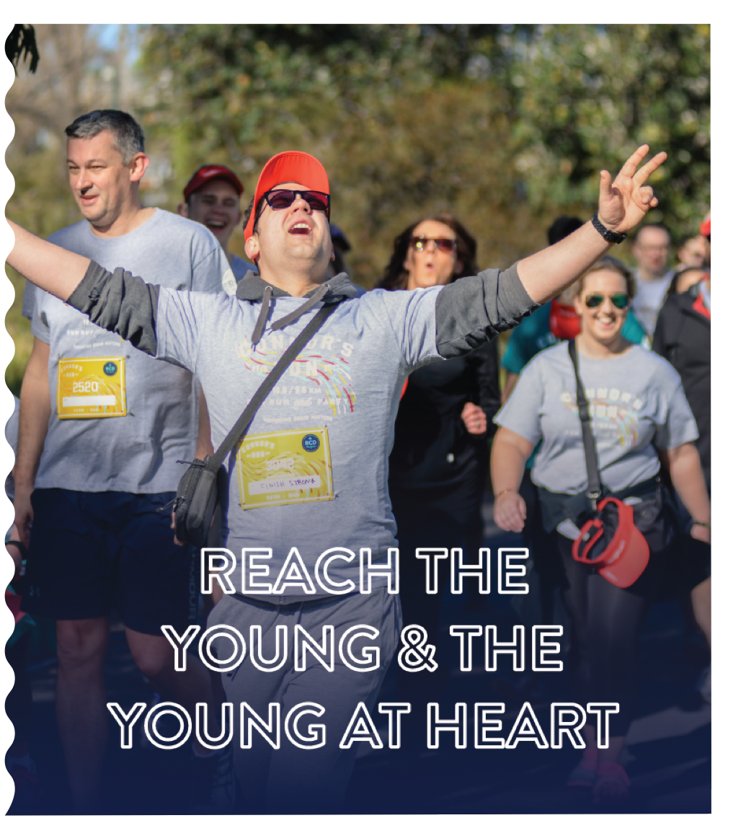
THE BRAND
View our brand guidelines HERE
The event vibe is:
Fun
Beachy
Incredible energy with a 'vibe you can't describe'
Young + young at heart
Sensory sensation (music, dancing, activations)
The event vibe is not:
About winning
Being too serious
Competition

Slide 9
DELIVERABLES
The design you create must work across a range of print and digital assets. The first priority is the poster, we hope to have this complete by early January.
Themed poster
T-Shirt
Social Tile Posts (1 x based off poster, 1 x mp4/gif, 1 x frame template)
Social banners (Facebook, Twitter, LinkedIn)
Mailchimp banner
Electronic billboard mock-up
Website banner

Slide 10

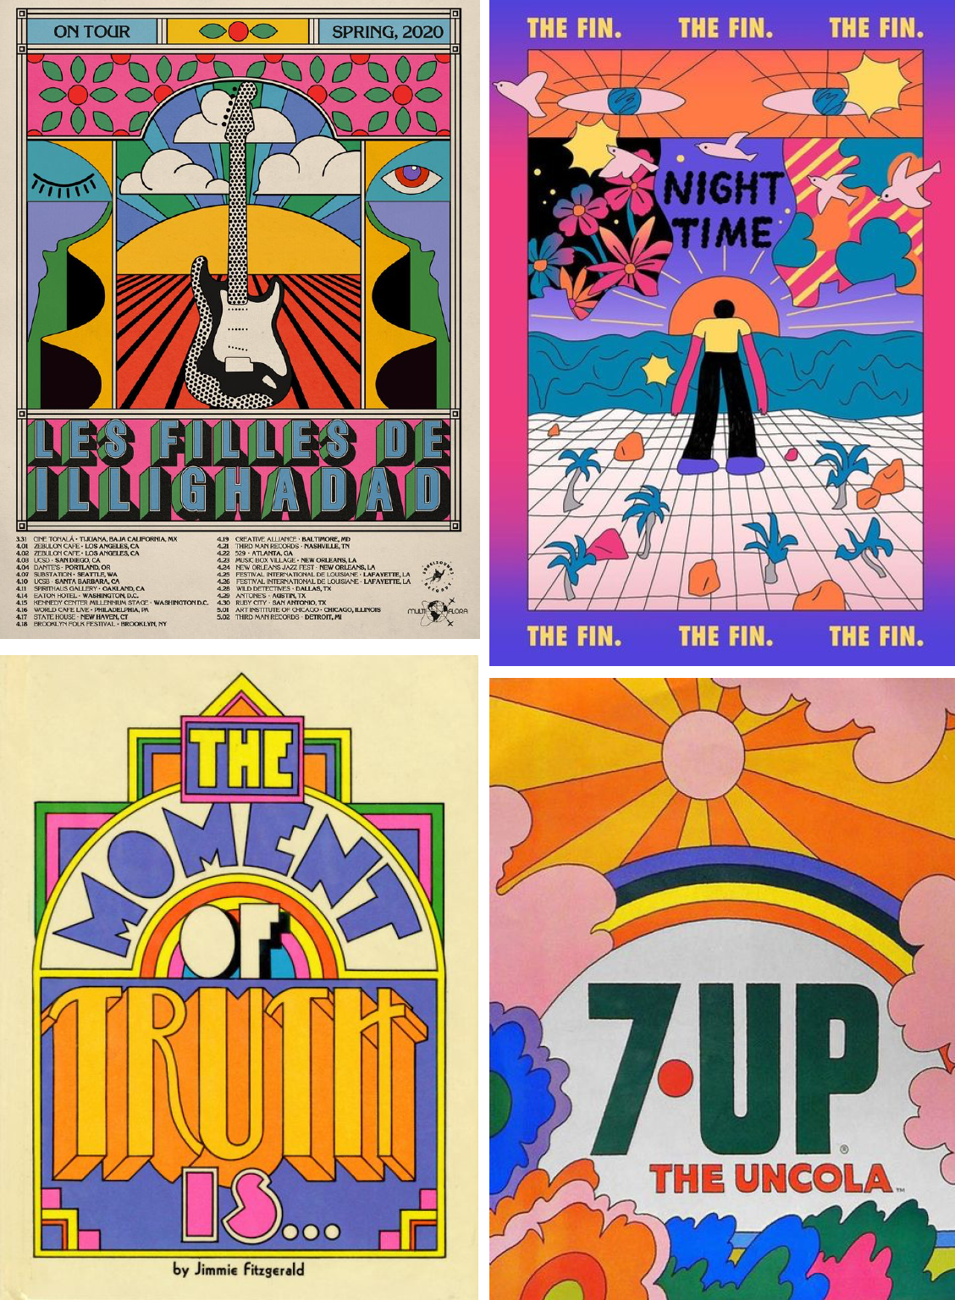
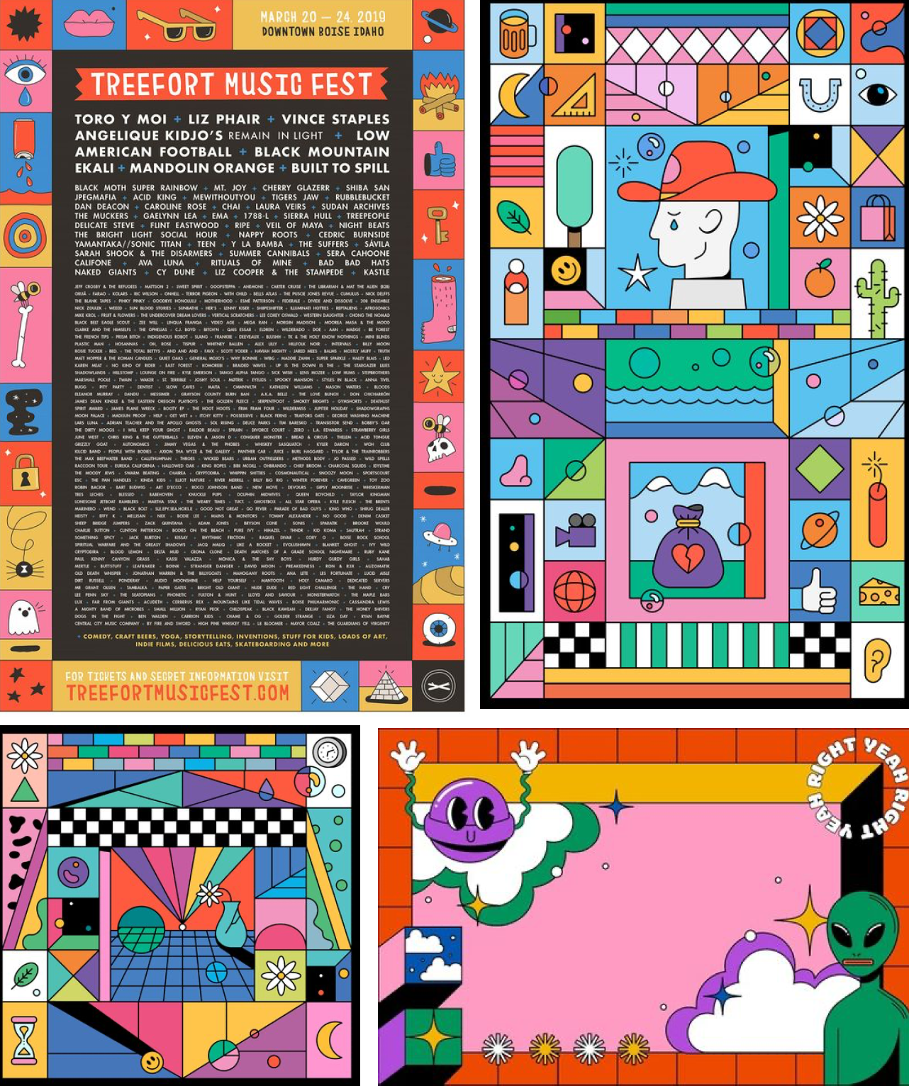
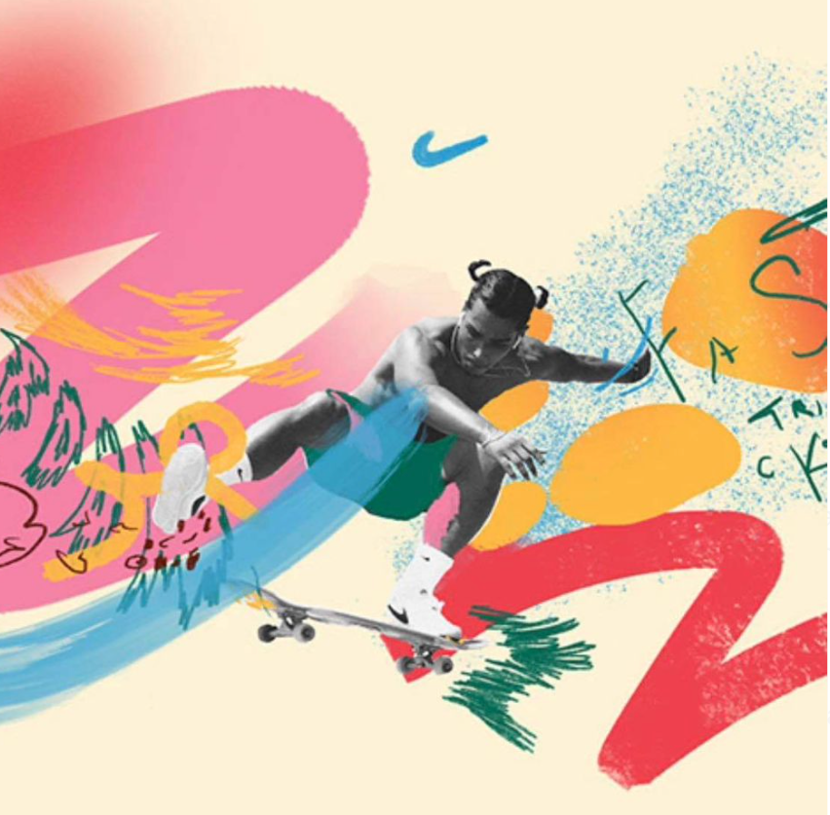
MOOD BOARDS
Connor's Run Vector Village
Retro 60's, 70's poster
90's electric geometric
'Sandy Heat' Retro Miami
'beach vibe, juxtaposed
With event photo.

Slide 11
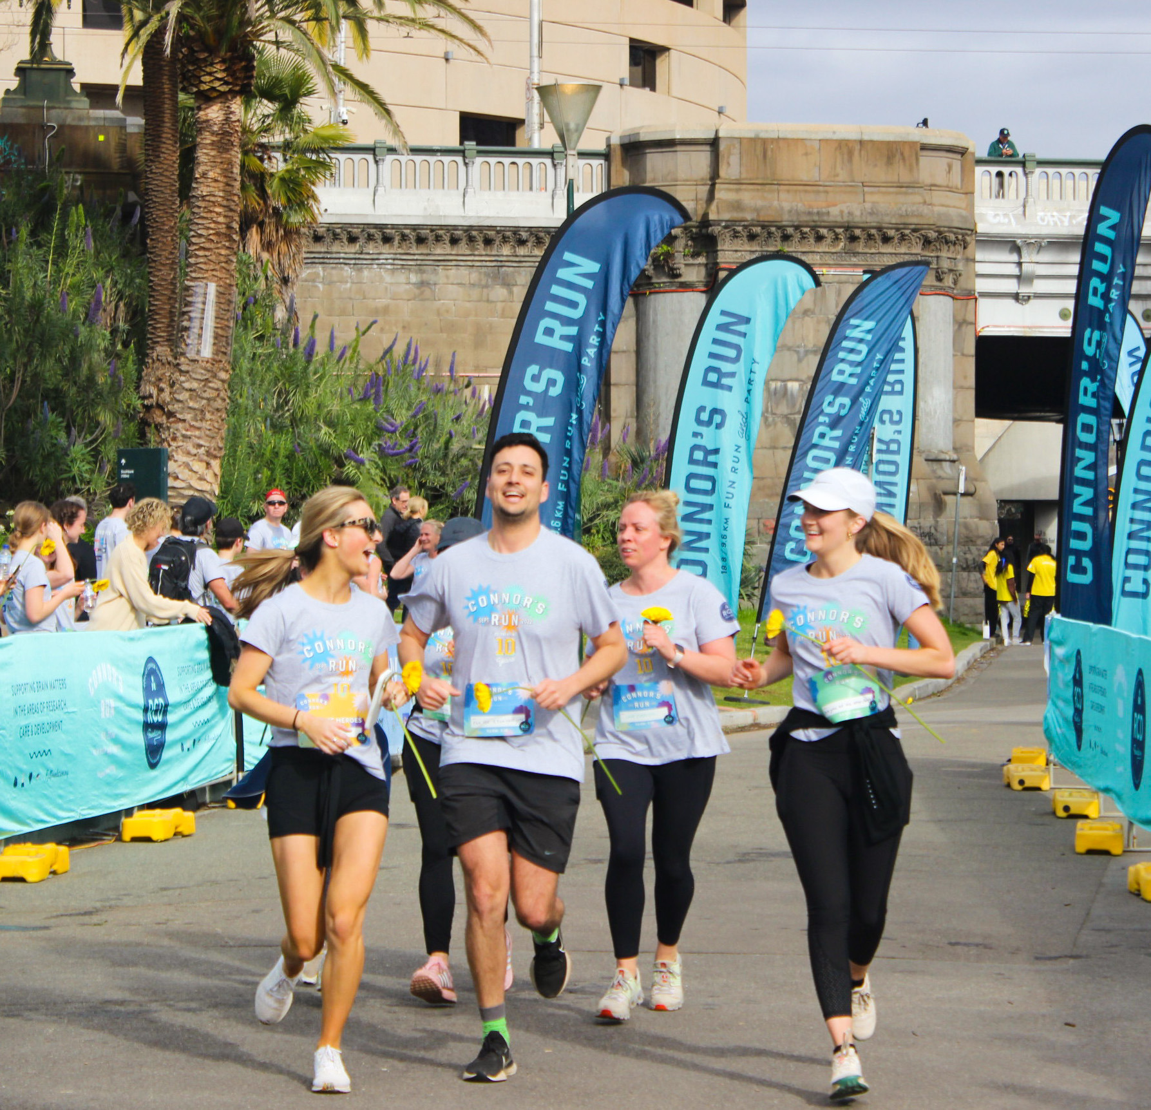
Thank
You!
Charlotte Westover
Marketing Manager
charlotte@rcdfoundation.org
Jackie De Santis
Marketing & Events Coordinator
jackie@rcdfoundation.org
CONNORSRUN.COM

