Slide 1
FabWest, is a multi-disciplinary design/engineering and fabrication company based in Welshpool , Western Australia
The guiding force in all that we do is our commitment to providing hands-on reliable customer service and quality metal and plastic components for a broad range of industries including Mining, Chemical Industry, Oil and Gas , Water Treatment, Agricultural Equipment, Material Handling, Construction Equipment, Renewable Energy & more.
At our Welshpool location, you will find a team of experienced manufacturing professionals ready to provide value-added services including integrated project management, new product development, engineering collaboration, fabrication, welding and finishing. We have the machinery and the expertise to provide highly integrated, comprehensive manufacturing solutions.
With over 100 years of our combined experience and years of service in Metal and Plastic fabrication shops as well as design offices , we are grateful to our customers who helped us get here. That gratitude is reflected in the work we do and it’s what drives us forward each day. We are proud of who we are and excited to share our future.

Slide 2
Mission Statement
From local outreach to environmental impact, our team is committed to bettering the communities we serve through our processes, practices, and actions.
FabWest Mission
FabWest is committed to providing our customers with quality products, on-time and at competitive prices.
FabWest will treat our employees, suppliers and customers in a fair and equitable manner.
We will conduct our business based on high ethical standards, integrity and honesty, while creating a safe, challenging environment that promotes learning, teamwork and personal growth.
WHERE INNOVATION MEETS PRECISION
The work we do at FabWest is cutting edge, but every project comes down to how our team handles your needs. That’s why your dedicated project team is with you every step of the way, focusing on your unique design ideas, budget, and schedule.
Our turnkey fabrication services range from the design phase through to the very end of your project.
THE TEAM AT FabWest REMAINS COMMITTED TO:
THE GOLDEN RULE
Many say it, but we live by it. From clients to staff, everyone at FabWest leads by treating others how they would like to be treated, with dignity and respect.
QUALITY AND PRECISION
The projects that FabWest contributes to are largely dependent on the quality and precision of the fabrication work that we do. Regardless of how big or small the scale of the project is, our team delivers quality every single time.
UNBEATABLE SUPPORT
We take customer support seriously, making it our mission to always be upfront with our capabilities, pricing, and timelines. When you have questions or concerns, your dedicated project team is there to offer guidance and provide answers.

Slide 3
OUR COMMITMENTS TO YOU
With every job we take on, FabWest promises to deliver
QUALITY
We understand the level of precision required to seamlessly carry out fabrication projects, so our processes are designed to guarantee the highest level of quality on every job.
TRANSPARENCY
From initial budget estimates to the end of construction, our team is dedicated to transparency throughout the entire process, so you always know where your project stands.
SUPPORT
A dedicated project team, including some of our top executives, will guide you through your project. When you have questions or concerns, we’re right by your side.

Slide 4
INNOVATIVE FABRICATION SERVICES FROM A TEAM YOU TRUST
FabWest operates steel and plastic fabrication facilities, utilizing the latest high-tech machinery and cutting-edge computer-driven processes to bring the pieces you need to life with the precision you rely on.
Our team of enthusiastic and highly skilled and qualified tradesmen put their craftmanship, knowledge, and passion into every piece that leaves our plants .
We can fabricate almost any item from a huge range of mild steel, and stainless steel as well as variety of plastic materials. All fabrication is performed and inspected under strict quality assurance program.
Our facilities include several pieces of innovative CNC equipment that utilize the latest industry technology,

Slide 5
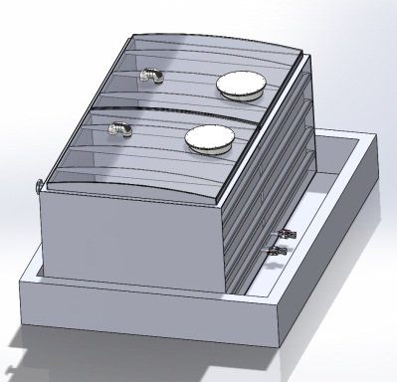
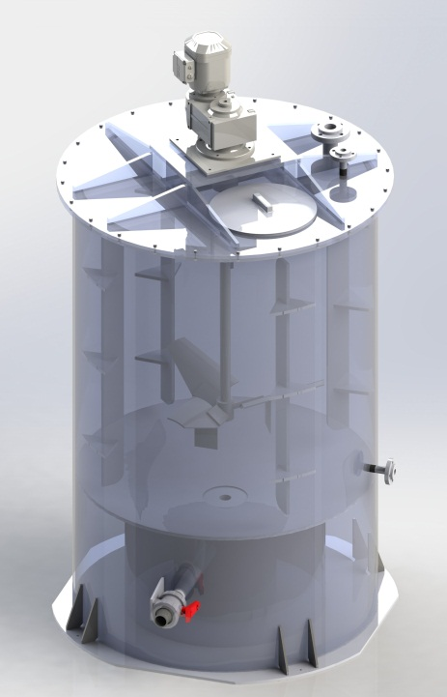
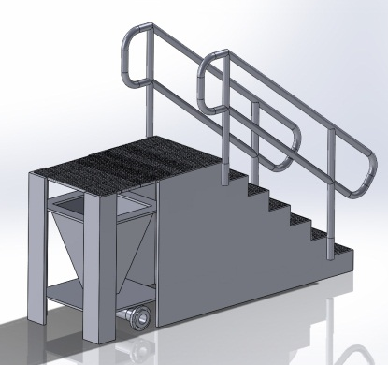
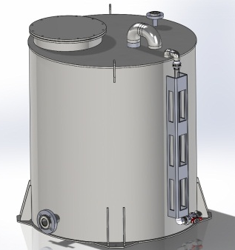
Computer Aided Design
From beginning to end, FabWest provides unbeatable engineering support to ensure every project is a success.
One of the services that FabWest offers its customers is its ability to provide extensive 3D Computer Aided Design. From templating/ concept to product design, FabWest team uses state-of-the-art SolidWorks 3D software to effectively model entire projects and produce detailed drawings of parts and assemblies for customer review. This allows for design issues to be resolved prior to manufacturing and minimizes the need for costly and time delaying rework. After designs are approved by customers, the project information is uploaded to the CNC router or a milling machine, allowing for production of accurate and consistently high-quality parts.

Slide 6
Industrial Storage and Process Tanks
FabWest plastic tanks manufactured out of HDPE sheet, Polypropylene (PP) sheet, Polyvinylchloride (PVC) or other plastics provide long term, corrosion free environment ideal for a diverse range of applications. This incorporates bulk holding purposes to store potable water, chemical, waste and effluent applications. With tanks manufactured from high density polyethylene (HDPE) with carbon black in the resin, which is a UV stabiliser allows HDPE tanks to be used in an exposed environment and/ or in a buried application. With custom fabrication we can supply and fit a wide range of various components such as inlet & outlet, flanges, threaded fittings, valves & taps, inspection ports, level indicators, sight glasses, anchor points, and baffles.
All our tanks are custom designed, fully fabricated to the highest standards offering up to 25 Years Design Life.

Slide 7
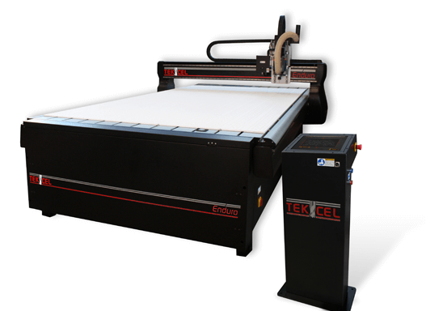
CNC Capabilities
Our Australian manufactured TekCel CNC router with 4m x 2 m bed has had a profound impact on the shop operations. The CNC has proven to be an efficient tool for producing complex, accurate and repeatable parts that simply cannot be matched with more traditional machinery. When parts get to assembly, they simply fit with little to no need for tweaking and adjustments.
The CNC offers us a unique opportunity to benefit from a production quality piece of equipment in a custom shop environment. FabWest also welcomes opportunities to use the CNC for production of component parts for commercial customers.
Whether you are looking for custom one-of-a-kind project or need help producing large quantities of component parts, FabWest has the capabilities to assist you with your project.

Slide 8
Chemical Bunds
It is an HSE requirement for tanks storing dangerous or hazardous chemicals to have a bund.
FabWest have a range of plastic bunded chemical storage tanks, bunds and drip trays which can help meet this legal requirement. Chemical bunds have an enviable record of limiting and preventing hazardous substances and chemical spills.
Manufactured from sheet plastic, rigid or flexible, predominantly HDPE, our bunds have many advantages over other types such as speed of manufacturing, ease of installation, site specific design, and relocatable if required. Whatever your requirement is our FabWest team can design and fabricate it to reduce your environmental and contamination risk.
Chemical Bunds can be open top for indoor applications or enclosed for outdoor to stop rainwater from entering the bund and also used within buildings for process vessels.

Slide 9
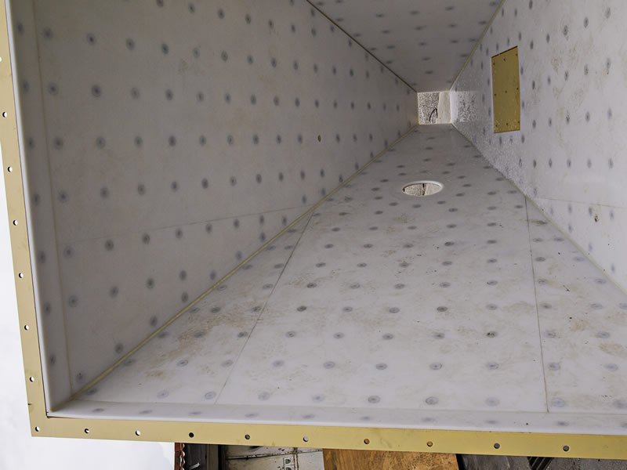
Lining/ Flow Promotion
FabWest team can design, machine and install a variety of liners to chutes, launders, tanks and process equipment. Typically chutes are lined in UHMWPE to improve wear resistance and promote flow. Sheets are secured using cap bolts or welded studs. CNC machining of the liner ensures accurate placement of holes as well as a good mechanical fit for the fastener cap. We recommend that seams between sheets are welded to avoid material hang up.
Other linings can be made in any thermoplastic, dependant on service requirements and such plastics include PVC, PE, PP, PVDF, ECTFE and PFA.

Slide 10
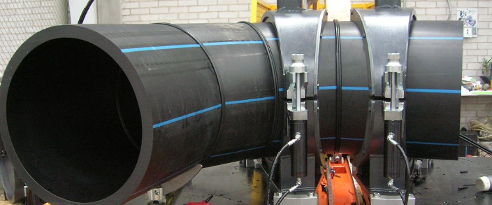
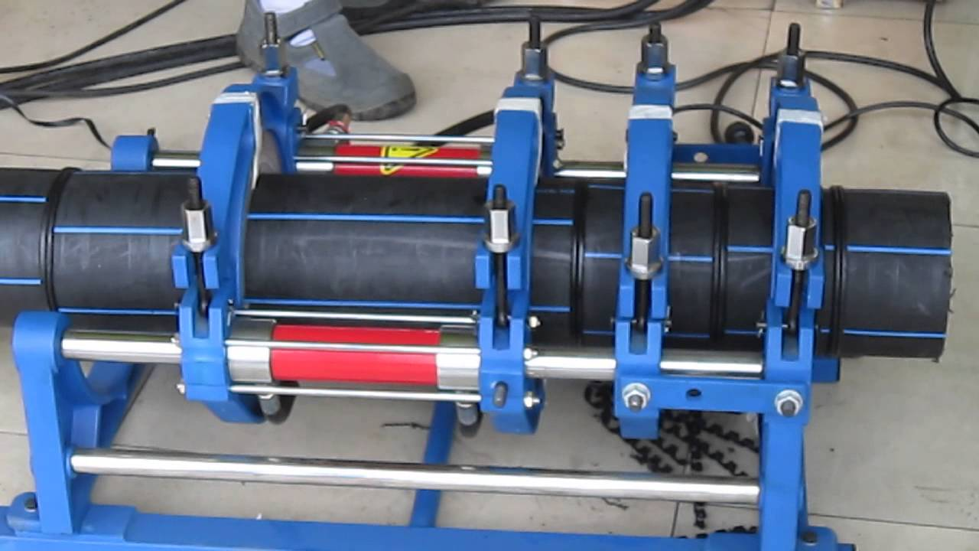
Onsite Services
We offer a wide range of on-site services such as: Electrofusion, butt fusion, extrusion welding as well as solvent cement joining according to clients’ requirements.

Slide 11
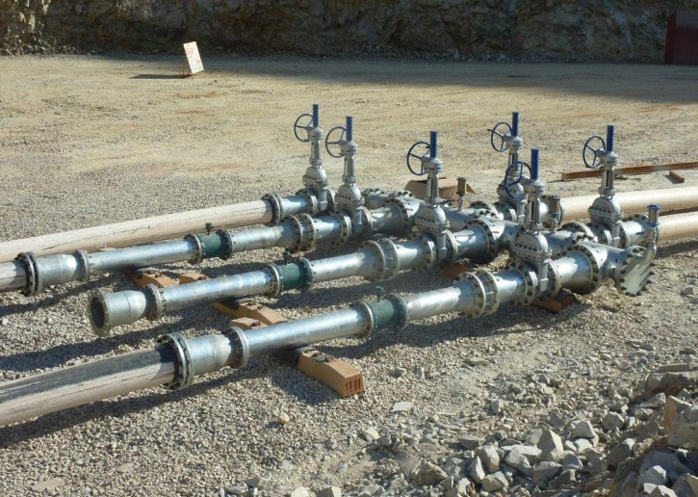
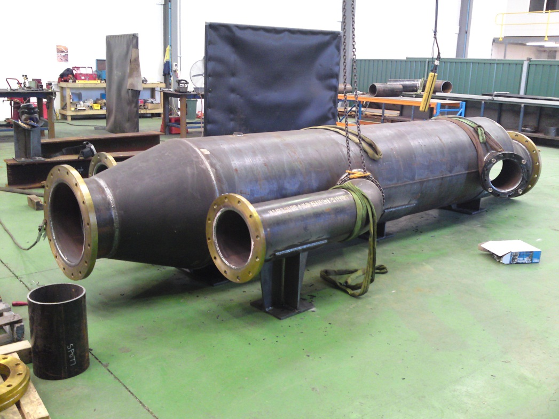
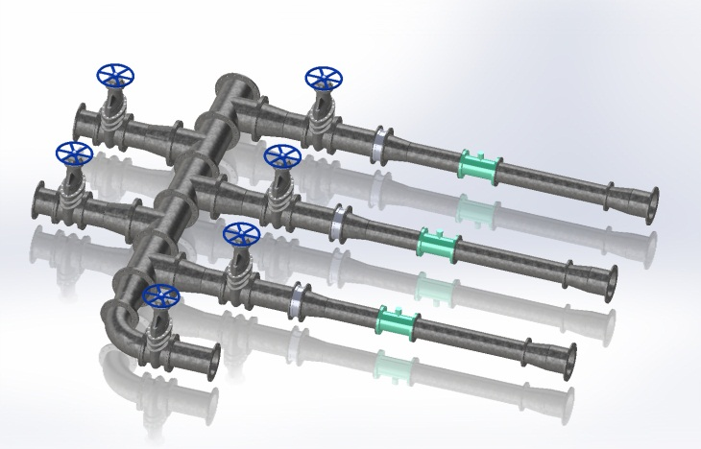
Steel Pipe Fabrication
FabWest steel division manufactures in house a vast array of steel pipe components for our own pipeline applications or for external sale. From butt weld or flanged pipe fittings in equal and reduced tee’s, reducers, bends, all components are made and tested to your specifications and can include final coatings such as paint, hot dip galvanising, epoxy, or powder coating. Typically we manufacture to AS4041 however if you nominate a different specification we will review these requirements and manufacture in accordance.

Slide 12
Plastic PIPE SPOOLS
FabWest manufactures a range of pipe spools to customer’s requirements.
Spools can be manufactured in most thermoplastics including PE, PP, PVDF, ECTFE and PVC. Material choice is dependent on operating conditions & customer requirements.

Slide 13
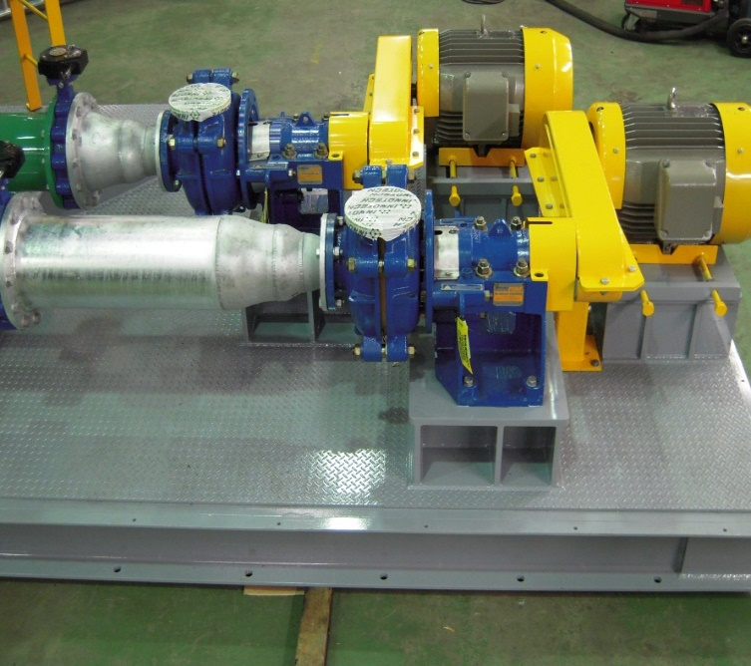
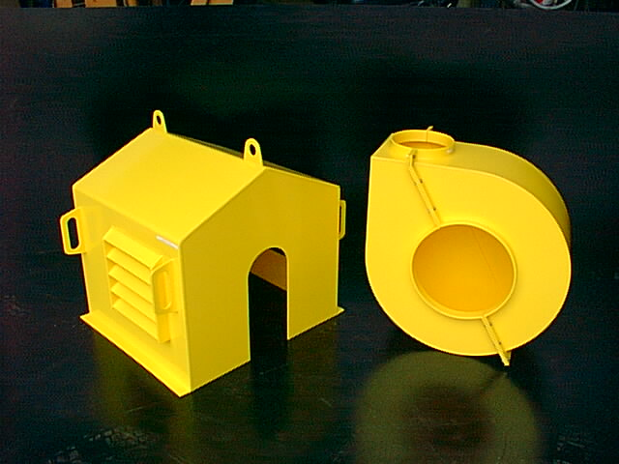
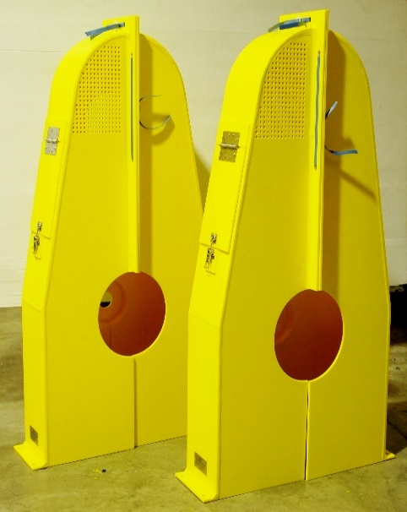
Pump Frames & Covers
FabWest can manufacture pump frames & covers to your specification for many pumping applications. Whether it is trailer mounted, pontoon mounted skid mounted, semi-submersible or any special requirements we will manufacture and assemble all components for your pumping requirements.

