Slide 1
Byherbs Corporate Profile
Version: 25 October 2016
Wellness You Can Trust | Produk Halal Yang Diyakini

Slide 2
Mission, Vision, Values
Mission
Providing premium quality health supplements
& holistic wellness for all.
Vision
A leading wellness brand with a heart –
helping the community to live healthier & more meaningful lives.
Values
Learning | Integrity | Family | Empathy

Slide 3




Our LIFE Values Shape Our Byherbs Beliefs
Integrity
We value the trust built with colleagues & customers by emphasising high standards of responsibility in our people, products & processes.
Family
We treat our colleagues & customers as family by strengthening relationships proactively with good communications & mutual respect.
Empathy
We invest in the time to listen & better understand the needs of colleagues & customers before offering solutions.
Learning
We believe in the continuous improvement of people & products in order to grow & better serve our colleagues & customers.
Byherbs
Beliefs

Slide 4
Growing Team Led with 20 Years of
Industry Experience
Board of Directors
CEO
Marketing & Sales Manager
General Manager
Marketing Executive
CSO Supervisor
Admin Officer
Operations Assistant
Customer Service Officer
Customer Service Officer
Customer Service Officer
Customer Service Officer
Byherbs
Growth
Stages:
1997: SNM Marketing
2010: Sole Proprietorship
2014: LLP
2016: Pte Ltd
Notes:
Verbalise:
SNM Marketing Pte Ltd: 1997
Byherbs Wellness: 2010
Byherbs Wellness LLP: 2014
Byherbs Pte Ltd: 2016

Slide 5





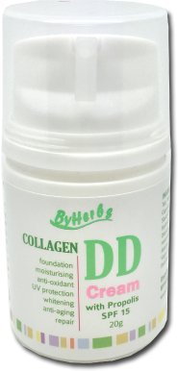
Byherbs Collagen Products
Collagen Health Supplements:
Collagen Gold & Collagen Gold with Vitamin C
Collagen Skin Care:
Collagen DD Cream & Collagen Lip Care

Slide 6


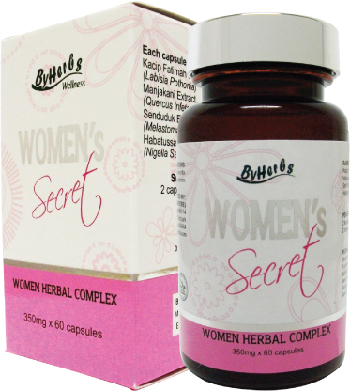

Byherbs Health Supplements
For Him & Her:
Black Jack & Women’s Secret
For wholesome health & prevention of diseases:
Royal Jelly & Bumi Plus

Slide 7

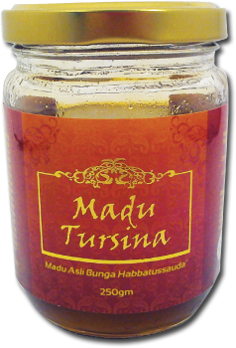
Byherbs Health Supplements
For detox & slimming: TrimLite Essence
Natural honey: Madu Tursina

Slide 8
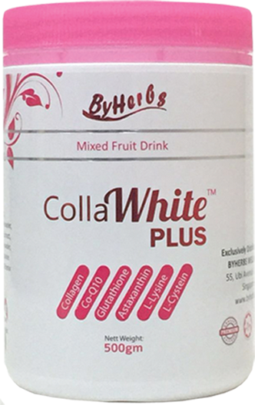

Latest Byherbs Product:
CollaWhite Plus

Slide 9








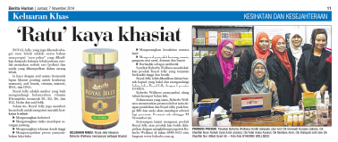
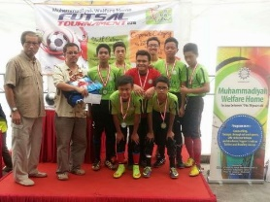
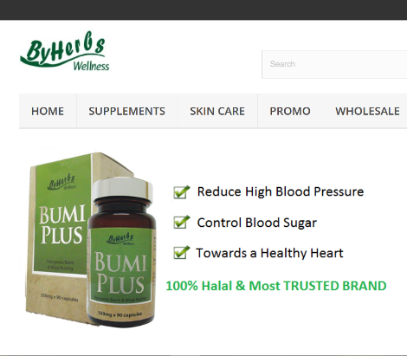
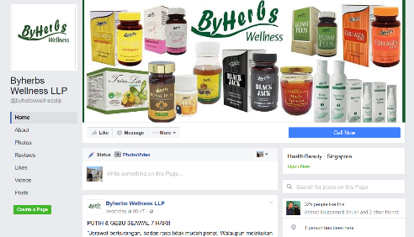
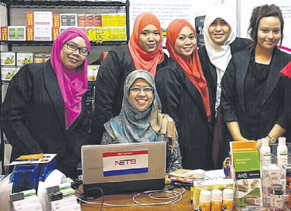
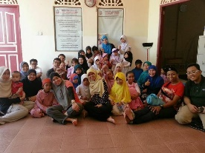
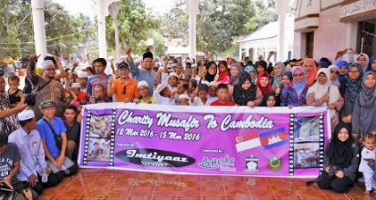
Promoting Wellness via Multiple Platforms
Print: Advertising & PR
Radio
TV
Brochures
Website
Social Media
Events
CSR
byherbs.com.sg
fb.com/byherbswellnessllp
Wedding & Shopping
Asia Expo 2014

Slide 10
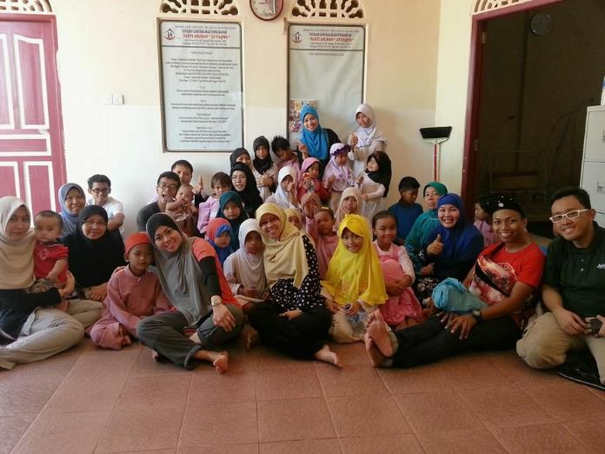
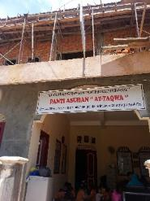
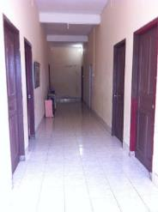
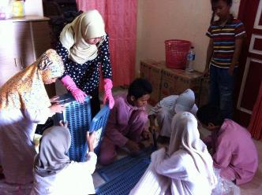
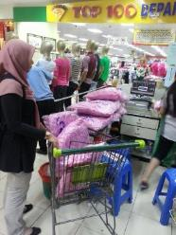
Giving Back to the Community:
At-Taqwa Orphanage at Batam (March 2015)
Collected funds through FEED organization
Built 2 floors of orphanage building
Cleaned living area & bought daily essentials
Level 2 in the midst
of construction
Bedrooms on level 2
after completion
Cleaning of living area
Buying of groceries at
the local supermarket
Byherbs staff with the children
of At-Taqwa Orphanage
Notes:
FEED is a non-profit organisation with a vision to provide orphans and underprivileged children a safe home, adequately fed and efficiently provided education as long as they need.
We raise funds through sales, charity drives and other activities and promote the values of sharing, giving and loving. No contribution goes unappreciated. We believe that everyone has the strength from within, to do great things, with big, beautiful hearts. We hope that our efforts will help make lovely living moments for everyone!

Slide 11
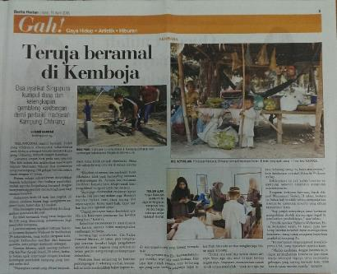
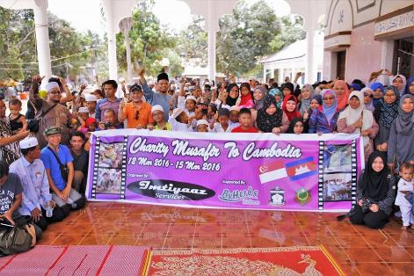
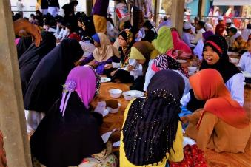
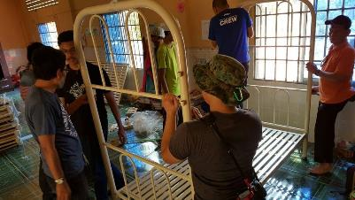
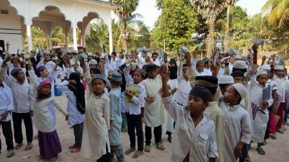
Giving Back to the Community:
Cambodia Charity Trip (12 to 15 March 2016)
Organized by Imtiyaaz Services
Byherbs Wellness sponsored total of 2 teachers & 6 students
Donated water pumps, mattresses,
bicycles, Al-Quran books to students & villagers in Chhnang Village, Cambodia
BH coverage on Cambodia Charity Trip 2016
Sponsored mass lunch
Assembling the beds in the girls’ dorm
Small token to each child of Madrasah Nikmah
Group picture of students & volunteers
Notes:
https://www.youtube.com/watch?v=gZv5njGXen8
http://vsco.co/atiqs/journal/two-different-worlds
Imtiyaaz Services LLP:
We provide services to people who want to spread their helping wings through korban, aqiqah, badal haji, building of facilities and charity funds.

Slide 12

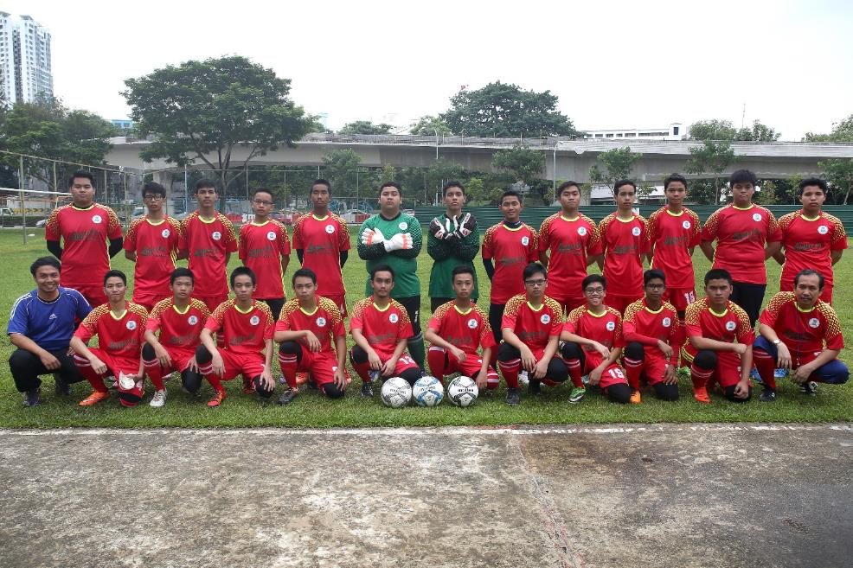
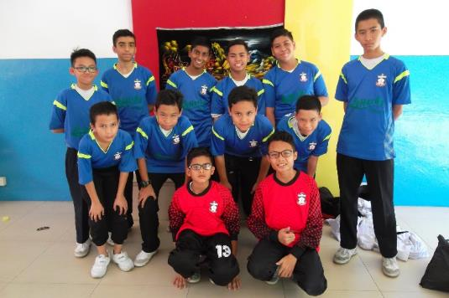
Giving Back to the Community:
Madrasah Soccer Jerseys (2016)
Madrasah Al-Arabiah Al-Islamiah won 2nd place in
Muhammadiyah Welfare Home Futsal Tournament 2016
Madrasah Irsyad Zuhri Al-Islamiah Upper Secondary boys sporting Byherbs jerseys
Madrasah Aljunied Al-Islamiah soccer boys in Byherbs Jerseys
Notes:
Objective of Soccer Jersey Sponsorship:
Giving back to the community. Promoting wellness.

Slide 13
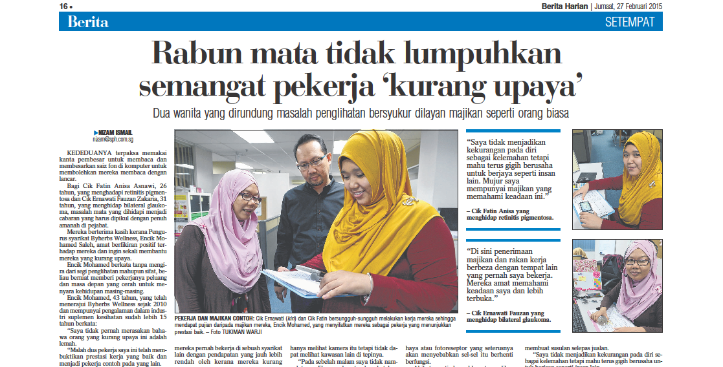
Giving Back to the Community: Our Staff

Slide 14


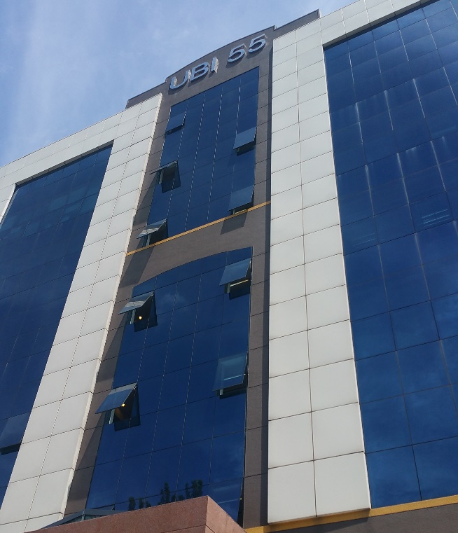


Let’s Connect
55 Ubi Ave 1, #07-16, Singapore 408935
www.byherbs.com.sg
fb.com/ByherbsSG
+65 6848 3633

