Slide 1
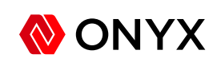
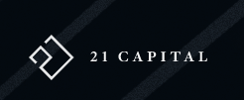
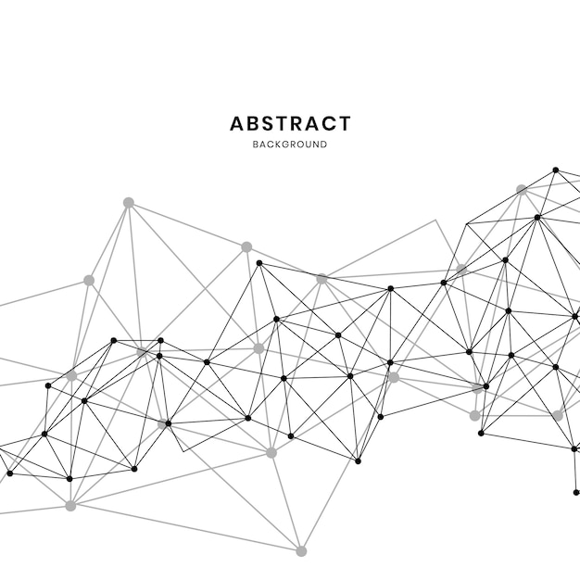
Here’s the starting point. We like the overall concept, but it looks a little bit like clip art.
We have drawn inspiration from this logo, which is sleek and modern. The website 21-capital.com is also a good example of where we are taking our website.
We evolved the original concept to look like this, but we need help exploring how to make it look better and more professional. Thickness of lines, negative space between lined, should the lines be perfectly parallel or slightly skewed?
We also like the idea of neural networks and minimalist line art. Here’s an example of the type of graphic we would want to incorporate into our website and reports
ONYX
Here’s an example of what a web homepage could look like when the logo and graphics are combined
ONYX

