Slide 1
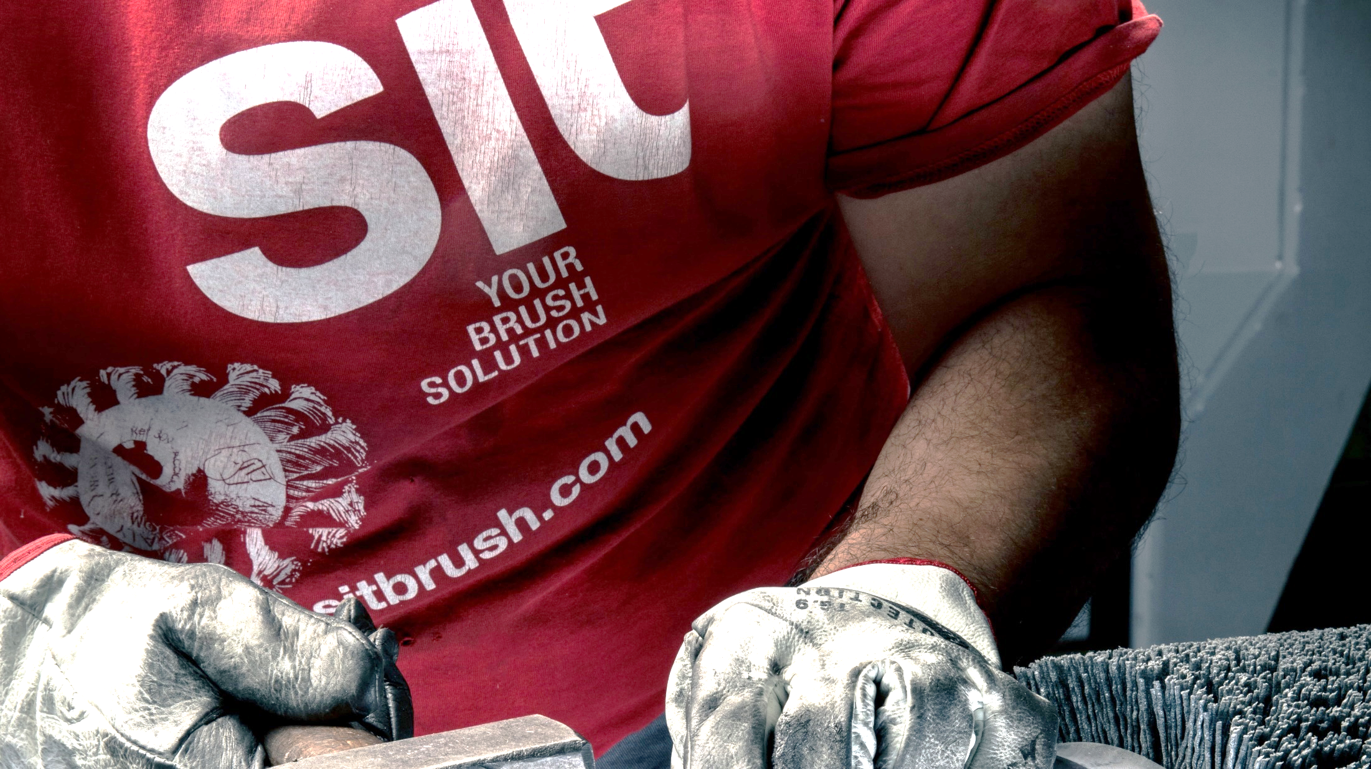

YOUR BRUSH SOLUTION

Slide 2
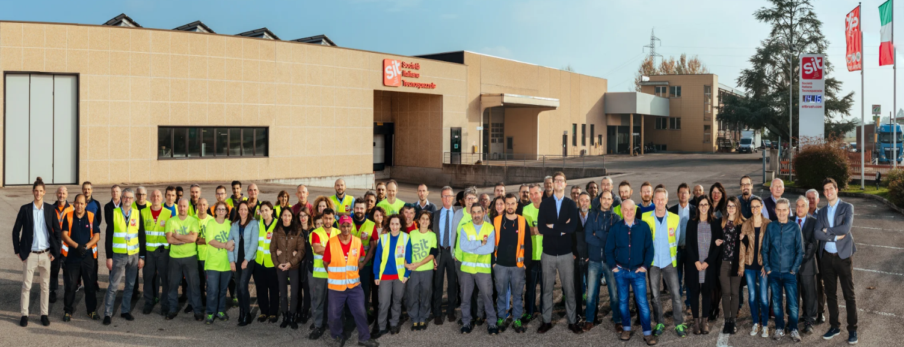
A FAMILY COMPANY
Driving excellence and keeping on developing innovative products thanks to our incredible Team of Talents.
Notes:
Adattare il box alla forma del logo.

Slide 3
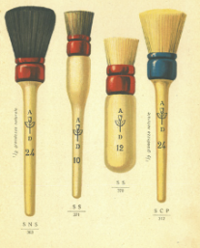






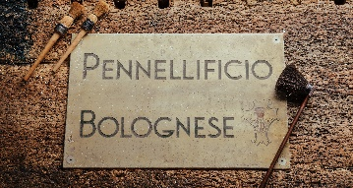


OUR STRONG HERITAGE
1662
2019
2021
2014
2012
1908
2018
2020
2023
Ready for the next
115 years

Slide 4
KEY FACTS
  One of the oldest family owned businesses in Italy:
  Leading player on the brush market
  Turnover 2021, €:
110+ years
15,6 mln
  We drive excellence thanks to our team of talents in Italy, Romania & Spain:
  We offer a wide range of solutions b2b & b2c:
115+ talents
2000+ SKUs
Notes:
Aggiornare i numeri, adattare gli elementi grafici alla forma del logo

Slide 5
OUR JOURNEY AROUND THE WORLD
Constantly growing customer base: 5,000+
Our products are sold in 75+ countries
2 production sites in EU (Italy & Romania)
Notes:
Mappa uniformare colori

Slide 6
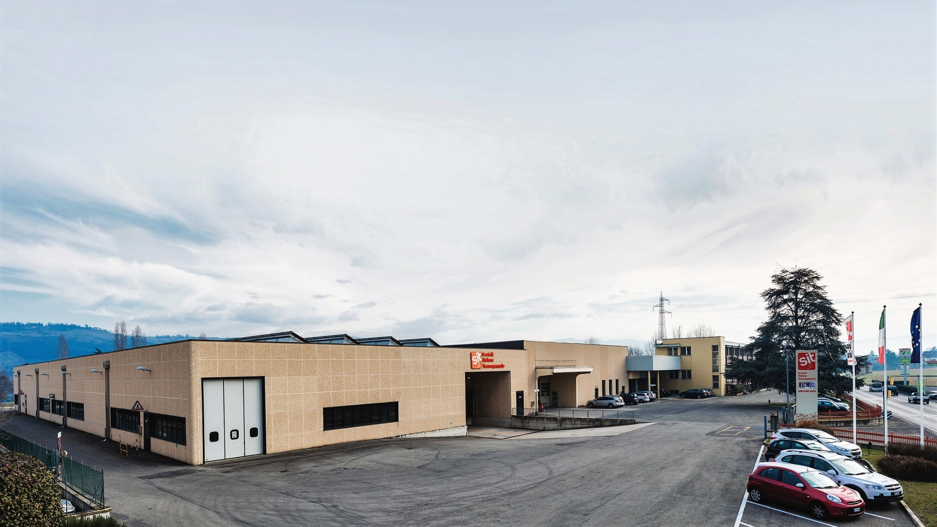
PROUDLY MADE IN ITALY
Our HQ in Casalecchio di Reno, just outside Bologna covers over 11.000 square meters of production, warehouse and offices.

Slide 7
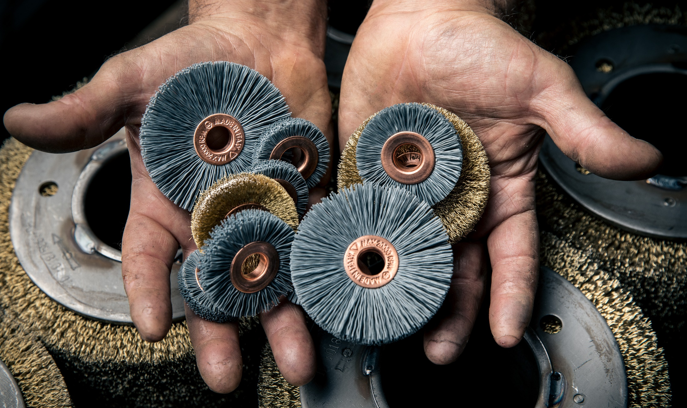
OUR SOLUTIONS TO MEET YOUR NEEDS

Slide 8

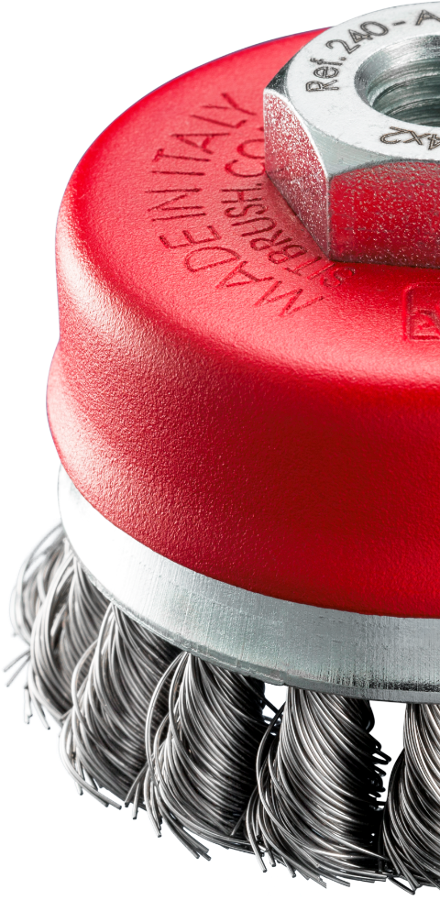
OUR PROFESSIONAL SOLUTIONS
Broad product offer requires constant attention to high quality standards and maximum production flexibility
2,000+ SKUs are available in our catalogue
600+ are on stock, ready for pick up & delivery
Notes:
Spazzole per elettroutensili, spazzole manuali, scovoli per caldaie e camini, spazzole per decespugliatore …

Slide 9
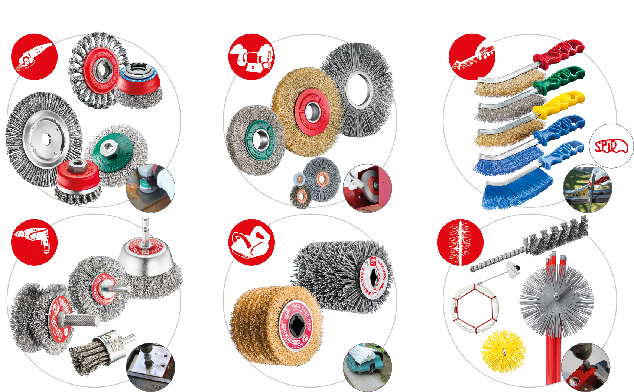
PROFESSIONAL BRUSHES | KEY CATEGORIES
Notes:
Spazzole per elettroutensili, spazzole manuali, scovoli per caldaie e camini, spazzole per decespugliatore …

Slide 10
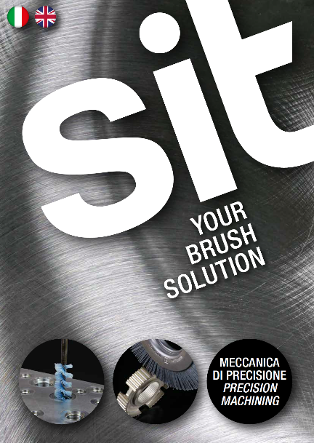
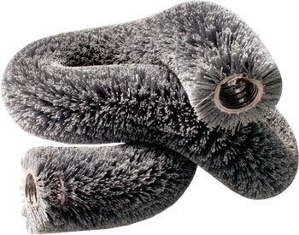
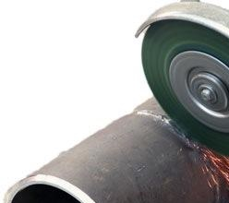
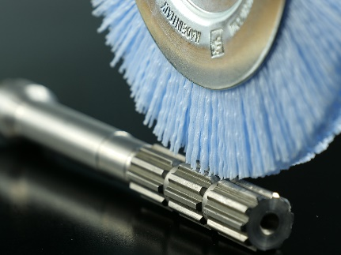
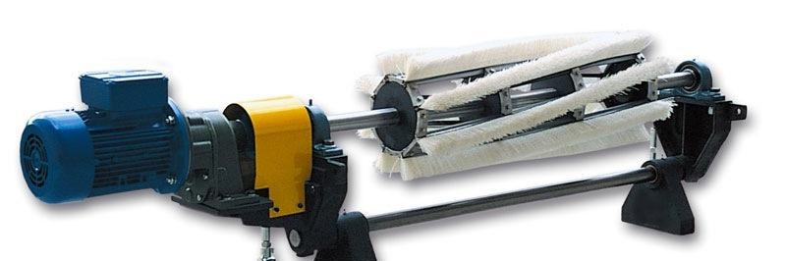
OUR INDUSTRIAL SOLUTIONS
We design tailor made solutions for multiple sectors & applications, such as:
Pipeline industry
Tyre retreading
Rolling mills
Automotive
Conveyor belts
Deburring
Foundry industry
Wood processing

Slide 11
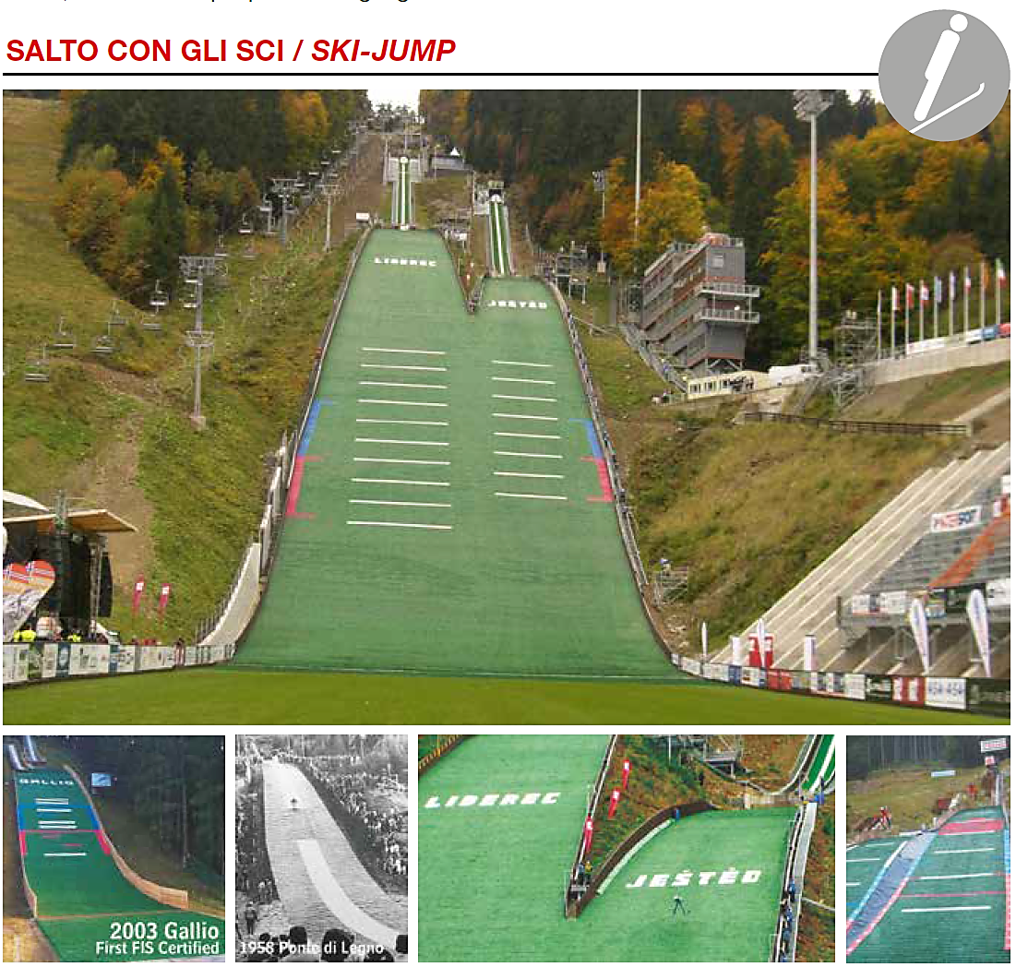
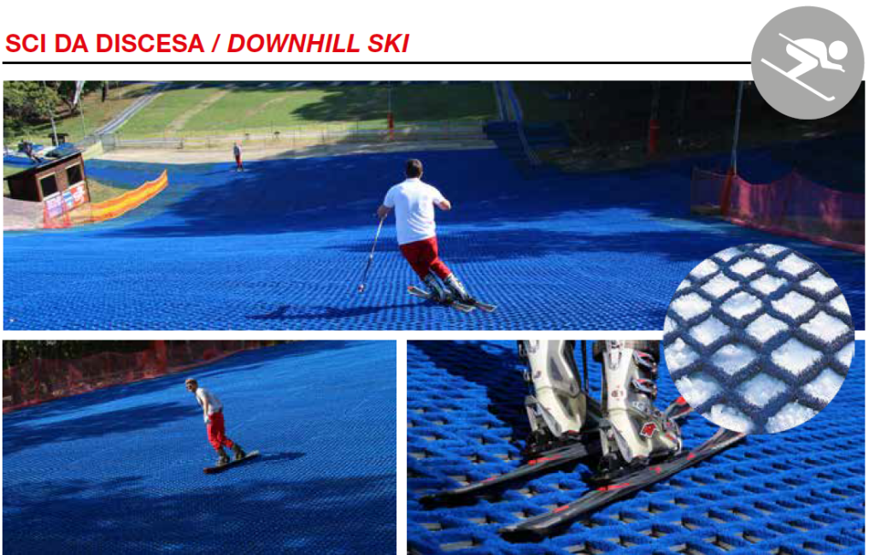
OUR SPORTS DIVISION
Our high quality & secure solutions are designed for athletes who practice ski-jump, downhill or cross-country skiing all year round.
Notes:
Ottimizzare foto

Slide 12
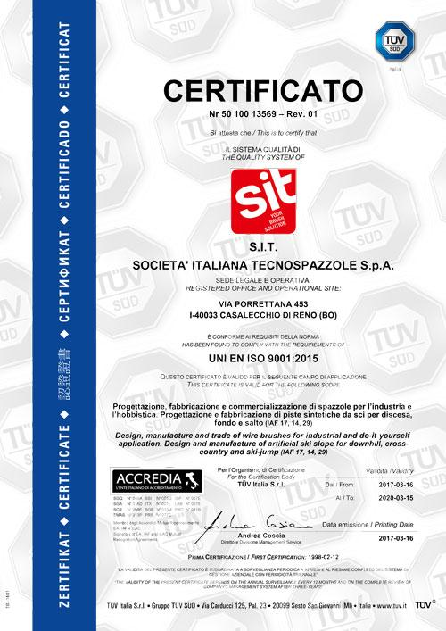

CONTINIOUS COMITTMENT TO EXCELLENCE
SIT is certified by TUV Sud following quality standard of ISO 9001:2015.
Our brushes are carefully tested in accordance with the UNI EN 1083 safety regulations concerning their manufacture and use.
All our products are performance assessed by our internal quality department.

Slide 13
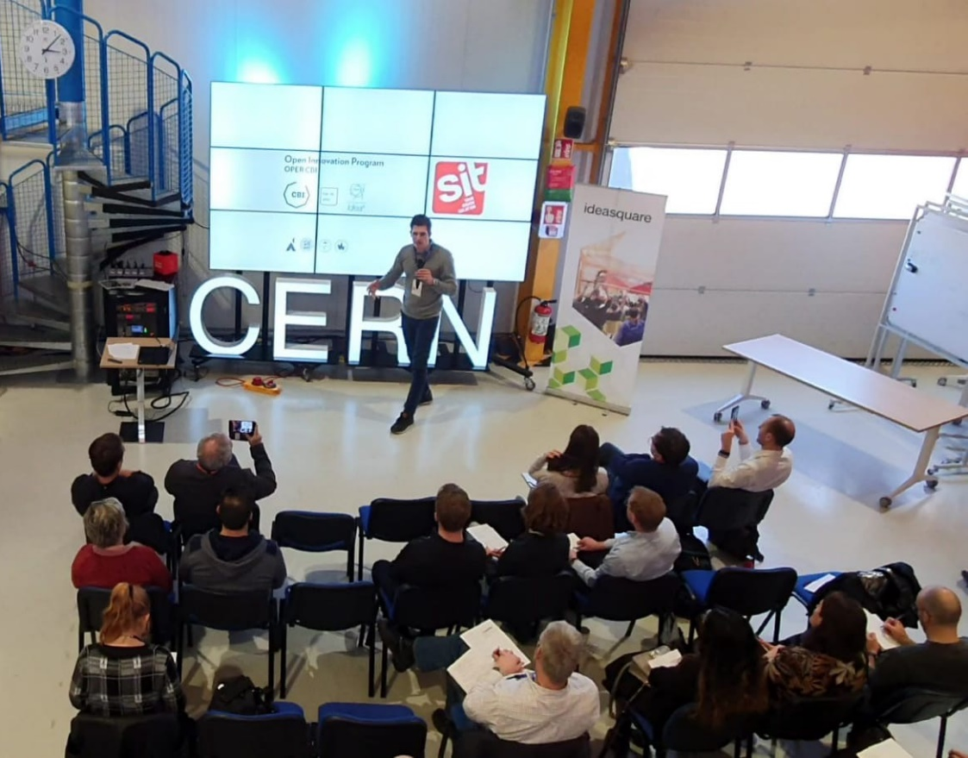
ONGOING INNOVATION
Innovation is at the heart of our values and development strategy.
With so many years of technical expertise, we develop dedicated solutions to meet your specific needs.
Our recognized know-how goes hand in hand with ongoing innovation, quality and customer satisfaction.

Slide 14

Thank you!

