Slide 1

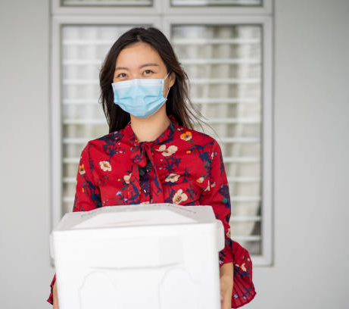
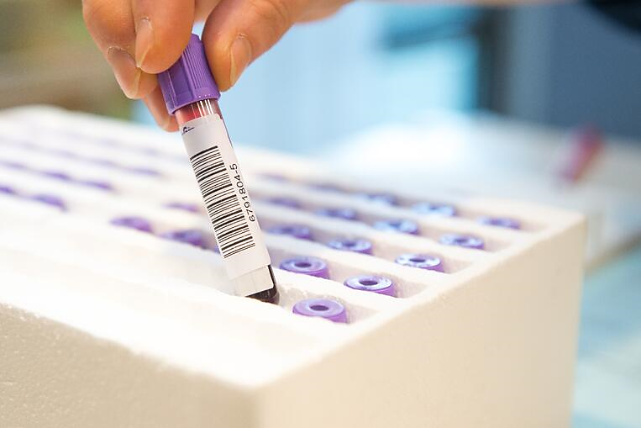
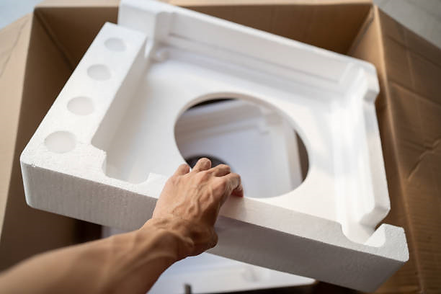

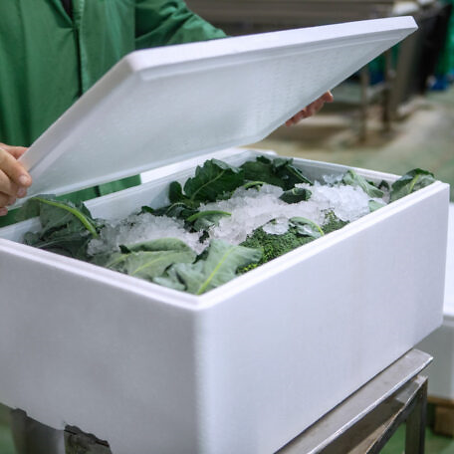
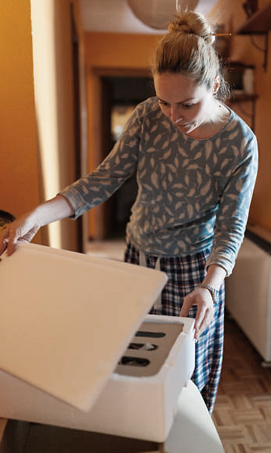
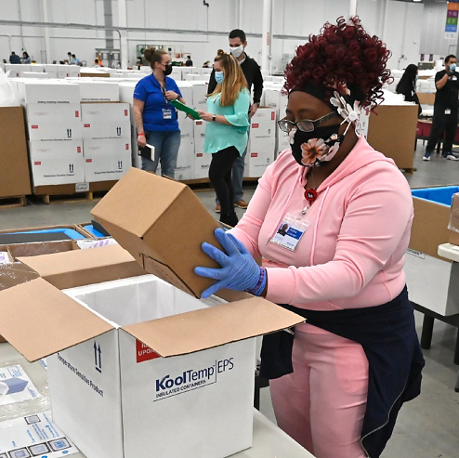

Circular Economy for EPS Packaging
Making the Right Decision for the Environment
April 2022
Notes:
Change title – Circular Economy for EPS Packaging

Slide 2
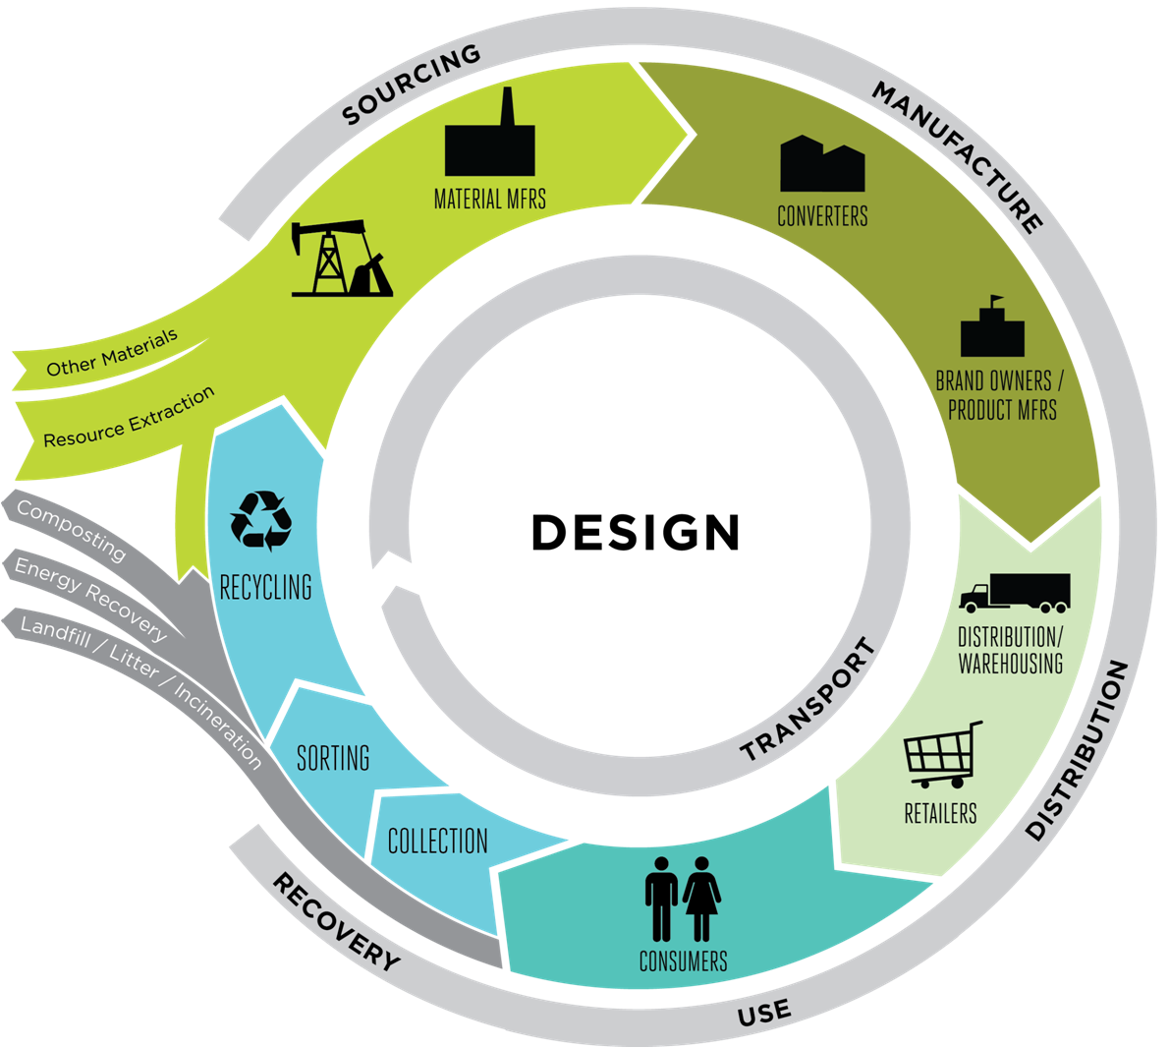
CIRCULAR ECONOMNY REQUIRES CAREFUL CONSIDERATION
Non-Plastic Packaging Isn’t The Only Sustainable Solution
Creating sustainable packaging requires questions on sourcing, efficiency, recovery, health, and safety.
Data and science should drive decision making.
Risk mitigation and damage avoidance metrics are key to minimize environmental impacts.
Packaging life cycle performance should be properly weighted in addition to end-of-life disposal.
Notes:
okay

Slide 3

EMAF CIRCULAR ECONOMY LITMUS TEST
Ellen MacArthur Foundation (EMAF) Endorses & Promotes A One-Size-Fits-All Approach to Environmental Improvement
EMAF All or Nothing Elimination Criteria Discards Critical Thinking
EMAF Drives Increased Recycling At the Exclusion of Life Cycle Impacts
"The U.S. Plastics Pact lacked a transparent third-party, data-driven and scientific approach, and its process seems to be rooted in ideology and a predetermined, misguided outcome. In fact, the list of plastic materials they suggest be eliminated by 2025 will only hinder the acceleration of a circular economy, slow progress toward a lower carbon future, and reduce our ability to use greater amounts of recycled material in plastic packaging."
Joshua Baca
Vice President, Plastics Division
American Chemistry Council

Slide 4

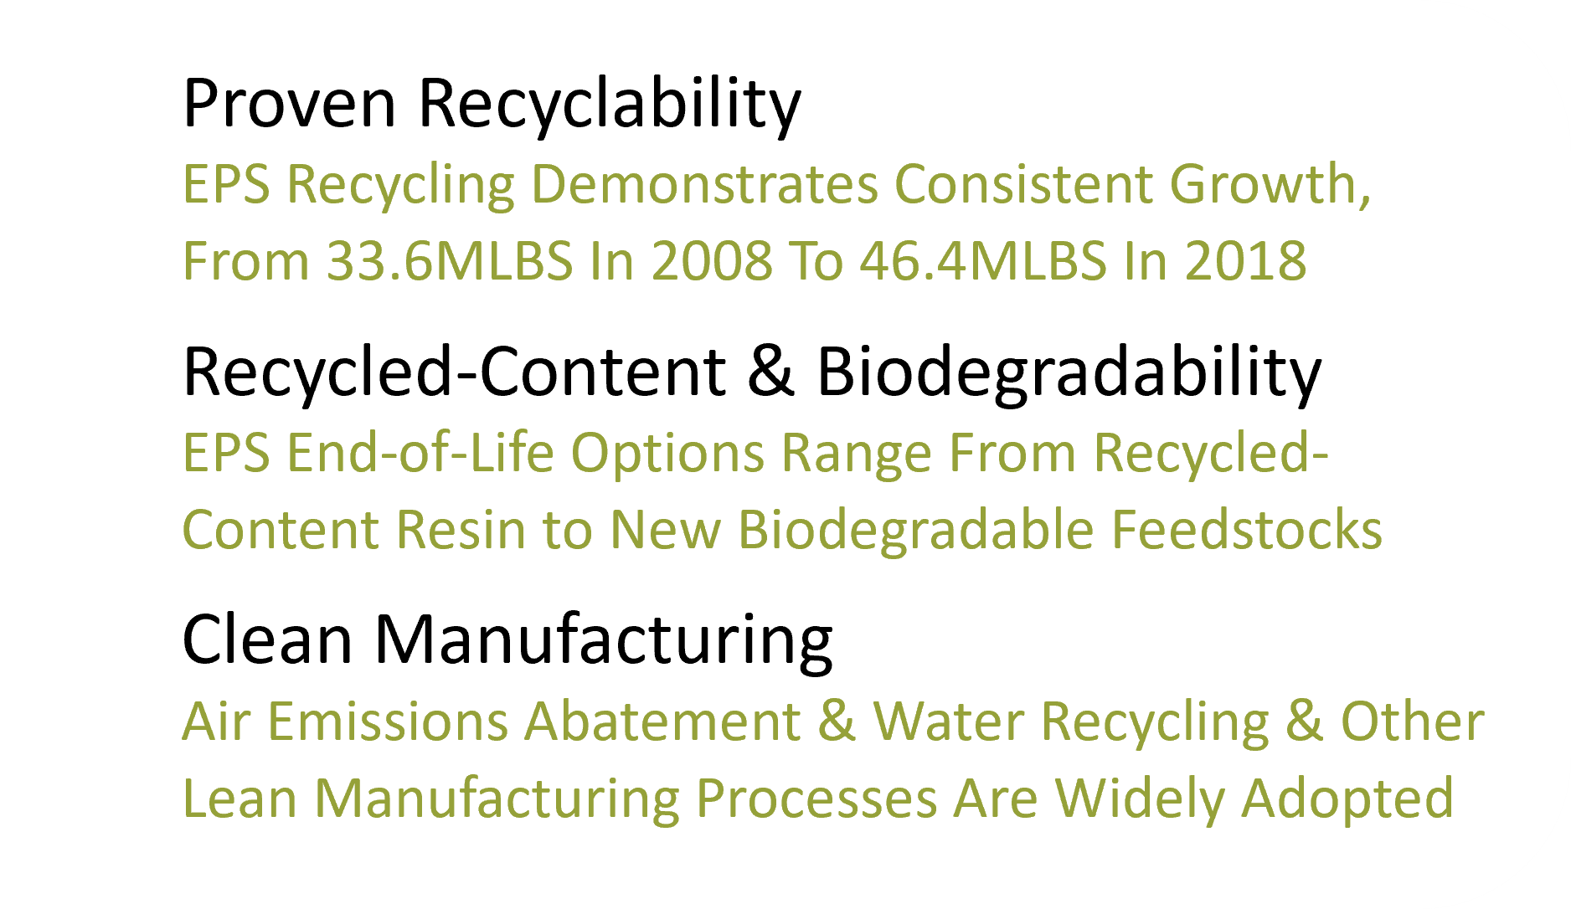
EPS CONTRIBUTES TO CIRCULAR ECONOMY SOLUTIONS
Proven Recyclability
EPS Recycling Demonstrates Consistent Growth, From 33.6MLBS In 2008 To 46.4MLBS In 2018
Recycled-Content & Biodegradability
EPS End-of-Life Options Range From Recycled-Content Resin to New Biodegradable Feedstocks
Clean Manufacturing
Air Emissions Abatement & Water Recycling & Other Lean Manufacturing Processes Are Widely Adopted

Slide 5

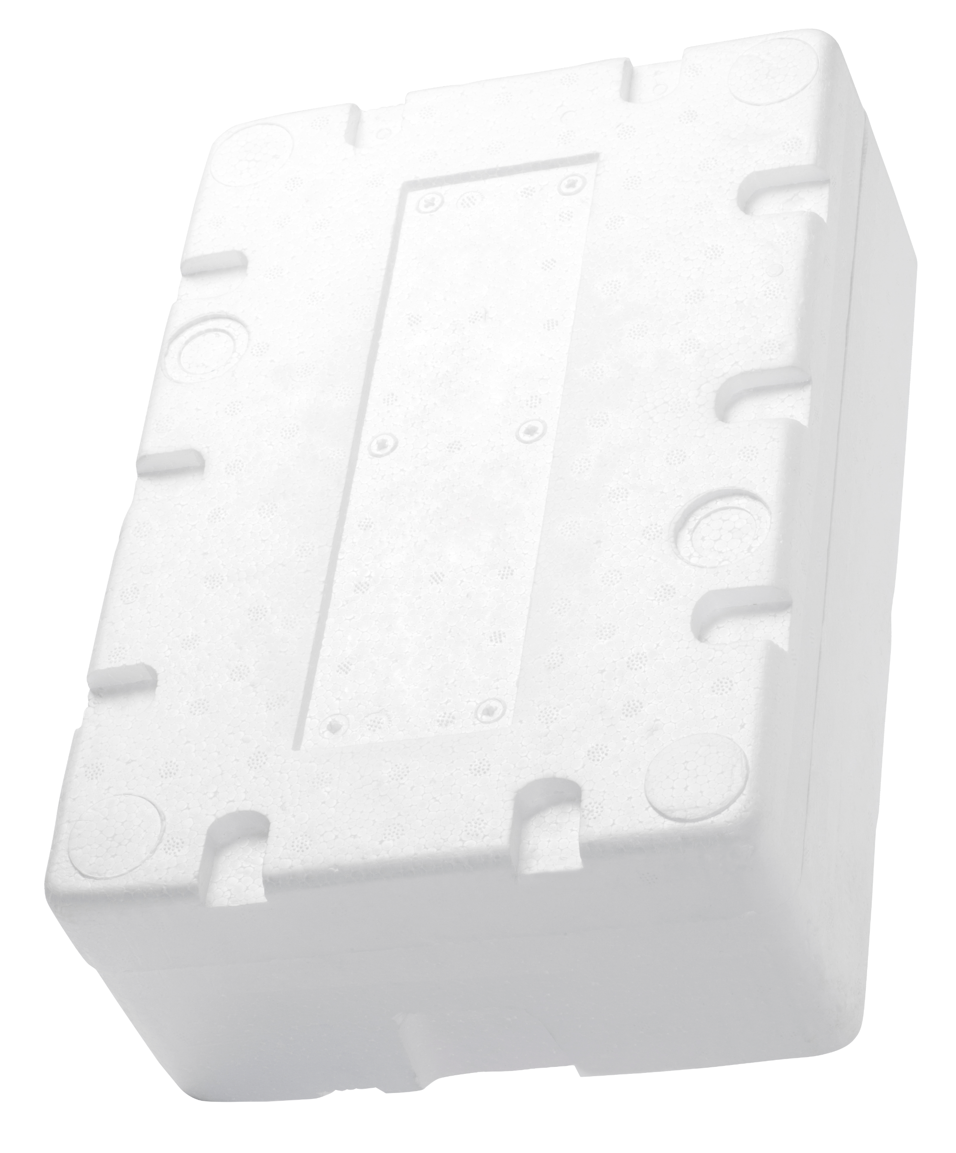




EPS Provides A Unique Combination of Performance Characteristics for Packaging Logistics
THERMAL INSULATION
Keeps your home warm, your food fresh,
and your medicine properly stored
SHOCK ABSORPTION
Protects everything from fragile high-value electronics, to large home appliances,
and delicate fruits & vegetables
ULTRA LIGHTWEIGHT
With 95% of its volume composed of air, a little material makes a big difference in protecting goods cheaply during transport
SAFE TO USE
BPA and Phthalate free, mildew resistant, FDA-approved for medical & food-grade applications, and safer for handling
Notes:
Remove “for Cold-Chain Packaging’

Slide 6
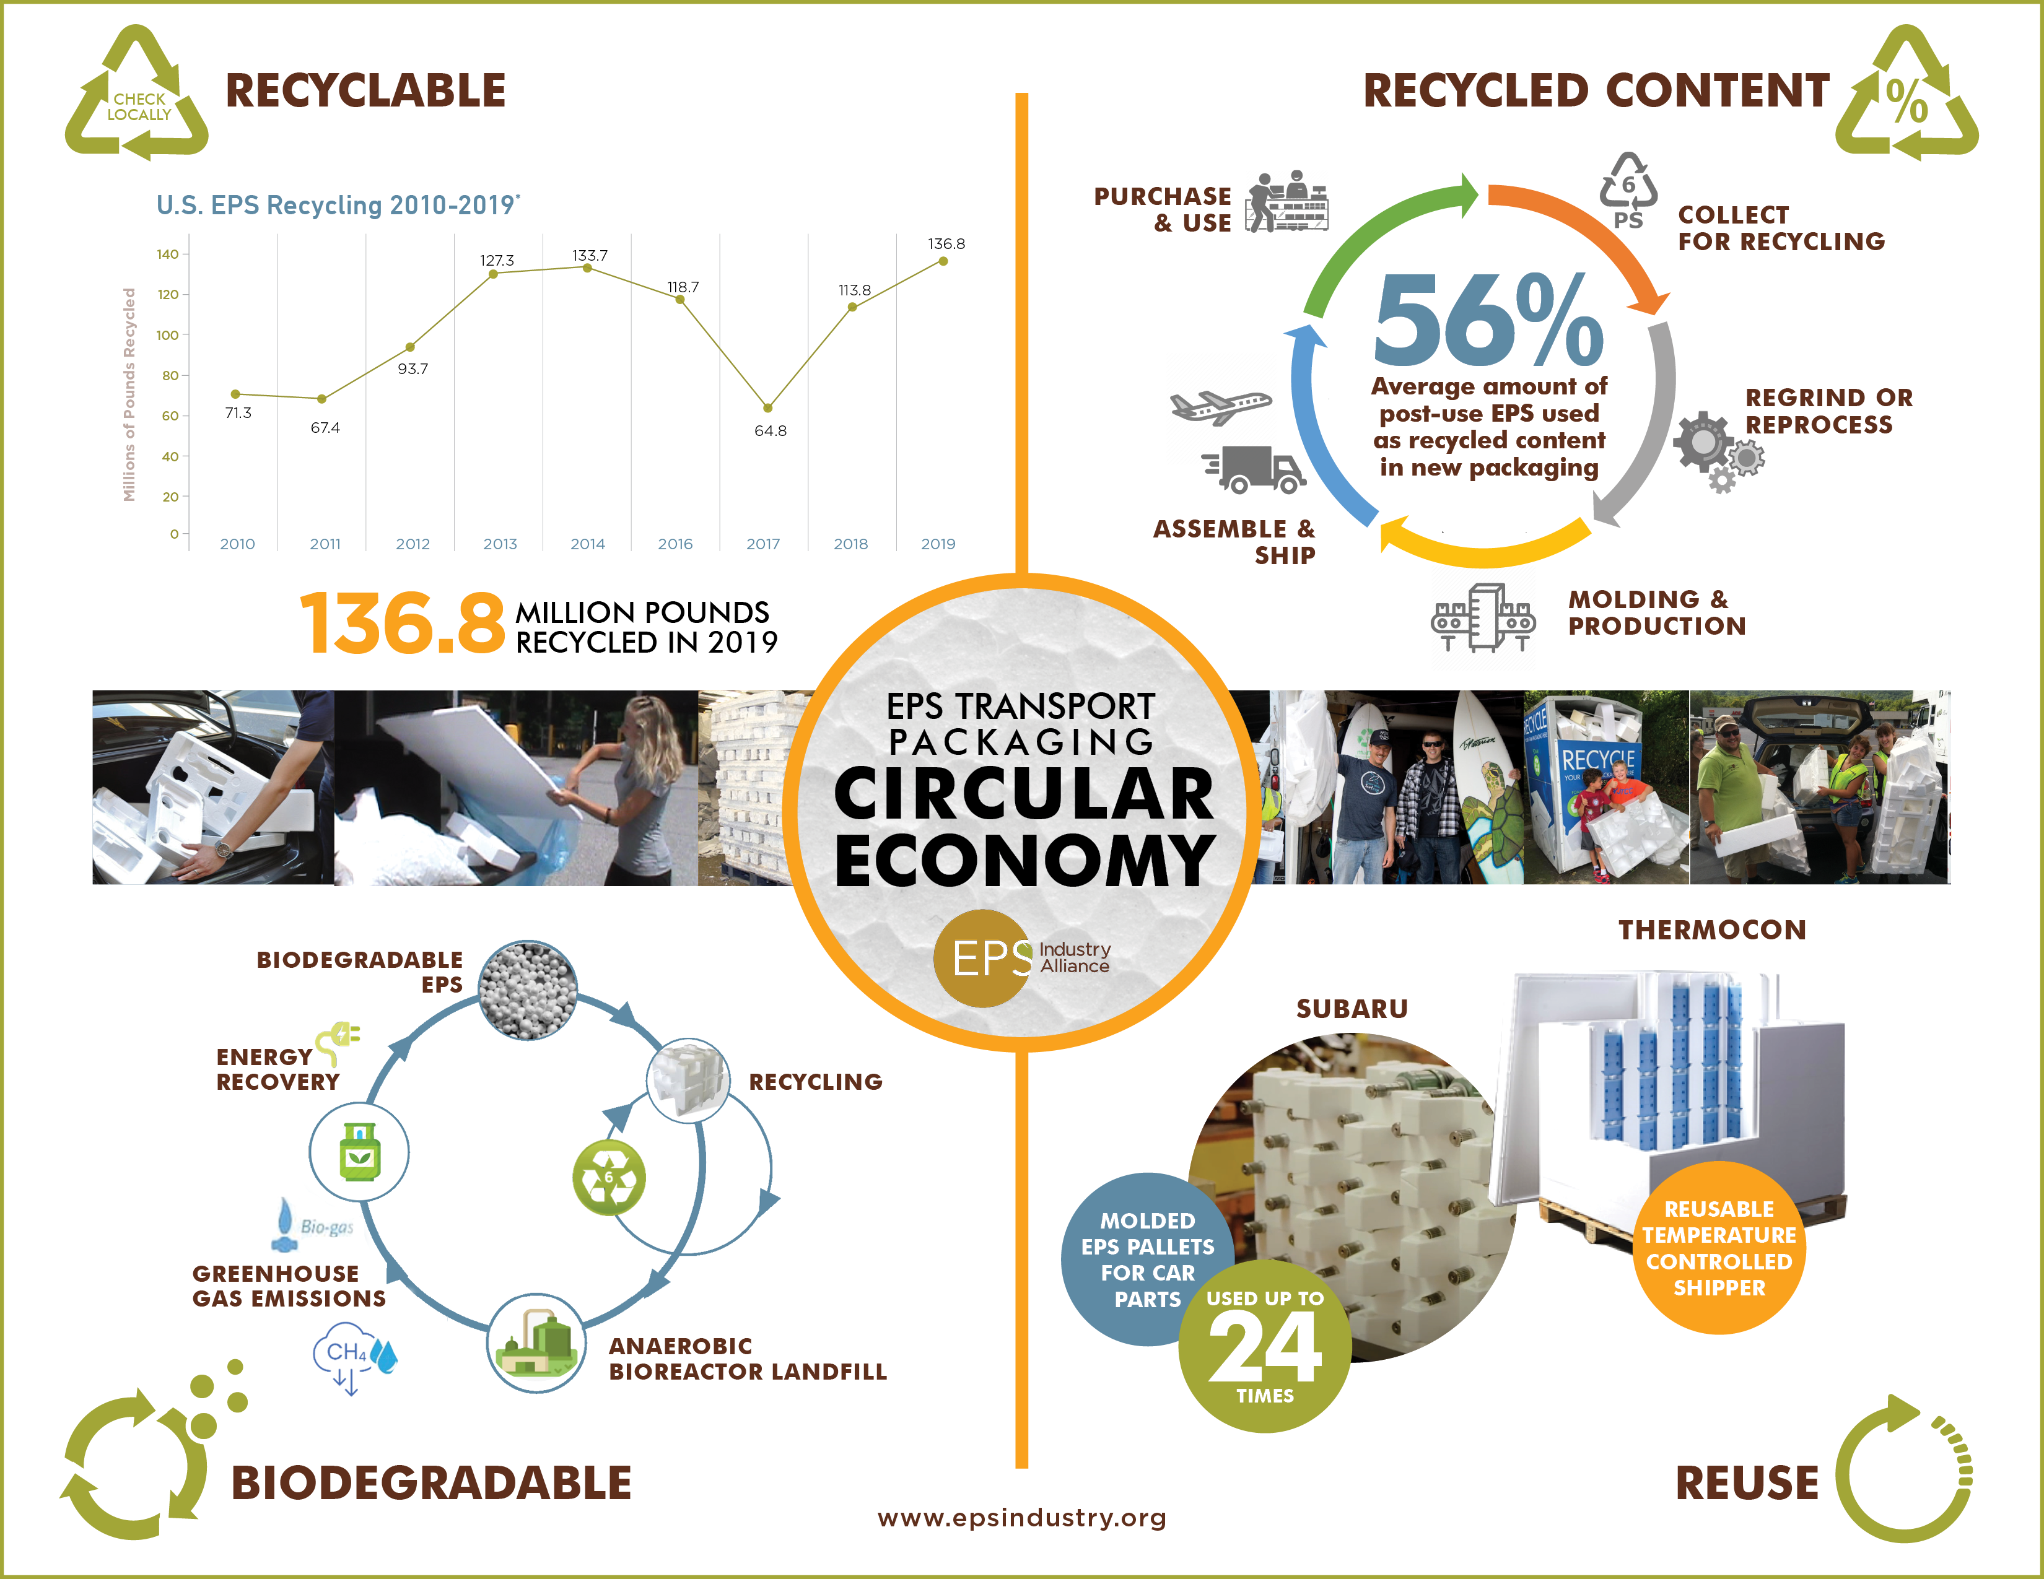
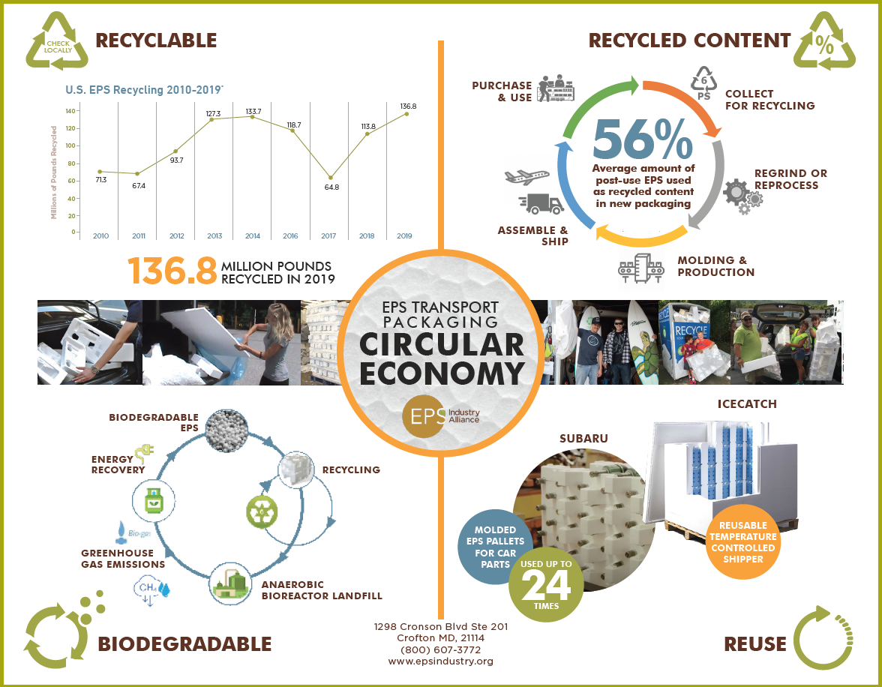

Slide 7
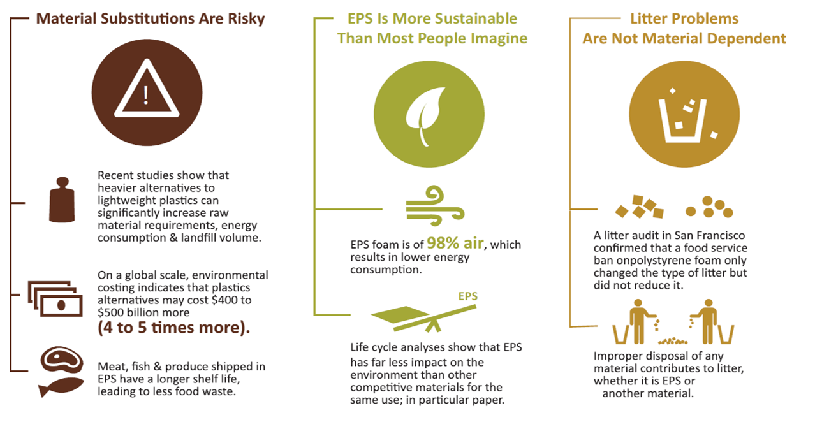
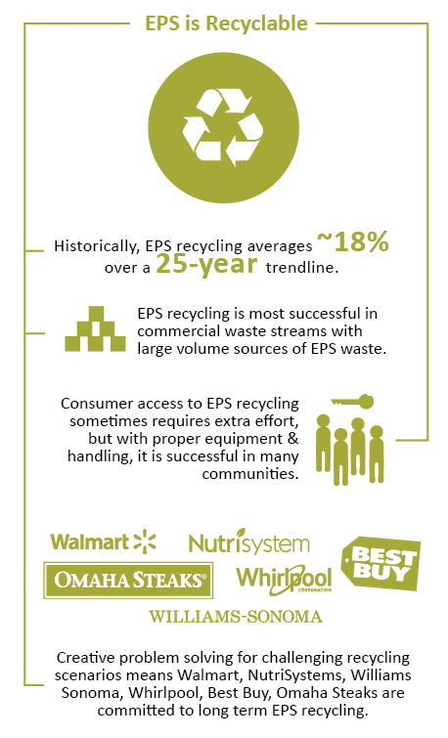

Slide 8
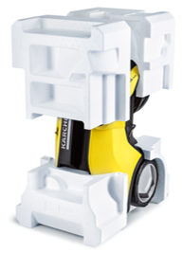
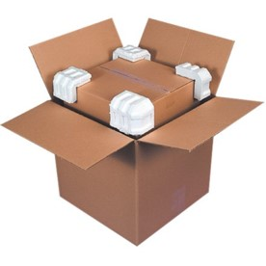
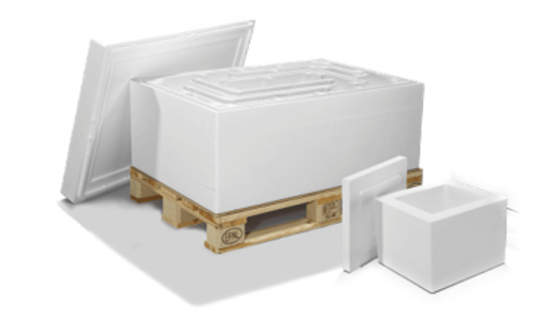
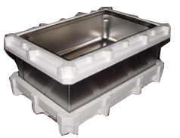
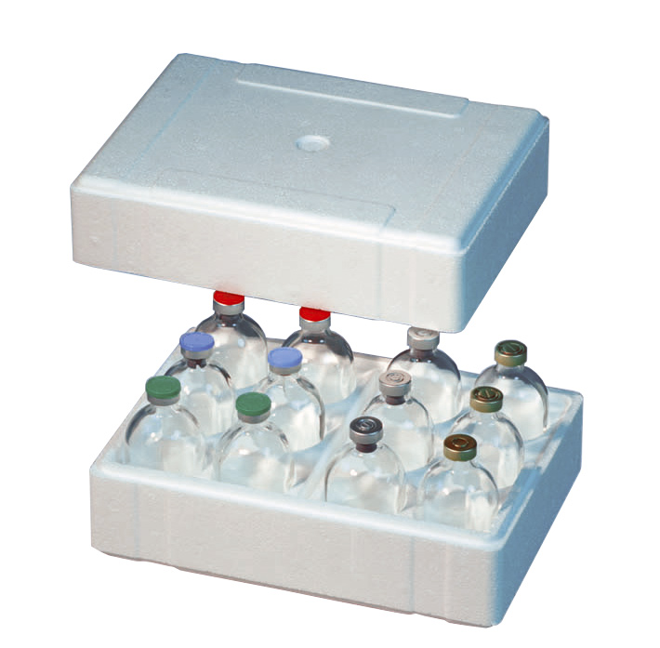
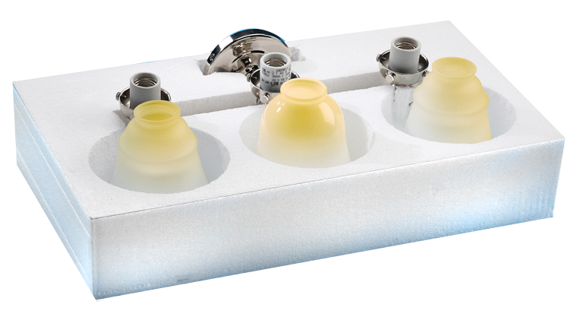
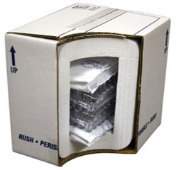
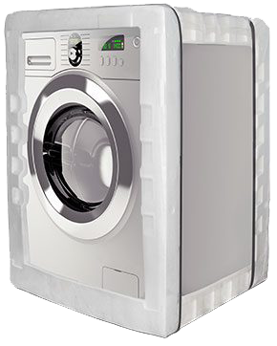

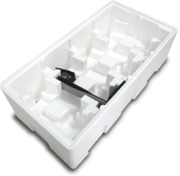
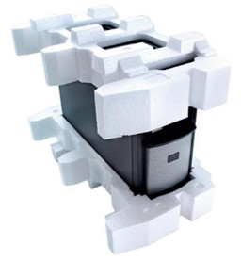
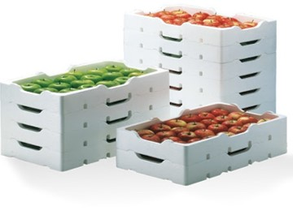

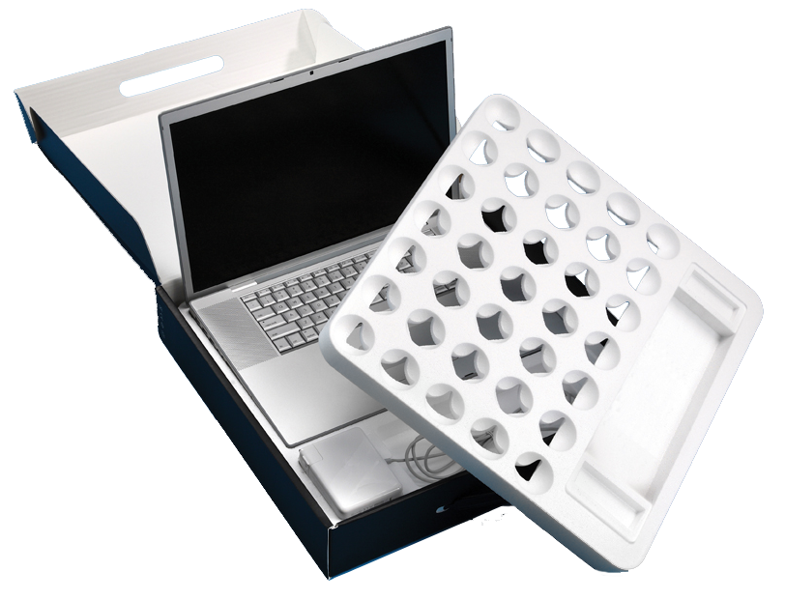
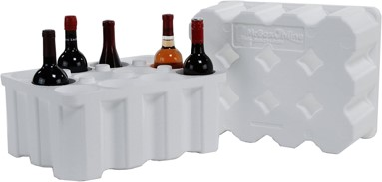
ELIMINATING POLYSTYRENE IS NOT THE ANSWER
EPS Transport Packaging Plays An Integral Role in Global Product Distribution

Slide 9
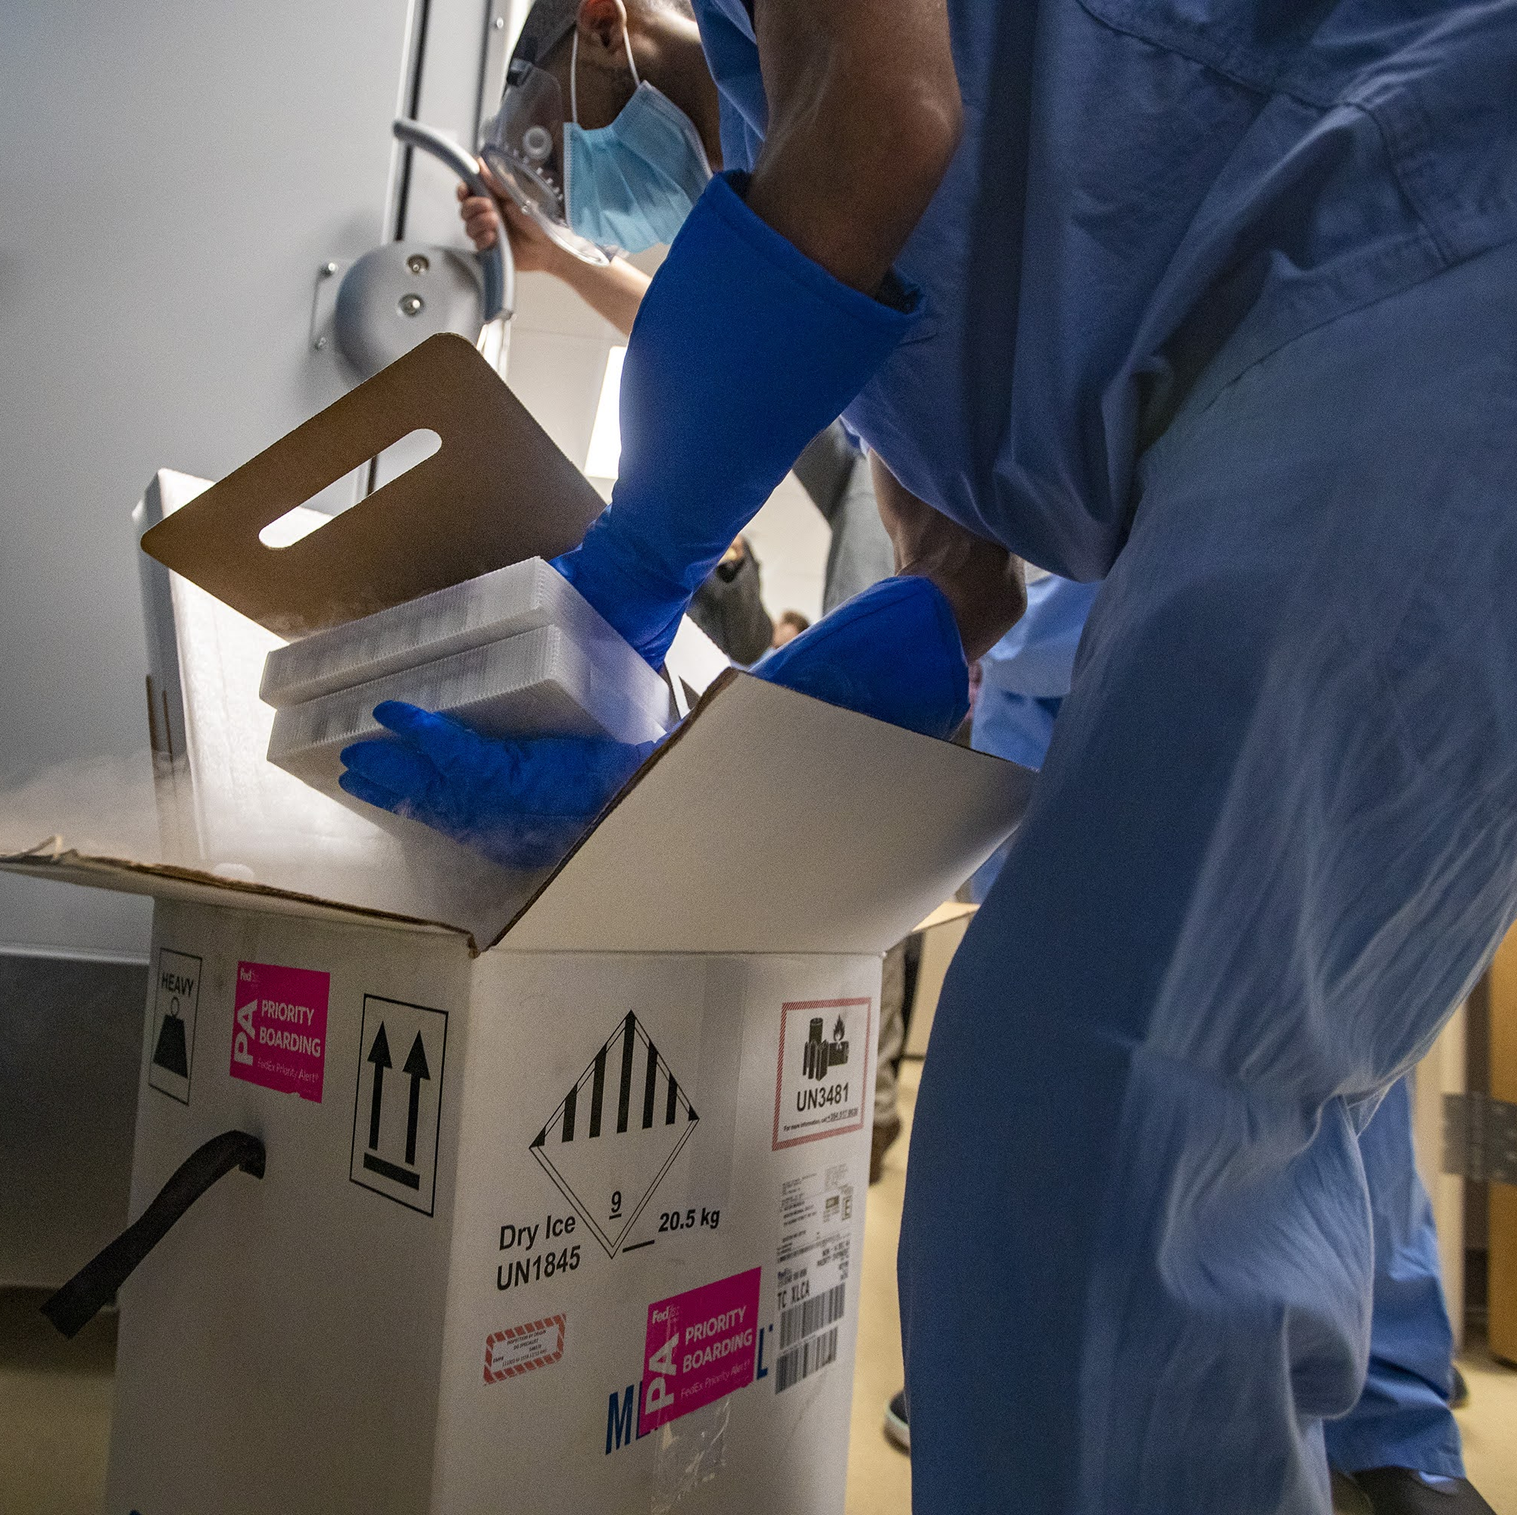
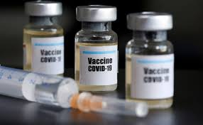
U.S. DOE RELIES ON EPS FOR COVID VACCINE DISTRIBUTION
The Importance of Cold-Chain Packaging Material Criteria
Interdisciplinary, Complex Decision Making Across Six Major Supply Chain Networks Involving 15+ Environmental Impact Stages
Industry Best Practices for Health & Safety to Maintain Product Integrity
Packaging Use & Labeling Must Comply w/ FAA, FTC, FDA, DOT, ASTM & ISO Environmental Standards
Inter-State Commerce Laws Pose Certain Challenges for Transport Packaging
Notes:
Replace cold-chain with ‘protective’
Omit ‘health & safety’

Slide 10
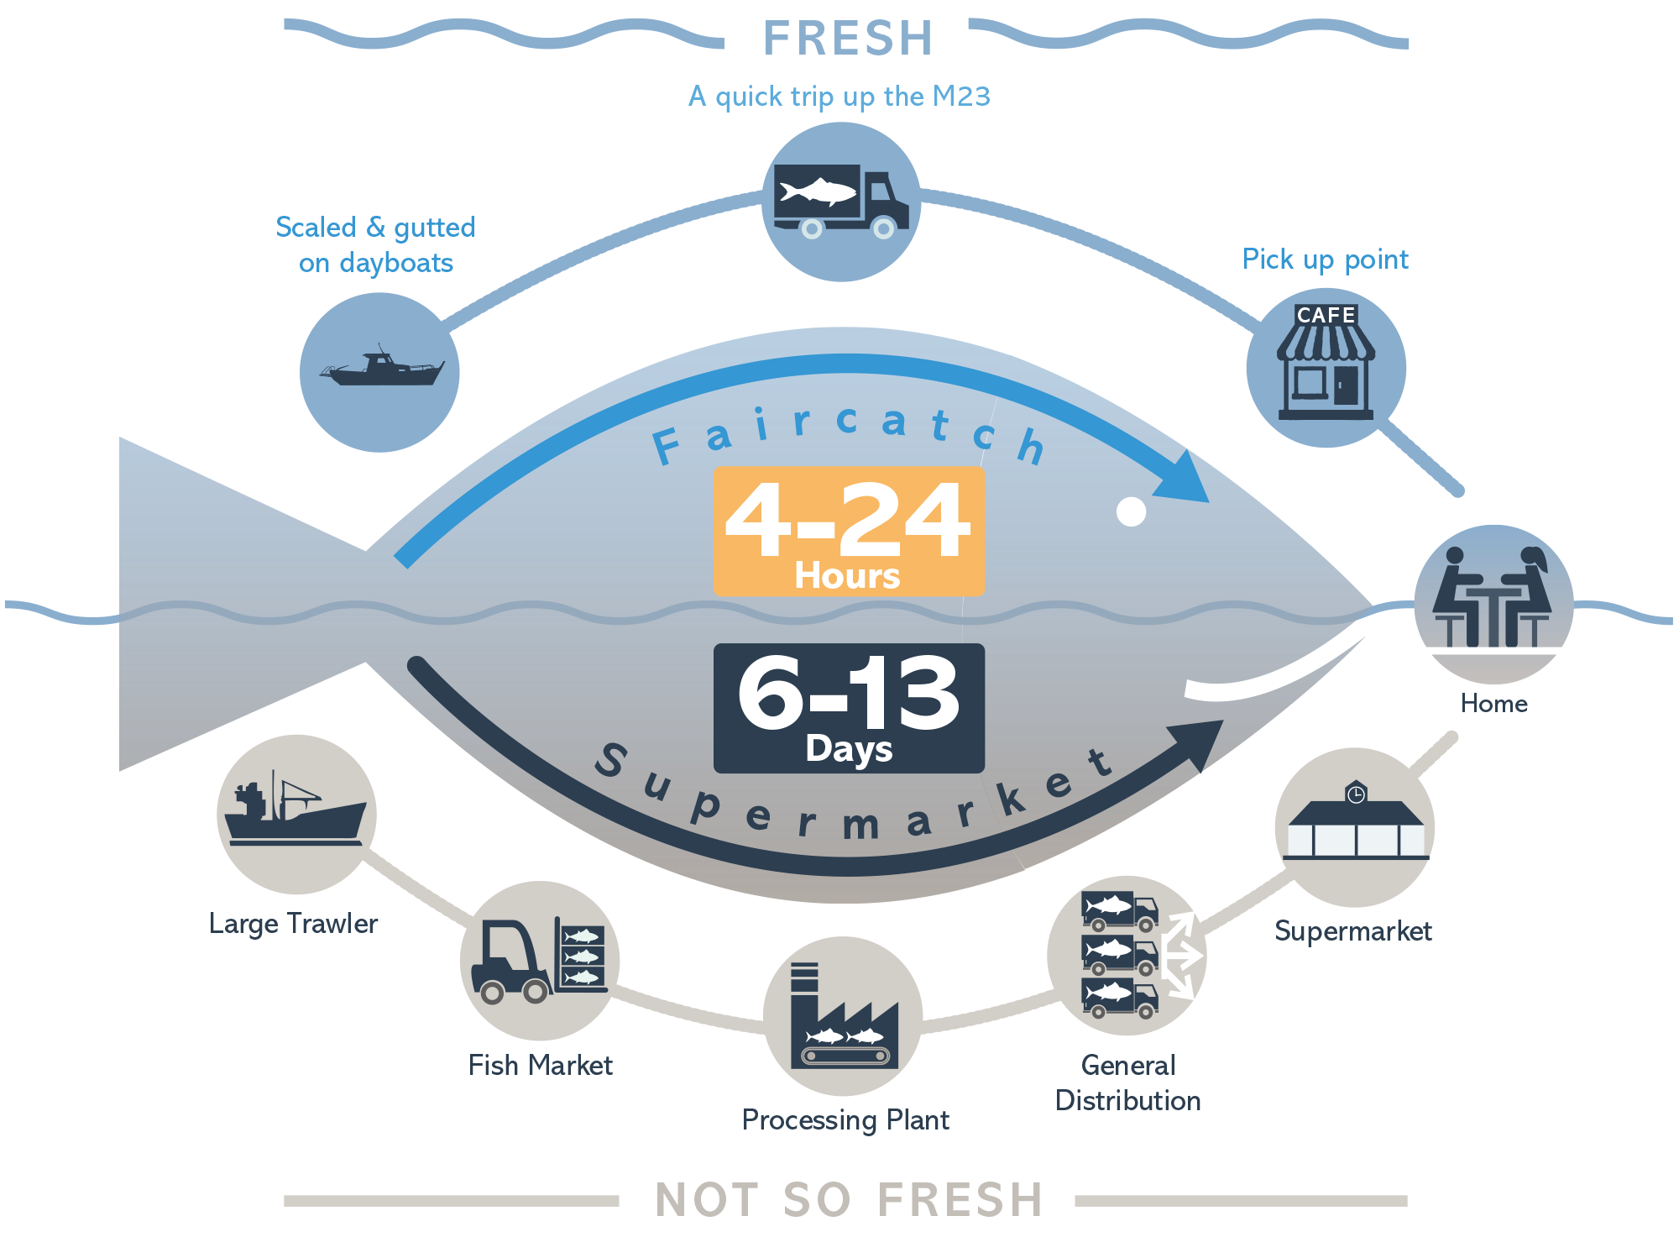
EPS Is The Gold Standard for Cold-Chain Packaging
Fish Spoilage 101
  Begins at Catch, Continues Throughout Shelf Life
  Tipping Point is at Core Temperature (~40⁰F)
  Occurs More Rapidly at Higher Temperatures
  Results in Post-Harvest Losses, Decreased Shelf Life & Food Safety Risks
  Maintaining Core Temperature From Catch is Essential
Infallibility Factors
  Multiple Transfer Points
  Reliability of Refrigeration Equipment
  Point of Sale Display

Slide 11


“EPS IS SIMPLY A BETTER PRODUCT”
Here in Puerto Montt, fishing is a way of life, and salmon is king. During the summer, we can sometimes spend weeks out at sea, and once we make a catch, the clock starts running. Fish must arrive as fresh as possible in places as far as the USA, and every penny we spend getting it there matters to us and our families.
Fortunately, cheap & lightweight EPS boxes are a great way to keep fish fresh without affecting taste or smell during the journey. Pretty much everyone I know uses EPS boxes many times over before having to recycle them.
Lucas Meyer
Fisherman for over 30 years
Puerto Montt, Chile

Slide 12
Ellen MacArthur Elimination Criteria
ASSESMENT OF PLASTIC PACKAGING IN THE GLOBAL ENVIRONMENT
Problematic & Unnecessary Plastic Packaging
1. It is not reusable, recyclable or compostable (per EMF definitions).
2. It contains, or its manufacturing requires hazardous chemicals that pose a significant risk to human health or the environment (using precautionary principal).
3. It can be avoided (or replaced by a reuse model) while maintaining utility.
4. It hinders or disrupts the recyclability or compostability of other items.
5. It has a high likelihood of being littered or ending up in the natural environment.
EPS Transport Packaging
Does Not Meet the Elimination Criteria
Not All Polystyrene Is the Same

Slide 13
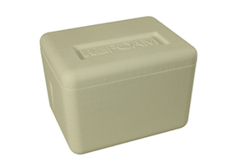
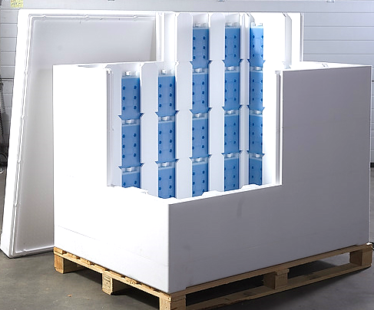
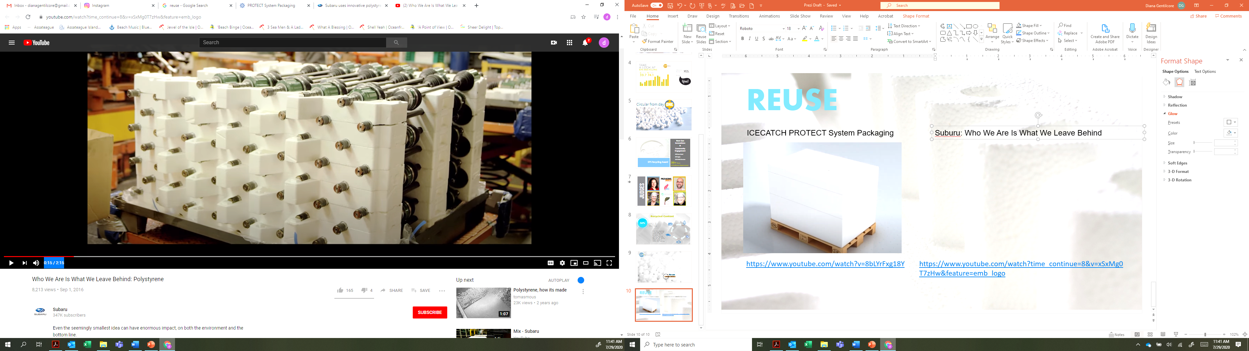
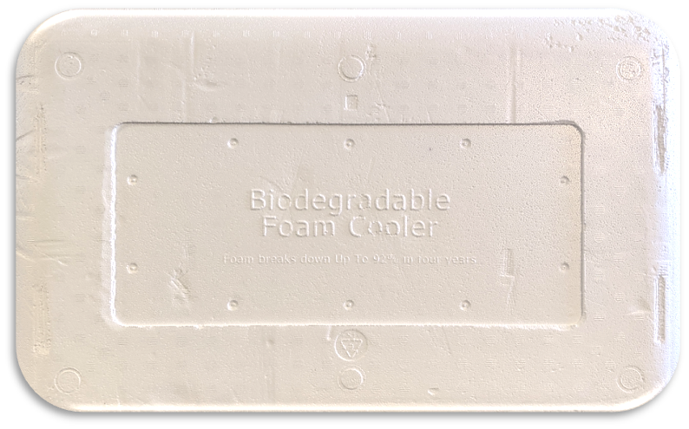
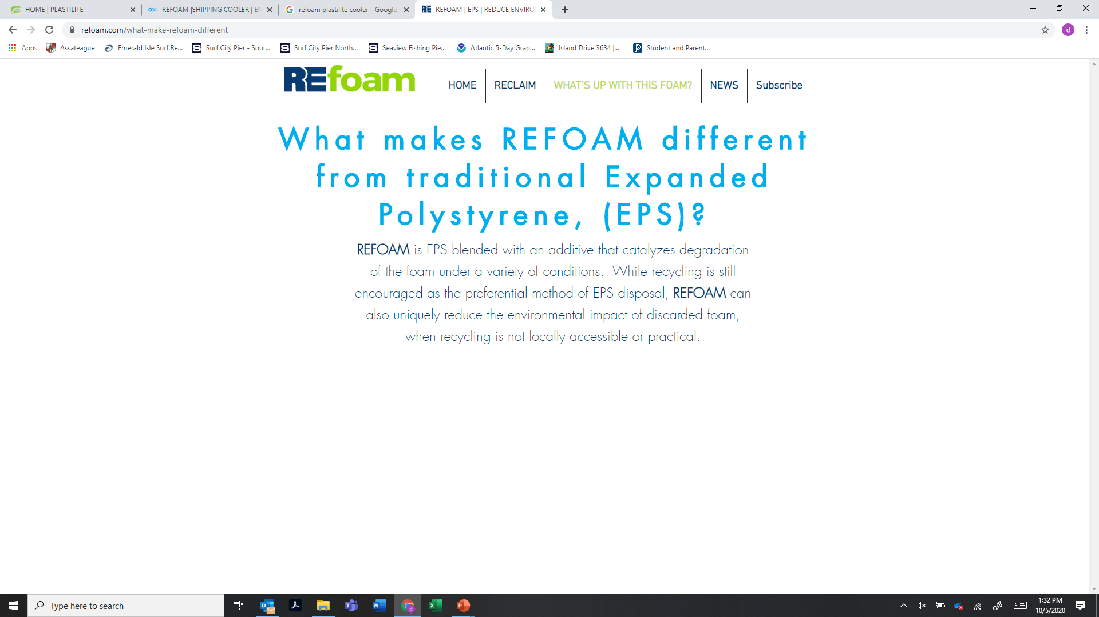



Ellen MacArthur Elimination Criteria #1
It Is Not Reusable, Recyclable Or Compostable
EPS Transport Packaging Is Widely Recycled, Frequently Used In Innovative Reuse Applications & Has Biodegradable Feedstock Options
THERMOCON PROTECT System Packaging
Subaru Re-Use Solutions
EVRgreen™
Biodegradable EPS Resin
EPS Using an Additive to Catalyze Degradation

Slide 14
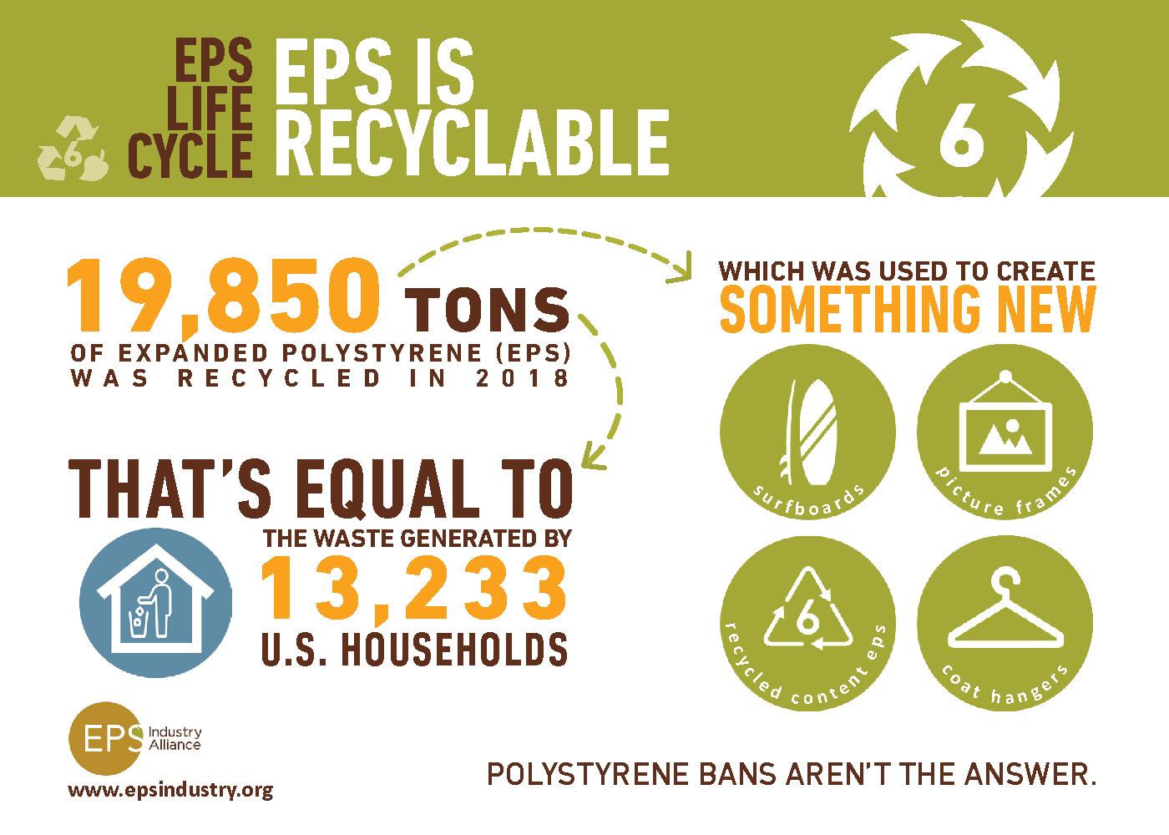

Slide 15
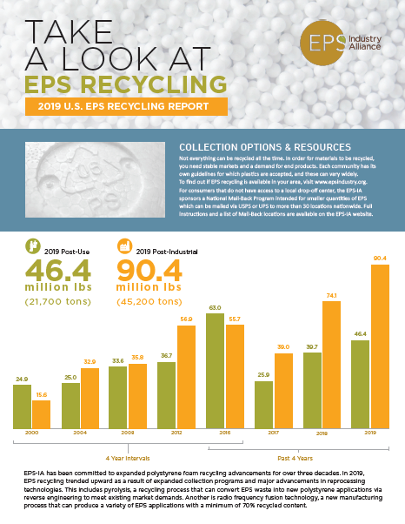
EPS Recycling Solutions
Mechanical Recycling | Clean EPS Waste Holds Its Value In Recycling Markets
Advanced Recycling | Employs Reverse Engineering To Incorporate Recycled Polystyrene Into Existing Applications
Recycled-Content Resin | Eco-Six™ Resin Uses 80%+ Recycled EPS Since 2012
Consumer Access
Curbside | 50 U.S. Cities Serving 24 Million
Drop-Off | Over 230 Drop-Off Locations
Collection Events | 100’s of Community Recycling Drives
Mail-Back Program | Accepted by 30 EPS Manufacturers

Slide 16

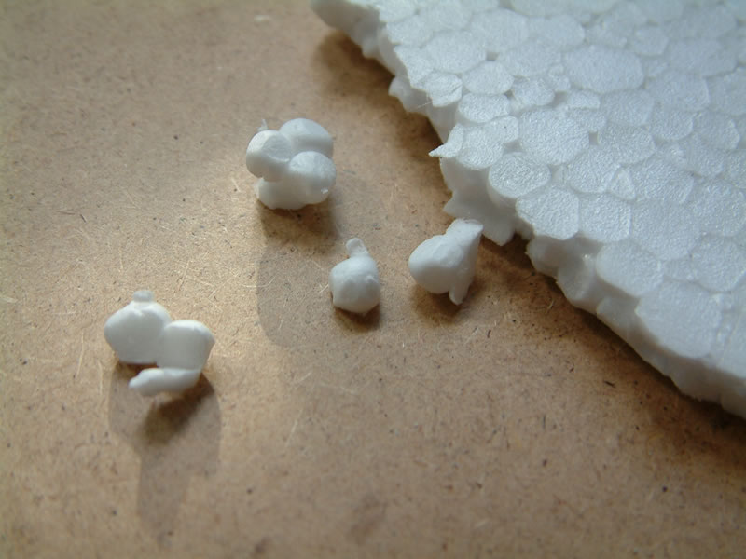
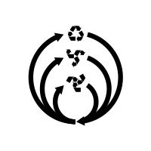
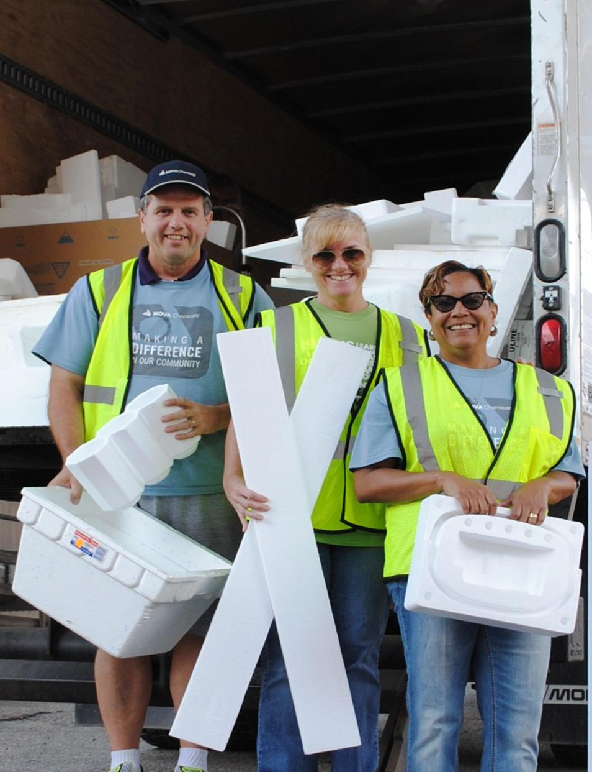
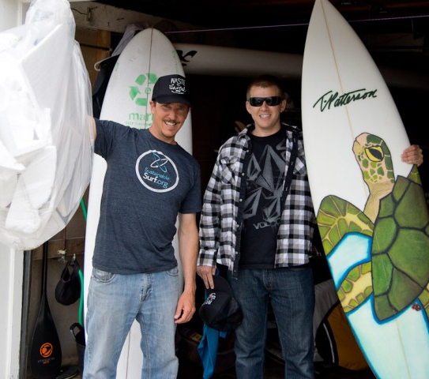
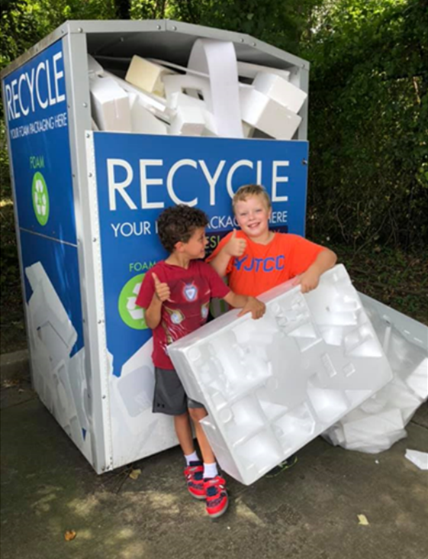
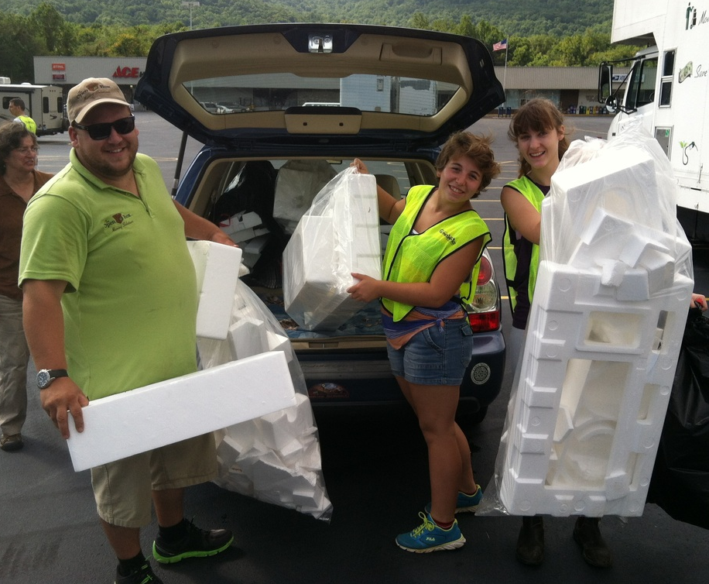
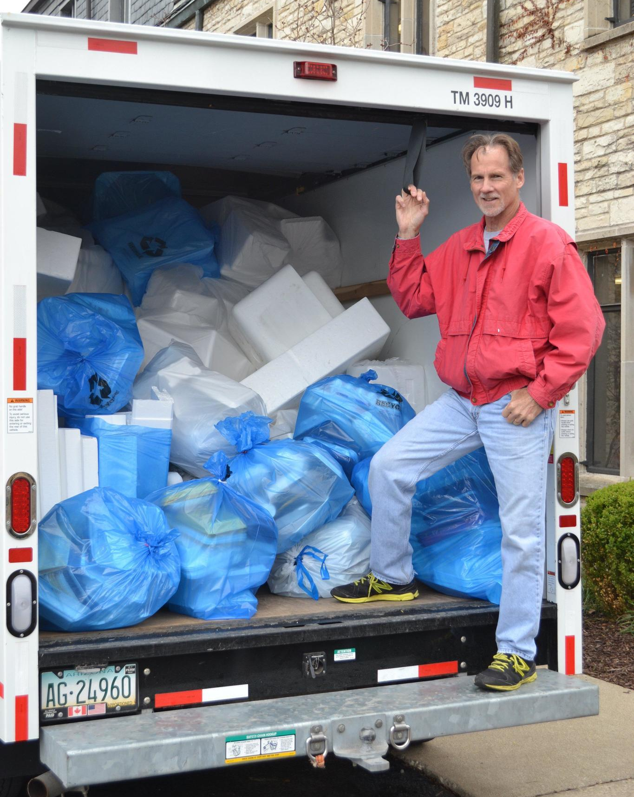
Expanded Polystyrene is easily used as ‘regrind’ to produce new EPS products with recycled content.
Unexpectedly Circular

Slide 17
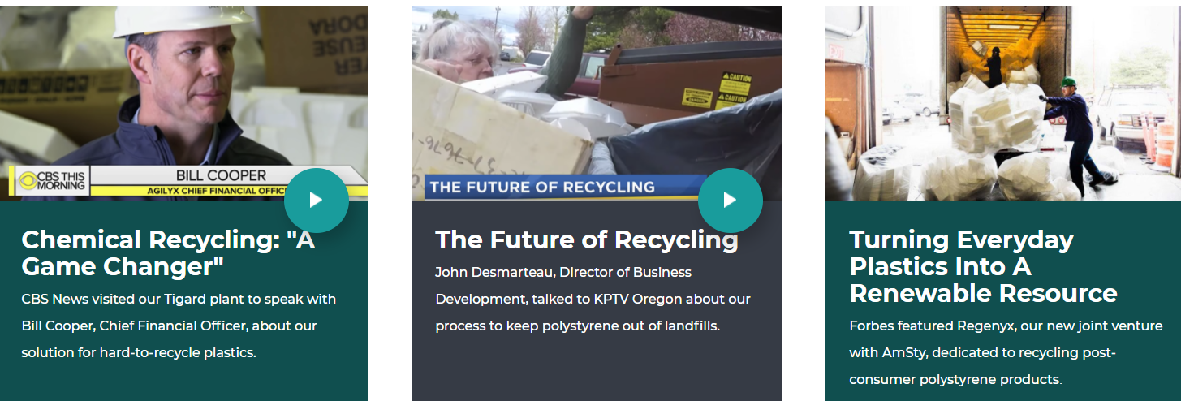
EPS Recycling Innovations
Polystyrene Waste – Including EPS Packaging – Is a Major Driver in Advanced Recycling
Notes:
Currently working with American Styrenics & others on circular solutions for polystyrene using reverse engineering to meet existing market demands. Launching community-based collection programs – Portland, OR

Slide 18

“RECYCLING IS NOT A PREDICTOR OF ENVIRONMENTAL IMPACT”
“Simply knowing that an item is recyclable or compostable tells us surprisingly little about the actual impact on human health and the environment or the trade-off between different materials.
A lot of consumers are making their choices based on whether or not something is easy to recycle and that is not a meaningful predictor. It's pretty random, it's about as useful as tossing a coin or consulting a Ouija board.
Popular is not always wise.”
David Allaway
Senior Analyst
Oregon Department of Environmental Quality

Slide 19
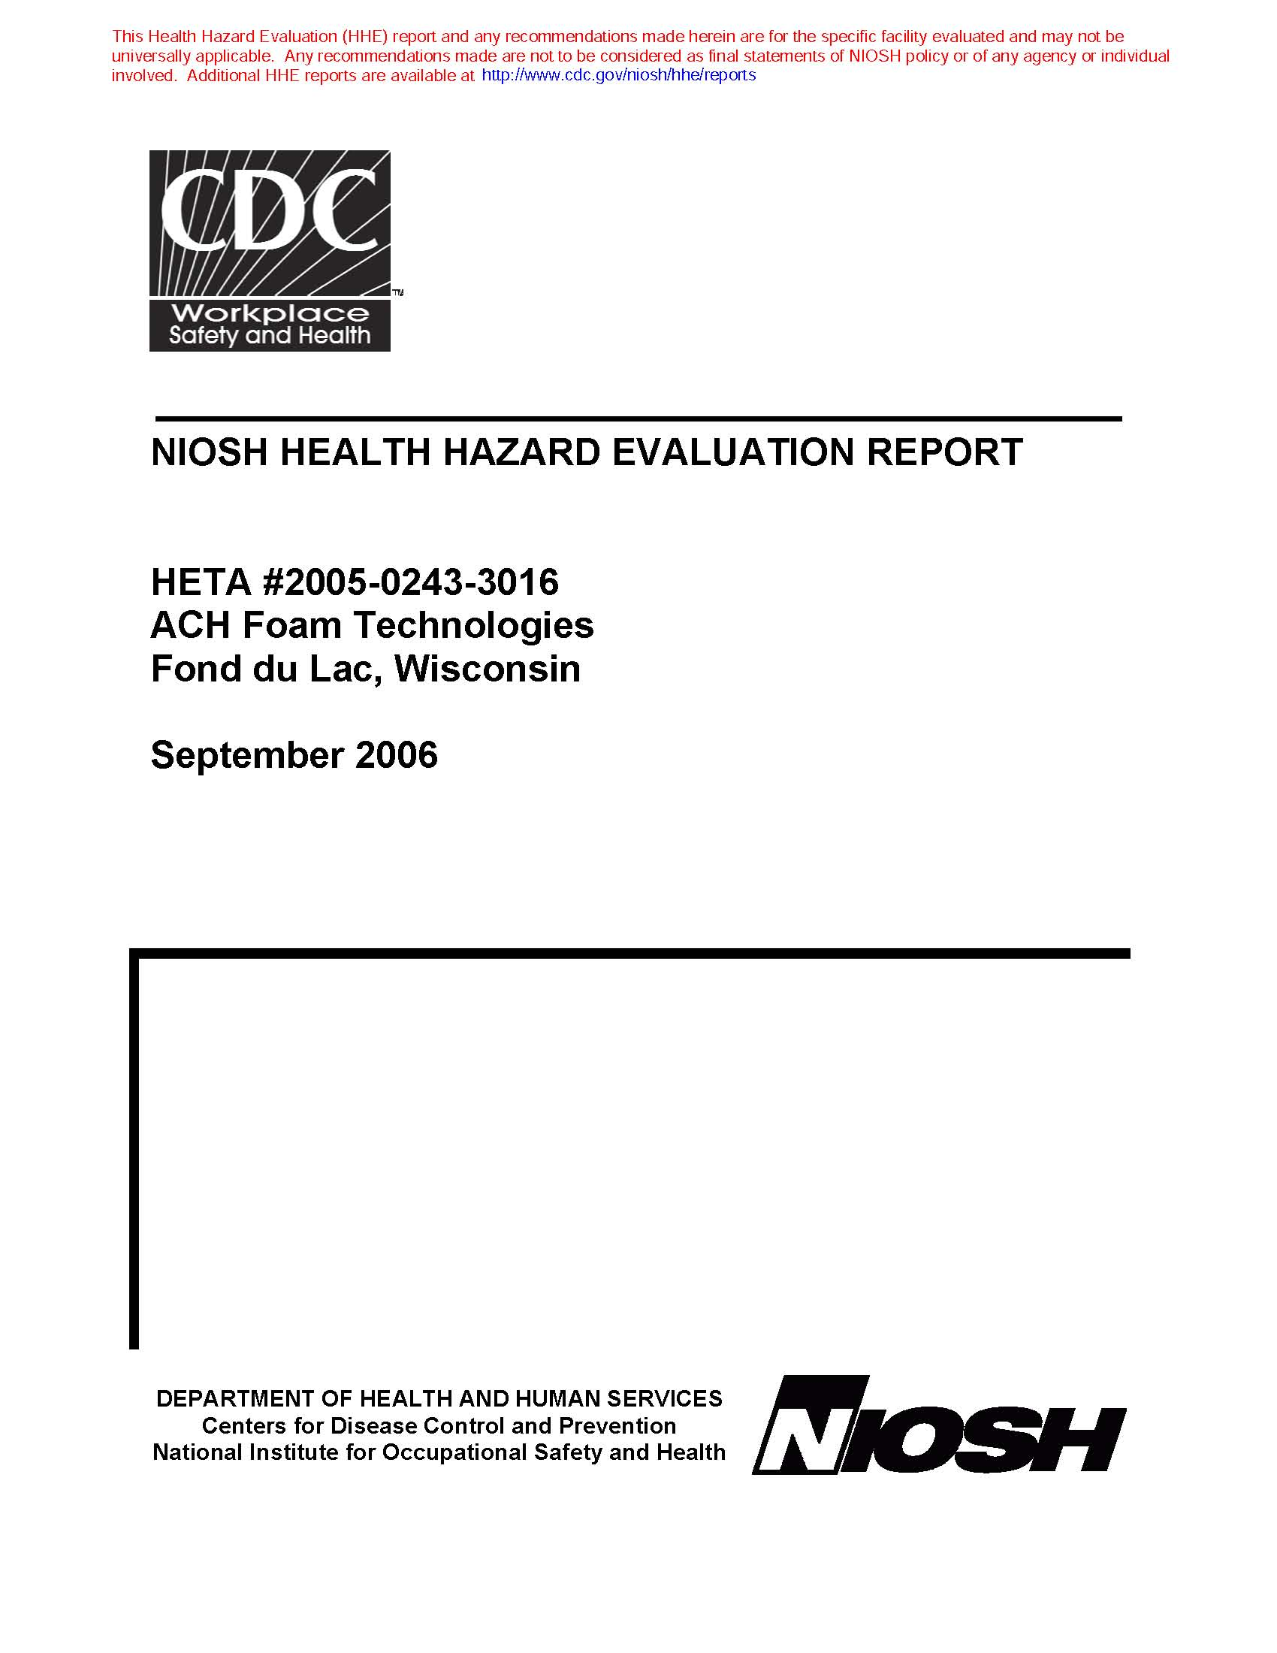
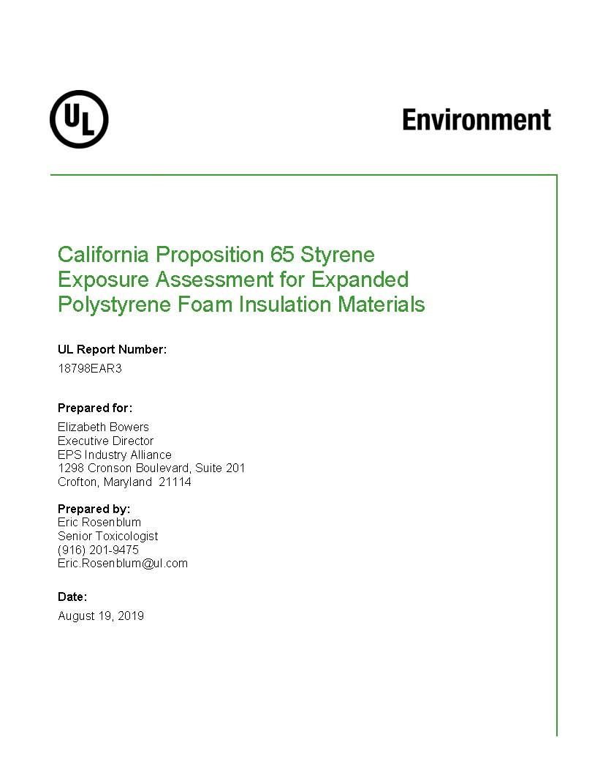
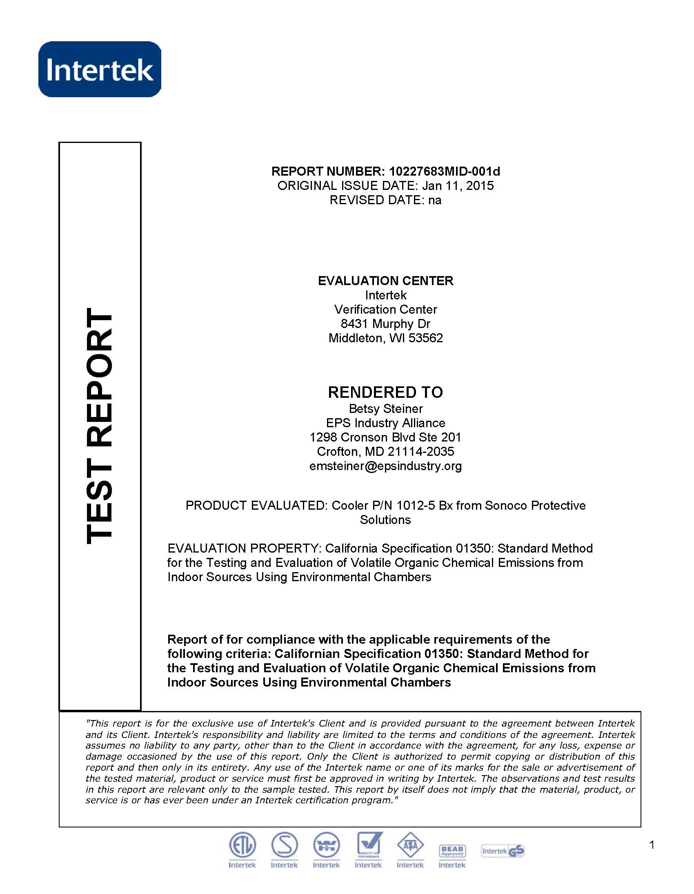
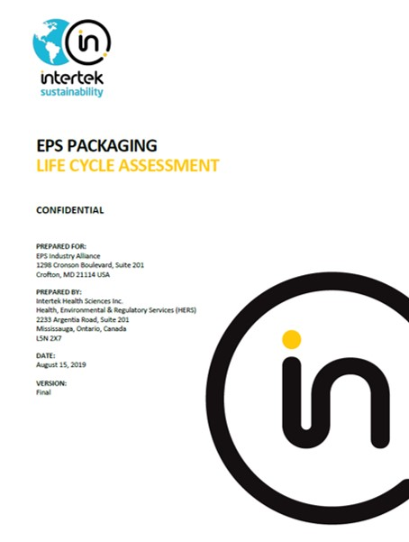
Ellen MacArthur Elimination Criteria #2
It contains, or its manufacturing requires hazardous chemicals that pose a significant risk to human health or the environment.
Science Shows EPS Chemical Composition Is Below Established Risk Levels
Independent Govt Investigation
Styrene Risk Assessment
VOC Emissions CA Specification 01350
Life Cycle Assessment Eco-Toxicity

Slide 20
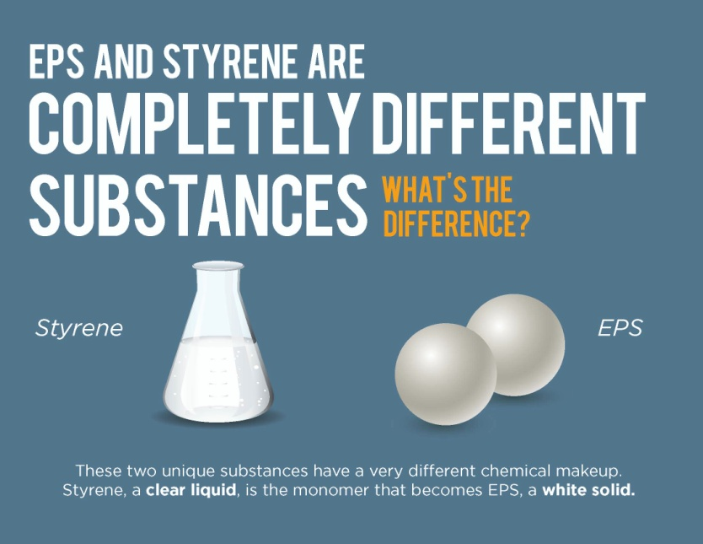
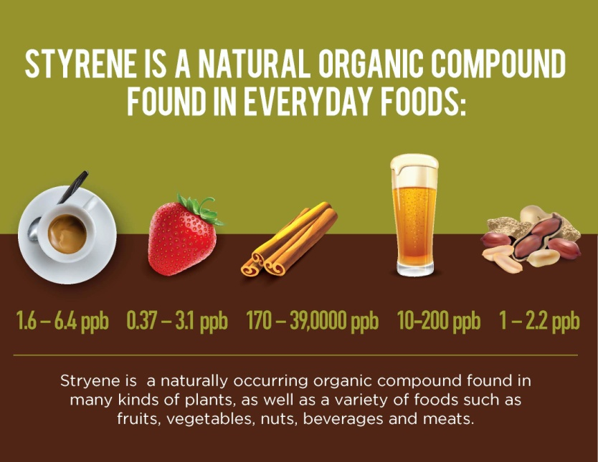
Styrene Used In EPS Is Approved By U.S. Food & Drug Administration For Use In Food-Contact

Slide 21

Ellen MacArthur Elimination Criteria #3
It Can Be Avoided (Or Replaced By A Reuse Model) While Maintaining Utility
EPS Outperforms Alternative Materials To Minimize Damage-In-Transit
Many nuances must be considered in plastic substitutes, from their recyclability and global warming potential (GWP) to their versatility and suitability for applications. The shifts to alternative materials have emerged as a knee-jerk reaction to consumer anti-plastic sentiment, but these abrupt alterations are not as environmentally-sound as they might first appear.
Energy Use
C02
Water Consumption?
Biodegradable? Compostable?
Product Protection
& Safety?

Slide 22


Slide 23
LIFE CYCLE ANALYSIS SUPPORTS EPS PACKAGING
Environmental Impact | EPS | PP | Cardboard
 | 6 kg
Non- Renewable Primary Energy (MJ) | 1 | 1.3 | 1
Depletion of Non-Renewable Resources (kg eq Sb) | 1 | 1.3 | 1
Greenhouse Gas Emissions (kg CO2 eq 100 years) | 1 | 1 | 1.3
Air Acidification (g SO2 eq) | 1 | 1.2 | 1.9
Photochemical Oxidants Formation (g eq ethylene) | 1 | 0.3 | 0.2
Water Consumption (m3) | 1 | 0.8 | 3.5
Water Eutrophication (in g eq PO43) | 1 | 1.2 | 5.1
Total Waste Production (kg) | 1 | 2.3 | 5.2
Comparisons of life-cycle impact of the uses of three different packaging materials shows that EPS compares favorably with polypropylene (PP) & cardboard packaging because of its energy-efficient production & light weight.
* Comparative Results of Three Packaging Solutions in an Average 6kg European Situation, Pricewaterhouse Coopers, November 2011.

Slide 24

“EDUCATING TOWARD SMARTER CHOICES”
As a professor, there is one skill I strive to ensure all my students develop in class. That skill is critical thinking. Avoiding snap judgements, and thoroughly thinking through the pros and cons of the decisions we face, makes us better as individuals and as a society.
Hot topic discussions always arise in class, such as how to solve the world’s growing waste problem, and I’ve been surprised by how often the narrative on this issue has changed over time.
We’ve come a long way from disregarding the issue, to considering bans on problematic products, and finally embracing a model of circularity with proper waste disposal, as the issue has been better understood.
EPS products have a long way to go to reach this ambitious goal, but their irreplaceability makes the journey ahead worthwhile.
Rachel Robinson
College professor
Houston, USA

Slide 25

Ellen MacArthur Elimination Criteria #4
Ellen MacArthur Elimination Criteria
It Hinders Or Disrupts The Recyclability or Compostability of Other Items
Contamination Is The Single Largest Threat To Recyclability Disruption

Slide 26

Ellen MacArthur Elimination Criteria
Ellen MacArthur Elimination Criteria #5
It Has A High Likelihood Of Being Littered Or Ending Up In The Natural Environment
5. It has a high likelihood of being littered or ending up in the natural environment. | People don’t litter because of the type of material being illegally discarded into the environment. Paper would be subject to this criteria.
EPS Transport Packaging Is 2.7% of U.S. Litter
& Less Than 0.5% of Plastic Marine Debris

Slide 27

BIG PICTURE
“WE SHOULD THINK ABOUT THE BIG PICTURE”
I think society has focused on solving the waste problem, and we definitely need to do that, but we shouldn’t lose sight of the real problem facing our generation: climate change. Said differently, if all we do is recycle more, does that mean we are doing less harm to the environment?
More and more people are doing their part, choosing fully recyclable materials, putting garbage in the right place, and starting action in their communities, but I think that we should also start questioning corporations about everything that happens before and after we as consumers get to make a choice. Fixing the amount of carbon emissions needed to heat my home, or get an Amazon package delivered to me, now that’s big picture stuff.
Olivia Turella
College Student, São Paulo, Brazil

Slide 28

EPS PACKAGING PERFORMANCE & ENVIRONMENTAL CHARACTERISTICS ARE HARD TO BEAT
  When Evaluating Alternative Materials:
  Is It Recyclable At Scale & Profitable?
  Are Life Cycle Impact Trade-Offs Net Zero?
  Are Material Costs Equivalent or Less?
  Are Optimized Shipping Loads Maintained or Improved?
  Does It Achieve Equal Damage Avoidance?
  Does It Comply With U.S. FDA, DOT & FAA Guidance?

Slide 29






Additional EPS Sustainability Resources
EPS Recycling Access Map
U.S & Canada
www.epsindustry.org
The EPS Industry Alliance is the North American trade association representing the expanded polystyrene manufacturing supply chain. EPS-IA members produce innovative packaging solutions following best practices for environmental stewardship throughout the EPS product life cycle.
1298 Cronson Boulevard, Suite 201
Crofton, MD 21114 USA
(800)607-3772
www.epspindustry.org

Slide 30

SEE POLYSTYRENE RECYCLING IN ACTION
EPS Industry Alliance
Foam Recycling With Manufacturers
(1:00) — 2019

Slide 31

Environmental Impacts of EPS Packaging Systems
1,000 Units of EPS for Vacuum Cleaner Packaging
‘Resource and Environmental Profile Analysis of EPS Packaging Products’, Franklin Associates, Ltd., 1997

Slide 32

Questions?
Please Contact Us…
EPS Industry Alliance
1298 Cronson Boulevard, Suite 201
Crofton, MD 21114 USA
Phone: 410-451-8340 Fax: 410-451-8343
betsy.bowers@epsindustry.org • www.epspindustry.orgy.org

Slide 33


