Slide 1



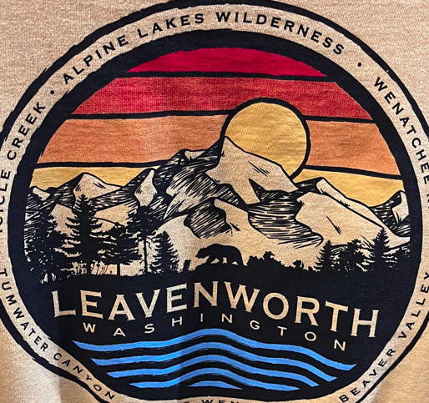
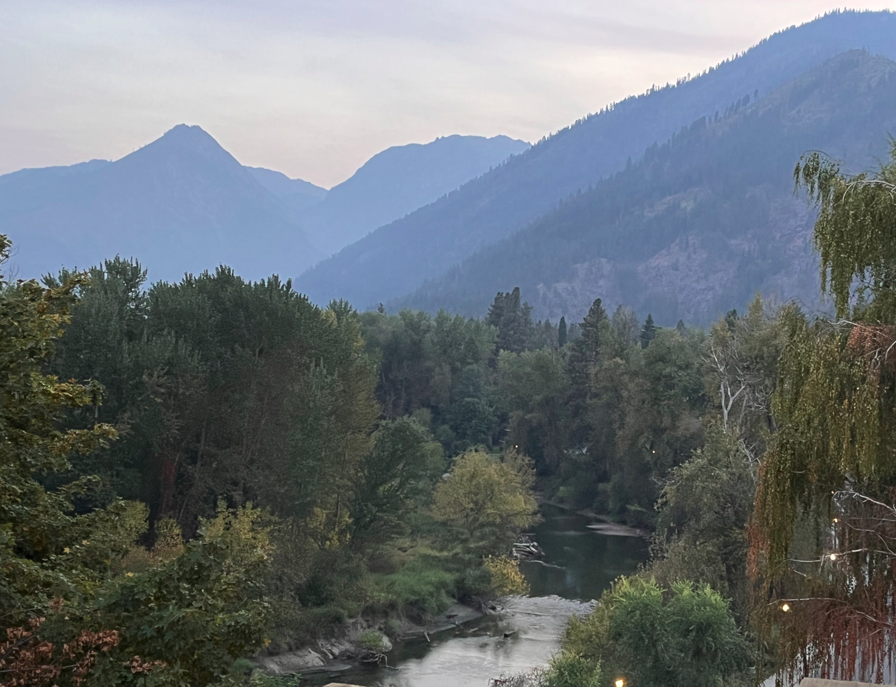
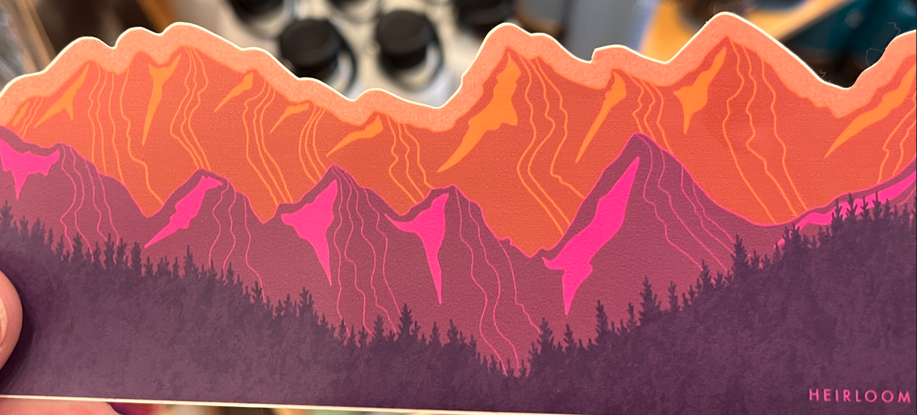
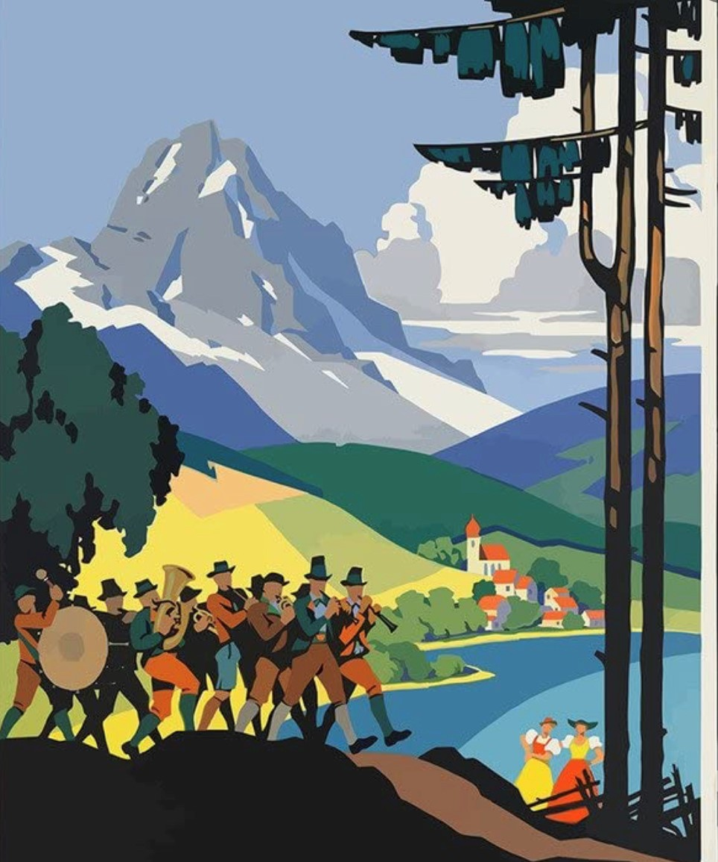
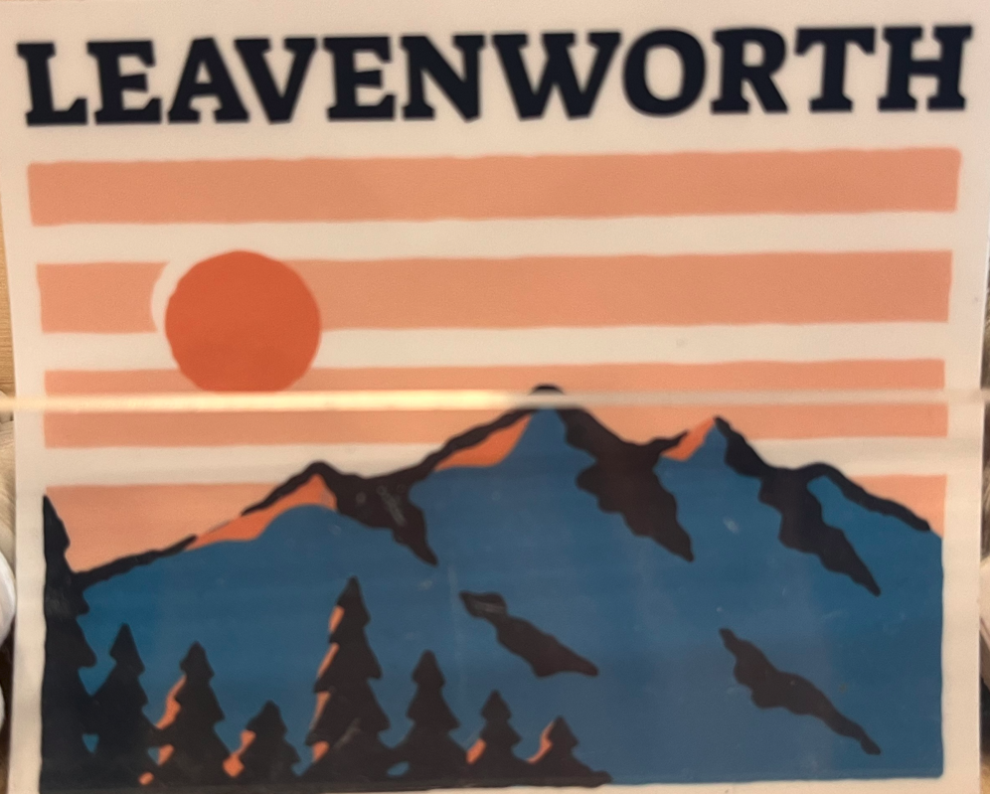
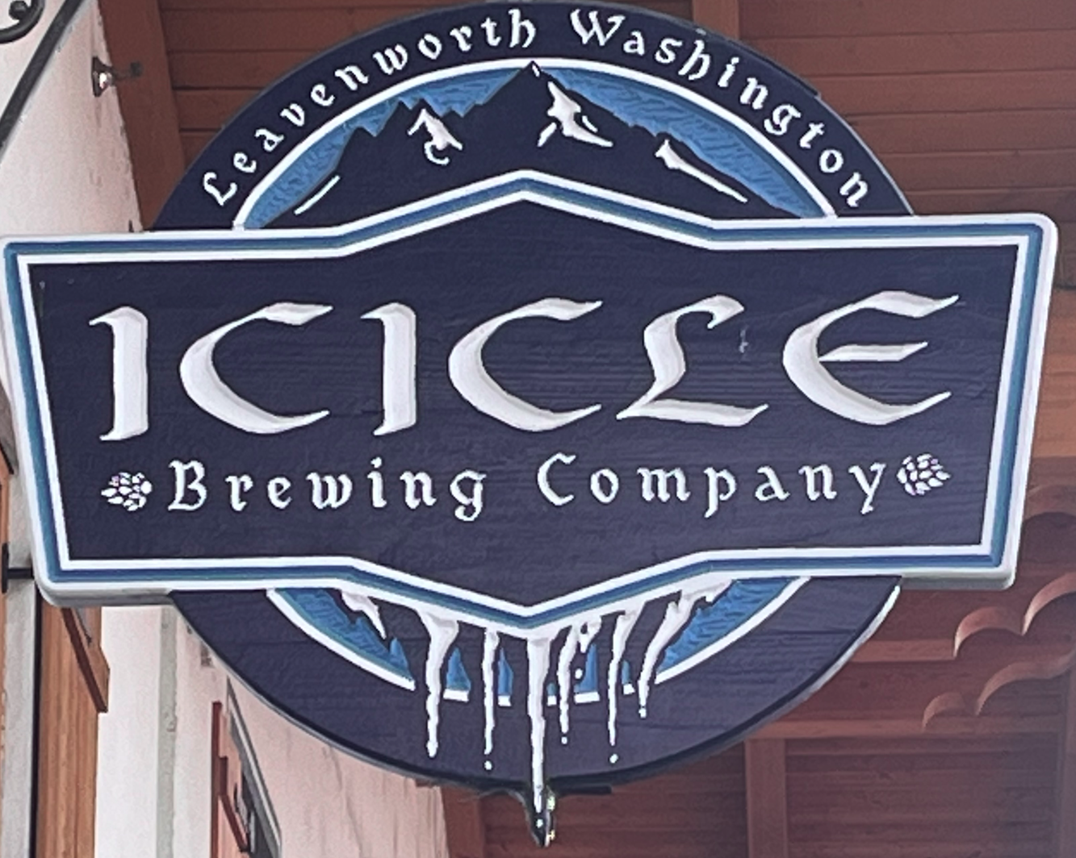
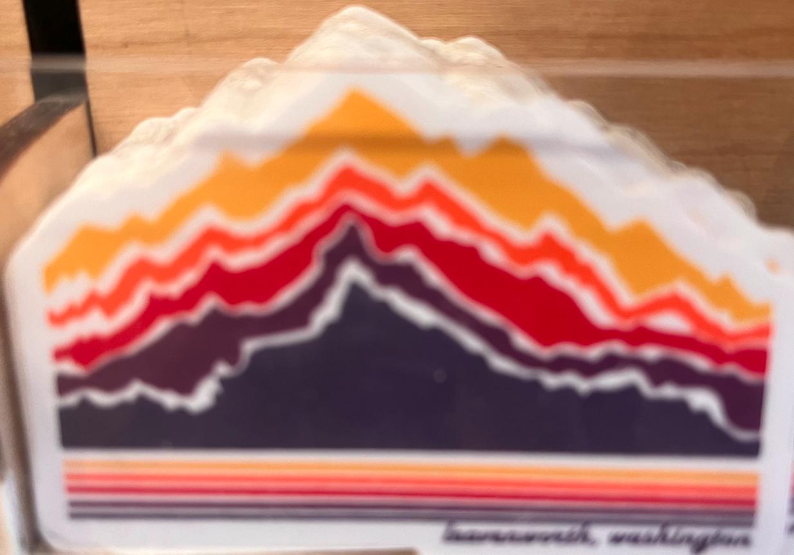
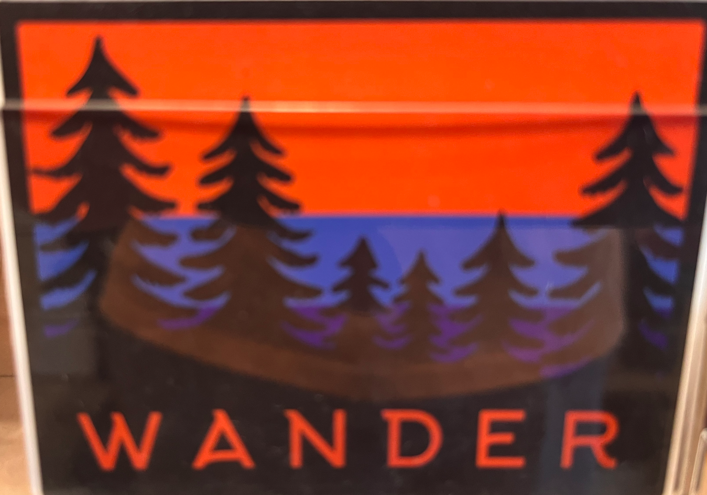
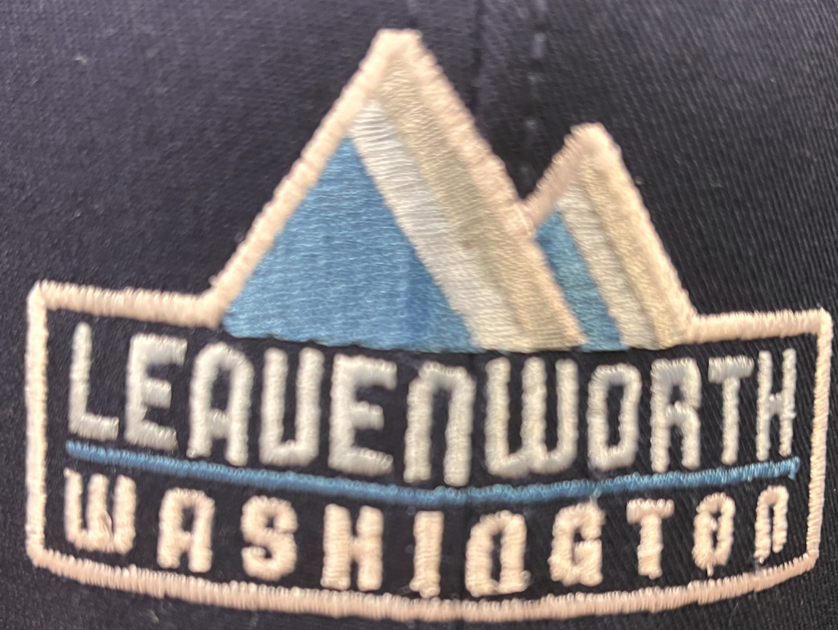
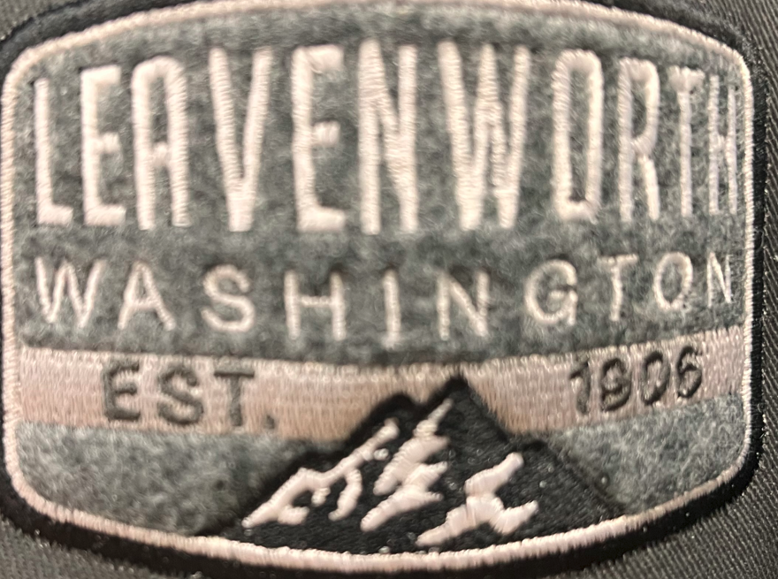
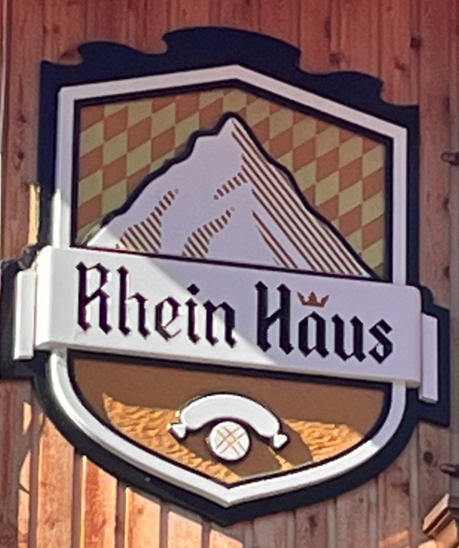
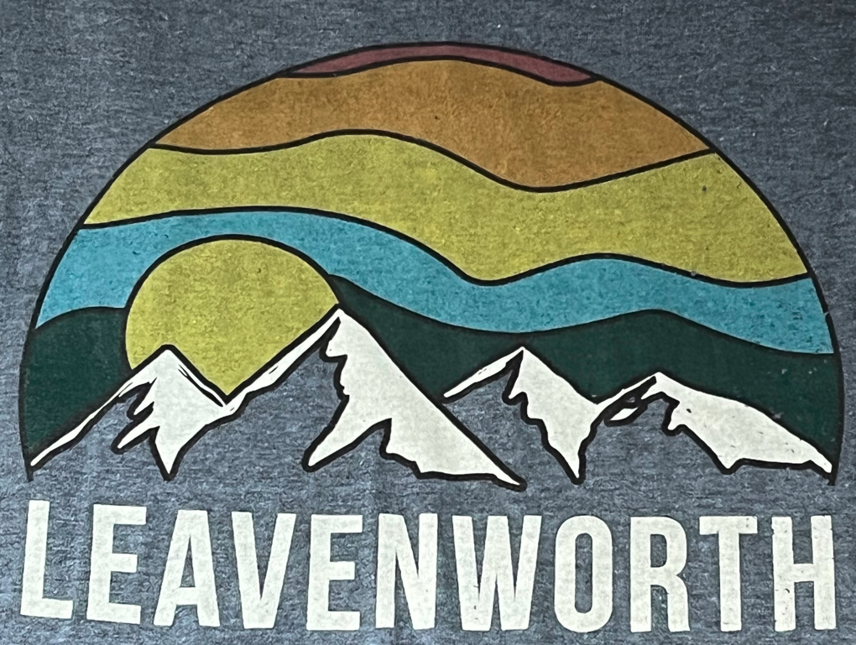
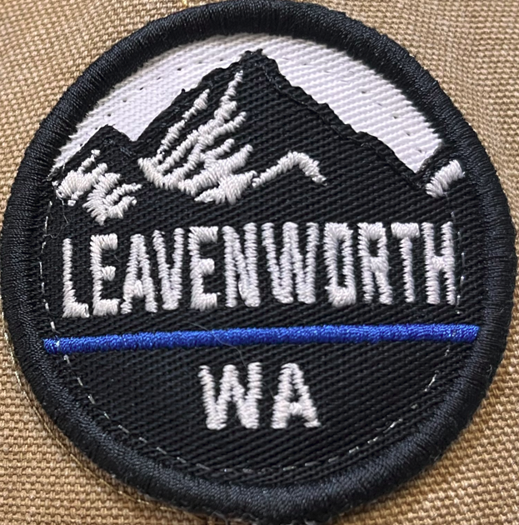
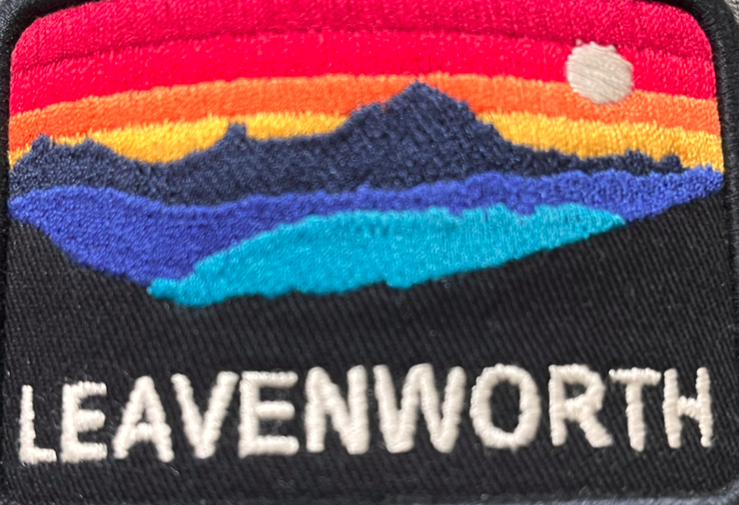
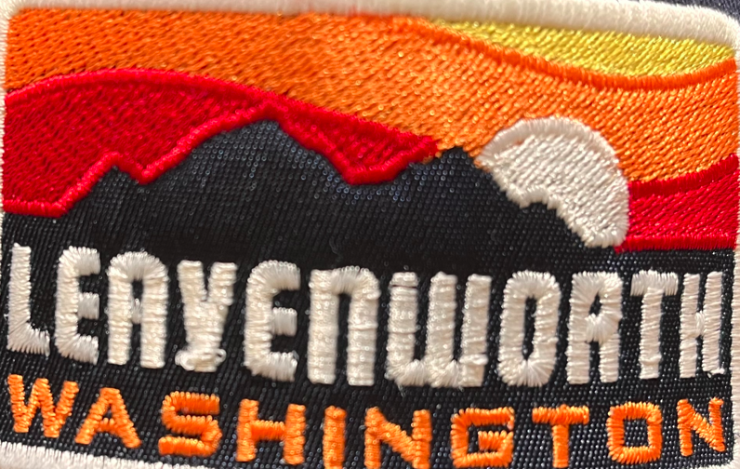
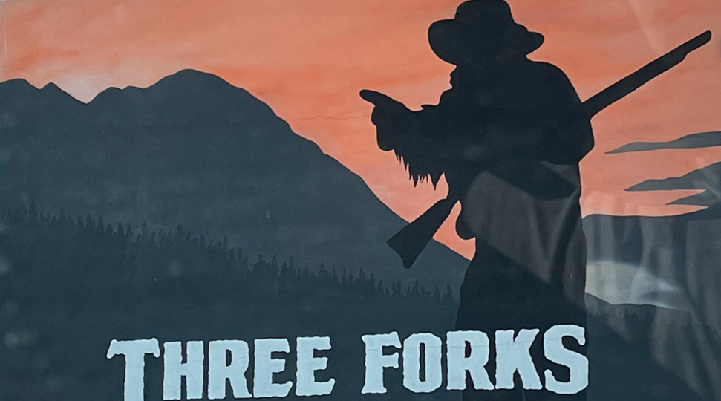
Mountain Inspired Signs

Slide 2
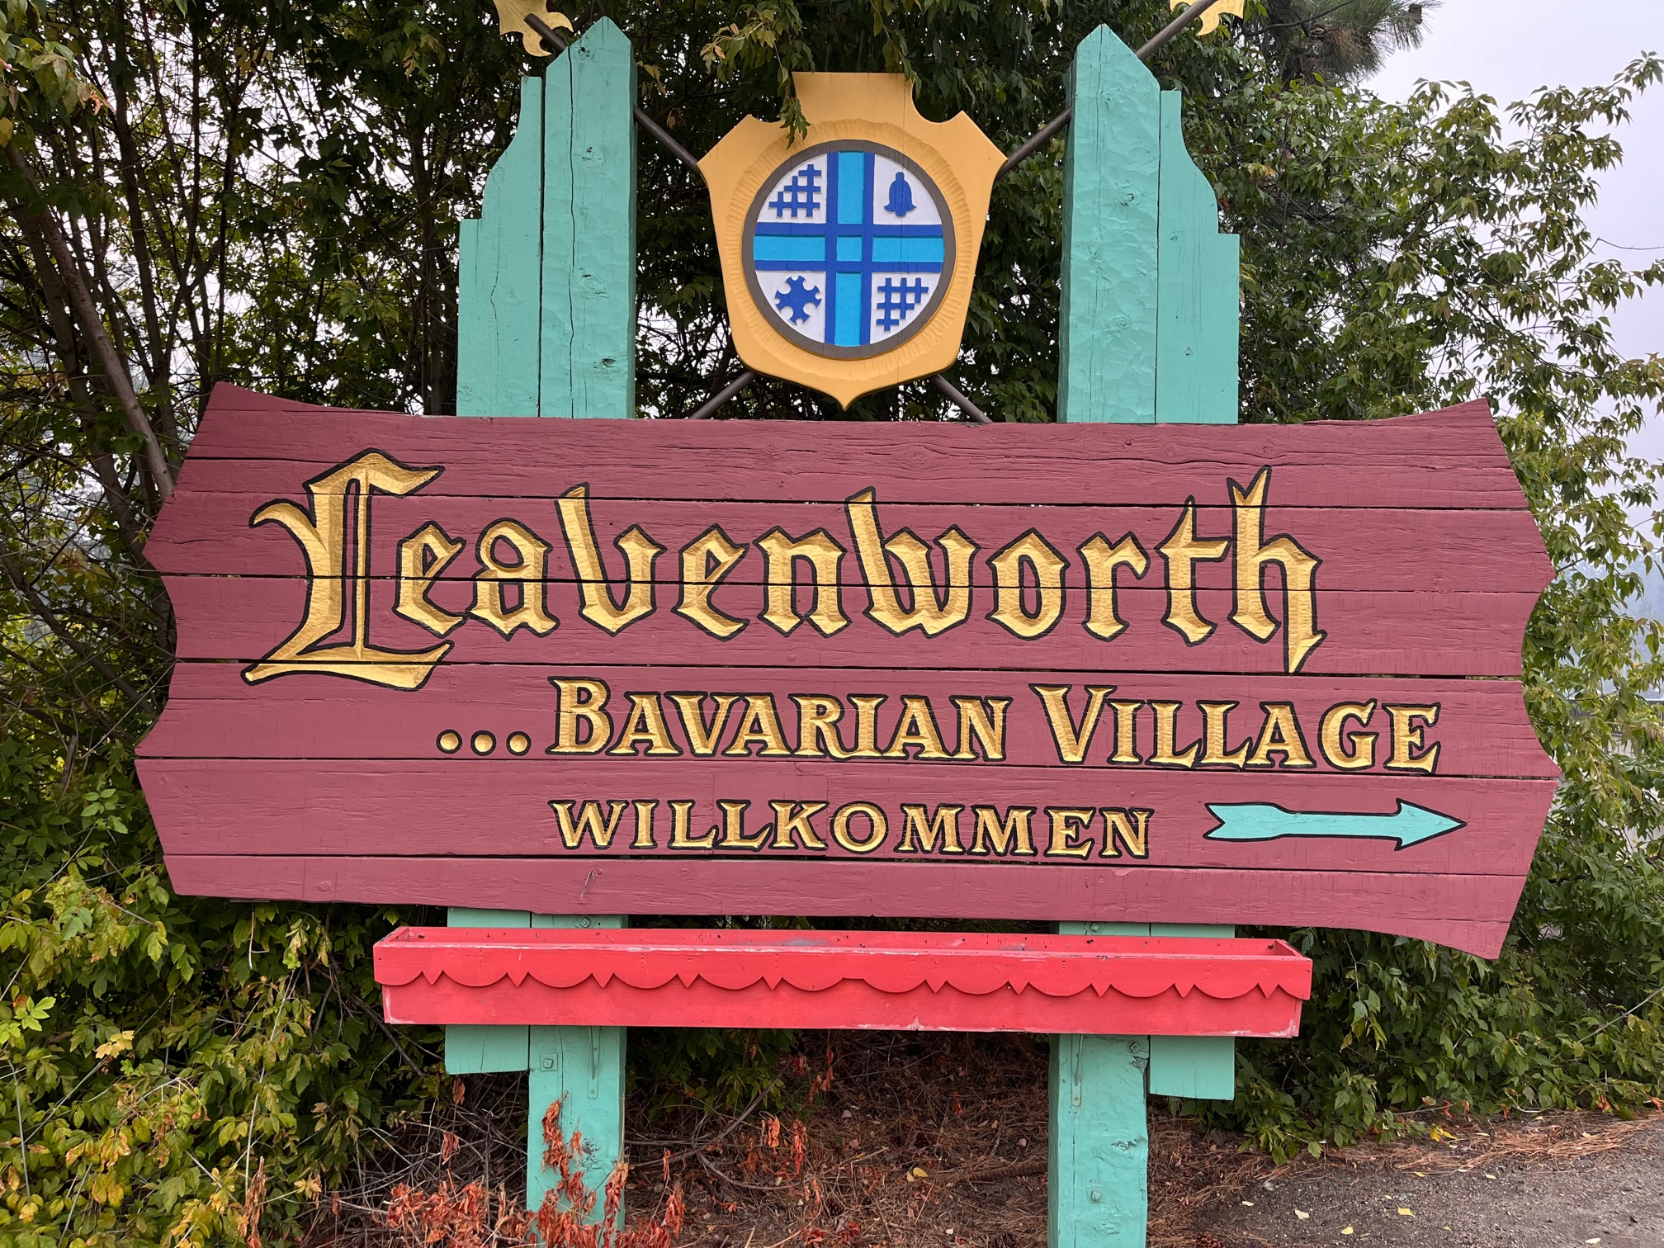
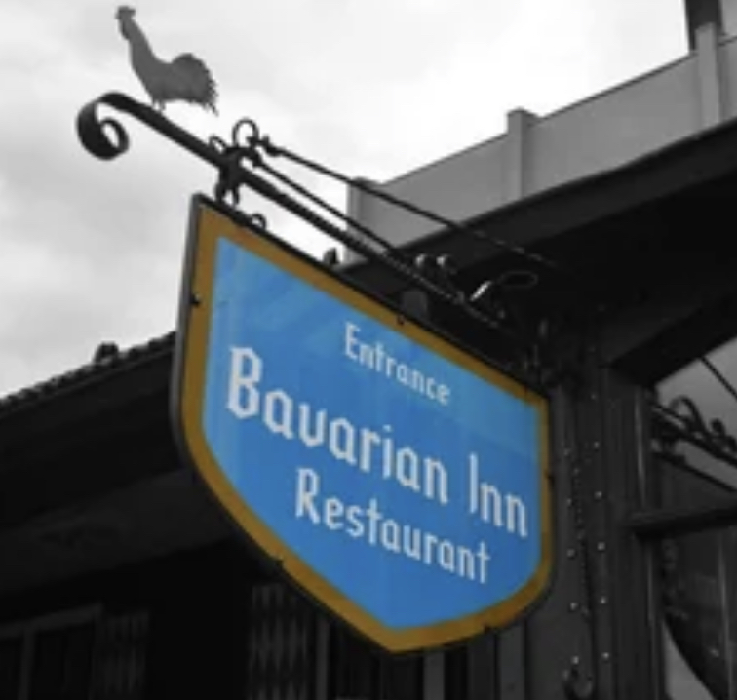
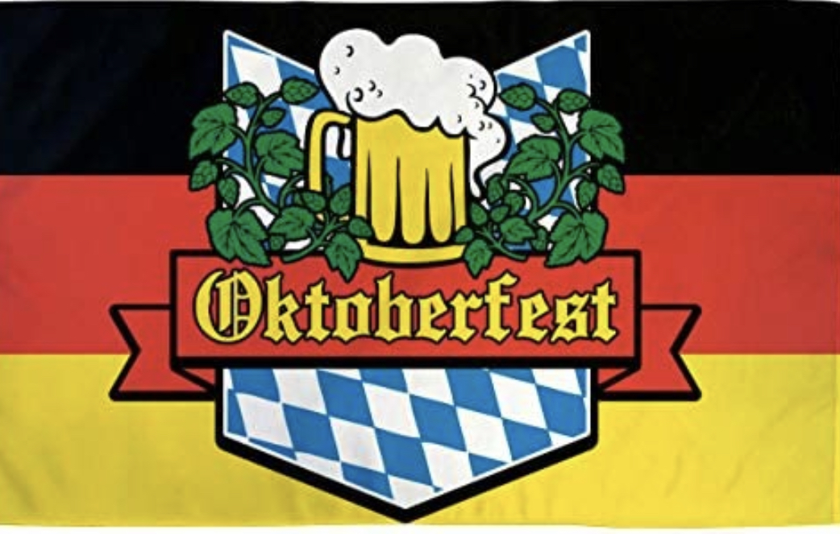
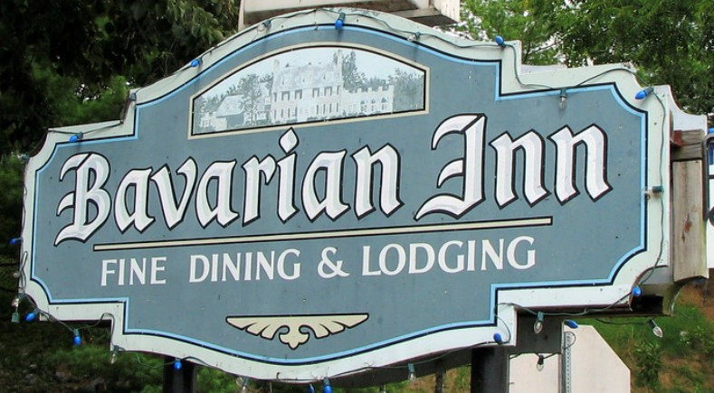
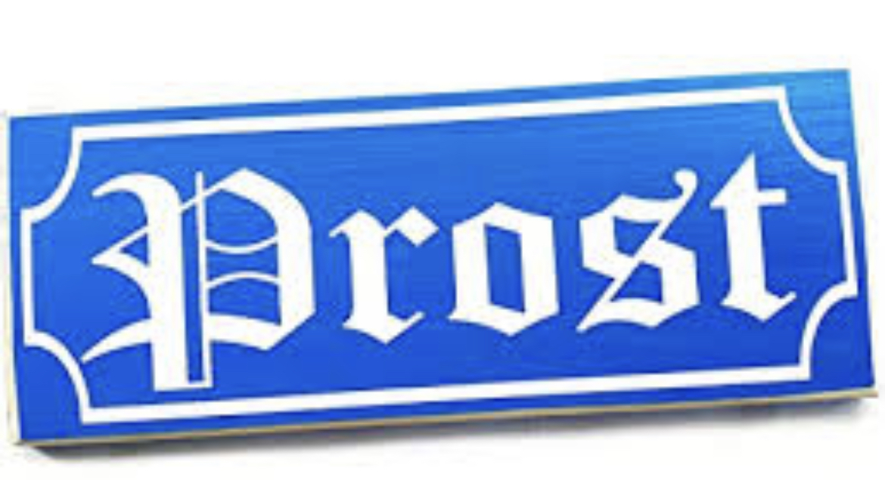
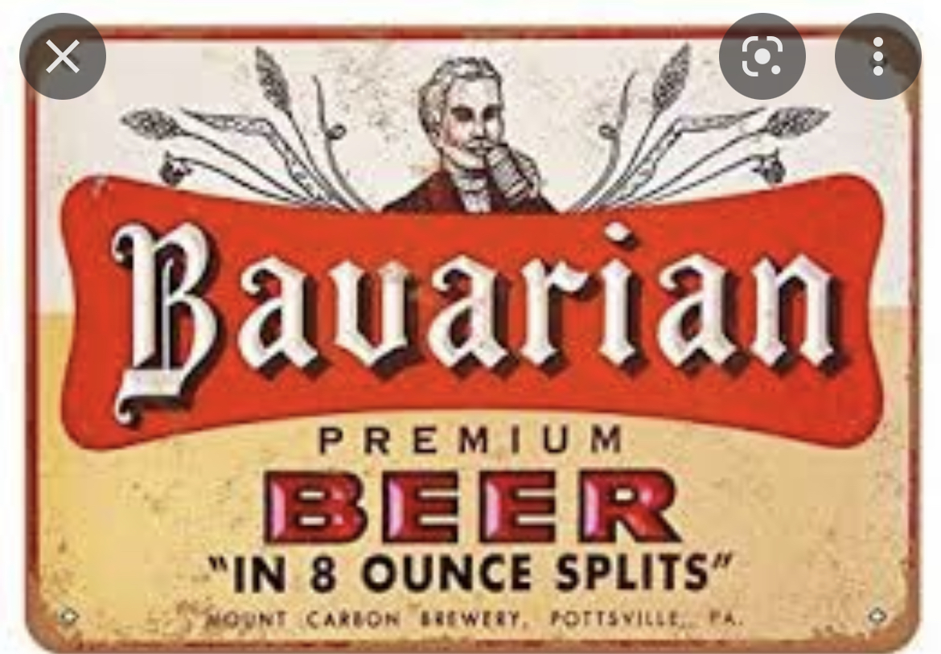
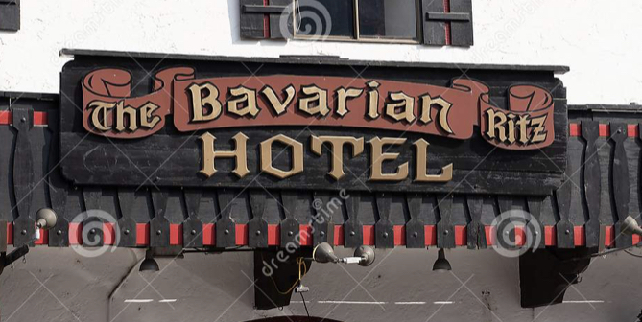
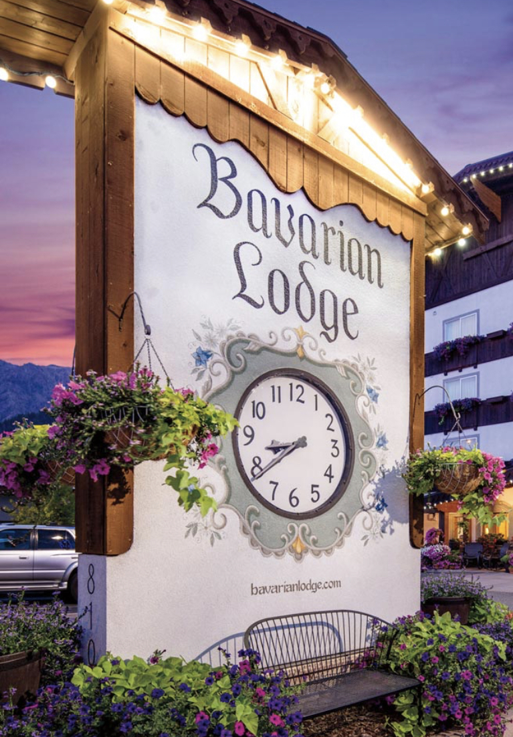



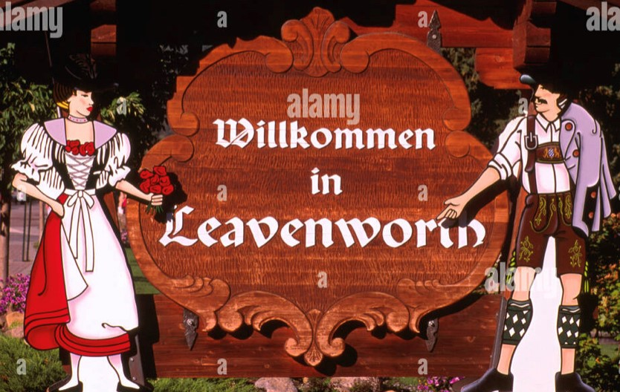
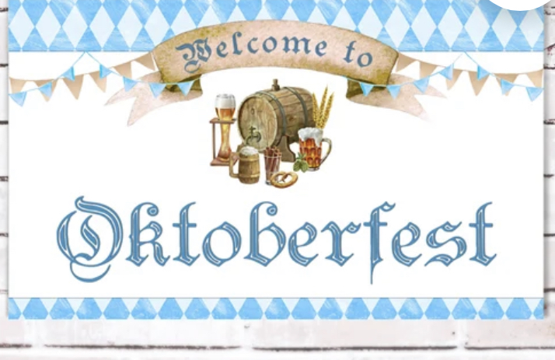

Bavarian Signs

Slide 3

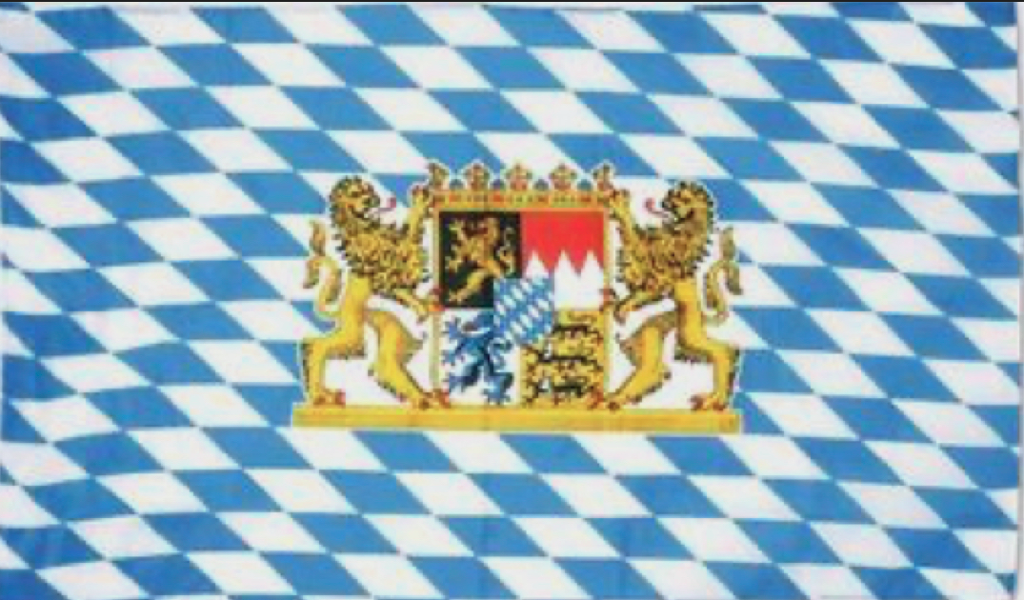
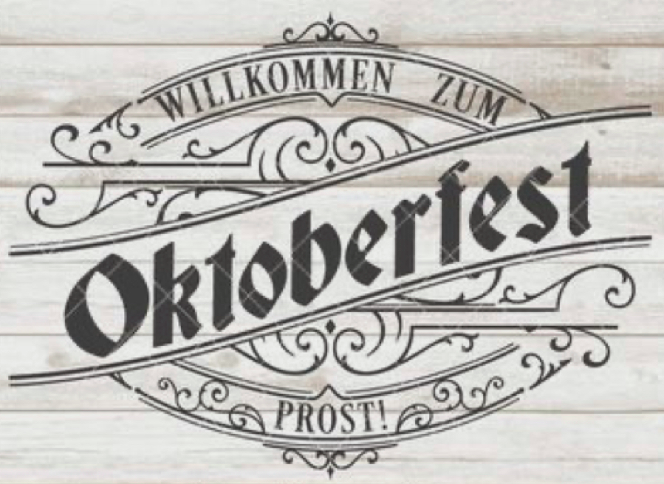




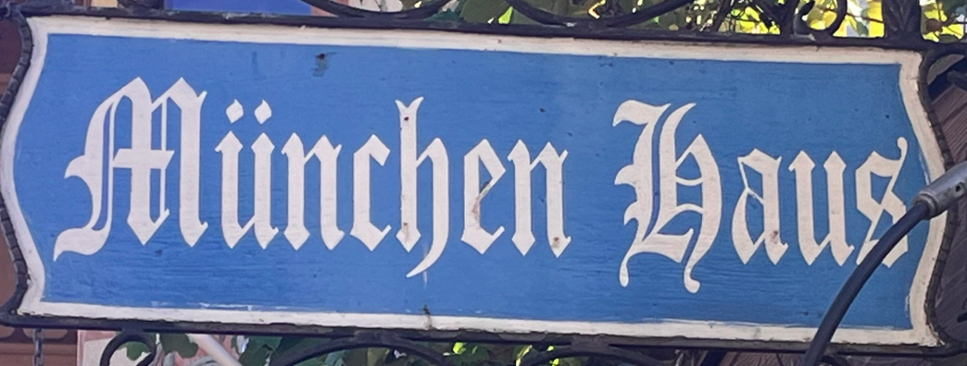
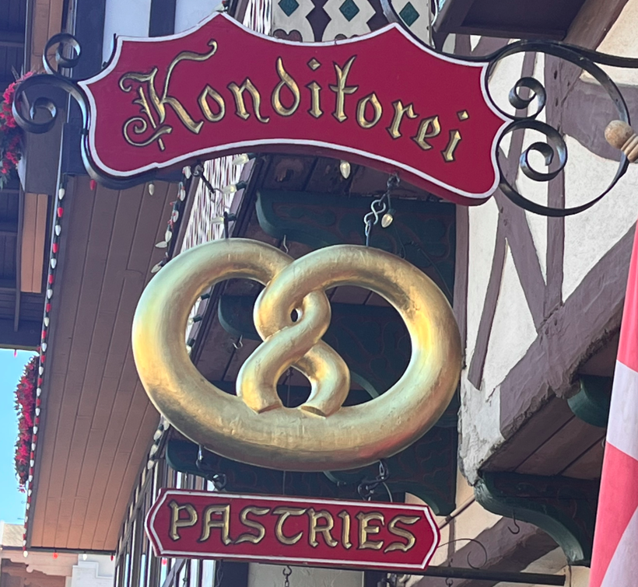
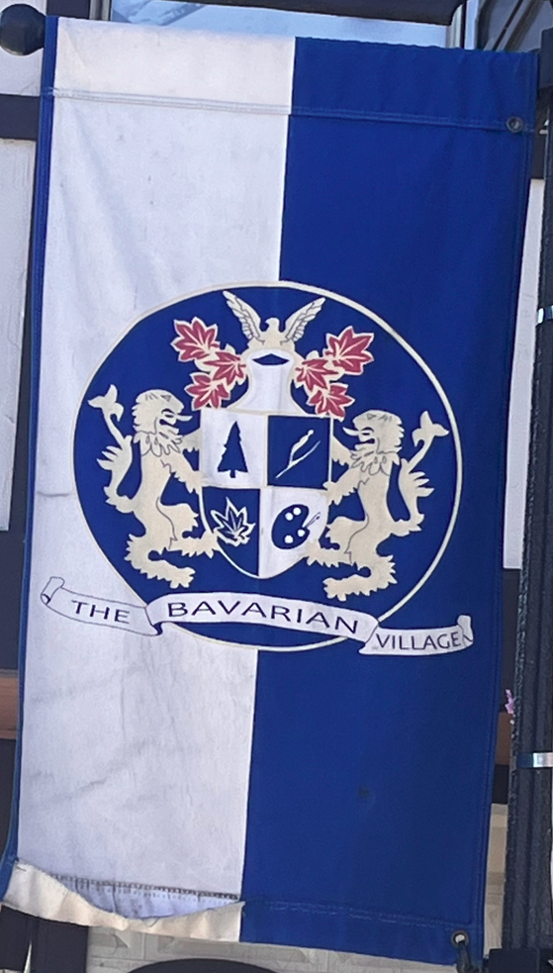
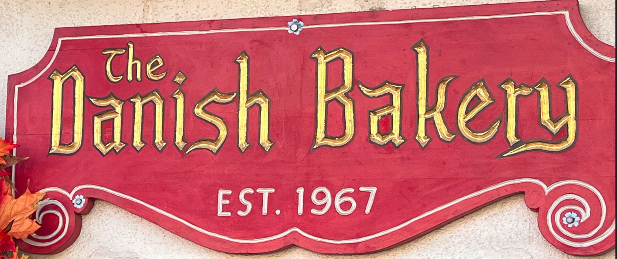
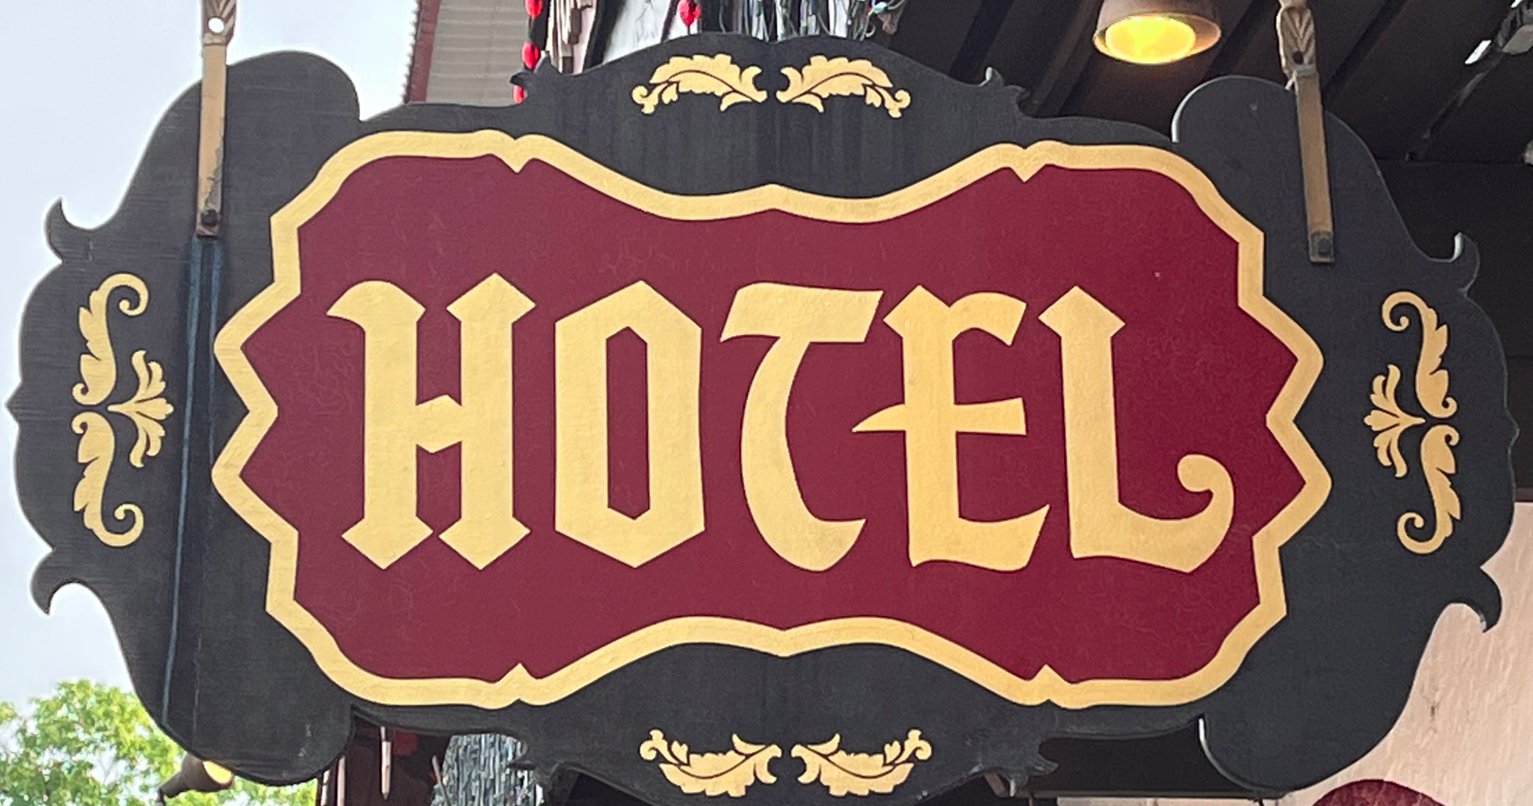

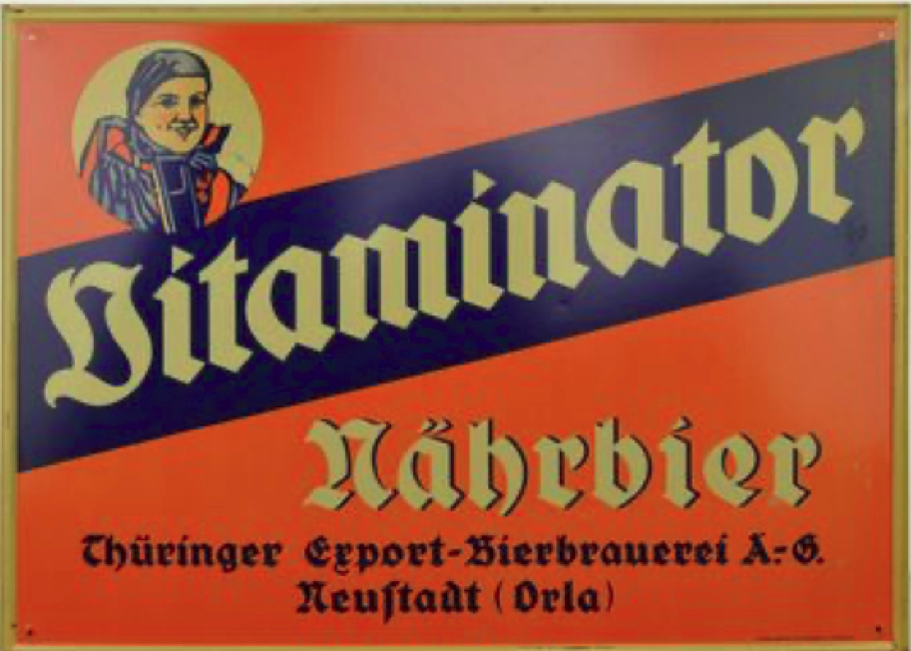
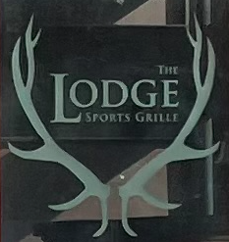
Bavarian Signs

Slide 4
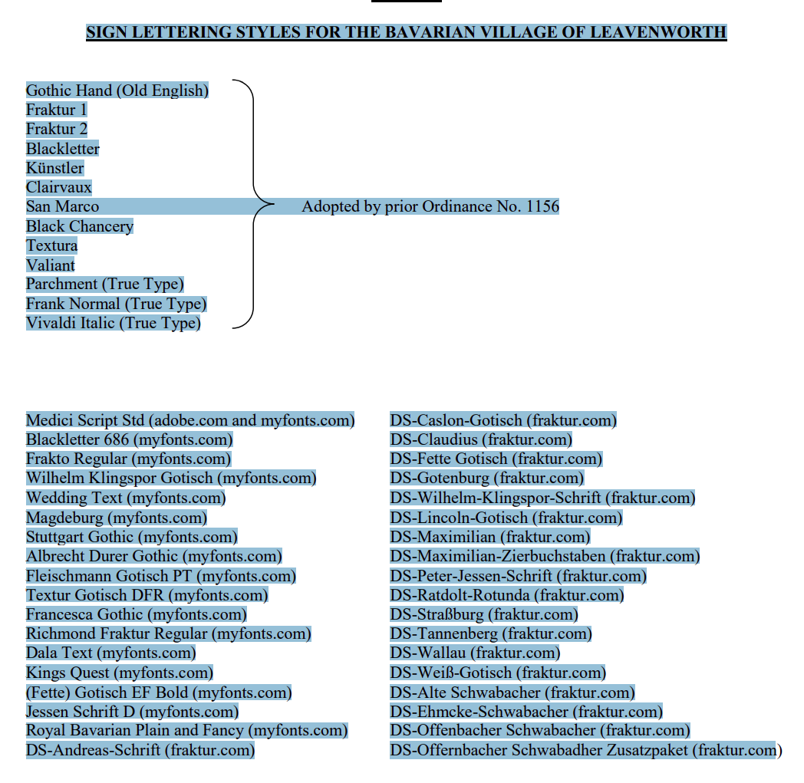











Frakto
Wilhelm Klingspor Gotisch
Wedding Text
Stuttgart Gothic
Linotype Dala(?)
Jessen Schrift
Old English(?)
Blackletter
Clairvaux
Vivaldi
Required to Use
these fonts

Slide 5
Some Ideas

Slide 6

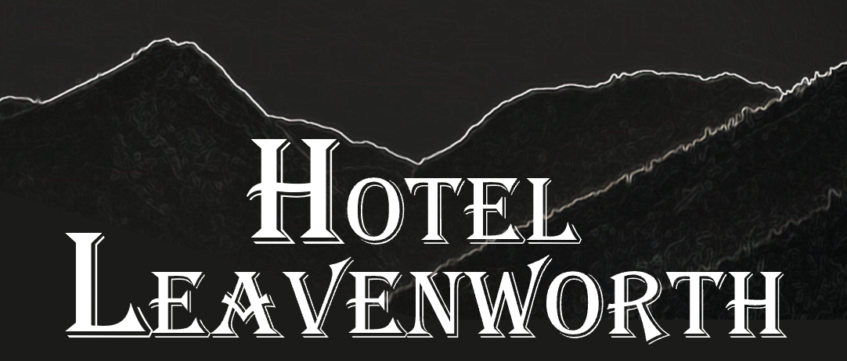
Wrong Font

Slide 7



Too
Dark

Slide 8


View from
Hotel

Slide 9


Slide 11
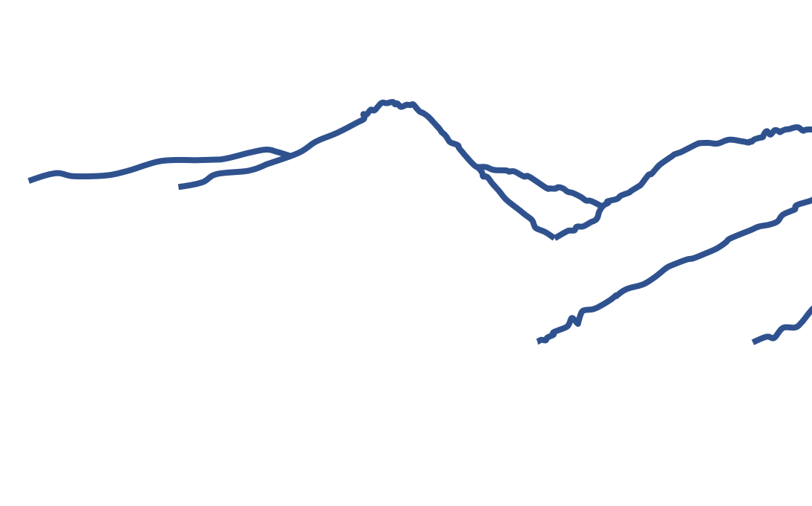

Slide 13
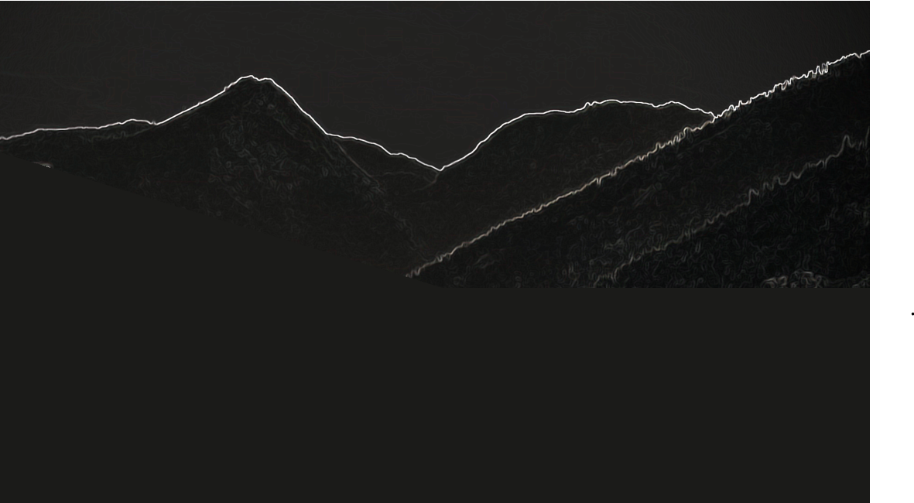
Hotel Leavenworth

Slide 14
Hotel
Leavenworth

Slide 15

0-204-255
0-128-255
The exact shade of blue has never been codified, but most flags used by the public are approximately RGB 0-204-255; officials use something closer to RGB 0-128-255. The lozenges are not set in number, except there must be at least 21, and the top left (incomplete) lozenge must be white.^{[3]}

Slide 16
0-204-255
0-128-255
The exact shade of blue has never been codified, but most flags used by the public are approximately RGB 0-204-255; officials use something closer to RGB 0-128-255. The lozenges are not set in number, except there must be at least 21, and the top left (incomplete) lozenge must be white.^{[3]}

Slide 17


0-204-255
0-128-255
The exact shade of blue has never been codified, but most flags used by the public are approximately RGB 0-204-255; officials use something closer to RGB 0-128-255. The lozenges are not set in number, except there must be at least 21, and the top left (incomplete) lozenge must be white.^{[3]}

Slide 18
0-204-255
0-128-255
The exact shade of blue has never been codified, but most flags used by the public are approximately RGB 0-204-255; officials use something closer to RGB 0-128-255. The lozenges are not set in number, except there must be at least 21, and the top left (incomplete) lozenge must be white.^{[3]}

