Slide 1


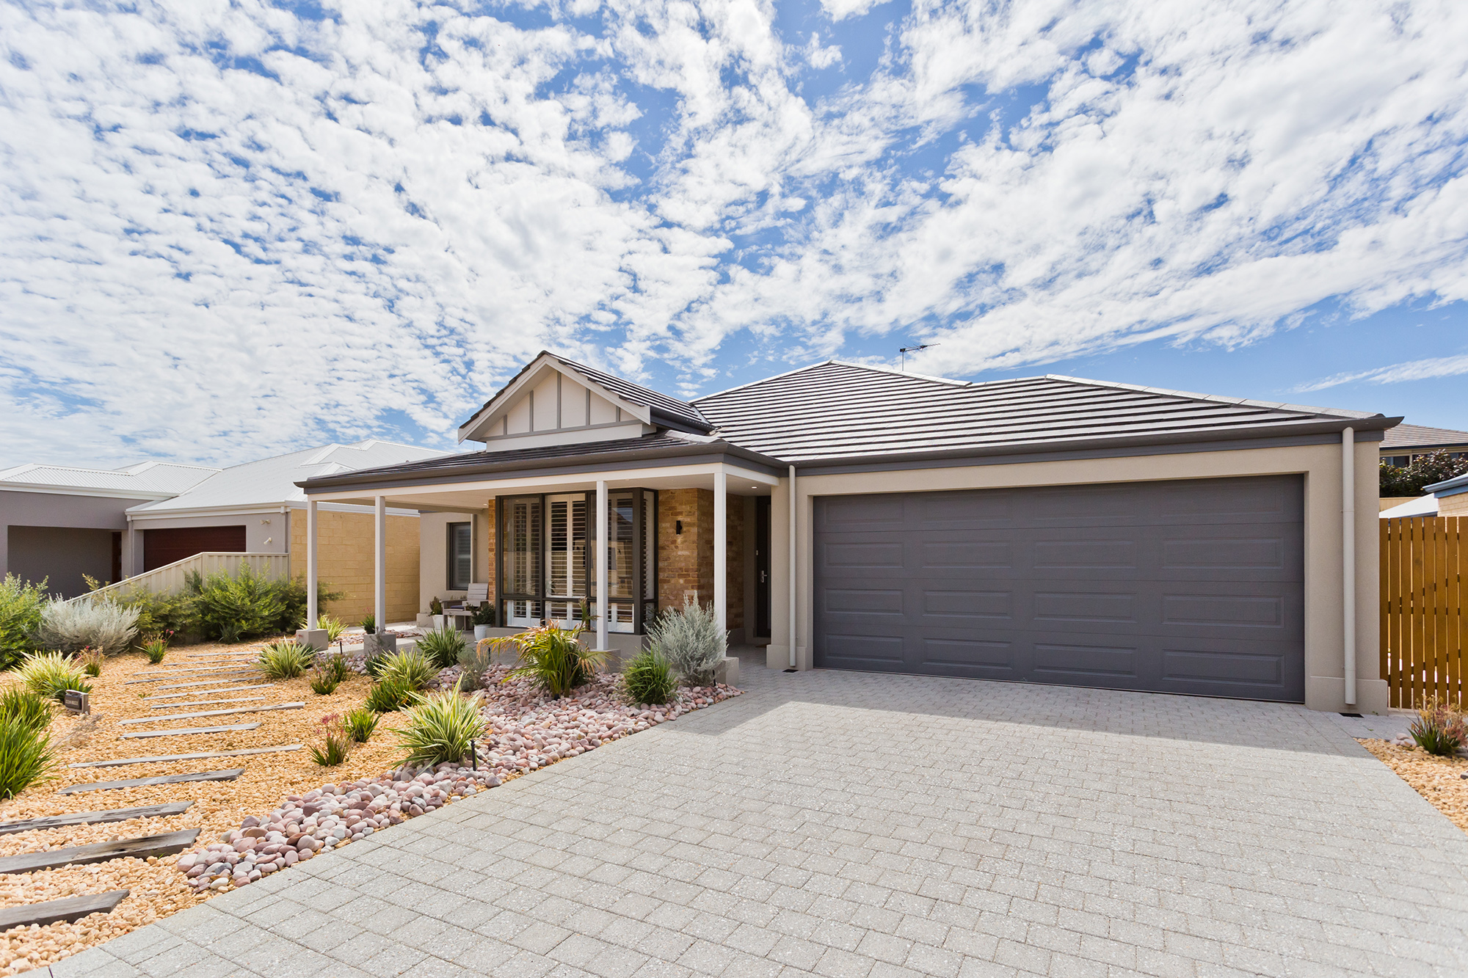

Fairway Realty
Home About Buy Sell Project Sales Contact Us
Thinking of selling, buying or investing? Please contact us : Name email Submit
Buy
Fairway Villages
Sell
About Fairway Realty text
FEATURED PROPERTIES
Set 3 across

Slide 2



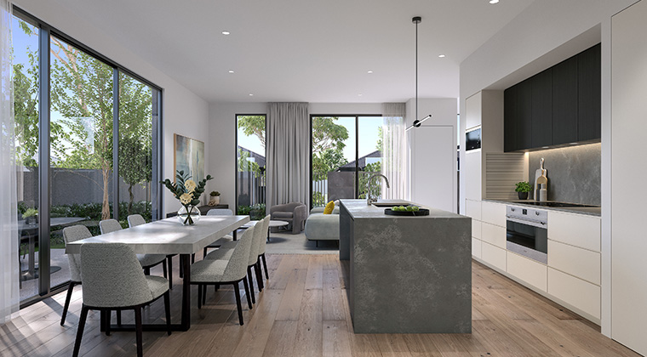
Property 1 text – click on pic goes to page about property
Property 2 text
Property 3 text
Property 4 text
Property 5 text
Property 6 text

Slide 3



THINKING OF SELLING?
Testimonial
Testimonial
Testimonial
Testimonial
Fairway Realty Pty Ltd
Terms Privacy

