Slide 1


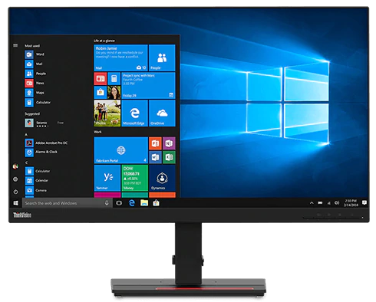
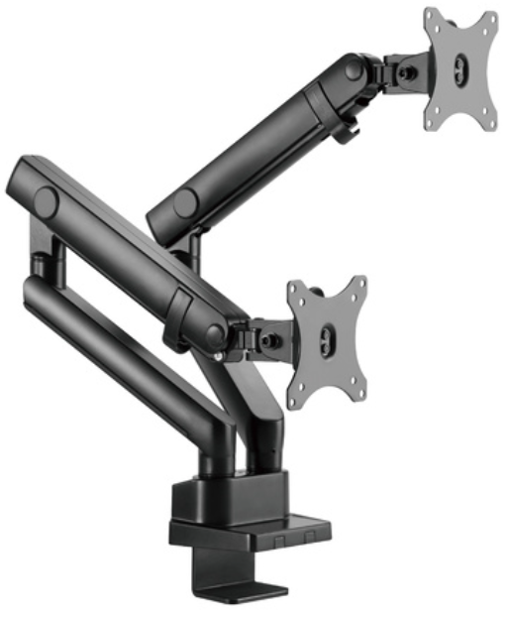
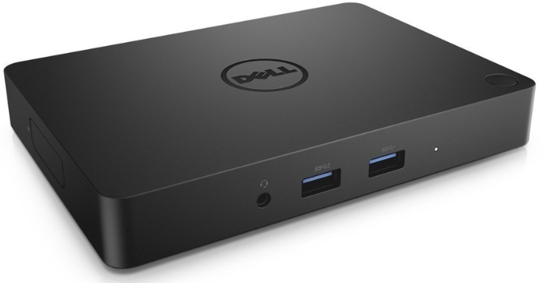

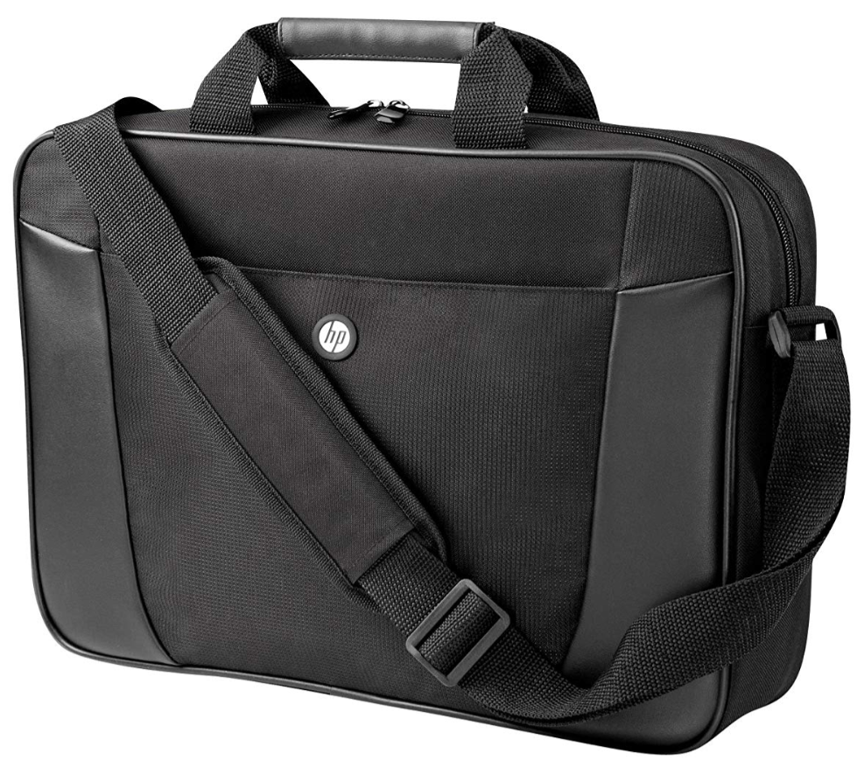
Background description of the nature of the offering.
Bundle DaaS
Concept
Device-as-a-Service
$ per month, per primary device covering hardware and range of opt-in services
Customer choice of equipment and equipment supplier (may alternatively elect for Bundle to provide the equipment)
Customer choice of services as provided by Bundle to be included in the solution, on a per order basis
IT devices including laptops, desktops, peripherals
Bundle services include: procurement, pre-deployment, deployment, asset management, hot-swap, helpdesk, collection, data erasure
Pay on a monthly basis for as long as the customer has the equipment
Minimum term of the customer’s choosing
Customers: mid-market, large enterprise, government.
Example
Value proposition
Customer demand
Convenient, single party solution
All-in bundled price (no other charges)
Opt-in services on per-order basis
Brand-agnostic equipment sourcing
Structure
Reseller or Bundle offering
Master program accommodating ongoing /repeat device orders
End of term control of assets
Customer off-balance sheet form of payment
Features
End of term flexibility, unlike leases
Coverage of both old outgoing & new devices
Asset Management portal
Certified data erasure & reporting
ISO-accredited disposal/recycling
Work From Home employee upgrade solution
ESG: Managed Social initiatives via donations, community support programs
ESG: Quantified environmental impact savings
$78.00 ex taxes
per month per bundle*
*includes peripheral devices
Pricing
Cost of all devices and services are bundled up into a monthly cost of the primary device, such as the laptop
The monthly price is fixed for the period of time that the customer is using the equipment
Notes:
Everyone has their own version of DaaS
Popular due to its simplicity and convenience
Customer may have own supplier or may choose to leverage Reseller
Include Reseller’s own service/project costs into the bundle

Slide 2
Description of each page
Flyer
Overall appearance
The solution being offered is procurement of IT equipment (usually laptops, desktops, monitors) to be paid for on a monthly basis over the term of use
Any brand of equipment therefore product images may reflect different brands – HP, Lenovo, Dell, Apple
The solution includes a range of services being offered by Bundle and included in the overall price. These services are broadly defined on the rear page.
These services are provided at various stages throughout the “lifecycle” of the device:
  At the outset e.g. deployment
  Mid-term e.g. hot-swap, tier 1 helpdesk
  End term e.g. data erasure
  Some type of circular lifecycle image should be displayed, in part illustrating the repeat nature of the concept, i.e. procure equipment, use, replace …..repeat cycle
Front Page
High level description
Detail description
Procedural Steps
Key benefits
Rear Page
Lifecycle image
Service descriptions
Disclaimer at bottom
Notes:
Everyone has their own version of DaaS
Popular due to its simplicity and convenience
Customer may have own supplier or may choose to leverage Reseller
Include Reseller’s own service/project costs into the bundle

Slide 3
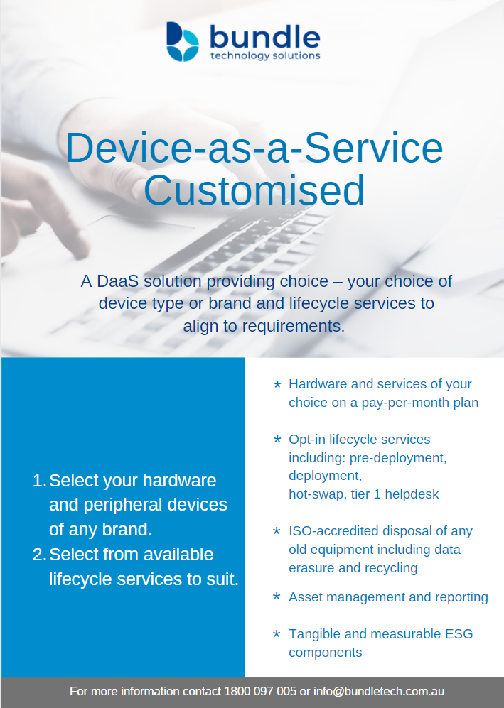
Front Page
Example only – seeking to overhaul
Banner
Device as a Service Customised
Procedural steps
Select your hardware and peripheral devices of any brand.
Select from available lifecycle services.
Select term of service.
By-line
An IT DaaS solution providing choice – your choice of device type or brand and lifecycle services to align to requirements.
Key benefits
Hardware and services combined on a pay-per-month plan
Opt-in lifecycle services including: pre-deployment, deployment, hot-swap, tier 1 helpdesk
ISO-accredited disposal of any old equipment including data erasure and recycling
Asset management and reporting
Tangible and measurable ESG components
Notes:
Everyone has their own version of DaaS
Popular due to its simplicity and convenience
Customer may have own supplier or may choose to leverage Reseller
Include Reseller’s own service/project costs into the bundle

Slide 4
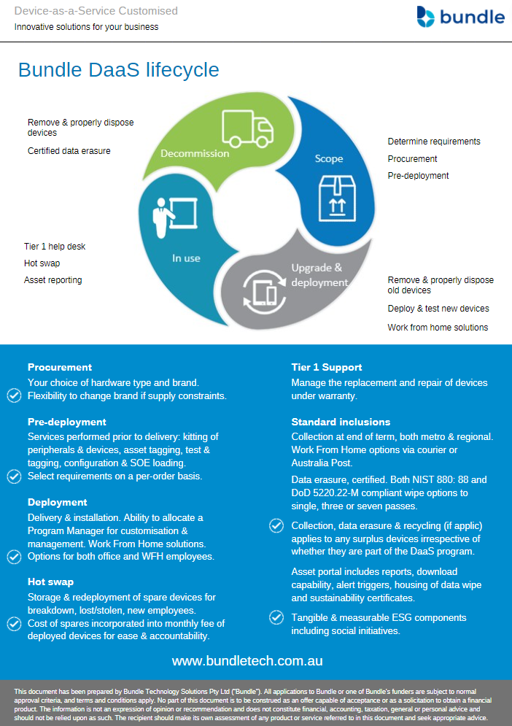
Rear Page
Lifecycle image
Require some sort of circular graphic that depicts the lifecycle nature of computer provisioning and management in the eyes of a customer.
Graphic to the right is an example – something similar to this
Requires better icons for each phase or service
Likely four sectors:
Scope
Upgrade & deployment
In-use
Decommission & replace
Service descriptions
See overpage for descriptions
The tick symbols represent highlighted benefits of the service.
Disclaimer
This document has been prepared by Bundle Technology Solutions Pty Ltd (“Bundle"). All applications to Bundle or one of Bundle's funders are subject to normal approval criteria, and terms and conditions apply. No part of this document is to be construed as an offer capable of acceptance or as a solicitation to obtain a financial product. The information is not an expression of opinion or recommendation and does not constitute financial, accounting, taxation, general or personal advice and should not be relied upon as such. The recipient should make its own assessment of any product or service referred to in this document and seek appropriate advice.
Notes:
Everyone has their own version of DaaS
Popular due to its simplicity and convenience
Customer may have own supplier or may choose to leverage Reseller
Include Reseller’s own service/project costs into the bundle

Slide 5

Service descriptions
Procurement
Your choice of hardware type and brand. Flexibility to change brand if supply constraints.
Pre-deployment
Services performed prior to delivery: kitting of peripherals & devices, asset tagging, test & tagging, configuration & SOE loading. Select requirements on a per-order basis.
Deployment
Delivery & installation. Ability to allocate a Program Manager for customisation & management. Work From Home solutions. Options for both office and WFH employees.
Hot swap
Storage & redeployment of spare devices for breakdown, lost/stolen, new employees. Cost of spares incorporated into monthly fee of deployed devices for ease & accountability.
Tier 1 Support
Manage the replacement and repair of devices under warranty.
Standard inclusions
Collection at end of term, both metro & regional. Work From Home options via courier or Australia Post.
Data erasure, certified. Both NIST 880: 88 and DoD 5220.22-M compliant wipe options to single, three or seven passes.
Asset portal includes reports, download capability, alert triggers, housing of data wipe and sustainability certificates.
Tangible & measurable ESG components including social initiatives.
Collection, data erasure & recycling (if applic) applies to any surplus devices irrespective of whether they are part of the DaaS program.

