Slide 1

THE EXCEPTIONAL
CLIENT EXPERIENCE
PRINCIPALS OF SUCCESS!

Slide 2

BECOMING PRESENT
Identify a specific moment you felt proud to be a part of Reith & Associates.
What business are YOU really in?
What do your customers really want from you?

Slide 3

OUR PURPOSE
Our Mission
To provide independent, personalized advice, advocacy and choice with integrity and dedication to those who value the well-being and dignity of their family and success of their business.
Our Vision
Reith & Associates is the dedicated intermediary for the people and property that matter most to you.
Our Values
We will promote a workplace that delivers excitement and challenge for everyone.
We will be accountable and work with integrity and a commitment to the highest ethical standard for our clients, our teammates and ourselves.

Slide 4

WAYS TO MEASURE SUCCESS
  Retention Ratio
  Client Feed Back - Testimonials
  Growth

Slide 5
WAYS TO MEASURE SUCCESS
  Retention Rate Year to Date:
  96.11%
Update for 2022

Slide 6
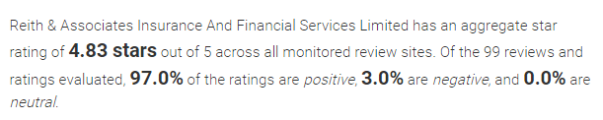
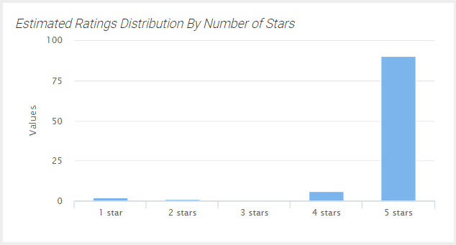

SEO / DIGITAL MARKETING ACHIEVEMENTS
Update

Slide 7
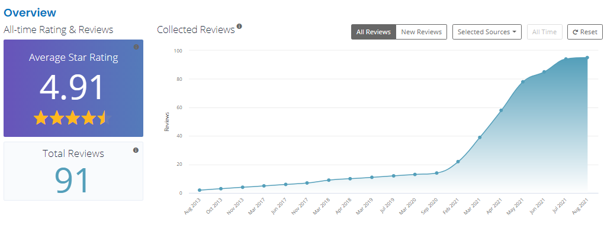
SEO / DIGITAL MARKETING ACHIEVEMENTS
Update

Slide 8
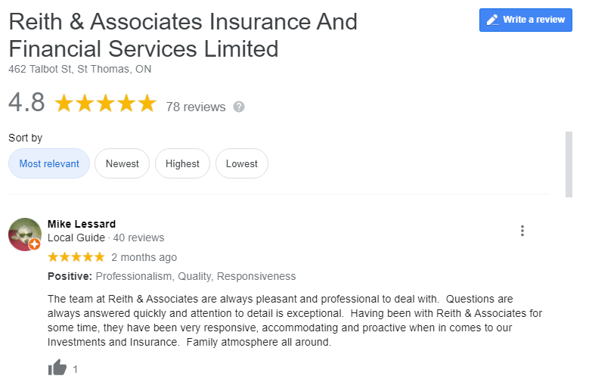
REVIEWS & TESTIMONIALS

Slide 9
REVIEWS & TESTIMONIALS
ADD RECENT REVIEWS

Slide 10
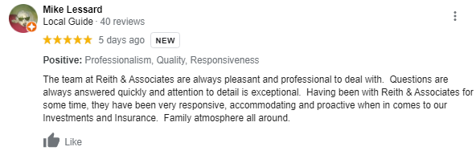

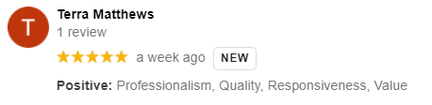
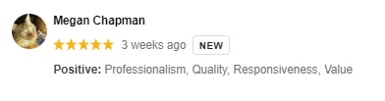
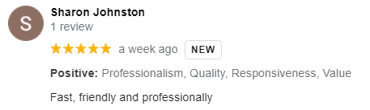
REVIEWS & TESTIMONIALS

Slide 11

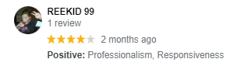
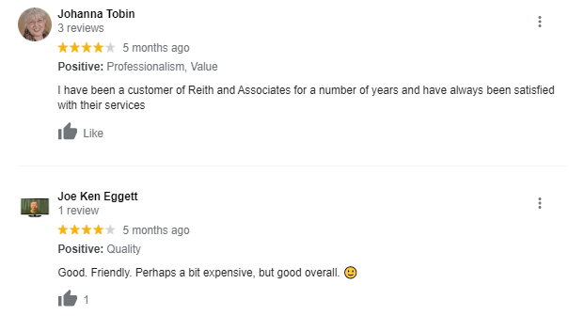
REVIEWS & TESTIMONIALS

Slide 12
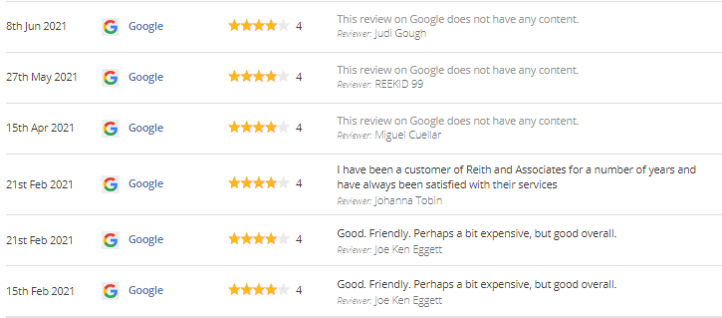
“ALL PERFECT” REVIEWS
UPDATE
HOW DO WE TURN A 4-STAR INTO A 5-STAR REVIEW ?

Slide 13
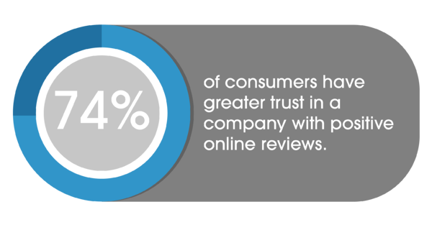
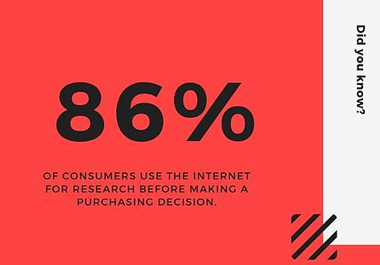
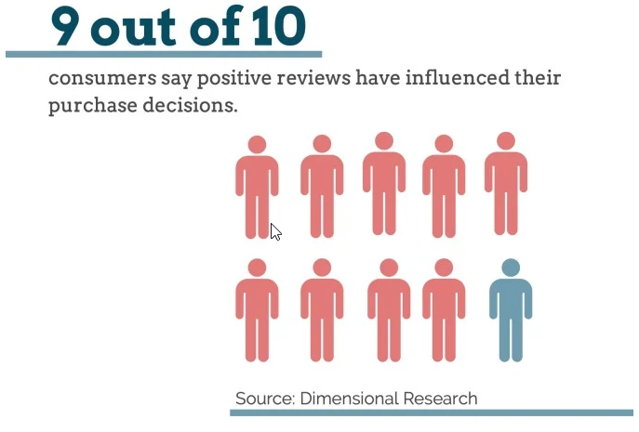
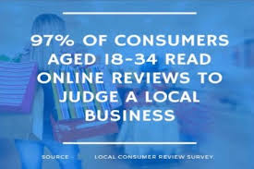
ONLINE REPUTATION STATISTICS
CHECK AND UPDATE

Slide 14
KEY ELEMENTS OF SMART GROWTH
IDEAL CLIENT
BRAND VIEW
SIMPLISTIC ASSESSMENT
CLIENT SELECTION
RIGHT FIT
MORE OF YOUR FAVOURITE
RETURNS VS NOT ALWAYS A FIT
QUALITY VS. QUANTITY
GRATITUDE = ABUNDANCE

Slide 15
OUR GOAL
  AN EXCEPTIONAL CLIENT EXPERIENCE

Slide 16

“AN Exceptional Experience”
Not normal, more than ordinary
Webster’s Dictionary

Slide 17

“Exceptional Experience”
Webster’s Dictionary:
Not normal, more than ordinary

Slide 18



“Exceptional Experience”
Webster’s Dictionary: Not normal, more than ordinary
Exceptional customer service is a game-changer when building loyalty among clients.
- Dan Sullivan, Strategic Coach
Exceptional service experiences:
  Restaurant
  Business Consultants
  Luxury Hotels

Slide 19
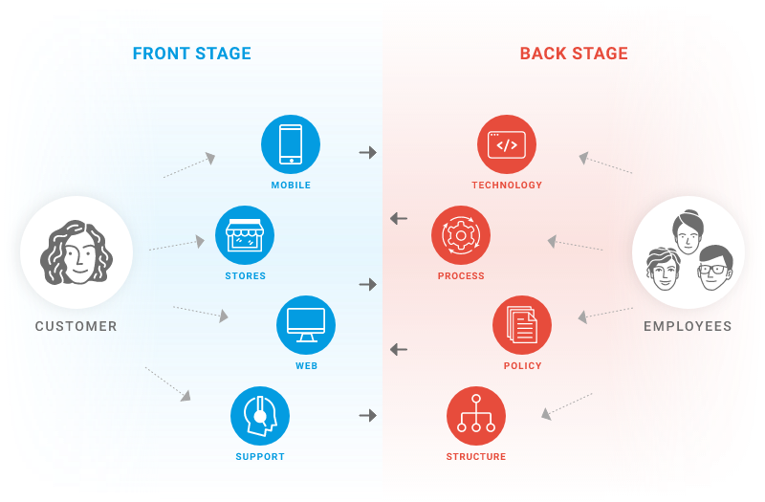
The “Exceptional Experience”
FRONT STAGE VS BACK STAGE

Slide 20

THE RITZ-CARLTON EXPERIENCE
  Give a warm welcome
  Anticipate client needs
  Provide a fond farewell

Slide 21
The “Exceptional Experience”
BREAKOUT
Identify a specific time/event where you had an exceptional customer experience.
Why do you consider it exceptional?
How did it make you feel?
What one element do all “Exceptional Experiences” have in common?

Slide 22

“EMOTION BASED SELLING REALIGNS THE CLIENT/BROKER RELATIONSHIP”
- CHUBB Insurance

Slide 23
EMOTION BASED SELLING
  73% Want Expert Personally Tailored Service
  70% Want Guidance To The Best Product + Services
  80% Expect Their Broker Can Provide Service Beyond Their Expectations By Explaining How They Are/Can Be Protected
  92% Expect to speak to their broker at least once during a policy term
  - CHUBB Insurance

Slide 24

“EMOTION BASED SELLING = SUCCESS IN THE CURRENT MARKETPLACE”
- CHUBB Insurance

Slide 25
EMOTION BASED SELLING
  HOW DO WE ENGAGE IN EMOTION BASED SELLING AND PROVIDE THE “EXCEPTIONAL EXPERIENCE”?
  BY KNOWING AND UNDERSTANDING OUR PROSPECTS’/CLIENTS’
  D.O.S. (DANGERS, OPPORTUNITIES & STRENGTHS).
  WE LEARN BY ASKING AND LISTENING.

Slide 26


EMOTION BASED SELLING
Emotion
Rationality
Here’s what our product PROVIDES.
Here’s what our product PREVENTS.
Acquisition
Rejection

Slide 27
STEPS TO CREATING The “Exceptional Experience”
  Build Relationships
  Create Value
  Product to Culture
  Nurture Relationships
  Packaging
  Leadership
  Influence

Slide 28
BUILDING RELATIONSHIPS
PEOPLE BUY INTO A “CULTURE ” THEY CAN IDENTIFY WITH,
FEEL AN ATTACHMENT OR ASPIRE TO

Slide 29

BUILDING RELATIONSHIPS
BUILDING RAPPORT
  Demonstrate gratitude
  Ask questions—things people don’t talk about
  Set expectations
  R Question & DOS
  Be Authentic
ESTABLISH EMOTIONAL CONNECTION
  To product
  To you
  Sincerity
  Empathy
DEMONSTRATE VALUE

Slide 30
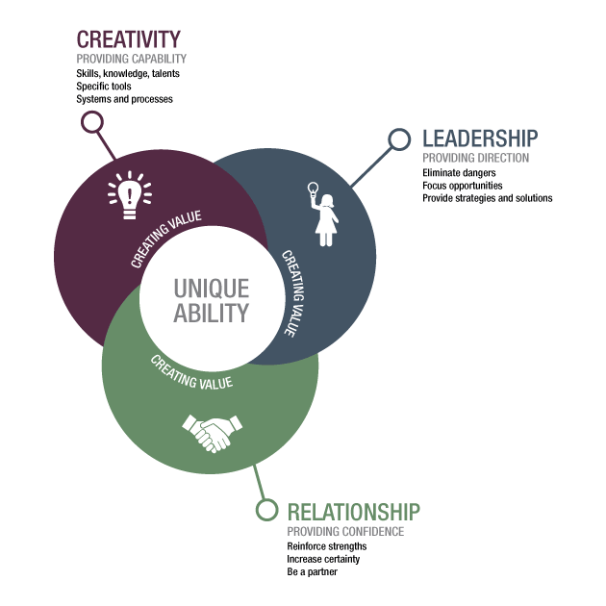
VALUE CREATION
Leadership – provide direction
Relationship – provide confidence
Creativity – demonstrate capability

Slide 31
IDEAL OUTCOME
A value monopoly leads to a competition free zone that is granted by clients and becomes permanent through the continual strengthening and expansion of unique positive experiences.
-Dan Sullivan, Strategic Coach
  Do you believe you have succeeded in a competition
  free-zone with your clients? Yes or No

Slide 32

VALUE CREATION
BREAKOUT
Where have you, as a customer, granted a value creation monopoly to others and why?
What current resources in Reith & Associates can you leverage to create greater value for customers?

Slide 33

MOVING FROM “PRODUCT” TO “CULTURE”
Begins when we set aside the product and focus on the Dangers, Opportunities & Strengths
of the customer.
  We need to understand:
    What scares them?
    What excites them?
    What gives them confidence/ comfort?
    Reduce complexity -- Bring simplicity
BREAKOUT
How can we move our clients’ attention from Product to Culture?

Slide 34
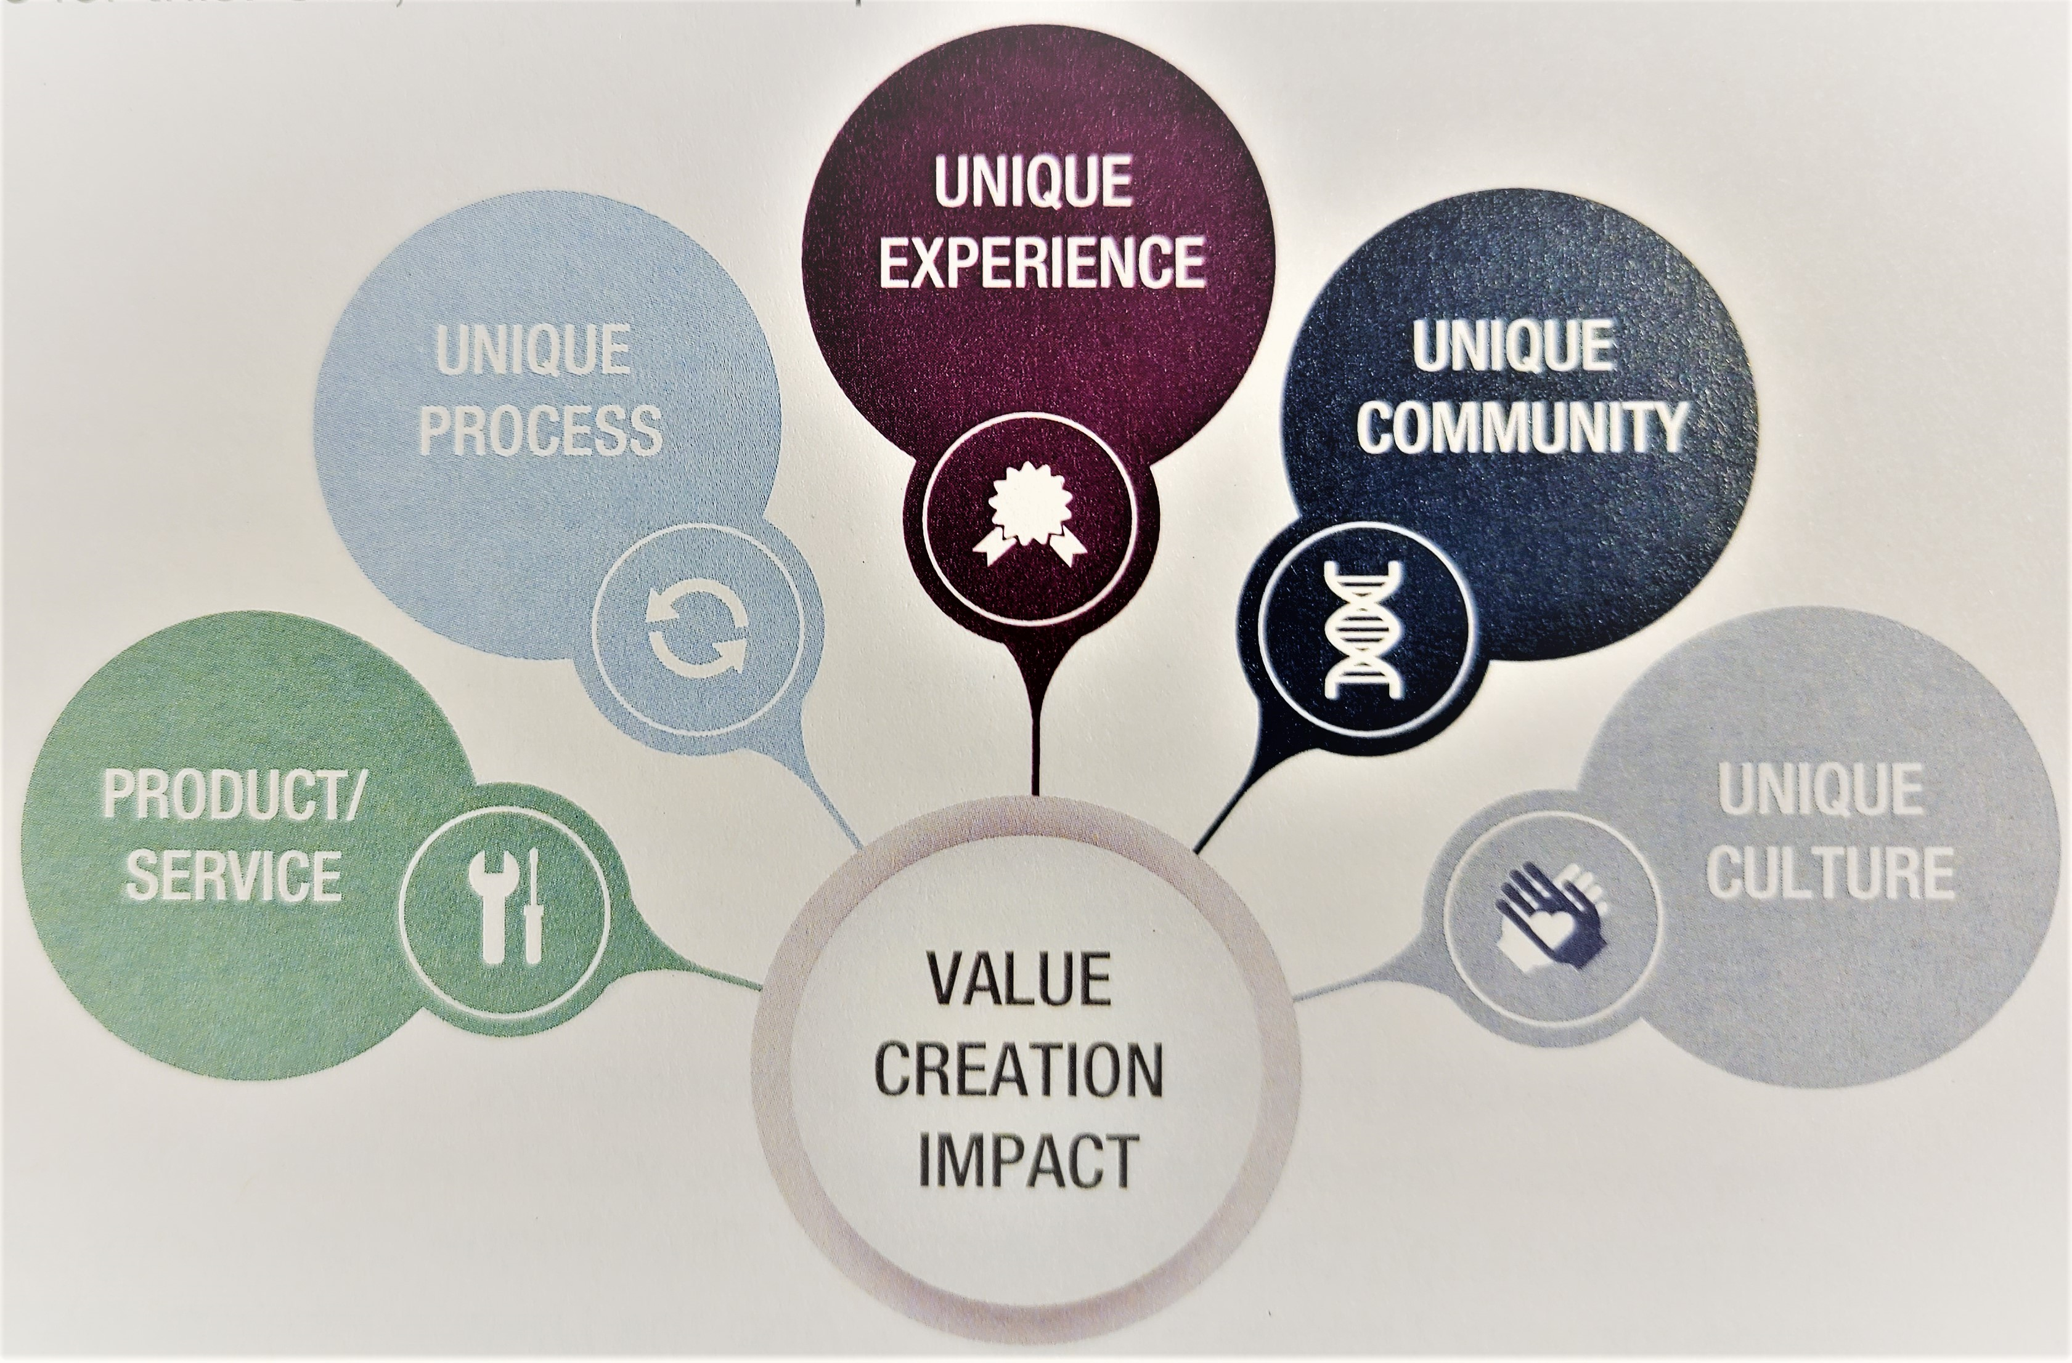
The Exceptional Experience
When we combine our unique ability and creativity with the client’s D.O.S. and we make our client the star!
When the client feels like a “star’ you have initiated the emotional attachment.

Slide 35

NURTURING
RELATIONSHIPS
VALUE CREATION
On-going
Demonstrating knowledge and ability
Being the “hero” or “leader” for your client
Proving yourself the “trusted advisor”
Renewal process

Slide 36

NURTURING
RELATIONSHIPS
BREAKOUT
How do you currently nurture client relationships?
What can you do to better nurture the client relationship?

Slide 37
NURTURING AT RENEWAL
Set aside price
Ask Questions & Actively Listen:
  Revisit their DOS
  Reaffirm their expectations: for claims, for premium budget
  Listen to what they are and aren’t saying
Do for them what they can’t
Set the expectation

Slide 38

NURTURING RELATIONSHIPS
How can we better make a client feel like a “STAR”?
Personal Advantage Discovery / Commercial Advantage Discovery / Lifestyle Maximizer
Asking questions others don’t know to ask
Recognizing
  Key dates
  Achievements
  Life experiences
  Remembrances
  Meeting expressed expectations
Using the information gathered for future use
  PAD / CAD / Lifestyle Maximizer information at renewal
  R Question and DOS at renewal and/or during a policy change
Random mid-term touches by phone or email
Offering Zoom and in-person meetings
Making the client feel like a “STAR”!
Do it in ways others are not

Slide 39

PACKAGING MINDSET FOR GROWTH
THE BOX
THE STORY
WHAT SETS ONE APART
  Positive
  Appealing
  Impactful
  Permanent
  Escape commoditization
  Gear everything to your very best clients’ prospects

Slide 40

THE POWER OF PACKAGING
ESSENTIAL SERVICE STEPS:
  Realistically manage client expectations
  Under promise, over deliver
  Always be on time
  Do what you say you are going to do
  “Please” and “Thank you”
  Listen – Choose your words wisely
  Our behaviour/performance must follow our packaging
  No excuses – Never say “sorry”

Slide 41
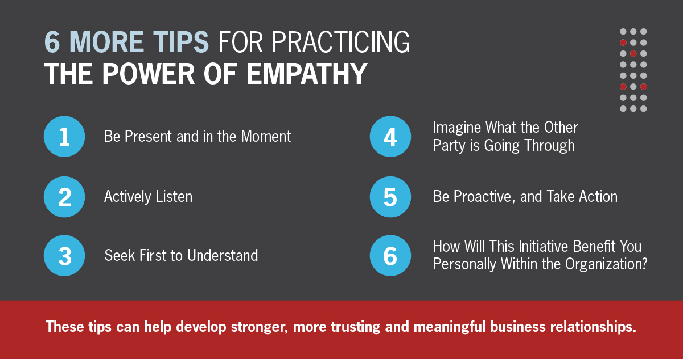
PACKAGE THE CULTURE
NO EXCUSES – NEVER SAY “SORRY”
EMPATHY OVER EXCUSES
UNDERSTANDING OVER JUSTIFICATION
LISTENING OVER TALKING

Slide 42
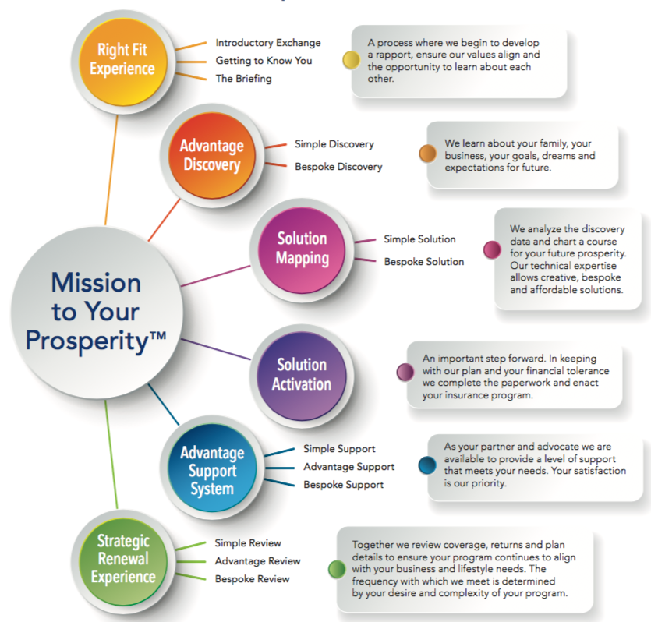
OUR PACKAGING
UNIQUE PROCESS™

Slide 43
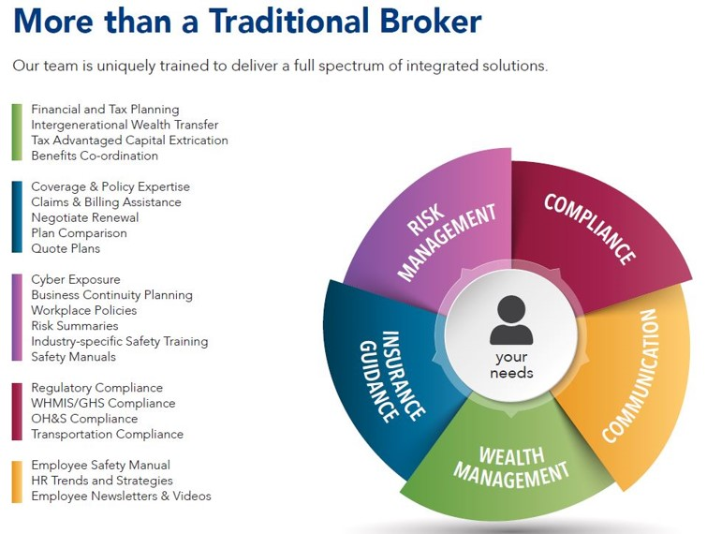
OUR PACKAGING
The Reith Advantage™
Our digital platform offering anytime, anywhere, 24/7 access through our web based portal and mobile app
An integrated insurance and financial services brokerage
Our unique process —Mission to Your Prosperity™—developed through our over 100 years providing insurance and investment services to businesses and families
Our exclusive discovery method of data collection and risk assessment
Our ability to provide creative and affordable solutions that are truly bespoke for today yet flexible for the future
Being the most award winning insurance broker in the St. Thomas & London region
A team that completes mandatory continuing education which exceeds regulatory requirement
Being family owned since 1914 (read our history)

Slide 44
PACKAGING
- OUR HISTORY
FROM 1914 TO PRESENT
1914 - 1961
  While working the family farm near Shedden Ontario, Alvin McCauley Brown began his insurance practice selling accident and sickness policies to area farm families. He formed the A.M. Brown Insurance Agency.
  The A.M. Brown Insurance Agency opened its St. Thomas,.
  Harold Jackson, Alvin Brown’s cousin, left his position as a Field Inspector with a major Canadian insurer to join the agency, acquiring it in 1962.
1963 – 1987
  Harold Jackson’s son-in-law, Dan Reith Sr., joined the agency and the practice was acquired from A.M. Brown.
  The agency grew through acquisitions and structured partnerships. In late 1973, Harold Jackson retired, and Jerry Beavis took a partnership after merging his agency with Reith & Jackson. The practice changed its operating name to Reith & Beavis Insurance Agency Limited.
  Provincial regulation introduced a new regulatory authority, The Registered Insurance Brokers of Ontario (RIBO), to govern and provide professional oversight. Subsequent to the establishment of RIBO, insurance agencies were subject to higher professional standards of practice and education and were identified as brokers. This regulatory change caused the firm to rebrand as Reith & Beavis Insurance Brokers Limited.
  After the acquisition of George S. McLachlan Insurance, the brokerage updated its brand to Reith & Associates Insurance Brokers Limited.
1992 - 2022
  The brokerage welcomed Dan Reith Jr., and in 1994 his brother Darren Reith. At that time, the brokerage changed its operating name to Reith & Associates Insurance and Financial Services Limited to reflect the expansion of products and services with the introduction of a life insurance and investment services team.
  Brothers Dan and Darren Reith have led the brokerage since December 2000, after the passing of their father.
  The brokerage embarked on a significant capital investment transforming to a fully digital platform with enhanced online capabilities and the introduction of their own mobile App Reith OnLineTM.
  Pandemic Ease of Doing Business – with clients & remote team work.

Slide 45

PACKAGING YOU
  Positive
  Appealing
  Impactful
  Permanent
  Escape from commoditization
  Gear everything to your very best clients

Slide 46




HAVING A
PACKAGING MINDSET
1 DIFFERENTIATING - Stands out from competition
3 EASY TO UNDERSTAND - Purpose and benefits immediately clear
4 ATTRACTIVE - Pleasing and inviting
5 SIMPLIFYING - Eliminates obstacles or complexities
6 USEFUL - Procedures significantly improved results
7 ECONOMICAL - Transforms value of existing resources
8 STANDS ALONE - Valuable in itself
9 INTEGRATIVE - Fits in with other things
10 BENEFICIAL - Makes life significantly better
2 INNOVATION - New and different

Slide 47

BE A LEADER
“Genius is in the idea, impact, however, comes from action”
--Simon Sinek
DO YOUR CLIENTS SEE YOU AS A LEADER?
Or
IF ASKED, WOULD YOUR CLIENTS DESCRIBE YOU AS A LEADER?

Slide 48

BE A LEADER NOT A DESPERADO
Leader > Hero > Trusted Advisor
Creating a connection
  Having an impact and having a relationship
    Steering in the right direction
    Doing for them what they cannot do for themselves
    Doing it for them NOT for you
Outcome: Sustainable positive influence
Abundance mindset
In the end let go graciously

Slide 49

INFLUENCING CUSTOMERS & PROSPECTS
Know your product
Maintain a positive attitude
Respond quickly
Actively listen
Creatively problem-solve
Personalize your service
Focus support on the customer
Help customers help themselves
Keep your word
Be proactively helpful

Slide 50
THE EXCEPTIONAL
CLIENT EXPERIENCE
KEY TAKE AWAYS
TAKE AWAY 1
  XXXXXX
TAKE AWAY 2
  XXXXXX
TAKE AWAY 3
  XXXXXX
TAKE AWAY 4
  XXXXXX
TAKE AWAY 5
  XXXXXX

Slide 51
THE EXCEPTIONAL
CLIENT EXPERIENCE
PRINCIPALS OF SUCCESS!

Slide 52
Remembering the Consultative Approach to Client Care
June 2022

Slide 53

THE CONSULTATIVE APPROACH TO CLIENT CARE
OCTOBER 2022

Slide 54
THE CONSULTATIVE APPROACH TO CLIENT CARE
WHAT IS THE CONSULTATIVE APPROACH?
  A sales process
  Relationships prioritized over price
  Involves open dialogue:
ASKING QUESTIONS + LISTENING TO ANSWERS = SOLUTIONS TO CUSTOMER’S NEEDS
  Client sets the agenda, but you lead them to the conclusion by following the “process”
* Hyper focused on the customer rather than the product being sold *

Slide 55
THE CONSULTATIVE APPROACH TO CLIENT CARE
THE CONSULTATIVE PROCESS:
Target & Qualify (Quantify)
Explore & Assess
Access & Develop Solution
Present solution
Follow-Up / Negotiate & Close
Implement / Follow through / Assess Results and Expand

Slide 56
THE CONSULTATIVE APPROACH TO CLIENT CARE
PRODUCT-BASED SELLING
CONSULTATIVE SELLING
Focuses on the value of the product and company as a whole
The salesperson’s role is to provide value and advice, often outside of company specialization
Relies on a smaller number of customer spending more
Focuses on building long-term relationships for continued success.
Focuses on the direct benefits and features of a product
Sources all value from the product
The salesperson’s role is to communicate product information
Relies on high-volume, low-value accounts
Focuses on short-term, immediate wins

Slide 57
THE CONSULTATIVE APPROACH TO CLIENT CARE
THE CONSULTATIVE PROCESS:
Being an integrated insurance and financial services brokerage
Our unique process —Mission to Your Prosperity™—developed through our over 100 years providing insurance and investment services to businesses and families
Our exclusive discovery method of data collection and risk assessment
Our ability to provide creative and affordable solutions that are truly bespoke for today yet flexible for the future
Being the most award winning insurance broker in the St. Thomas & London region
A team that completes mandatory continuing education which exceeds regulatory requirement
Being family owned since 1914 (read our history)
Being an integrated insurance and financial services brokerage
Our unique process —Mission to Your Prosperity
Our exclusive discovery method of data collection and risk assessment
Our ability to provide creative and affordable solutions that are truly bespoke for today yet flexible for the future

Slide 58
THE CONSULTATIVE APPROACH TO CLIENT CARE
CONSULTATIVE SKILLS & TECHNIQUES
  Avoid being “seller” centric
  Shift to a mindset of Authenticity
  Lead the conversation with a plan, and authority
  Build decisive momentum
  Leverage insights through questioning
  Understand why buys “buy” or don’t
  Work from facts, not assumptions

Slide 59
THE CONSULTATIVE APPROACH TO CLIENT CARE
Q & A
Sample Experiences

