Slide 1

Brief Logo
Chief Product Officer Lab’

Slide 2
Who we are
Losam is a marketing agency specializing in the creation and animation of communities.
Losam created Chief Product Officer Lab’ for the company Amplitude, a project dedicated to Chief Product Officers.
What is Chief Product Officer Lab’ ?
1 founding committee composed of 6/8 leaders which will define the themes of the different meetings.
4 meetings a year (4 dinners).

Slide 3
Who is
Amplitude
Amplitude is a Digital Optimization System. They help business optimize the business value of digital product innovation as well as the user experience.
More information can be found here :
https://amplitude.com/

Slide 4
Amplitude - Brand Guidelines
Color palette
MAIN COLOR
SECONDARY COLOR
TIERTIARY COLOR
Purple I
HEX: 7743de
Purple II
HEX: aa89eb
Amp Blue
HEX: 1e61f0
Teal
HEX: 48d2e5
Purple III
HEX: 5a35b5
Light Amp Blue
HEX: #5084f2
Light Teal
HEX: #91e2ed

Slide 5
Amplitude - Brand Guidelines
Color palette
TEXT COLOR
BACKGROUND COLORS
Dark Slate
HEX: 021028
85 Slate
HEX: 364966
Alice Grey
HEX: E1E7EE

Slide 6
Amplitude - Typography Guidelines
S E C T I O N D E S I G N A T I O N
Page Headline
Content Title/Sub-headline
Body
IBM Plex Sans, 10pt, Bold
IBM Plex Sans, 24pt, Normal
IBM Plex Sans, 14pt, Semi-bold
IBM Plex Sans, 14pt, Normal

Slide 7
Amplitude - Brief
What: Creating a logo
Sector: Chief Product Officer
Logo text: Chief Product Officer Lab’ or CPO Lab’
Elégant
Amusant
Traditionnel
Personnel
Féminin
Coloré
Bas de gamme
Audacieux
Sérieux
Moderne
Professionnel
Masculin
Noir et Blanc
Haut de Gamme
v
v
v
v
v

Slide 8
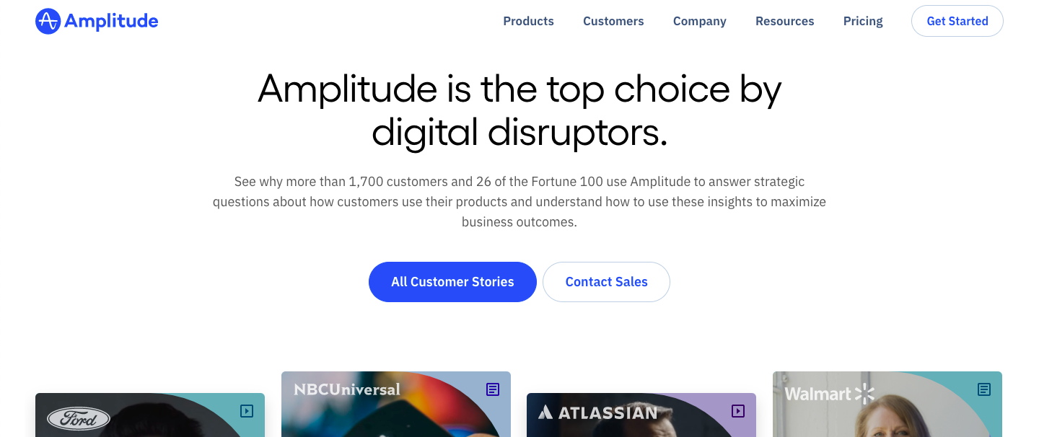
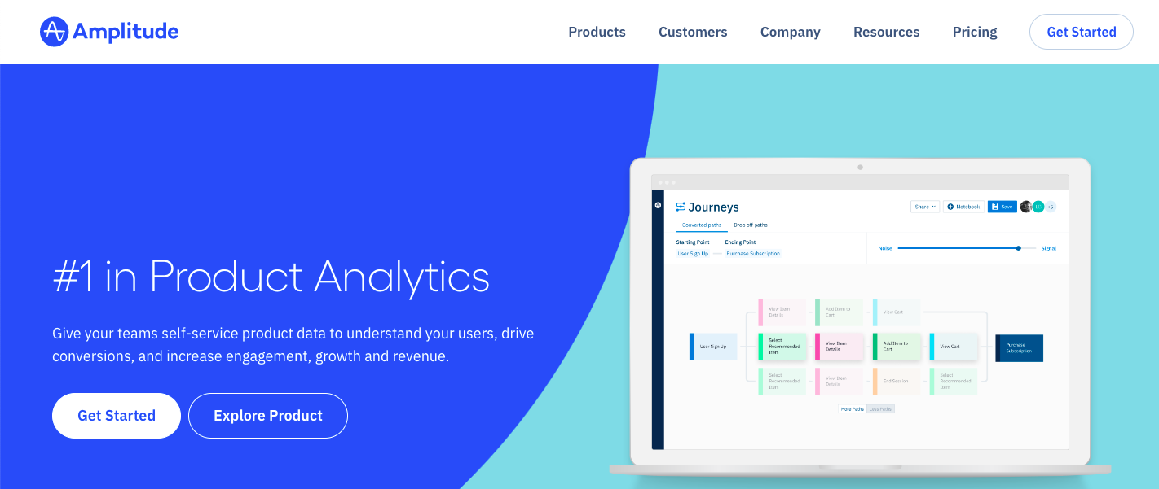
Amplitude - DNA

Slide 9
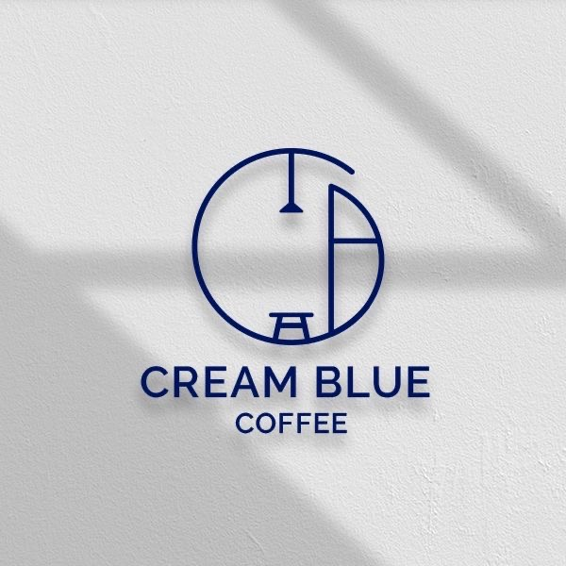

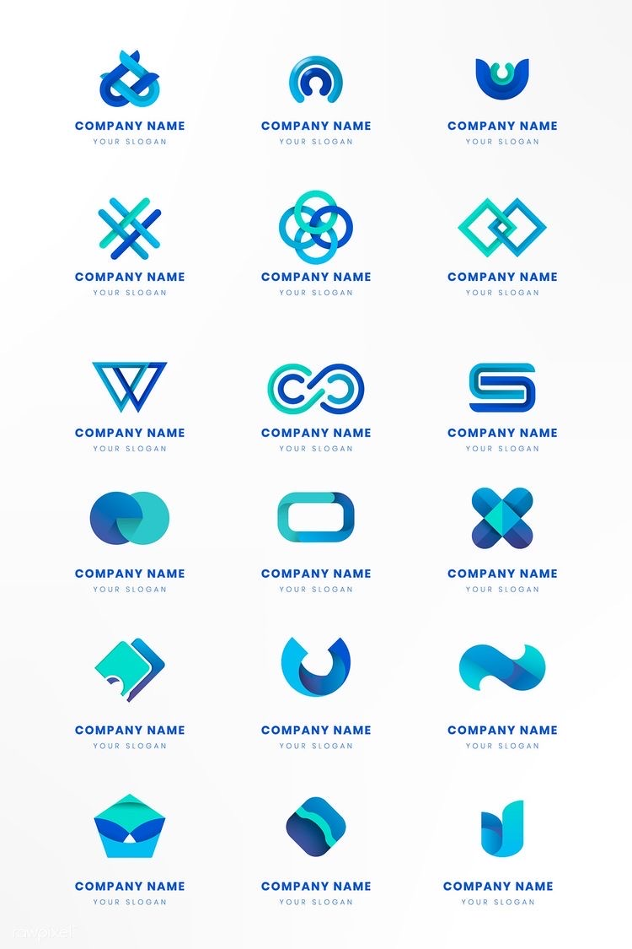
MOODBOARD

Slide 10
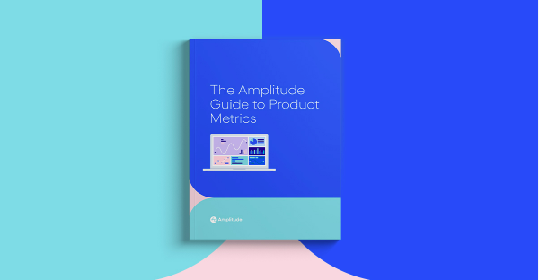
MOODBOARD

