Slide 1
EPB
Echo Park Brewing

Slide 2
Mission Statement
To become one of the defining breweries in the greater Los Angeles Area. Our location will become a brewery featuring the essences of L.A. Depicting the grittiness of Echo Park, the multicultural diversity of LA, flavors of LA barrios, and LA sports teams. We are physically born in Dodger Town. Echo Park is the location and home of The Los Angeles Dodgers. The Dodger Stadium area has been underserved and contains untapped potential. we want to become the pre-game and post-game spot for dodger fans and for other sporting events as well.

Slide 3
Penetration and Growth Strategy
We will first launch a brewery tap room with limited EPB offerings. The pilot brewing system is intended as a first step and marketing device to establish our brand as a legitimate brewing operation. We will work out the kinks here with our brews and our food offerings. All beers at this site will be produced for onsite consumption or Growler and to go packages. Our strategy here is focus on establishing our brand and perfecting our liquid. The plan is to grow our fan base throughout Southern California and beyond with the support of our Dodgers base. Once we are approaching success with our liquids and customer demand, we will launch phase two our growth strategy.

Slide 4
Echo Park Brewing Notes
Identity include River views, river walk dog friendly, fishing, kayaking, bicycling, etc
How do capture edginess, Latino neighborhood, integrated community and Dodgers?
Change Ryno Cause to homeless support, or second chancers
Brass ring brings music, entertainment, hotel , cruise lines etc.
Brewmaster Steven is edgy, creative passionate.
History for art, Charlie Chaplin's first film was made at Keystone Studios, as well as the very first feature-length comedy ever made, which starred Charlie Chaplin and Mabel Normand.[3]
first pie-in-the-face scene was filmed at what later became the Mack Sennett Studios on Glendale Boulevard near Effie Street.
Red Cars, used to run through Echo Park along the center of Glendale Boulevard. I think the red call running through Echo Park Blvd is a good emblem
Gangs, Echo Park Locos, the Crazys, the Big Top Locos, the Diamond Street Locos, Frogtown Rifa, and Head Hunters. Diamond Street, Latinos Unidos
Angelino Heights is most notable for its Victorian era residences,
Elysian Heights, along with Edendale, has been home to many of the counterculture, political radicals, artists, writers, architects and filmmakers. The CPA (the communist party of America were stationed here) that’s why they call it Red Hill
Angels Point, a small hill in Elysian Park overlooking Dodger Stadium a
Chavez ravine
Frank Zappa lived on Bellevue-Jackson Browne, The Eagles and Linda Rondstat lived in Echo Park
Danny Trejo
Fast and furious market is scene in the movie-Chinatown, LA Confidential and the Echo Park were filmed here

Slide 5


Slide 6
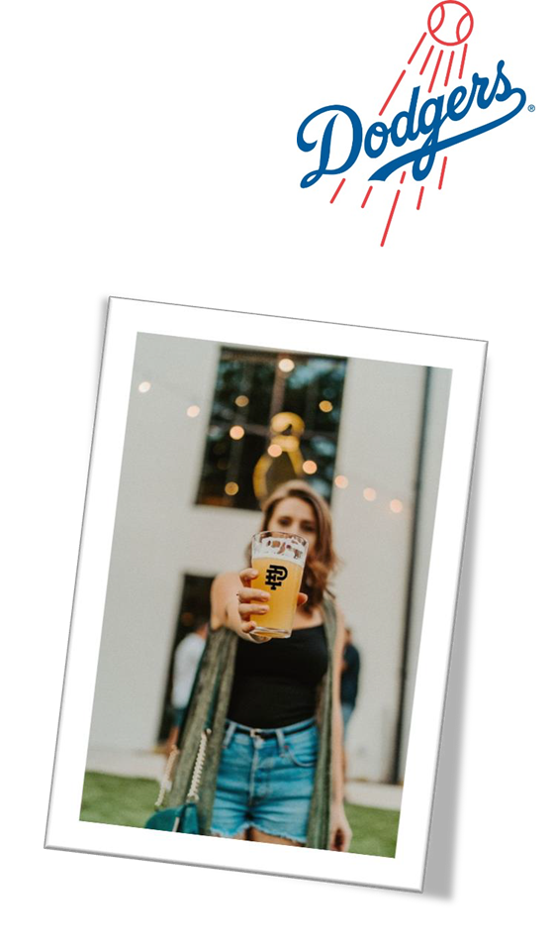

Slide 7
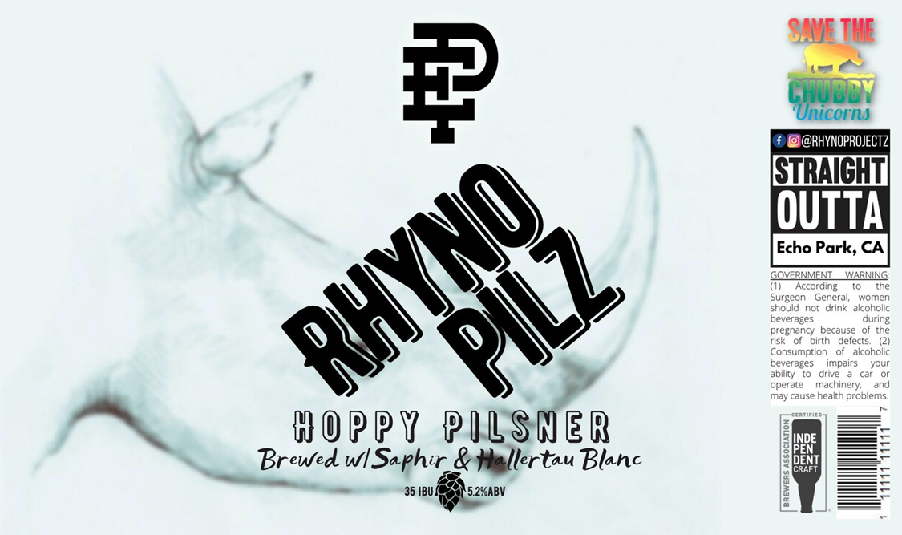

Slide 8
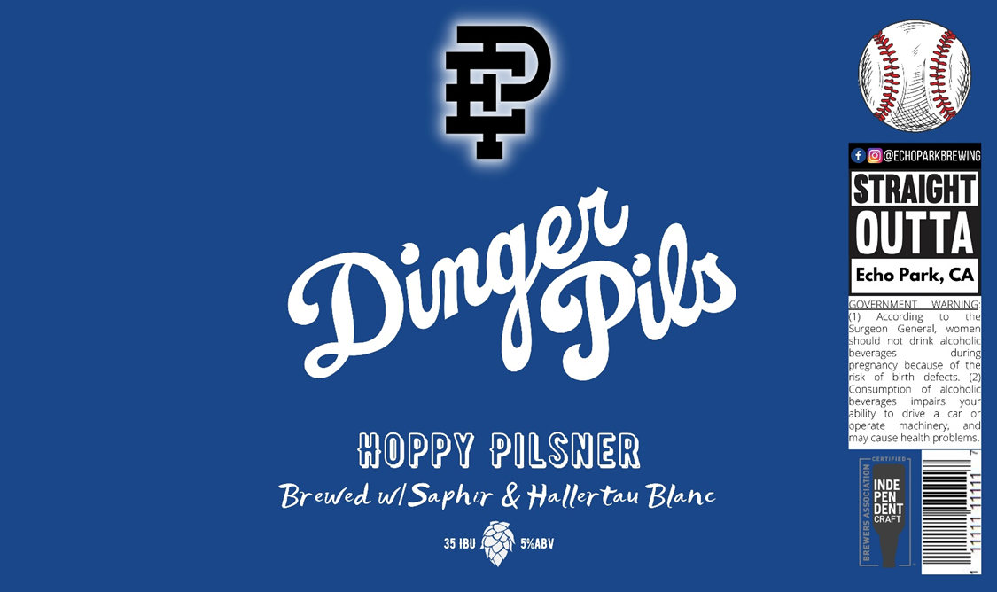

Slide 9
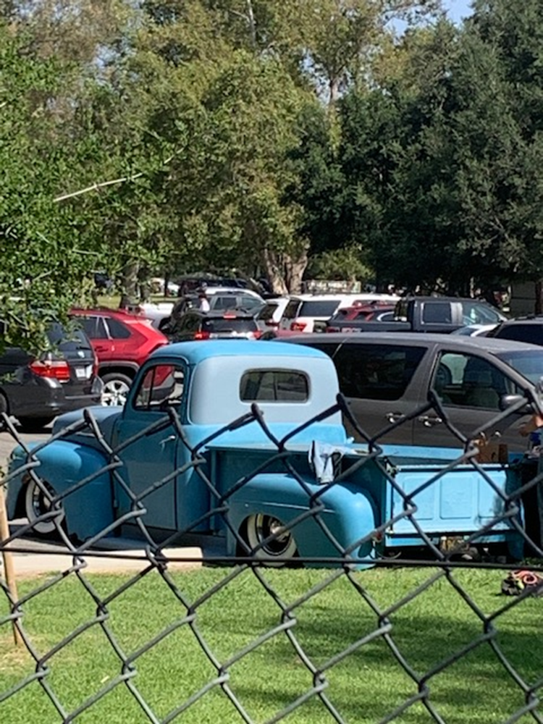

Slide 10
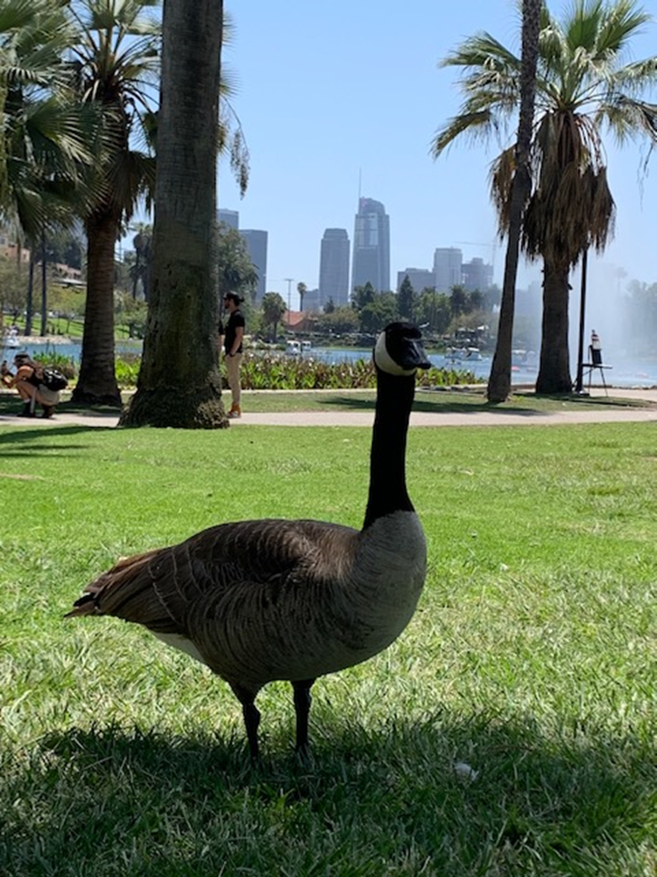
The ducks and geese are iconic of echo park lake

Slide 11
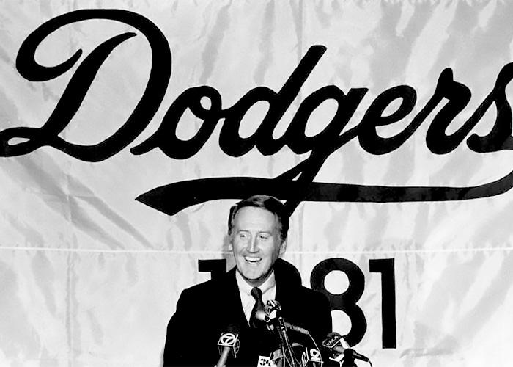
Echo Park is known for having Dodgers (baseball team) stadium

Slide 12

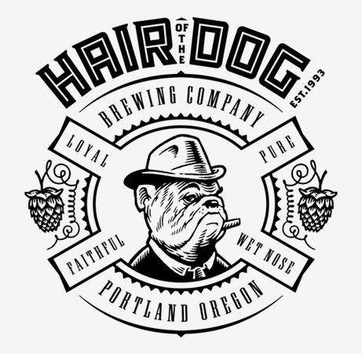

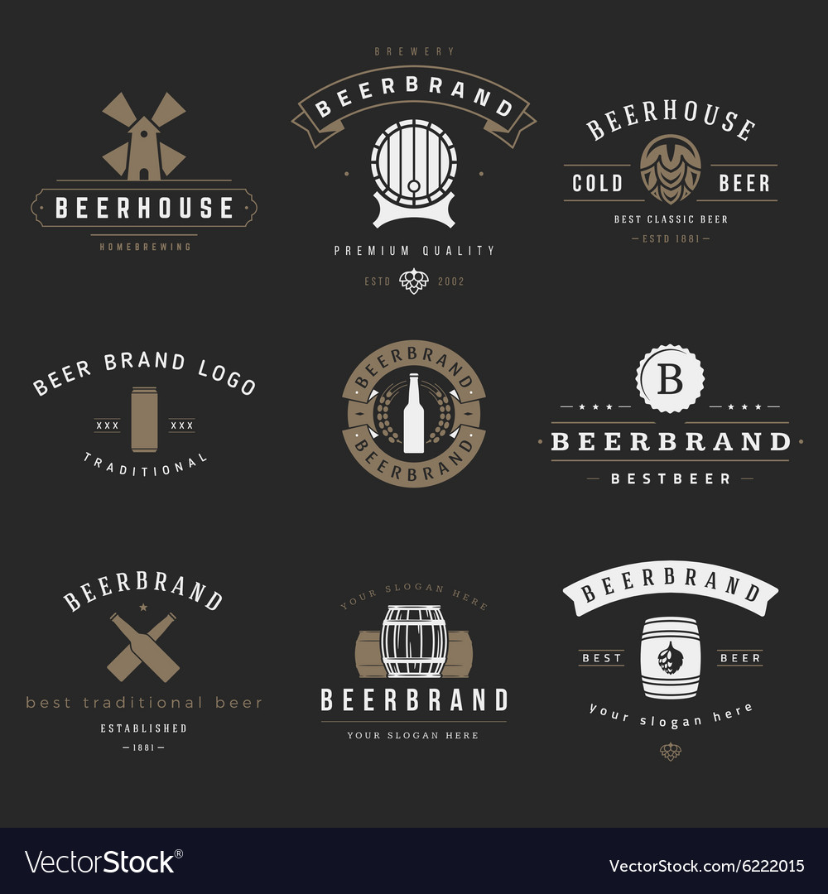
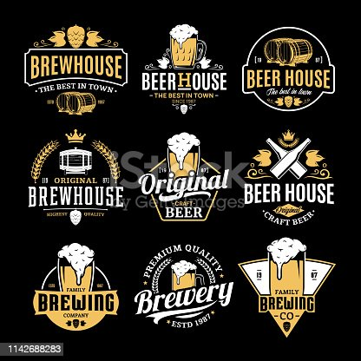
Samples

Slide 13
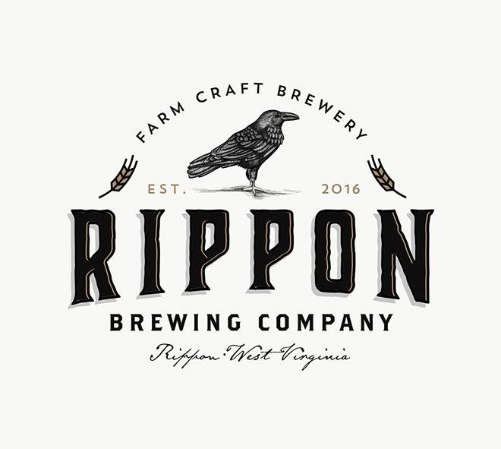
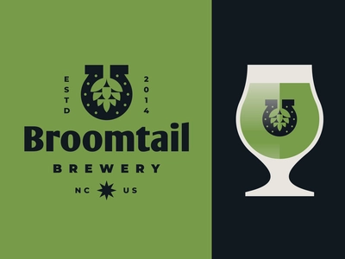
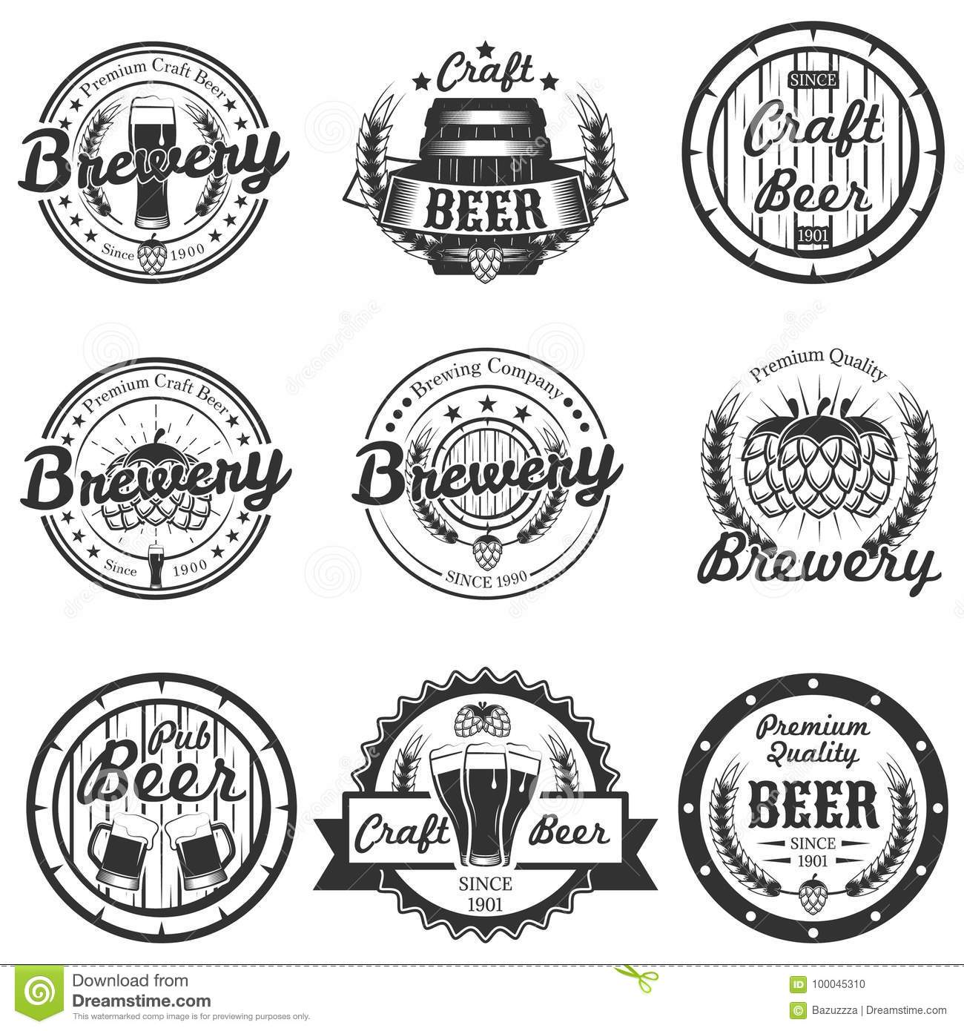
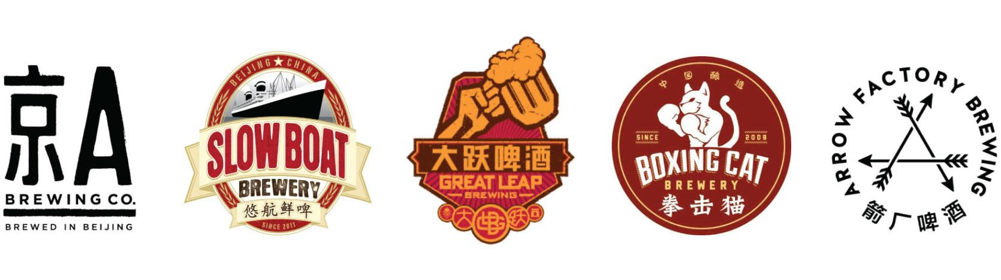

Slide 14
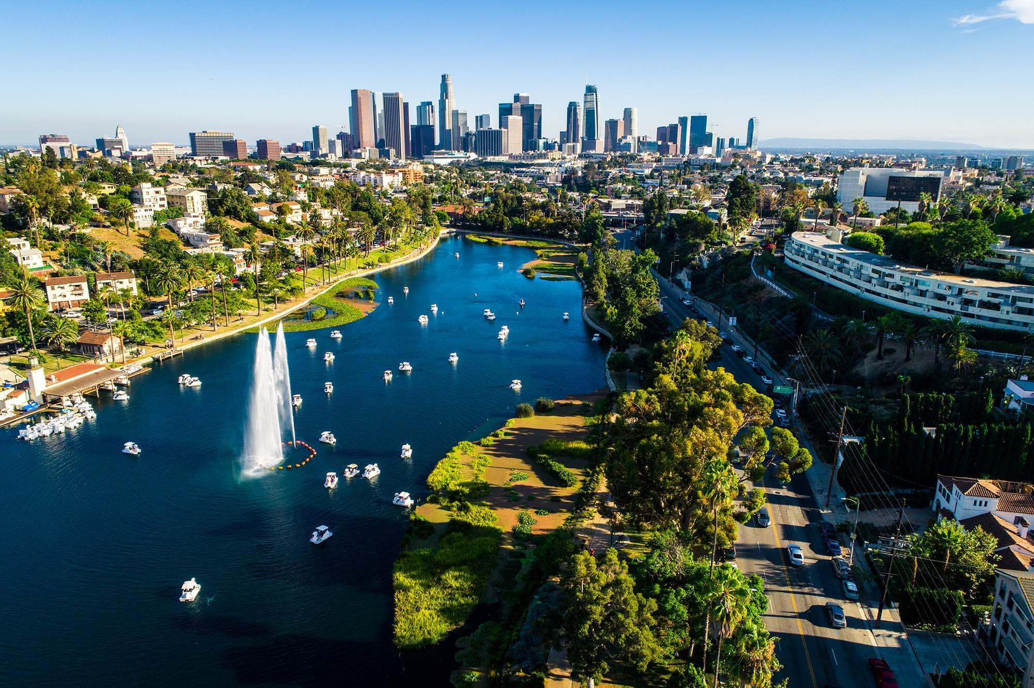
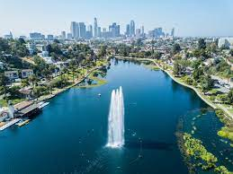
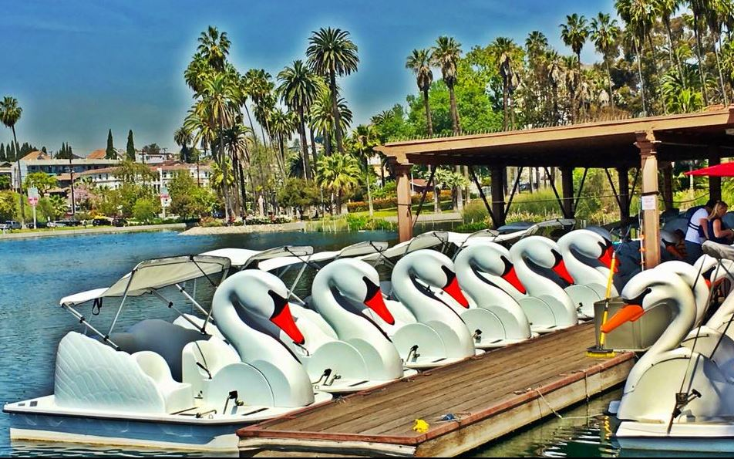
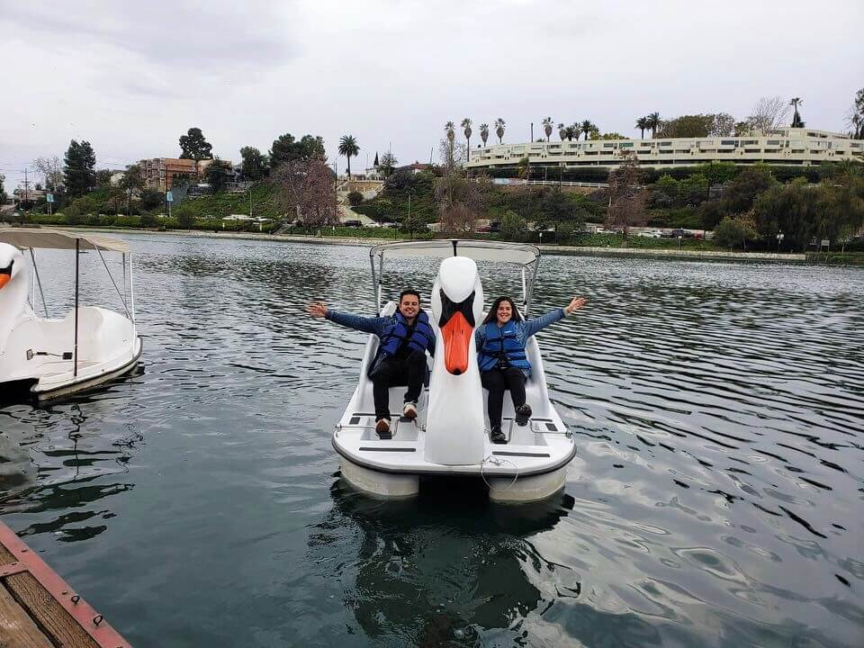
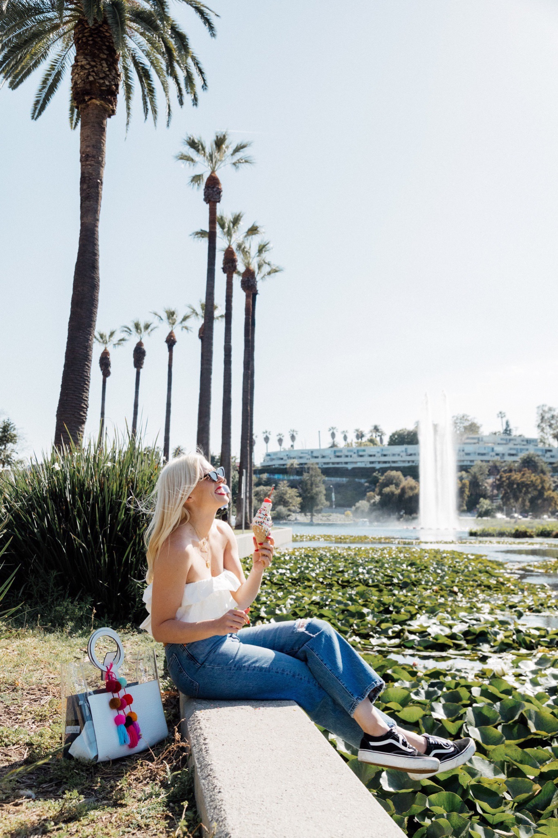
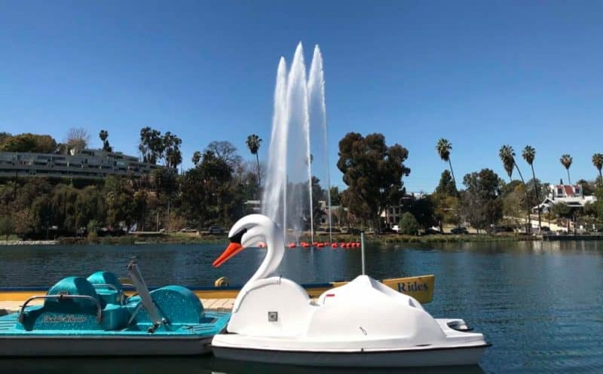
Pictures of Echo Park Lake

Slide 15
